Slide 1
FL customers & Boat Man.

Slide 2
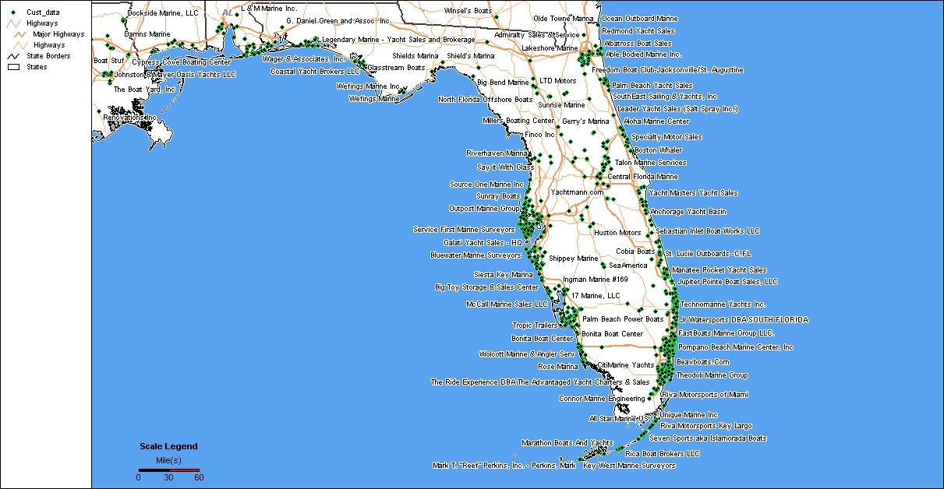
FL Customers

Slide 3
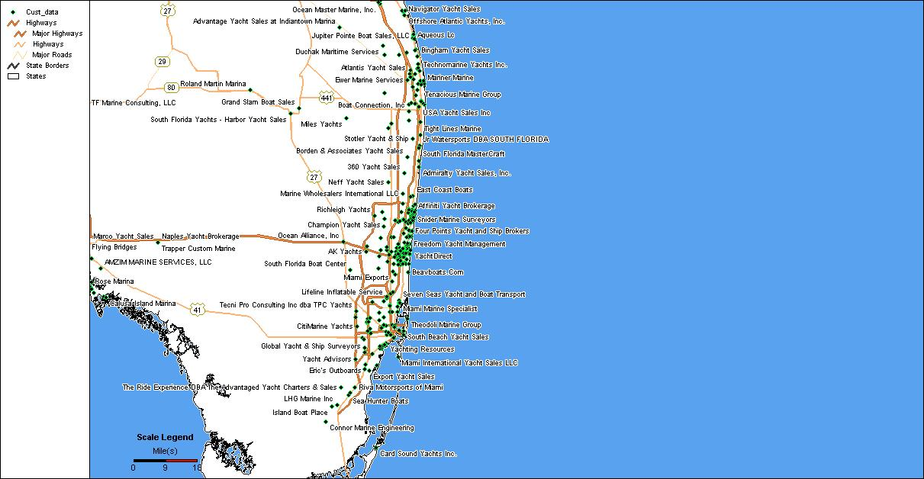
Miami DMA Customers

Slide 4
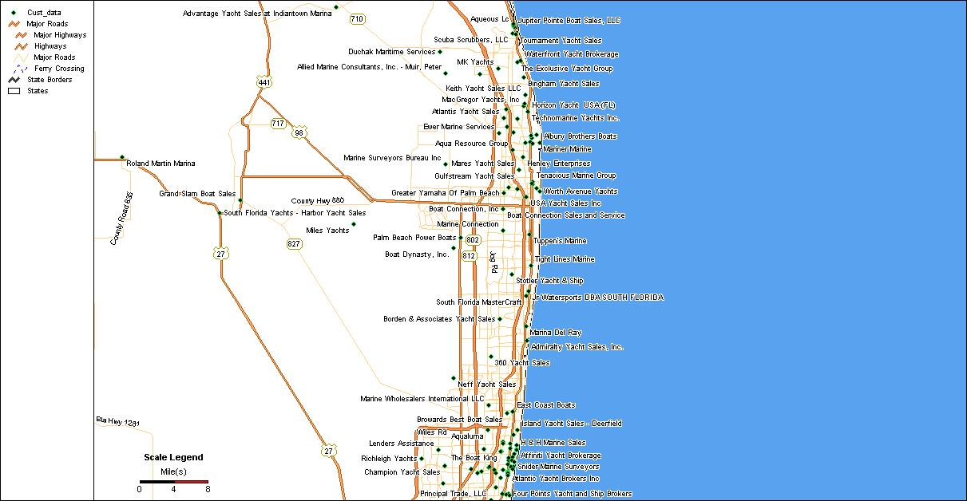
Miami DMA Customers - North

Slide 5
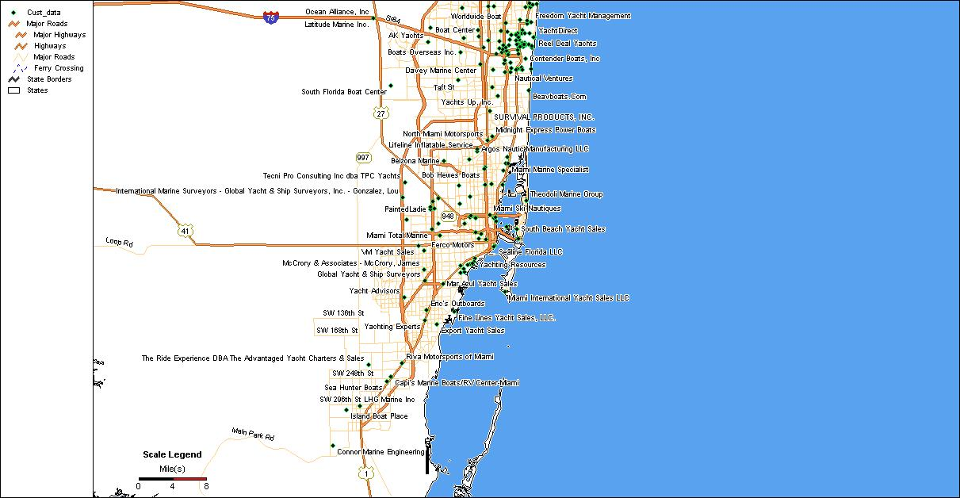
Miami DMA Customers - South

Slide 6
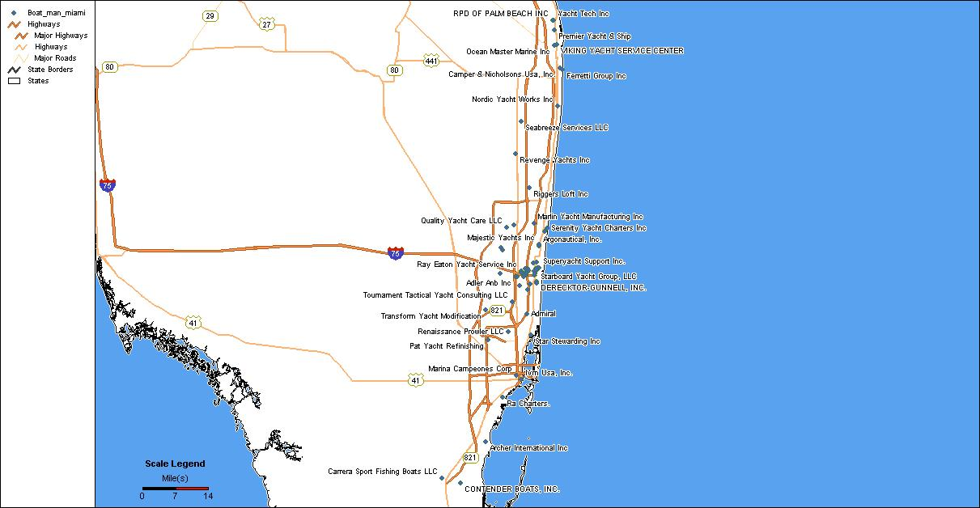
Boat Manufacturers in Miami DMA

Slide 7
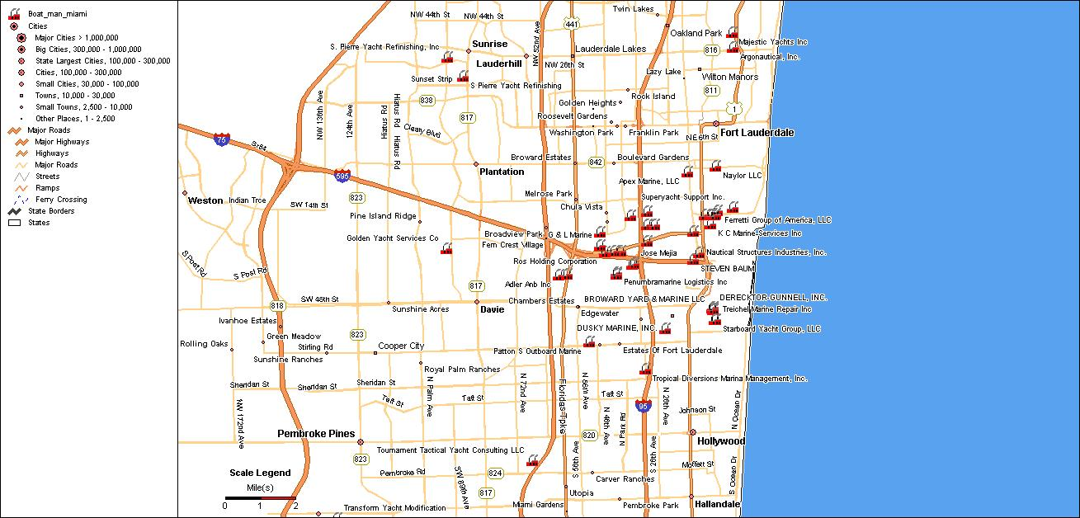
Boat Manufacturers in Miami DMA

Slide 8
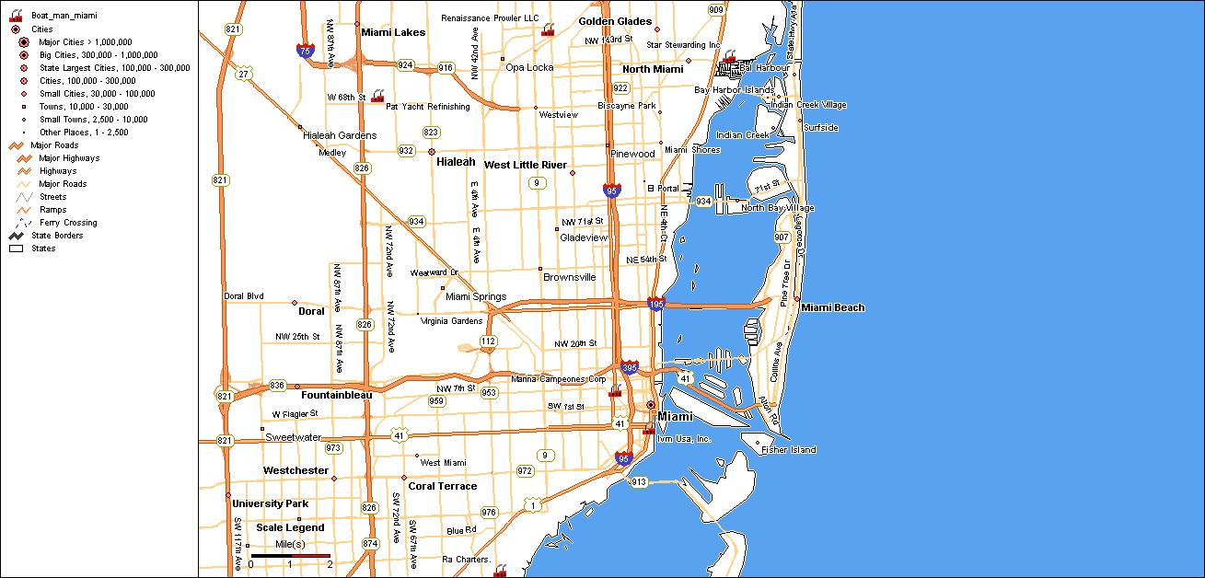
Boat Manufacturers in Miami DMA

