Slide 1
Banner Sales & Opportunities

Slide 2
Overview of Revenue & Drivers

Slide 3
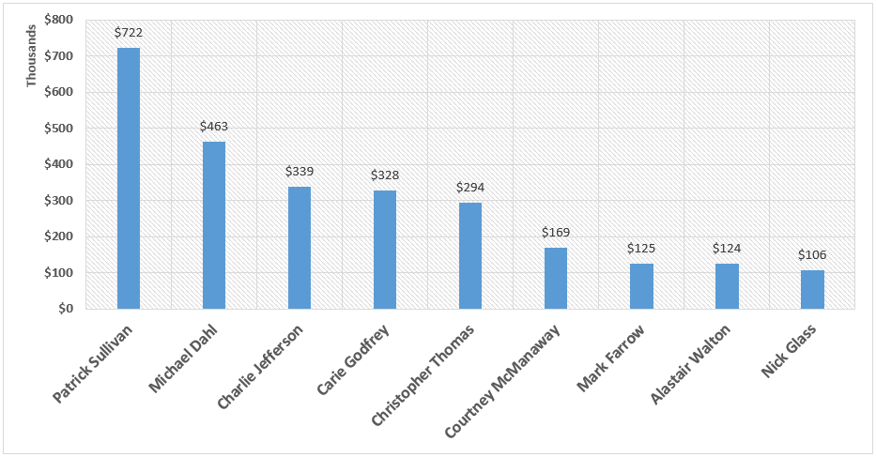
Top 10 Sales Associates Display Revenue 2016
Congratulations to our top sales associates this year!

Slide 4
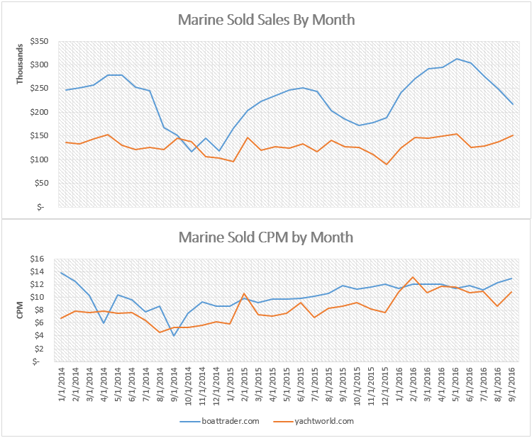
Overview – Total Sales
Revenue contracted by our sales team continues a slow climb in recent months driven by higher CPM

Slide 5
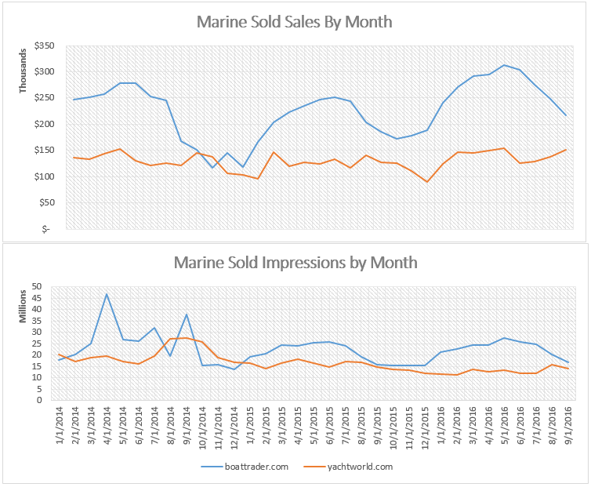
Overview – Total Sales
Marine sold impressions continues to remain flat and is a large area of opportunity.

Slide 6
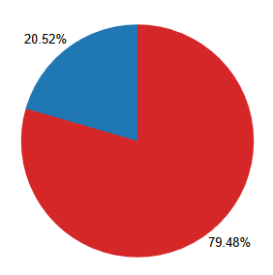

Overview – Total Sales
The Marine sales group sold ~20.52% of total impressions sold in 2016
Marine sold impressions continues to remain flat and is a large area of opportunity.

Slide 7
Opportunities to sell more impressions data: 2016 impressions by marine vs ddm (network) sold

Slide 8
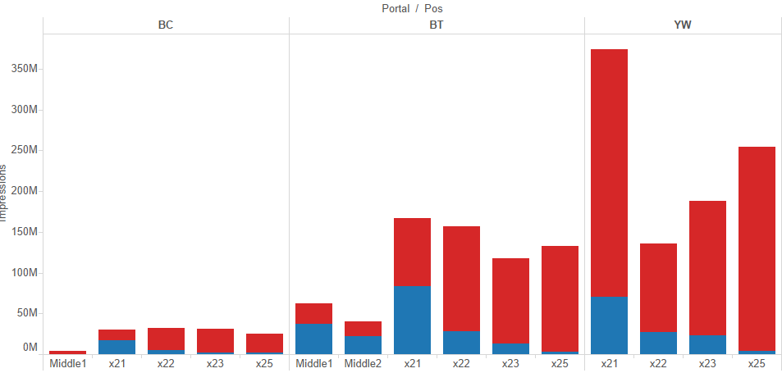

Opportunities to sell more impressions – NOT x21
High opportunity – Lots of availability in x22, x23 & x25 across all portals.

Slide 9
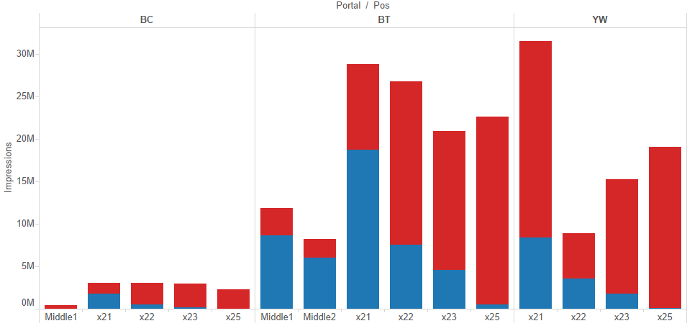
Opportunities to sell more impressions – NOT x21 Miami Market
This phenomenon is seen everywhere even in tight markets such as Miami

Slide 10
Opportunities to sell more impressions – YW x21
YW x21 is large area of opportunity for BCG

Slide 11
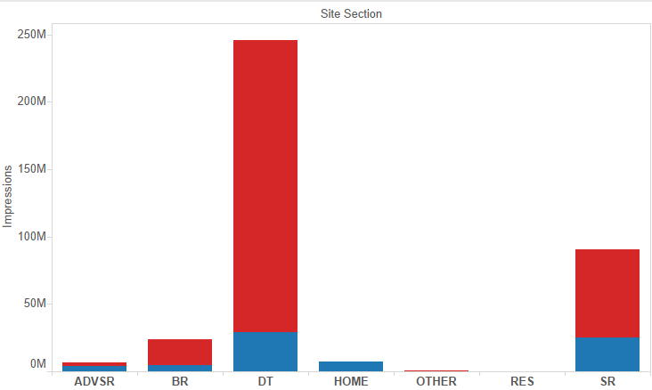
Opportunities to sell more impressions – YW x21 Details pages
YW x21 has the most opportunity to be sold for BCG group on the details pages

Slide 12
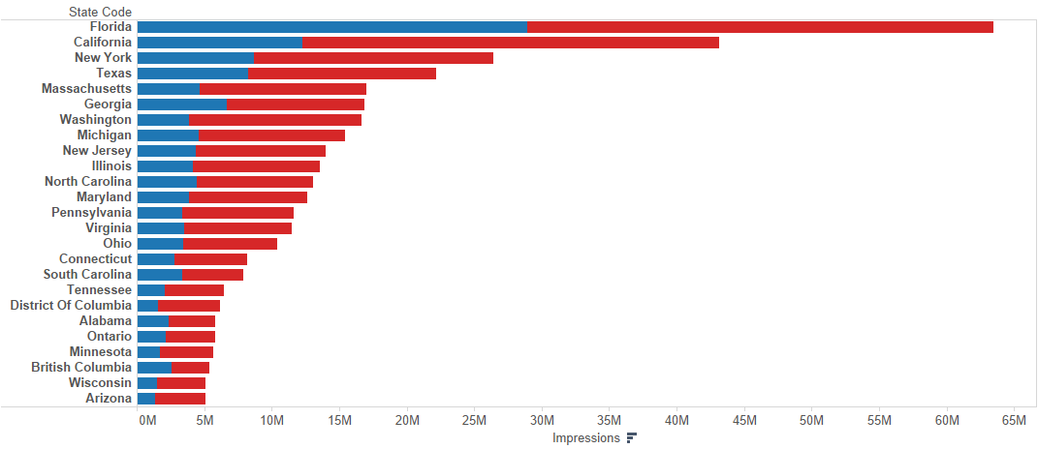
Traffic By State (top 25) – all portals
Best Penetration in FL; Lots of Opportunity in every geography.

Slide 13
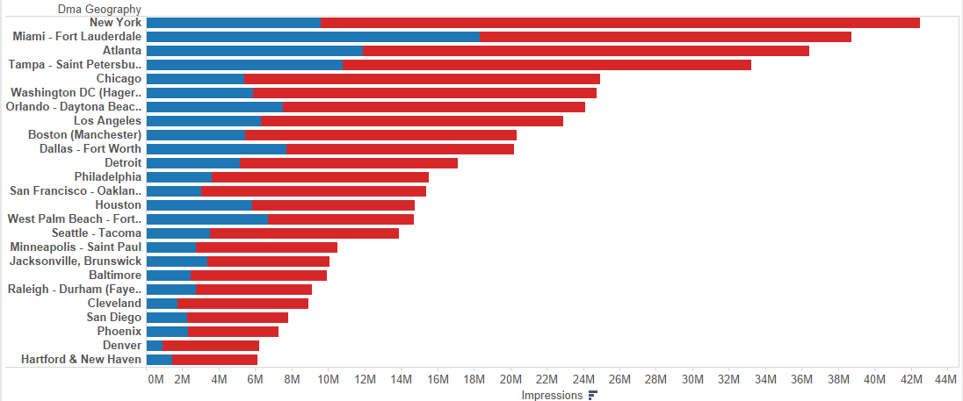
Traffic By DMA (top 25) – BoatTrader
Best Penetration in Miami; Lots of Opportunity in every DMA.

Slide 14
Sales Challenge
Who can sell the most x22, x23 and x25 impressions?
What are the best ways to frame the conversation to sell non x21 positions?
Who in the BCG group can sell the most YW-x21 Details?

Slide 15
Roadblocks to Success – High Targeting

Slide 16
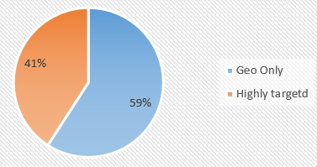
Highly Targeted Banners Constrict Our Ability to Sell Inventory
Targeted banners restrict impressions to less than 5% of what would have been available for geo only
Since 2015-01 roughly 41% of all ads contain some highly targeted component

Slide 17
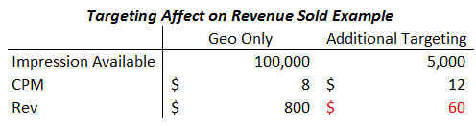
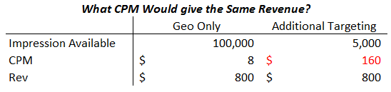
Highly Targeted Banners Constrict Our Ability to Sell Inventory
How the change in quantity sold affects revenue:
Additional targeting significantly restricts our ability to make revenue due to significant reduction in availability
To make the same revenue CPM would need to increase by 20 times!

Slide 18
Do Highly Targeted Ads Benefit the Customer?
(+) More relevant consumers
(-) Less Audience: Many consumers browse for many makes and models
What is the effect of high targeting on Click Through Rate (CTR)?
NONE!
After controlling for length of campaign, portal, site section, device type and position… highly targeted ads are found to be highly insignificant to contributing to CTR
(pvalue always greater than 0.5 in many specifications)
If you want to sell a position with high CTR – sell HERO ads
Conclusion: Targeting is bad for Revenue & the Customer

Slide 19
Sales Challenge
Who can sell the most inventory with Geo only targeting?
How does the conversation change for selling your customer geo only?
Is your customer looking to sell a boat? Or increase its brand in the market?
If selling a boat, banner sales are probably not the best

Slide 20
Dashboard Updates

Slide 21
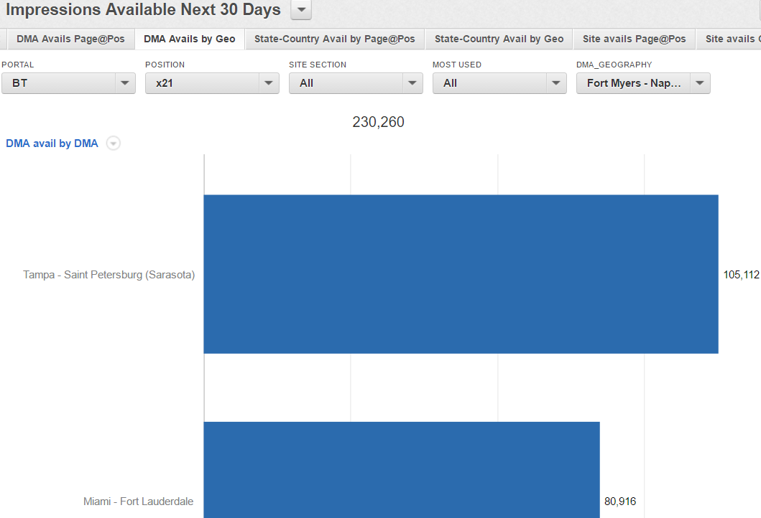
New Dashboard - Availability
Now includes DMA!
As well as…
State-Country
Website Specific to get avails on
YWEUR & YWAU
Get comfortable using dashboard as a tool to understand where we have the most inventory to sell.
Reach out to your sales-planner to learn more about how to use the Availability Dashboard to increase your business

Slide 22
Appendix – CTR analysis

Slide 23
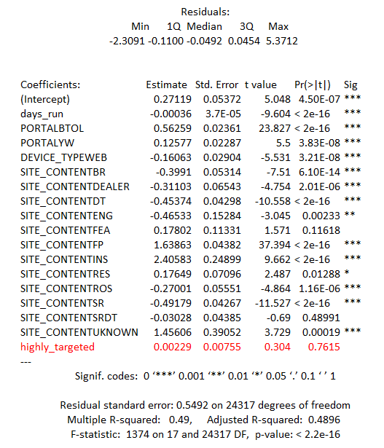
Highly targeted ads effect on CTR

