Slide 1
Effect of being an ebusiness customer on fei sales
By
Christopher Brossman
Ebusiness analytics
2/26/2016

Slide 2
Overall findings
FEI customers increase their sales by ~21.57% after becoming an FOL customer.
FEI customer increase their sales by ~12.59% after becoming a S2S customer
FEI customer increase their sales by ~21.51% after becoming an eBusiness customer (either S2S or FOL)

Slide 3
Incremental sales
Since average historical sales per month of the FOL group is roughly $17,252, we realize incremental sales of $3,721 per customer per month ($44,654 annual)
Since average historical sales per month of the S2S group is roughly $51,793, we realize incremental sales of $6,521 per customer per month ($78,250 annual)

Slide 4
EBUSINESS EFFECT - TREND
Overall AVG
Effect is statistically insignificant after 24 months

Slide 5
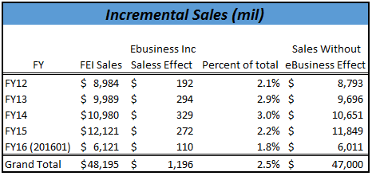
INCREMENTAL SALES
The total impact of the past 4.5 years is ~1.2 billion in Incremental Sales
The “eBusiness effect” increased total FEI sales by 2-3% each year.
The far right column highlights what sales were estimated to be if no customer had ever been an ebusiness customer.

Slide 6
EBUS effect over time

