Slide 1
EFFECT OF EBUSINESS
ON
INCREMENTAL TOTAL SALES

Slide 2
QUICK
OVERVIEW
OF
METHODOLOGY

Slide 3




THE NEED FOR MATCHING
FEI Customer Population
FOL Customer Population
Not Comparable
Samples are not comparable because treatment is non random causing samples to be very different – eBusiness sought after most desirable FEI customers for FOL

Slide 4
THE NEED FOR MATCHING
FEI Customer Population after matching
FOL Customer Population
Comparable
Matched samples will greatly reduce bias. We still need to control for differences within each population. Regression will help.

Slide 5
STILL NEED TO CONTROL FOR OTHER “STUFF”…
Anything else that can explain sales changes will contaminate the “eBusiness” effect
  We need to control for this to isolate “eBusiness” effect
Things held constant in analysis using Fixed Effects Regression
  Fixed Effects (things that don’t change over time)
    Such as type of customer
  Macro Economic Effects
    (economic changes in US)
  Micro Economic Effects at Branch level
    (economic changes in MSA)
  Tenure
    Individual time – loosens assumption of design

Slide 6
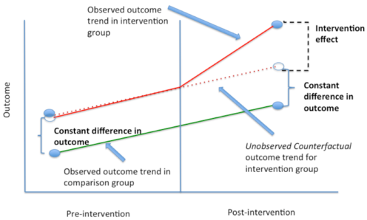
DIFFERENCE IN DIFFERENCE: AFTER ISOLATION OF EBUS EFFECT

Slide 7
FINDINGS
OF
ANALYSIS

Slide 8
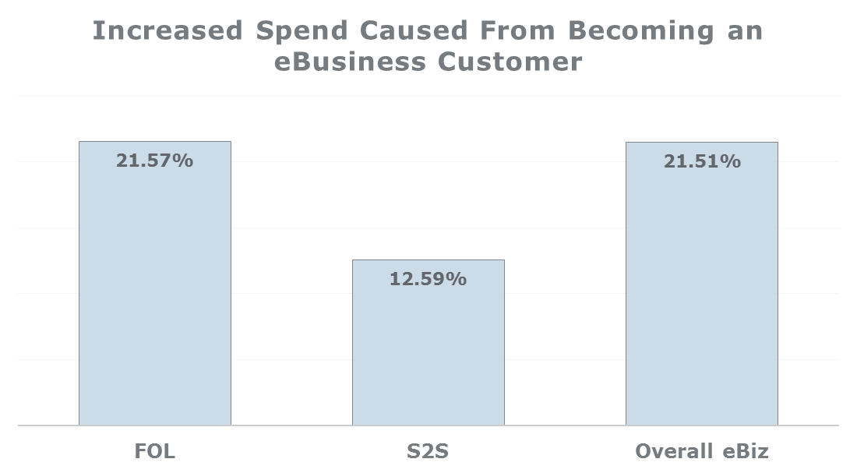
OVERALL FINDINGS
FEI customers increase their sales by ~21.57% after becoming an FOL customer.
FEI customer increase their sales by ~12.59% after becoming a S2S customer
FEI customer increase their sales by ~21.51% after becoming an eBusiness customer (either S2S or FOL)

Slide 9
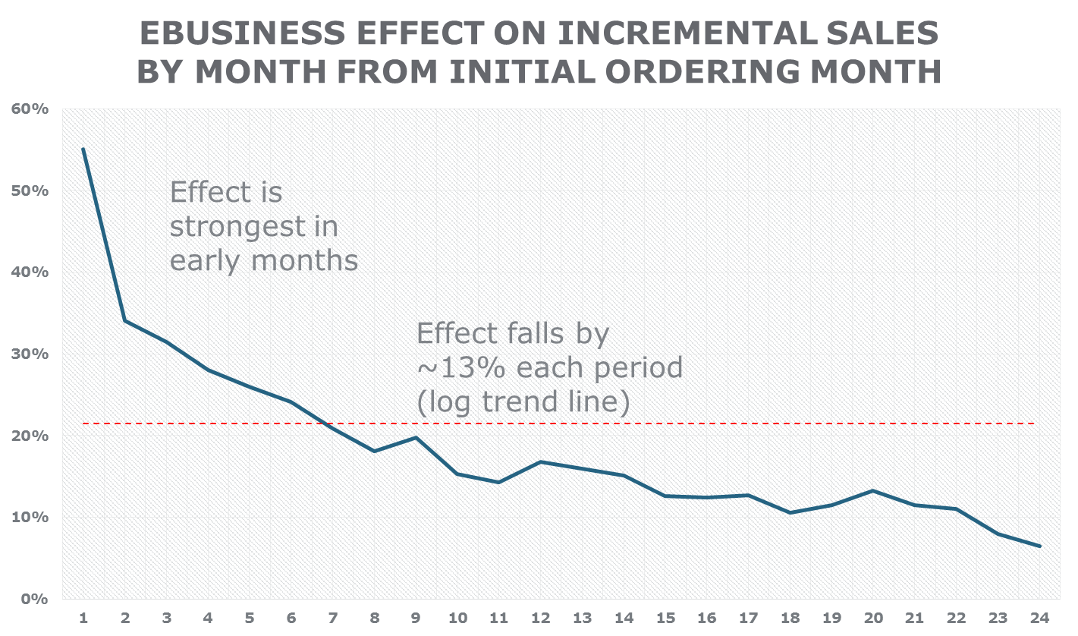
EBUSINESS EFFECT - TREND
Overall AVG
Effect is statistically insignificant after 24 months

Slide 10
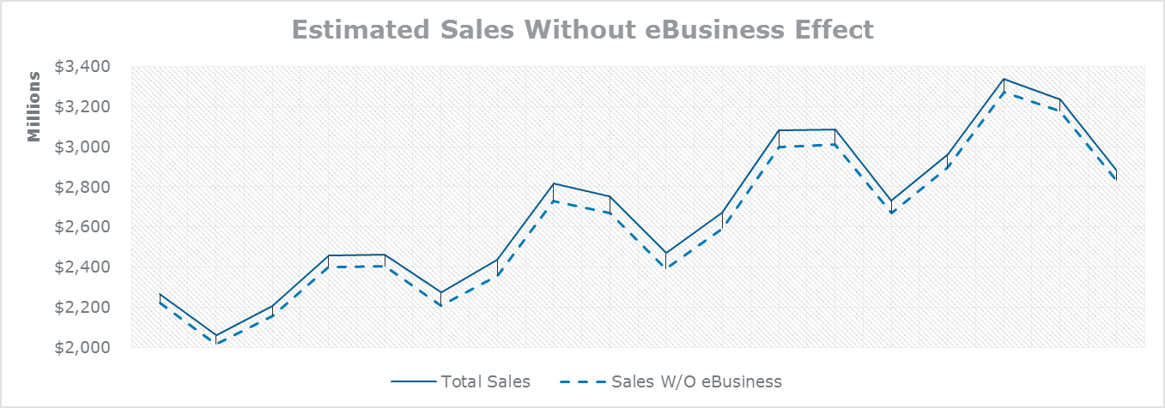
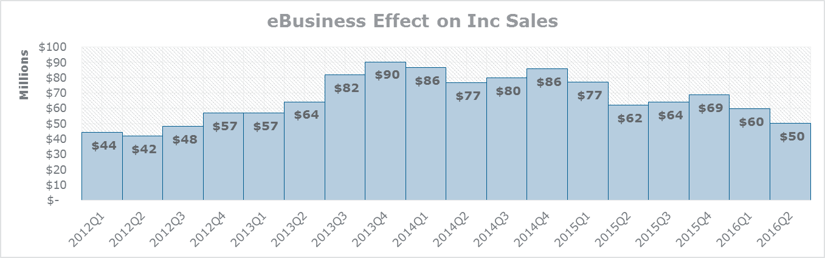
EBUS EFFECT OVER TIME

Slide 11
QUESTIONS

