Slide 1
Effect of being an ebusiness customer on fei sales
Findings & Methodology
By
Christopher Brossman
Ebusiness analytics
3/25/2016

Slide 2
Overall findings
FEI customers increase their sales by ~21.57% after becoming an FOL customer.
FEI customer increase their sales by ~12.59% after becoming a S2S customer
FEI customer increase their sales by ~21.51% after becoming an eBusiness customer (either S2S or FOL)
See methodology to get details on matching & regression

Slide 3
Incremental sales
Since average historical sales per month of the FOL group is roughly $17,252, we realize incremental sales of $3,721 per customer per month ($44,654 annual)
Since average historical sales per month of the S2S group is roughly $51,793, we realize incremental sales of $6,521 per customer per month ($78,250 annual)
See methodology to get details on matching & regression

Slide 4
EBUSINESS EFFECT BY BUSINESS GROUP
See methodology to get details on matching & regression

Slide 5
EBUSINESS EFFECT - TREND
Overall AVG
Effect is statistically insignificant after 24 months
See methodology to get details on matching & regression

Slide 6
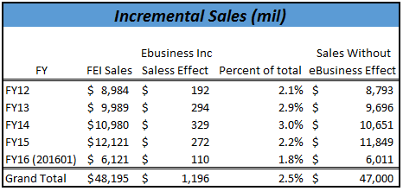
INCREMENTAL SALES
The “eBusiness effect” increased total FEI sales by 2-3% each year.
The far right column highlights what sales were estimated to be if no customer had ever been an ebusiness customer.
See methodology to get details on matching & regression

Slide 7
EBUS effect over time
See methodology to get details on matching & regression

Slide 8
Ebusiness Effect on gross profit & Margin
Gross profit gross nearly as quickly as sales indicating nearly identical profit margins
See methodology to get details on matching & regression

Slide 9
Ebusiness effect by proplus engagement
Silver customers grow incremental sales faster and have higher engagement levels than Bronze customers
Not significantly different from zero
See methodology to get details on matching & regression

Slide 10
how to get fei to $25B
Investment in eBusiness
Invest in converting more customers to the ebusiness solution to reap higher returns (~21.51% increase in incremental sales)
It is estimated that eBusiness has caused a lift in incremental sales by 2-3% of total sales each year since FY12
Average Quarterly Incremental Sales is ~60 million
If every customer were on ebusiness in FY15 we estimate that total Ferguson sales may have been ~one billion higher than realized sales
Gross profit is growing nearly as fast as sales, indicating we are growing profitability as well as top line sales.

Slide 11
how to get fei to $25B
Reduce Churn
Churn is highly prevalent in both Ferguson and FOL
On average, a customer will “last” on FOL for 3.5 months before churning
A customer is highly likely to reengage, but churn again
As churn reduces the “eBusiness effect” grows
Invest more in identifying why and how customers are churning to gain more intelligence
Use existing tools
Customer Action Report/Pipeline MGMT/CRM
Get more customers on the Pro Plus Loyalty Program
Customers who engage in Proplus grow incremental sales faster than their Bronze counterparts
Proplus customers churn less frequently from eBusiness.

Slide 12
Appendix Methodology Matching & D.I.D. Fixed effects for non detailed audience --------------------------------------------- See detailed explanation if desired ---------------------------------------------

Slide 13




The need for matching
FEI Customer Population
FOL Customer Population
Not Comparable
Samples are not consistent because treatment is non random – eBusiness sought after most desirable FEI customers for FOL

Slide 14
The need for matching
FEI Customer Population after matching
FOL Customer Population
Comparable
Matched samples will greatly reduce bias. We still need to control for differences within each population. Regression will help.

Slide 15
Still need to hold control for other “stuff” that explains differences
Anything else that can explain sales changes will contaminate the “eBusiness” effect
We need to control for this to isolate “eBusiness” effect
Things held constant in analysis using Fixed Effects Regression
Fixed Effects (things that don’t change over time)
Such as type of customer
Macro Economic Effects
(economic changes in US)
Micro Economic Effects at Branch level
(economic changes in MSA)
Tenure
Individual time – loosens assumption of design

Slide 16
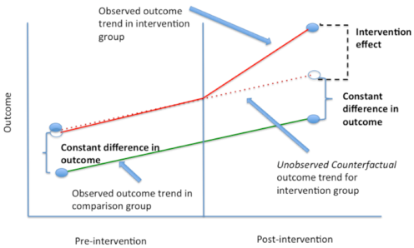
difference in difference: after isolation of ebus effect

Slide 17
Appendix Methodology Matching & D.I.D. Fixed effects --------------------------------------------- detailed explanation ---------------------------------------------

Slide 18
Matching
What is matching?
Matching is a technique to match the treated group with those not treated in the population but who are similar to emulate a suitable control
Why is it important?
Matching reduces bias, when the treated group differs greatly from the overall population, or if the treatment is non-random.
FOL or S2S customers are much larger than the average FEI customer for example. Treatment is non-random
See here for more details:
https://en.wikipedia.org/wiki/Matching_(statistics)

Slide 19
Matching
Who was included prior to matching?
Customers with 6 months or more of FEI data
Customers with greater than 10,000 in total lifetime spend
Customers with greater than 10 lifetime orders
Customers with greater than 50 lifetime lines items.
What type of Matching was used?
Distance = Logit, method =Nearest Neighbor, 1-1 matching, with replacement
Example Logit Formula:
EVER_EBIZ_CUST ~ DOM_TYPE_II + OS_HA + CREDIT_BIN + CNT_YM + I(log(SLS_PER_MONTH)) + I(log(SLS_PER_ORDER)) + I(log(SLS_PER_MONTH*SLS_PER_ORDER)) + PCT_JOB_SLS

Slide 20
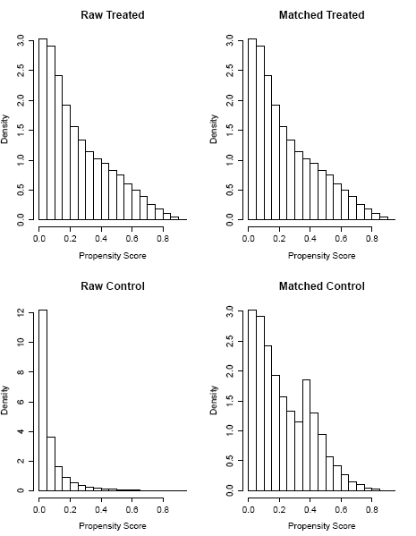
Matching – ebusiness
Treatment and control groups are not similar prior to matching
Treatment and control groups are much more similar after matching

Slide 21
data
Data used came from data warehouse/Appex tables:
Branch customer history
Ferguson customers
Matched Customers described earlier
Data was setup as panel
Each row represents a customer at a particular month
Each column represents variable of interest
Since this resulted in millions of rows, which became computationally difficult, roughly 25% of the customers were sampled
Robustness checks ensured a robust estimator.

Slide 22
Identification strategy
Difference in Difference Fixed Effects model
This model holds constant time invariant effects and uses the variation over time.
Example: being a plumber doesn’t change over time. All variables which don’t change over time were held constant
For more information go here
https://web.stanford.edu/~mbest/8_-_Panel_Data-Fixed_Effects_and_Differences_in_Differences.pdf

Slide 23
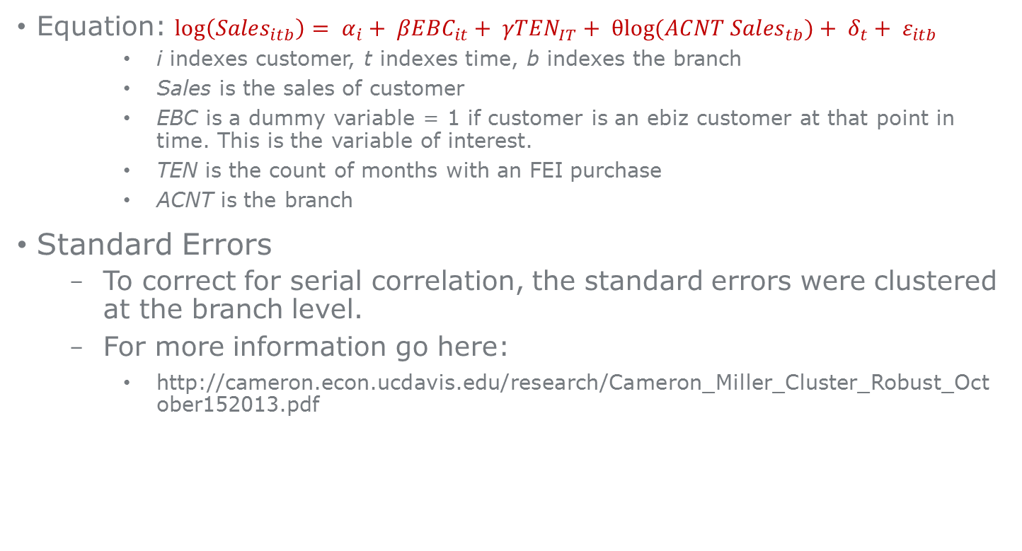
Identification strategy
Equation: $\log\left({Sales}_{itb}\right)= α_{i}+ {βEBC}_{it}+ {γTEN}_{IT}+ {θlog⁡(ACNT Sales}_{tb})+ δ_{t}+ ε_{itb}$
i indexes customer, t indexes time, b indexes the branch
Sales is the sales of customer
EBC is a dummy variable = 1 if customer is an ebiz customer at that point in time. This is the variable of interest.
TEN is the count of months with an FEI purchase
ACNT is the branch
Standard Errors
To correct for serial correlation, the standard errors were clustered at the branch level.
For more information go here:
http://cameron.econ.ucdavis.edu/research/Cameron_Miller_Cluster_Robust_October152013.pdf

Slide 24
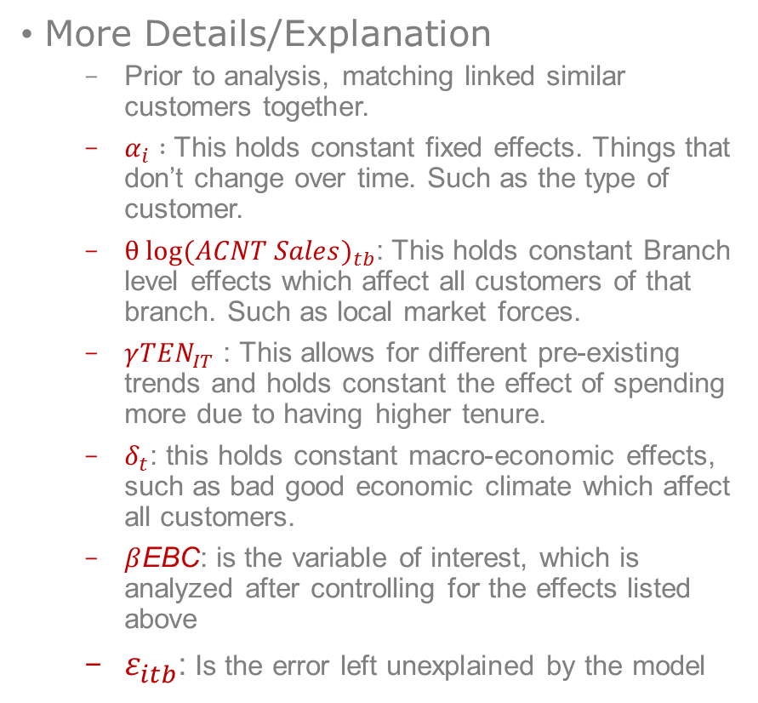
Identification strategy
More Details/Explanation
Prior to analysis, matching linked similar customers together.
$α_{i} :$This holds constant fixed effects. Things that don’t change over time. Such as the type of customer.
$θ {log⁡(ACNT Sales)}_{tb}$: This holds constant Branch level effects which affect all customers of that branch. Such as local market forces.
$γ{TEN}_{IT}$ : This allows for different pre-existing trends and holds constant the effect of spending more due to having higher tenure.
$δ_{t}$: this holds constant macro-economic effects, such as bad good economic climate which affect all customers.
$β$EBC: is the variable of interest, which is analyzed after controlling for the effects listed above
$ε_{itb}$: Is the error left unexplained by the model

Slide 25
All Data & analysis files
All data and analysis documents to recreate the analysis can be found here
S:\eCommerce\E-Commerce\Analysis & Reporting\Omni-Channel\eBiz effect on FEI sls
Programs used:
Oracle SQL
R

Slide 26
Appendix other slides

Slide 27
HVAC STAND ALONE COMPARISON EFFECTS
See methodology to get details on matching & regression

