Slide 1
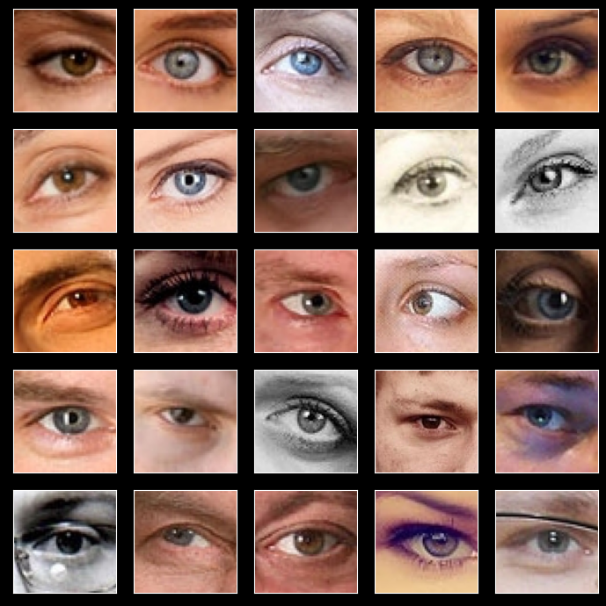
Male or Female eyes?
https://www.kaggle.com/pavelbiz/eyes-rtte
femaleeyes folder with 5202 images
maleeyes folder with 6323 images
42MB total

Slide 2

How are the different colors combined at first step?
All three Conv2D are 3*3 pixel convolutions. Why do later versions use more parameters?
Conv2D (3*3*3 +1)*32
SpacialDropout2D
20% (training)
BatchNormalization 4*32
Dense 3136*128 + 128
MaxPooling
Conv2D (17*17)*32
Dropout 20% (training)
MaxPooling
Dense
128 + 1
(sigmoid activation)
Conv2D
(17*17)*64
MaxPooling
Flatten
75*75*3
(RGB)
73*73*32
(different filter patterns)
73*73*32
36*36*32
34*34*32
17*17*32
15*15*64
15*15*64
7*7*64
3136
128
128
1

Slide 3
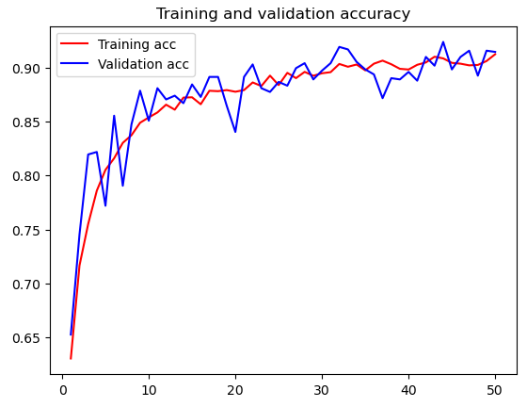
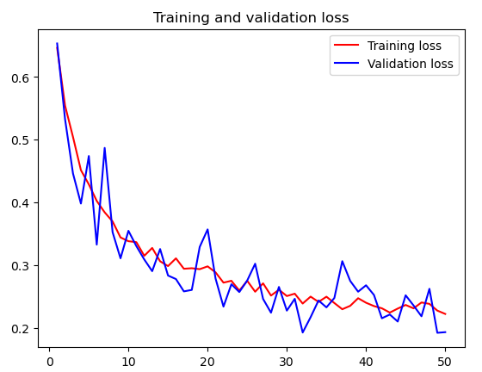
Training details
7779 files training + 884 validation
4729 male eyes
3914 female eyes
50 training passes through entire dateset (epochs)
images modified in each pass to simulate more data
Shift up to 10% u/d/l/r
Flip horizontal, vertical
Zoom up to 20%
Rotate up to +/-20°
Shear up to 20%
Target size 75x75 pixels
54 min training time (on desktop)

Slide 4
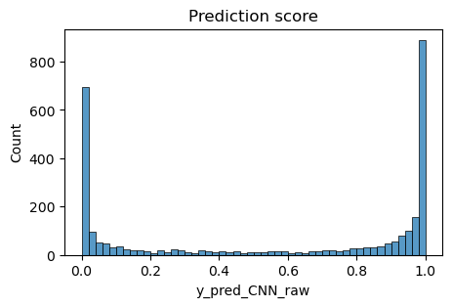
Test dataset predictions
2882 test images
~2.8ms/image to predict
Y_pred_CNN_raw >=0.5 is “maleeyes”
Y_pred_CNN_ra < 0.5 is “femaleeyes”
Test accuracy 93%

Slide 5
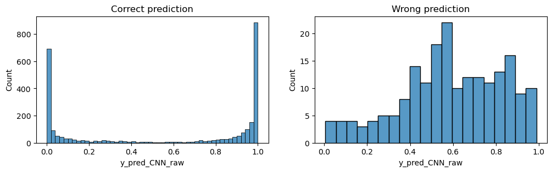
Distribution of correct, wrong predictions

Slide 6
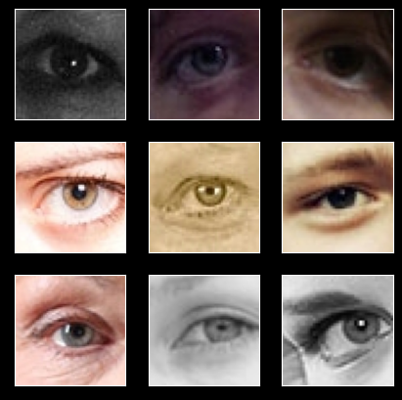
Lowest confidence predictions
0.49 < y_pred_CNN_raw < 0.51

Slide 7
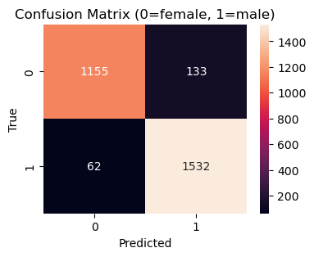
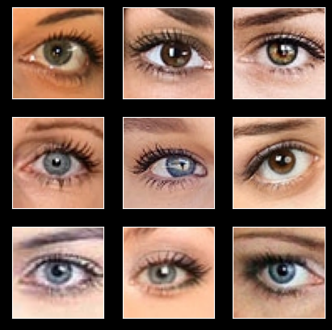
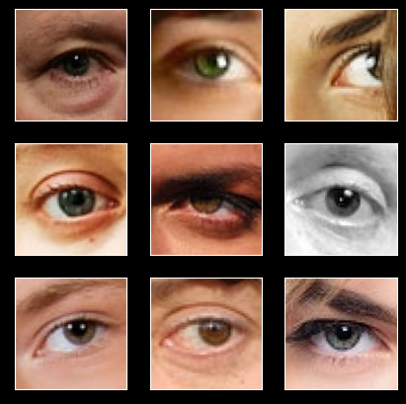
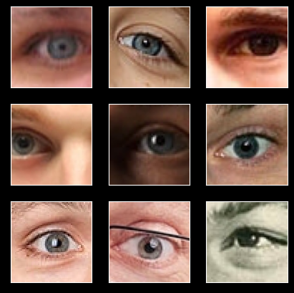
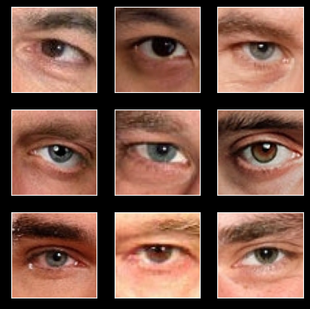
Test set prediction matrix
female
male
predicted
female
predicted
male

Slide 8
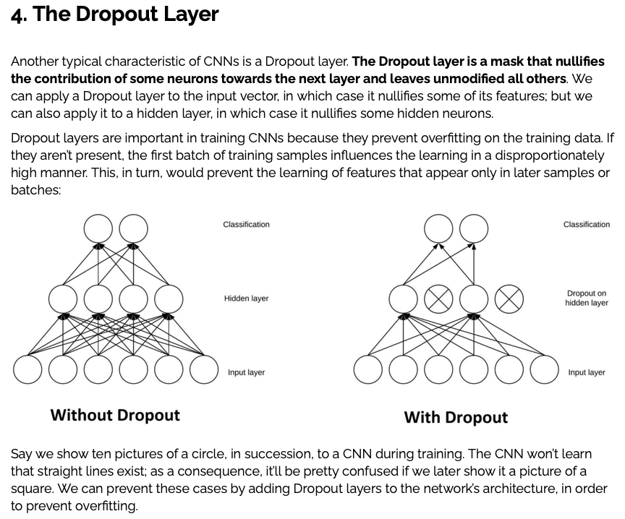
https://www.baeldung.com/cs/ml-relu-dropout-layers

Slide 9
SpatialDropout layer
during training, mask out random 20% of input “feature maps” (is this 20% of the 64 input slices, and a different 20% for each what (image?, batch?, epoch?)
https://keras.io/api/layers/regularization_layers/spatial_dropout2d/
Spatial 2D version of Dropout.
This version performs the same function as Dropout, however, it drops entire 2D feature maps instead of individual elements. If adjacent pixels within feature maps are strongly correlated (as is normally the case in early convolution layers) then regular dropout will not regularize the activations and will otherwise just result in an effective learning rate decrease. In this case, SpatialDropout2D will help promote independence between feature maps and should be used instead.
https://stackoverflow.com/questions/55231347/using-dropout-on-convolutional-layers-in-keras
Usually, dropout is used to regularize [later] dense layers which are very prone to overfit
https://machinelearningmastery.com/dropout-for-regularizing-deep-neural-networks/
Dropout is a regularization method that approximates training a large number of neural networks with different architectures in parallel.
During training, some number of layer outputs are randomly ignored or “dropped out.” This has the effect of making the layer look-like and be treated-like a layer with a different number of nodes and connectivity to the prior layer. In effect, each update to a layer during training is performed with a different “view” of the configured layer.
Dropout is not used after training when making a prediction with the fit network.

