Slide 1

Queen's University | Centre for Advanced Computing
Cursor for Research Computing
From Laptop to CAC HPC. Three hours of hands-on practice so you can use an AI coding agent without abandoning scientific judgment, file hygiene, or your SLURM checklist.
Shadi Khalifa, PhD <khalifa.s@queensu.ca>, Centre for Advanced Computing, Queen's University
3 hours - hands-on | Laptop + optional CAC SSH | Dry-runs count as success
CAC | Queen's University | cac.queensu.ca | Shadi Khalifa, PhD

Slide 2
Cursor the company
Anysphere builds Cursor
Cursor is the product of Anysphere, a company focused on AI-native software development tools rather than a generic chatbot bolted onto a text box. The company ships an editor that treats large language models as first-class collaborators inside your project files, terminals, and (when you allow it) external tools.
- You should care about the vendor story only insofar as it explains the product shape: Cursor is not a separate chat website you paste code into.
- It is a fork of a familiar VS Code-style IDE with deep hooks for agents, rules, skills, and Model Context Protocol servers.
CAC | Queen's University | cac.queensu.ca | Shadi Khalifa, PhD

Slide 3
Cursor the tool
An IDE with an agent, not a chat window with an afterthought editor
When you open Cursor you get the editor habits you already know (tabs, git, terminals, extensions) plus a chat and agent panel that can read your workspace, propose diffs, run commands you approve, and follow project rules you define.
- For research computing that combination matters because your work lives in repositories, scripts, SLURM templates, and lab conventions.
- An agent that can see those files in place is far more useful than one that only sees the last paste you remembered to include.
CAC | Queen's University | cac.queensu.ca | Shadi Khalifa, PhD

Slide 4
Why researchers care
Speed with a seatbelt
You already write analysis code, chase obscure traceback lines, draft job scripts, and translate methods sections into runnable steps. Cursor can accelerate the boring middle of that work.
- Typical wins: explaining a neighbor's pipeline, drafting argparse, turning a checklist into an sbatch template, or comparing a log against a broken script.
- What it cannot do is replace your judgment about data sensitivity, cluster etiquette, or whether a bootstrap CI actually matches Algorithm 1.
- This workshop trains the seatbelt habits so the speed does not become an expensive accident.
CAC | Queen's University | cac.queensu.ca | Shadi Khalifa, PhD

Slide 5
Workshop description
What you will do this afternoon
You will work through eight use cases, from Privacy Mode and chat hygiene through a GitHub MCP demo, using the synthetic workshop repository rather than your restricted research data.
- Each block combines a short concept explanation with prompts you copy into Cursor and concrete done-when checks so you know you finished for real.
- If CAC SSH is available you may sync the SLURM exercise and practice remote paths; if not, careful local dry-runs still count.
- The point is reproducible control: Ask before Agent, attach the few files you need, keep rules in the project, and never invent module names or accounts.
CAC | Queen's University | cac.queensu.ca | Shadi Khalifa, PhD

Slide 6
Workshop description
Where your materials live
- Hands-on work lives under exercises/ for each use case, with shared templates under config/.cursor for rules and skills.
- Keep handouts/budget-card.md and handouts/privacy-and-context.md nearby; they are the one-page habits cards for privacy, context, and spend.
- You will not need a separate prompts folder. Every prompt you should type appears on the slides in labeled boxes so you can copy it straight into Cursor.
CAC | Queen's University | cac.queensu.ca | Shadi Khalifa, PhD

Slide 7
Do this first
Privacy Mode how-to
- Windows/Linux: press Ctrl+Shift+J. macOS: Cmd+Shift+J.
- Open General and turn Privacy Mode on before you paste anything research-shaped.
- If you are on a Teams or Enterprise seat, check whether an admin already enforces Privacy Mode so you are not fighting policy.
- Skim handouts/privacy-and-context.md and keep it open while you work.
Do this before any exercise. Habit beats hope.
CAC | Queen's University | cac.queensu.ca | Shadi Khalifa, PhD

Slide 8
Privacy Mode
What it protects, and what it does not
With Privacy Mode on for supported models, Cursor documents that your code is not used to train Cursor or the model providers. That is the main protection you are buying with the toggle.
- Prompts and code context still travel to the model provider so answers can be generated. This is not a fully local offline mode.
- It also does not authorize pasting restricted, clinical, or identifiable research data into chat.
- Some models need admin approval for provider retention, and bring-your-own-key setups follow the provider's own terms.
cursor.com/help/security-and-privacy/privacy
CAC | Queen's University | cac.queensu.ca | Shadi Khalifa, PhD

Slide 9
Objectives
What you should be able to do by the end
- Choose Ask, Plan, Agent, or Multitask with intent, keep one research objective per chat, and ground answers in files you actually attach rather than in hopeful invention.
- Place stable lab policy in Project rules and skills so you stop re-explaining SLURM hygiene in every conversation.
- Draft a reviewable sbatch script from a checklist, diagnose a broken job from paired stdout/stderr, and decide when a dry-run is the honest stopping point for the day.
CAC | Queen's University | cac.queensu.ca | Shadi Khalifa, PhD

Slide 10
Outcomes
Artifacts you will have produced
- A grounded README for the literacy exercise, a local analysis script with a plot, and practice with /goal and a capped /loop against a mock job status file.
- A methods replication with notes on fidelity limits, and SLURM scripts that keep account and partition as placeholders.
- An Explorer-Implementer-Reviewer handoff and a read-then-approve GitHub MCP path. Those habits transfer to your own repos tomorrow morning.
CAC | Queen's University | cac.queensu.ca | Shadi Khalifa, PhD

Slide 11
Agenda - part 1
Morning path: UC0 Foundations through UC3 Skills
- 0:00-0:30 UC0 Foundations: Privacy Mode, chat context, modes, Projects, and tokenomics
- 0:30-0:45 UC1 Codebase literacy and documentation grounding
- 0:45-1:00 UC2 Local analysis pipeline
- 1:00-1:10 Break
- 1:10-1:30 UC3 Skills, /goal, and /loop
CAC | Queen's University | cac.queensu.ca | Shadi Khalifa, PhD

Slide 12
Agenda - part 2
Afternoon path: UC4 Paper replication through UC7 GitHub MCP
- 1:30-1:55 UC4 Paper method replication
- 1:55-2:25 UC5 CAC remote work, SLURM jobs, and debugging
- 2:25-2:30 Break
- 2:30-2:45 UC6 Multi-agent orchestration
- 2:45-3:00 UC7 GitHub MCP demo
- Dry-run paths are first-class. Not everyone needs a live sbatch today.
CAC | Queen's University | cac.queensu.ca | Shadi Khalifa, PhD

Slide 13
UC0
UC0 Foundations: Privacy Mode, chat context, modes, Projects, and tokenomics
The vocabulary and safety habits everything else depends on.
CAC | Queen's University | cac.queensu.ca | Shadi Khalifa, PhD

Slide 14
What this use case is
UC0 Foundations: when you need this
You use UC0 Foundations whenever you open Cursor for research work: before you touch cluster scripts, before you attach a methods brief, and before you let an agent edit files. It is deliberately off-cluster and local so you can practice control without burning SLURM time.
- What you will produce is a mental checklist (Privacy Mode on, mode chosen on purpose, context scoped, budget habits visible) plus a short scratch chat that shows the cost difference between vague Agent prompts and tight Ask-then-Plan-then-Agent sequences.
- Keep handouts/budget-card.md beside your laptop.
CAC | Queen's University | cac.queensu.ca | Shadi Khalifa, PhD

Slide 15
UC0 Foundations - concepts
Large language models and agents in plain language
- A large language model predicts likely next tokens given the text you and the tools provide. It is extraordinarily good at drafting and explaining, and cheerfully willing to invent module names or cluster accounts that sound plausible.
- Treat the model as a fast junior collaborator that must cite files, stay inside placeholders when reality is unknown, and accept "I do not know" as a valid answer. Scientific judgment stays with you.
- In Cursor, an agent is a loop that can read your workspace, propose edits, call tools you have enabled, and iterate toward a goal you stated. Ask mode mostly explains; Agent mode can change the tree.
- You invite Agent mode when the goal is clear, the files are attached, and you are ready to review diffs. You stay in Ask when you are still mapping the territory.
CAC | Queen's University | cac.queensu.ca | Shadi Khalifa, PhD

Slide 16
UC0 Foundations - concepts
Grounding, MCP, and Projects
- RAG-style grounding means you point the model at the documents that should constrain the answer (lab conventions, checklists, paper briefs) with @ file mentions, Project rules, and skills.
- When the model answers a conventions question, you should see quotes or clear pointers to the file it used. If it cannot find the policy, it should say so rather than invent one.
- MCP is a standard way for an agent to talk to external tools through servers you connect, with scopes you choose. Start read-only; draft writes for human approval. You will see it for real in UC7 GitHub MCP demo.
- A Project keeps stable guidance next to the code: rules that always apply, skills for recurring jobs like drafting SLURM scripts, and the habit of opening the right folder. Workshop templates live under config/.cursor.
CAC | Queen's University | cac.queensu.ca | Shadi Khalifa, PhD

Slide 17
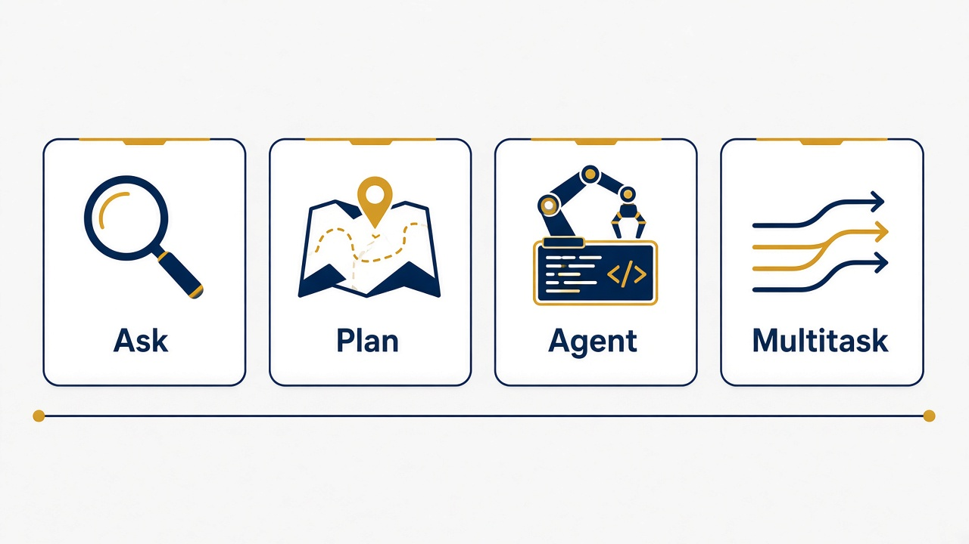
UC0 Foundations - modes
Ask, Plan, Agent, Multitask
Ask is cheap reconnaissance and explanation. Plan outlines steps without editing. Agent implements with your review. Multitask runs parallel agents when scopes are disjoint and your budget allows.
- Default order for research work: Ask, then Plan, then Agent. Multitask last.
- Ask: explain files, diagnose logs, extract methods. No edits. Lowest blast radius.
- Plan: name functions, packages, and verification steps before any diff appears.
- Agent: implement a plan you already agree with. Review every diff.
- Multitask: parallel agents on disjoint paths. Never two writers on one file.
CAC | Queen's University | cac.queensu.ca | Shadi Khalifa, PhD

Slide 18
Chat context
UC0 Foundations: chat context hygiene
What belongs in the same chat
What does not belong
- One objective, short follow-ups, and @ only the files you need for that objective.
- Ask then Agent is fine when the goal has not changed and the plan is still visible.
- Stable policy should live in rules and skills, not as a novel you re-paste each morning.
- Keep restricted or clinical data out of workshop and public threads entirely.
- Unrelated topic hopping (README polish morphing into paper replication mid-thread).
- Re-pasting huge SLURM logs when a tail or grep summary would do.
- Scope creep after you already said "done".
- Leaving /loop running while you start another expensive task.
CAC | Queen's University | cac.queensu.ca | Shadi Khalifa, PhD

Slide 19
UC0 Foundations - when context is full
Quality slips before the UI looks dramatic
Chat context is finite: prior turns, attachments, rules, tool output, and replies all compete for space. When it fills, older turns may drop or compact. Answers get vaguer, contradict earlier decisions, or re-ask questions you already settled, while cost often stays high.
- The fix is boring and effective: open a new chat, paste a three-line handoff, and @ the key files (or a short HANDOFF.md).
- Put durable policy in rules so you are not rebuilding the lab every session.
- Full context is not smarter; it is usually noisier and more expensive.
CAC | Queen's University | cac.queensu.ca | Shadi Khalifa, PhD

Slide 20
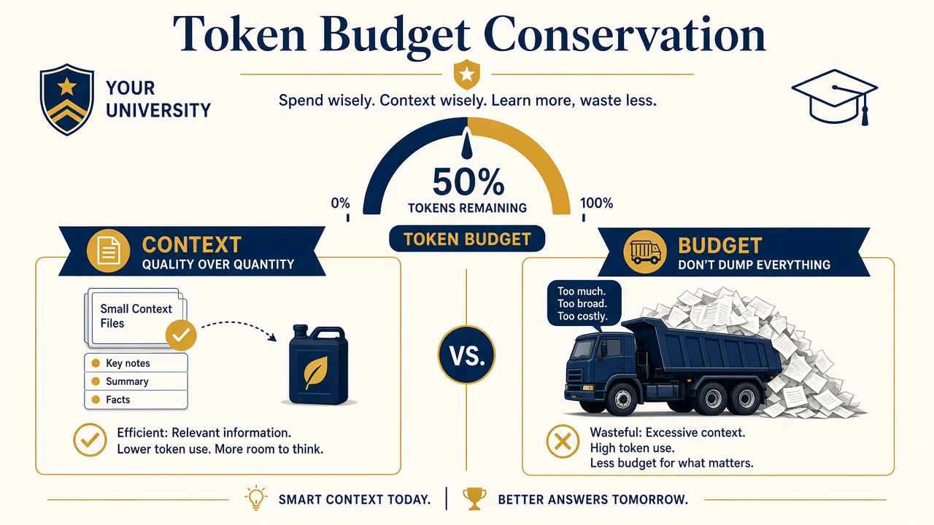
UC0 Foundations - tokenomics
Included usage vs on-demand
Your plan includes a monthly usage pool. On-demand usage is pay-as-you-go after that pool, billed for what you used, not a prepaid token pack you buy in advance.
- Check the dashboard before long Agent or Multitask sessions. On Teams, someone should set spending limits before a lab discovers curiosity is expensive.
- Requests are not silently downgraded in quality or speed when you move to on-demand.
- Alternative: upgrade the plan for a larger included pool. On-demand is a safety net, not a reason to attach the whole filesystem.
cursor.com/docs/models-and-pricing | handouts/budget-card.md
CAC | Queen's University | cac.queensu.ca | Shadi Khalifa, PhD

Slide 21
UC0 Foundations - budget habits
Twelve habits from the budget card
- Privacy Mode first; still no restricted data in prompts.
- Ask, then Plan, then Agent, then Multitask. Attach few files. One goal per chat.
- Smaller or faster models for explain and refactor; stronger models for hard bugs or method fidelity.
- Summarize long SLURM logs before pasting (tail, grep). Cap /loop. One write-scope per agent.
- MCP: draft, then you click send. Dry-run SLURM review counts as success when you cannot submit today.
- A long chat with a full context window is often the quiet budget leak.
CAC | Queen's University | cac.queensu.ca | Shadi Khalifa, PhD

Slide 22
UC0 Foundations - hands-on
UC0 Foundations: Ask, Plan, Agent practice
Prompt A - Ask mode (copy into Cursor)
In Ask mode: In two short paragraphs, explain what files exist under exercises/uc1-codebase-literacy and what problem they seem to solve. Do not edit anything.
Prompt B - Plan mode (copy into Cursor)
In Plan mode: I want a README for exercises/uc1-codebase-literacy that a new lab member can trust. Outline sections, which files you would read, and what you would verify by running code. Do not edit yet.
Prompt C - Agent mode (copy into Cursor)
In Agent mode: Using your plan, draft exercises/uc1-codebase-literacy/README.md from README.starter.md. Keep claims tied to files you actually read. Do not touch other use cases.
You are practicing cheap reconnaissance before any edit.
CAC | Queen's University | cac.queensu.ca | Shadi Khalifa, PhD

Slide 23
UC0 Foundations - hands-on
UC0 Foundations: token sanity, context, on-demand
Prompt D - Token sanity (Ask mode)
In Ask mode: List five ways the previous Agent prompt could have wasted tokens, and rewrite the Agent prompt to be tighter without losing the goal.
Prompt E - Context hygiene (Ask mode)
In Ask mode: We just finished the UC1 README goal. Should I keep using this same chat for UC4 paper replication? Explain in five bullets what happens to answer quality when a chat context is nearly full, and draft a three-line handoff I could paste into a new chat.
Prompt F (discuss, no tokens needed): What is included monthly usage versus on-demand on your seat? Who should set Teams spending limits? Open handouts/budget-card.md and mark habits you already follow.
CAC | Queen's University | cac.queensu.ca | Shadi Khalifa, PhD

Slide 24
Done when
UC0 Foundations: you are done when
- Privacy Mode is on and you can explain what it does and does not protect.
- You completed Ask, then Plan, then Agent on a narrow README goal without editing other use cases.
- You can describe context-full symptoms and produce a three-line handoff.
- You know included vs on-demand usage and where the budget card lives.
CAC | Queen's University | cac.queensu.ca | Shadi Khalifa, PhD

Slide 25
UC1
UC1 Codebase literacy and documentation grounding
Explain real files, then force the answer to cite lab conventions.
CAC | Queen's University | cac.queensu.ca | Shadi Khalifa, PhD

Slide 26
What this use case is
UC1 Codebase literacy: when you need this
You reach for UC1 Codebase literacy and documentation grounding when you inherit a lab folder, need to onboard yourself to a pipeline, or must write a README that a new student can trust. Work stays local under exercises/uc1-codebase-literacy; nothing needs the cluster.
- Researchers often ask an agent to "clean up the code" before anyone can say what the code does. UC1 flips that order: Ask to explain normalize.py and pipeline.py first.
- Only after that explanation do you ground answers in lab conventions and let Agent update the README. Grounding is how you stop polite fiction from becoming lab policy.
- You will produce a README whose run instructions match the repo and at least one claim explicitly tied to docs/lab-conventions.md.
CAC | Queen's University | cac.queensu.ca | Shadi Khalifa, PhD

Slide 27
UC1 Codebase literacy - hands-on
UC1 Codebase literacy: explain, ground, README
Step 1 - Ask for an explanation
@exercises/uc1-codebase-literacy/src Explain normalize.py and pipeline.py like I am a researcher who writes Python occasionally. What does each function do, and what could go wrong with messy CSV input?
Step 2 - Ground with docs (Ask)
Using @exercises/uc1-codebase-literacy/docs/lab-conventions.md and the source files, answer: Does pipeline.py already follow our lab conventions? Quote the convention text you relied on. If something is missing, say what is missing without inventing policy.
Step 3 - Agent writes the README
Update exercises/uc1-codebase-literacy/README.md so a new student can run the pipeline and knows where conventions live. Cite file paths. Do not invent CAC module names.
Open folder: exercises/uc1-codebase-literacy (or the whole workshop repo).
CAC | Queen's University | cac.queensu.ca | Shadi Khalifa, PhD

Slide 28
Done when
UC1 Codebase literacy: done when
- README run instructions match the repo.
- At least one claim is explicitly tied to lab-conventions.md.
- You caught one model mistake, or confirmed there was none after checking.
CAC | Queen's University | cac.queensu.ca | Shadi Khalifa, PhD

Slide 29
UC2
UC2 Local analysis pipeline
Plan a small script, implement it, then harden lightly.
CAC | Queen's University | cac.queensu.ca | Shadi Khalifa, PhD

Slide 30
What this use case is
UC2 Local analysis pipeline: when you need this
UC2 Local analysis pipeline is the everyday laptop workflow: load a CSV, clean empties, summarize by condition, write a plot. You work in exercises/uc2-analysis with synthetic data/measurements.csv, still off-cluster.
- Plan mode is where you insist on a small tool surface: standard library plus pandas and matplotlib only if that is already reasonable for your audience.
- You list steps and packages before any file changes, which keeps Agent from helpfully introducing a project generator you did not ask for.
- You will produce a runnable analyze.py, an output/mean_by_condition.png plot, and light argparse so paths are not hard-coded forever. Empty treatment rows must not crash the summary.
CAC | Queen's University | cac.queensu.ca | Shadi Khalifa, PhD

Slide 31
UC2 Local analysis - hands-on
UC2 Local analysis: plan, implement, harden
Step 1 - Plan the analysis
Plan mode: Expand analyze_starter.py into a small analysis script that (1) loads data/measurements.csv (2) drops empty values (3) summarizes mean and count by condition (4) writes a simple bar plot to output/mean_by_condition.png. List packages you will use. Prefer the standard library plus pandas/matplotlib only if already reasonable. Do not edit yet.
Step 2 - Agent implements
Agent mode: Implement the plan in analyze.py (you may replace or extend the starter). Create output/ if needed. Keep the script runnable with: python analyze.py
Step 3 - Light harden
Add argparse so I can pass --data and --outdir. Add a one-line docstring at the top describing the expected columns. Do not add a large framework.
Open: exercises/uc2-analysis
CAC | Queen's University | cac.queensu.ca | Shadi Khalifa, PhD

Slide 32
Done when
UC2 Local analysis pipeline: done when
- The script runs locally with python analyze.py.
- The plot exists under output/.
- An empty treatment row does not crash the summary.
CAC | Queen's University | cac.queensu.ca | Shadi Khalifa, PhD

Slide 33
Pause
Break (10 minutes)
Stretch. Refill coffee. Resist opening twelve new Agent chats just to try.
- We return with skills, /goal, and a capped /loop against STATUS.mock.txt.
- If UC2 is unfinished, finish the plot first; polish later.
CAC | Queen's University | cac.queensu.ca | Shadi Khalifa, PhD

Slide 34
UC3
UC3 Skills, /goal, and /loop
Reusable skills, a sticky goal statement, and capped polling.
CAC | Queen's University | cac.queensu.ca | Shadi Khalifa, PhD

Slide 35
What this use case is
UC3 Skills, /goal, and /loop: when you need this
UC3 Skills, /goal, and /loop is for the moment your analysis script needs to become job-shaped without you retyping the same SLURM advice. You copy workshop skill and rule templates from config/.cursor, set a durable goal, and optionally poll a mock status file so you learn to stop loops on purpose.
- Work is mostly local; the skill drafts SLURM content with placeholders, and you dry-run only.
- Materials live under exercises/uc3-skills-directives with a mock status file you can edit yourself.
CAC | Queen's University | cac.queensu.ca | Shadi Khalifa, PhD

Slide 36
UC3 Skills - how-to
Reusable playbooks the agent can load on demand
A skill is a packaged set of instructions for a recurring job (here, drafting a reviewable sbatch script with time, cpus, mem, logs, and an explicit working directory). Unlike a one-off chat paragraph, a skill survives across sessions once it lives in your project or personal skills store.
- Before prompts, copy config/.cursor/skills/cac-slurm-job into the project .cursor/skills/ (or your user skills store).
- Copy config/.cursor/rules/cac-research.mdc into .cursor/rules/.
- Those standing rules mean you stop retyping "do not invent CAC modules" into every chat.
CAC | Queen's University | cac.queensu.ca | Shadi Khalifa, PhD

Slide 37
UC3 /goal - when and how
A sticky north star across several tool steps
Use /goal when the next fifteen minutes will involve multiple prompts, a skill invocation, and maybe a loop, and you do not want the agent to quietly redefine success as "wrote any script." The goal statement stays visible and useful across steps.
- A good research goal names the artifact, the environment constraints (SLURM-ready, dry-run only), and the non-goals (do not submit).
- Vague goals like "make it better" invite expensive wandering.
- Research example: your UC2 analyze.py already runs on the laptop. The need is not more features; it is that this must be callable under SLURM with a data path via env or argparse, plus a draft sbatch that uses the cac-slurm-job skill.
CAC | Queen's University | cac.queensu.ca | Shadi Khalifa, PhD

Slide 38
UC3 Skills and directives - hands-on
UC3 Skills: set /goal and invoke the skill
Step 1 - Set /goal (copy into Cursor)
/goal Make exercises/uc2-analysis/analyze.py (or analyze_starter.py if analyze.py is missing) ready to run under SLURM on CAC: working entrypoint, data path via env or argparse, and a draft sbatch script using the cac-slurm-job skill. Dry-run only; do not submit.
Step 2 - Invoke the skill explicitly
Using the cac-slurm-job skill, draft exercises/uc5-cac-slurm/scripts/job.generated.sh for python scripts/analyze_job.py with 10 minutes, 1 CPU, 2G memory. Keep account/partition as placeholders. List verify-before-submit bullets.
CAC | Queen's University | cac.queensu.ca | Shadi Khalifa, PhD

Slide 39
UC3 /loop - exact how
Watch STATUS.mock.txt like a tiny SLURM status board
Use /loop when you are watching an external signal: a job status file, a build log path, a mock queue. Always set an interval and a maximum number of ticks, and define the stop states (DONE, FAILED) up front. Unbounded loops are how curiosity becomes an invoice.
- Open exercises/uc3-skills-directives/STATUS.mock.txt. It starts with JOB_STATE=RUNNING and a note that you may edit the state.
- Ask Cursor to read that file on an interval, summarize JOB_STATE in one sentence, and stop when the state is DONE or FAILED, or after four ticks.
- After one or two ticks, edit the file yourself to JOB_STATE=DONE (or FAILED) so you see a clean stop. That edit is the whole point: you are the human who decides the loop is finished.
- Tick pattern: Tick 1 reports RUNNING and waits ~30s; Tick 2 still RUNNING unless you edited; you change the file; Tick 3 sees DONE/FAILED and stops, or hits the 4-tick cap.
CAC | Queen's University | cac.queensu.ca | Shadi Khalifa, PhD

Slide 40
UC3 Skills and directives - hands-on
UC3 Skills: short capped /loop
Step 3 - Short capped /loop (copy into Cursor)
/loop 30s Read exercises/uc3-skills-directives/STATUS.mock.txt and summarize JOB_STATE in one sentence. Stop when JOB_STATE is DONE or FAILED, or after 4 ticks, whichever comes first.
After 1-2 ticks, edit STATUS.mock.txt to JOB_STATE=DONE yourself. Stop rules: stop on DONE/FAILED, stop at max ticks even if still RUNNING, stop if the loop is not helping, never leave a loop running while you start Multitask or a second expensive chat.
CAC | Queen's University | cac.queensu.ca | Shadi Khalifa, PhD

Slide 41
Done when
UC3 Skills, /goal, and /loop: done when
- The skill produced a reviewable script with placeholders.
- The goal statement stayed visible and useful across steps.
- The loop stopped on purpose (DONE/FAILED or tick cap), not by abandonment.
CAC | Queen's University | cac.queensu.ca | Shadi Khalifa, PhD

Slide 42
UC4
UC4 Paper method replication
Extract the method, plan functions, implement, then diff against Algorithm 1.
CAC | Queen's University | cac.queensu.ca | Shadi Khalifa, PhD

Slide 43
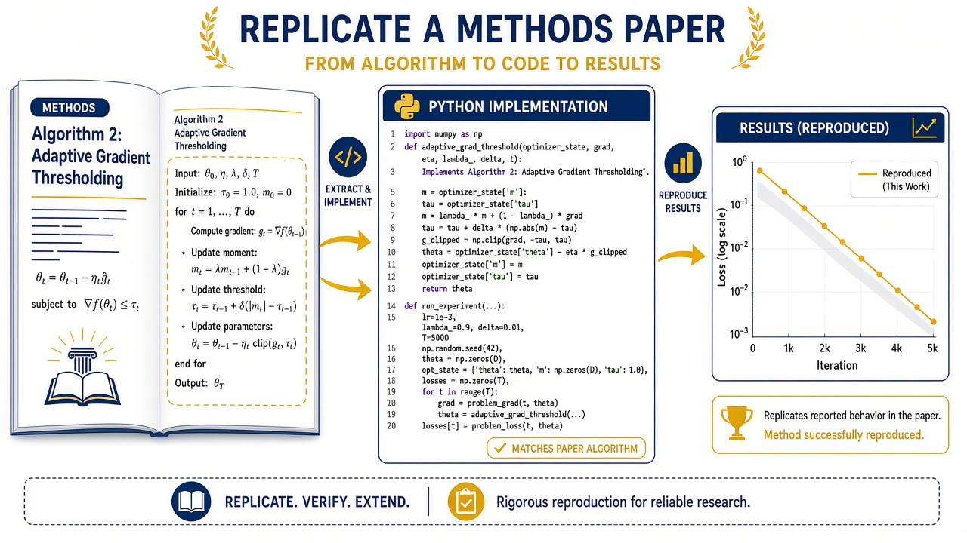
What this use case is
UC4 Paper method replication: when you need this
UC4 Paper method replication is for the common research need: a short methods brief (or paper supplement) must become runnable code with honest fidelity notes. You work in exercises/uc4-paper-replication using the workshop measurements CSV from the analysis exercise.
- Ask extracts the research question, Algorithm 1 steps, defaults, and acceptance checks before anyone writes code.
- Plan names functions and seed handling. Agent implements. Ask again diffs the implementation line by line against Algorithm 1.
- Approximations belong in REPLICATION_NOTES.md, not in silent shortcuts. You will produce replicate.py, printed mean difference and bootstrap CI with seed 7, and short fidelity notes.
CAC | Queen's University | cac.queensu.ca | Shadi Khalifa, PhD

Slide 44
UC4 Paper replication - hands-on
UC4 Paper replication: extract, plan, implement, verify
Step 1 - Ask extracts the method
Ask mode: Read PAPER_BRIEF.md. Extract the research question, Algorithm 1 steps, defaults, and acceptance checks as a bullet list I can implement against. Do not write code yet.
Step 2 - Plan the implementation
Plan mode: Propose a Python implementation plan for Algorithm 1 that satisfies the acceptance checks, including random seed handling and how you will exclude empty values. Name the functions you will create.
Steps 3-4 - Agent implements, then Ask verifies
Agent: Implement replicate.py from replicate_starter.py against PAPER_BRIEF.md and the measurements CSV. Print observed mean difference and 95% bootstrap CI. Use seed=7. Add a short REPLICATION_NOTES.md stating fidelity limits. Then Ask: Diff your implementation against Algorithm 1 line by line. Call out any step that is missing or approximated.
Open: exercises/uc4-paper-replication - Data: ../uc2-analysis/data/measurements.csv
CAC | Queen's University | cac.queensu.ca | Shadi Khalifa, PhD

Slide 45
Done when
UC4 Paper method replication: done when
- Acceptance checks 1-4 in PAPER_BRIEF.md pass, or are honestly marked incomplete.
- REPLICATION_NOTES.md states fidelity limits in plain language.
- Seed 7 is used and the CI printout matches what you asked for.
CAC | Queen's University | cac.queensu.ca | Shadi Khalifa, PhD

Slide 46
UC5
UC5 CAC remote work, SLURM jobs, and debugging
SSH when available, checklist-driven drafts, logs that tell the truth.
CAC | Queen's University | cac.queensu.ca | Shadi Khalifa, PhD

Slide 47

What this use case is
UC5 CAC remote work, SLURM jobs, and debugging: when you need this
UC5 CAC remote work, SLURM jobs, and debugging is the bridge from laptop scripts to CAC. If SSH is available you may connect and keep work under a demo directory; if not, you stay local and treat drafts as dry-runs. Either path is legitimate workshop success.
- Heavy compute does not belong on the login node. Editing, git, and light checks are fine; analysis and training belong in jobs on compute nodes through SLURM.
- Never invent CAC account names, partitions, or module versions. Use YOUR_ACCOUNT / YOUR_PARTITION placeholders and SLURM_CHECKLIST.md.
- Under exercises/uc5-cac-slurm you will generate a script with placeholders, diagnose paired logs from a broken job, and write a fixed script.
CAC | Queen's University | cac.queensu.ca | Shadi Khalifa, PhD

Slide 48
UC5 CAC + SLURM - concept
Checklist-driven drafts beat folklore
- A good sbatch script states time, cpus, mem, output and error logs, and an explicit working directory.
- The workshop template and SLURM_CHECKLIST.md exist so the agent (and you) stop relying on half-remembered flags from a different cluster.
- When logs disagree with the script, diagnose both stdout and stderr together with the broken script before you fix anything.
- Ranking failures beats guessing the first line that looks angry. If you cannot submit today, a reviewed dry-run still counts.
CAC | Queen's University | cac.queensu.ca | Shadi Khalifa, PhD

Slide 49
UC5 CAC + SLURM - hands-on
UC5 CAC + SLURM: Parts A and B
Part A - Remote project (when connected to CAC)
We are connected to CAC over SSH. Confirm the current workspace path, create a directory ~/cursor-workshop-demo if missing, and sync only the uc5-cac-slurm exercise files there if appropriate. Summarize login-node vs compute-node rules in three bullets.
Part B - Plan what must change
Plan mode: Using exercises/uc5-cac-slurm/scripts/job.template.sh and SLURM_CHECKLIST.md, list what must change before a real submit on CAC.
Part B - Agent drafts job.generated.sh
Agent mode: Create scripts/job.generated.sh from the template for analyze_job.py. Keep YOUR_ACCOUNT and YOUR_PARTITION placeholders. Fix the data path assumption in comments.
If SSH is unavailable, stay local and treat Parts B and C as dry-run.
CAC | Queen's University | cac.queensu.ca | Shadi Khalifa, PhD

Slide 50
UC5 CAC + SLURM - hands-on
UC5 CAC + SLURM: Part C debug from logs
Part C - Diagnose the broken job (Ask)
Ask mode: Diagnose exercises/uc5-cac-slurm/logs/slurm-4242.out and slurm-4242.err together with scripts/job.broken.sh. Rank the failures. Propose a minimal fixed script.
Part C - Write the fixed script (Agent)
Agent mode: Write scripts/job.fixed.sh that addresses the module, path, and data issues without inventing a real CAC account.
Done when: you reviewed SLURM_CHECKLIST.md, can explain the broken job in plain language, and job.fixed.sh exists. Submit is optional.
CAC | Queen's University | cac.queensu.ca | Shadi Khalifa, PhD

Slide 51
Pause
Break (5 minutes)
Almost done. Multi-agent handoffs next, then a careful GitHub MCP demo.
- If your job.fixed.sh still looks haunted, bring it to the wrap-up.
CAC | Queen's University | cac.queensu.ca | Shadi Khalifa, PhD

Slide 52
UC6
UC6 Multi-agent orchestration
Explorer, Implementer, Reviewer, with you as the gate.
CAC | Queen's University | cac.queensu.ca | Shadi Khalifa, PhD

Slide 53
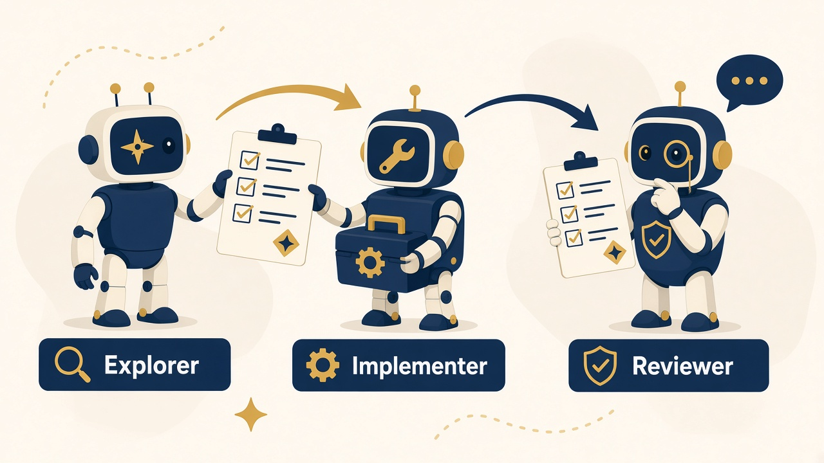
What this use case is
UC6 Multi-agent orchestration: when you need this
UC6 Multi-agent orchestration is for work that benefits from separated roles: one read-only map of the tree, one implementer with a narrow write scope, one reviewer against a checklist. Follow exercises/uc6-multi-agent/ORCHESTRATION.md.
- Parallel agents are useful when paths are disjoint. Two agents editing the same file is how you get a merge conflict dressed up as productivity.
- Optional Multitask is only worth the budget when Explorer reads while Implementer writes elsewhere, then you merge judgment manually.
- You will produce Explorer bullets, a generated sbatch under the uc5 scripts folder, and a pass/fail review. No sbatch submit is required. You remain the human gate: accept, request revisions, or stop.
CAC | Queen's University | cac.queensu.ca | Shadi Khalifa, PhD

Slide 54
UC6 Multi-agent - hands-on
UC6 Multi-agent: Explorer, Implementer, Reviewer
Agent 1 - Explorer (Ask, read-only)
Ask mode / Explorer role: Map exercises/uc5-cac-slurm for a teammate who will write an sbatch script. Max 10 bullets: key files, risks, and what not to invent.
Agent 2 - Implementer (Plan then Agent)
Implementer role: Create exercises/uc5-cac-slurm/scripts/job.generated.sh for analyze_job.py. Edit only under exercises/uc5-cac-slurm/scripts/. Assumptions as comments. Dry-run only. Paste the Explorer bullets first so Implementer inherits the map.
Agent 3 - Reviewer (Ask)
Ask mode / Reviewer role: Grade scripts/job.generated.sh against SLURM_CHECKLIST.md. Pass/fail per item. Do not edit files.
Human gate: accept, revise, or stop. Multitask last, and only when write scopes are truly disjoint.
CAC | Queen's University | cac.queensu.ca | Shadi Khalifa, PhD

Slide 55
Done when
UC6 Multi-agent orchestration: done when
- Explorer map exists (max 10 bullets).
- Implementer wrote only under the allowed scripts path.
- Reviewer produced pass/fail against SLURM_CHECKLIST.md.
- You made an explicit accept / revise / stop decision.
CAC | Queen's University | cac.queensu.ca | Shadi Khalifa, PhD

Slide 56
UC7
UC7 GitHub MCP demo
Read with tools, draft writes, you click send.
CAC | Queen's University | cac.queensu.ca | Shadi Khalifa, PhD

Slide 57
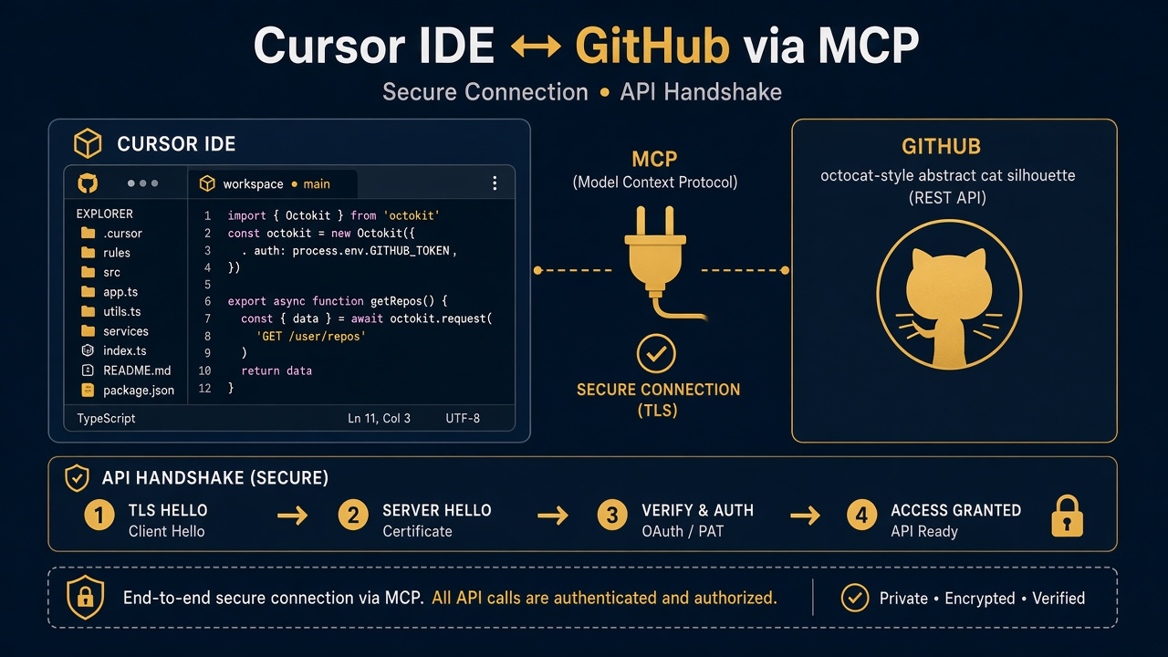
What this use case is
UC7 GitHub MCP demo: when you need this
UC7 GitHub MCP demo shows how an agent talks to GitHub through MCP with minimal scopes. You use it when issue triage or README pointers should not require pasting personal access tokens into chat. Materials and notes live under exercises/uc7-github-mcp.
- Connect GitHub MCP with minimal scopes before the demo prompts. Prefer read-only first.
- You will watch a read path (list open issues, summarize titles) and a write path that stops at a draft until you say to post.
- The safety discussion is part of the deliverable: what is risky on a shared lab repo, and what narrower alternative you would recommend for class use.
CAC | Queen's University | cac.queensu.ca | Shadi Khalifa, PhD

Slide 58
UC7 GitHub MCP - hands-on
UC7 GitHub MCP: read, draft, discuss risk
Demo prompt 1 - read only
Using the GitHub MCP tools, list the open issues on <ORG/REPO> (your instructor will fill this). Summarize the top 3 by title only. Do not comment or close anything.
Demo prompt 2 - draft, then wait
Draft a polite issue comment for issue #<N> that points newcomers to the workshop README section on SLURM dry-runs. Show me the comment text first. Do not post until I say "post it".
Optional follow-up - risk discussion (Ask)
Ask mode: What GitHub MCP actions are risky on a shared lab repo, and what narrower alternative would you recommend for class use?
Done when: read path without writing; write path as draft-then-approve; short scope and safety discussion completed.
CAC | Queen's University | cac.queensu.ca | Shadi Khalifa, PhD

Slide 59
Materials map
Where to look after class
- exercises/uc1-codebase-literacy through exercises/uc7-github-mcp
- config/.cursor for rules and skills templates
- handouts/budget-card.md and handouts/privacy-and-context.md
- This deck: presentations/cursor-cac-workshop.html and the PPTX beside it
CAC | Queen's University | cac.queensu.ca | Shadi Khalifa, PhD

Slide 60
Closing habits
Take these back to your own repo
Privacy Mode on, Ask before Agent, few attachments, one goal per chat, rules and skills for durable policy, dry-run SLURM review as legitimate success, MCP drafts until you approve. Those habits matter more than any single clever prompt.
- When something fails on CAC, bring the checklist and both logs.
- When something fails in chat, bring a new thread and a three-line handoff.
- Curiosity is allowed; unbounded spend is not.
CAC | Queen's University | cac.queensu.ca | Shadi Khalifa, PhD

Slide 61
Thank you | Centre for Advanced Computing
Go build carefully
You now have a path from laptop exploration to CAC-ready SLURM drafts, with Projects, modes, skills, and MCP as practical vocabulary rather than buzzwords.
Shadi Khalifa, PhD <khalifa.s@queensu.ca>, Centre for Advanced Computing, Queen's University
cac.queensu.ca | khalifa.s@queensu.ca
CAC | Queen's University | cac.queensu.ca | Shadi Khalifa, PhD

