Slide 1
Introduction to FORTRAN
Gang Liu, Hartmut Schmider
gang.liu@queensu.ca, hartmut.schmider@queensu.ca
CAC, Queen's University
Summer School, Compute Ontario
2017

Slide 2
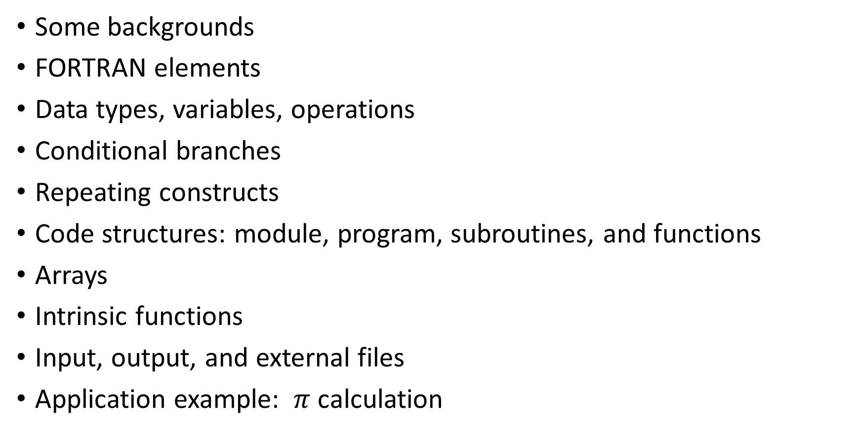
Overview
Some backgrounds
FORTRAN elements
Data types, variables, operations
Conditional branches
Repeating constructs
Code structures: module, program, subroutines, and functions
Arrays
Intrinsic functions
Input, output, and external files
Application example: $π$ calculation

Slide 3
Some backgrounds

Slide 4
Today's computers
are very powerful and clever
e.g. can help doctors to diagnose patient's problems (IBM Watson)
e.g. can win world top players in board game GO (AlphaGo)
however, machines/mechanics
always need instruction to do next
the instructions must be accurate, detailed, and complete
computer code is for that purpose.

Slide 5
Programming/coding principle
Logical
Then feasible, no conflicts, no ambiguity.
E.g. not cooking and playing volleyball at the same time.
E.g. in a many-road intersection, can not ask one to walk some steps without indicating direction.
E.g. not try to present your "fourth" apple to your friend when you have only three.
E.g. not try to divide 92 by "Please accept this cruise for our anniversary!"

Slide 6
How to learn coding
Testing
Testing
And testing …

Slide 7
Computers of bits
Almost everything in computers is bit or bits.
Each bit can be imagined as a simple circuit with current running or not, two states only.
Normally the two states are represented with 0 and 1.
Then do you mean a computer can only describe two states?
No. Each bit can do that. But we have many many bits.
E.g. 01011101100010001 may mean "I love you!"
Actually unlimited number of bits can express anything.
All data and code instructions are bits.
And anything computers do is on bits essentially.

Slide 8
Minimum working unit in computers
Not simply one bit, but
8 bits
Called one BYTE.
This means whatever you do anything, one or more BYTEs will be used.

Slide 9

What we get when we buy a computer?

Slide 10
Computer key parts
CPU. E.g. AMD A9-9410 2.9GHz
Memory. 8GB is about 8,000,000,000 BYTES
Hard disk: 1TB is about 1,000,000,000,000 BYTES
Accurately
1KB | = 2^10 BYTES | = 1024 BYTES
1MB | = 2^10 KB | = 1024 KB
1GB | = 2^10 MB | = 1024 MB
1TB | = 2^10 GB | = 1024 GB
1PB | = 2^10 TB | = 1024 TB

Slide 11
A sketch of computer structure and data flow
I/O
CPU
Main
Memory
Hard disk
Hard disk
Core Cache
CPU/Core can operate data only in cache at fixed frequency. Much additional time is spent in data transporting between the main memory and the cache. Fully making use of cache capacity reducing data movement between main memory and cache is critical for performance improvement.

Slide 12
Data and code
are stored in hard disks as files in certain format.
Files are placed in a hierarchy of directories.
Although everything is bits/BYTEs, some files are stored in a way such that the BYTEs can be converted into characters, letter, numbers, and/or other symbols, then readable to people. Called text files.
Other files are just bits, not indented to be converted. Called binary files. People can not read binary files. Meanwhile, computers can not run based on text files, but based on instructions in some binary files, called executable. Not all binary files are executable, e.g. movie data files.

Slide 13
Computer languages
Rules and facilities for writing (source) codes in text files, eventually converted into executable binaries to instruct computers what to do.
Although they were created like natural languages as much as possible, their rules (syntax/grammar) are applied absolutely strictly. Any violation will be refused.
There are a great number of computer languages.
For application, especially computing/data science, high-level programming languages fall into two categories.
Interpreted and compiled languages.

Slide 14
The difference
In interpreted languages, like R, Python, and Matlab, one or more lines of source code is (are) converted into binary then executed. Then another section of source code. This procedure is repeated till end. Then computation is interrupted by conversions.
In compiled languages, like C and FORTRAN, the whole source code is compiled into a big executable binary code. The compiled binary code can be run repeatedly later, forgetting the source code.

Slide 15
The difference
Post office
Post office
houses
houses
houses

Slide 16
The difference
Post office
Post office
houses
houses
The interpreted, like a postman on the left, needs to go back and forth to deliver letters. The compiled (on the right) can deliver all together and further optimize since knows all tasks.

Slide 17
So
The compiled ones usually run much fast than the interpreted ones.

Slide 18
FORTRAN
is for fast (maybe also for easy) scientific computation on purpose.
Then it supports features for such purpose as much as possible, and in principle refused other feature. Sure this is different from C/C++, which likes to be most powerful.

Slide 19
As a compiled language, FORTRAN
was proposed and developed by John W. Backus's team in IBM, late 1953
(a contraction of FORmula TRANslation)
Versions | Year | Versions | Year
FORTRAN | 1957 | Fortran 90 | 1991
FORTRAN II | 1958 | Fortran 95 | 1997
FORTRAN III | 1958 | Fortran 2003 | 2004
FORTRAN IV | 1961 | Fortran 2008 | 2010
FORTRAN 66 | 1966 | Fortran 2015 | 2018?
FORTRAN 77 | 1978 | Fortran ???????

Slide 20
Fortran 90 is a big jump
which makes FORTRAN a modern language.
We will talk about basic Fortran 90, which should be good for all later versions as well.

Slide 21
FORTRAN elements

Slide 22
Fortran character set
the 26 letters of the English alphabet (case insensitive)
the 10 Arabic numerals, 0 to 9
the underscore, _,
(all above is called alphanumeric characters)
and the ones in the table of the next page

Slide 23
Special characters of Fortran
Character | Name | Characer | Name
= | Equals sign | : | Colon
+ | Plus sign |  | Blank
- | Minus sign | ! | Exclamation mark
* | Asterisk | " | Quotation mark
/ | Slash | % | Percent
( | Left parenthesis | & | Ampersand
) | Right parenthesis | ; | Semicolon
, | Comma | < | Less than
. | Decimal point | > | Greater than
$ | Currency symbol | ? | Question mark
' | Apostrophe

Slide 24
Source form
Source code is made of lines
Each line may contain up to 132 characters
(For versions before 90 up to 72)
Each line usually contains one statement, e.g.
x = (-y + root_of_discriminant)/(2.0*a)
Anything after "!" in a given line is a comment, like
! Here is a comment to make some notes.
x = y/a - b ! Solve the linear equation
(For versions before 90, the first character must be "C" for comments)

Slide 25
Source form
If a line ends with "&", the next line is a continuation, thus a very long statement/line can be split into more lines, but limited to 39.
x = &
(-y + root_of_discriminant) &
/(2.0*a)
If the first non-blank character in the next line is "&", those blank characters and the "&" are ignored:
x = &
& (-y + root_of_discriminant) / (2.0*a)
(For versions before 90, continuation lines are identified by a nonblank, nonzero character in column 6)
More than one short statements can be written into one line, separated with ";", e.g.
a = 3.5 ; b = c + d ; speed = distance / time

Slide 26
Names
Programmers need to create/name many names, especially variable names.
All names must consist of between 1 and 31 alphanumeric characters of which the first must be a letter.
A, a, ggg, f3d, alpha, KING8, second_generation, TRY_003 are all legal.
However,
delete them
2 students
$20
are all illegal.

Slide 27
Compiling and running
A Fortran source code must be compiled before running with a compiler. Supposing a file called myfortran01.f90 contains
program mywork
print*, "My work is finished."
end program mywork
ls -ltr
f90 myfortran01.f90
ifort myfortran01.f90
gfortran myfortran01.f90
ls -ltr
./a.out

Slide 28
Compiling many files for one executable
Supposing myfortran01.f90, myfortran02.f90, myfortran03.f90 are source
ifort myfortran01.f90 myfortran02.f90 myfortran03.f90
./a.out

Slide 29
Compiling many files for one executable
ifort -c myfortran01.f90
ifort -c myfortran02.f90
ifort -c myfortran03.f90
ls -ltr
rm a.out
ifort -o myexe myfortran01.o myfortran02.o myfortran03.o
ls -ltr
./myexe

Slide 30
Compiling many files for one executable
ifort -c myfortran01.f90
ifort -c myfortran02.f90
ls -ltr
rm a.out
ifort -o myexe myfortran01.o myfortran02.o myfortran03.f90
ls -ltr
./myexe

Slide 31
Compiling many files for one executable
ifort -c -O3 myfortran01.f90
ifort -c -O3 myfortran02.f90
ifort -c -O3 myfortran03.f90
ls -ltr
rm a.out
ifort -o myexe -O3 myfortran01.o myfortran02.o myfortran03.o
ls -ltr
./myexe

Slide 32
Data Types, Variables, and Operations

Slide 33
Data Types
What and why types?
Each type was defined, so that a reasonable amount of bits or BYTEs allocated in memory to store such values with certain format.
Once a data type is defined, we can use it, forgetting its details.
FORTRAN has the following types defined in the language as intrinsic types. Programmers can define more combined data types for their own projects.

Slide 34
Intrinsic Types
INTEGER
REAL
DOUBLE PRECISION
COMPLEX
DOUBLE COMPLEX
LOGICAL
CHARACTER

Slide 35
INTEGER Type
2
5
INTEGER :: I, J, K
INTEGER :: LIMIT, SEAT_NUMBER = 34
INTEGER, PARAMETER :: NUMBER_OF_MONTHS_A_YEAR = 12

Slide 36
INTEGER Type
is for one integer.
normally has 64 bits (8 BYTEs) in memory.
one bit is used for sign, maybe 1 meaning +, 0 for -.
the rest 63 bits are for the actual integer absolute value.
the maximum positive value can be stored is 2**63 -1 = 9,223,3…,807
Usually one would assume the type is big enough for holding values we are interested, then forget all above details. In case an integer is bigger than the type can express, an overflow error will be reported then the code running will be stopped automatically. All other types similar.

Slide 37
REAL Type
2.0
5.4e12
REAL :: R, RG, SPEED = 90.0, DISTANCE
REAL, PARAMETER :: MASS_OF_THE_OBJECT = 1.45
A REAL usually has 32 bits (4 BYTEs) in memory (single precision).

Slide 38
DOUBLE PRECISION Type
2.0d0
5.4d12
DOUBLE PRECISION :: R, RG, SPEED = 90.0d0
A DOUBLE PRECISION usually has 64 bits (8 BYTEs) in memory (double precision).

Slide 39
COMPLEX Type
(1.0, 2.0)
(4.6e22, 5.4e12)
COMPLEX :: R, RG, SPEED = (0.0, 90.0)
A COMPLEX usually has 64 bits (8 BYTEs) in memory (two single precision).

Slide 40
DOUBLE COMPLEX Type
(1.0d0, 2.0d0)
(4.6d-22, -5.4d12)
DOUBLE COMPLEX :: R, RG, SPEED = (0.0d0, 90.0d0)
A DOUBLE COMPLEX usually has 128 bits (16 BYTEs) in memory (two double precision).

Slide 41
Although a kind number can be further specified
INTEGER (KIND = 2)
INTEGER (KIND = 4)
REAL (KIND = 4)
DOUBLE PRECISION (KIND = 4)
COMPLEX (KIND = 6)
DOUBLE COMPLEX (KIND =8)
I personally do not suggest it, as kind numbers are usually processor or compiler dependent, rather than universal applicable.

Slide 42
Other ways to specify BYTEs
INTEGER*8
REAL*8 !double precision
REAL*16 !quadruple precision
COMPLEX*16 !double precision
COMPLEX*32 !quadruple precision
which are good enough for most scientific computations and universally applicable.

Slide 43
Implicit rules
Fortran adopted an implicit rule for long period of time. It is called I-N rule, which means any variable beginning with I, J, K, L, M, N are assumed as integer type, otherwise real type. Then in such a case, variables can be used directly without declaration. This rule saved some typing effort for programming. But later people realized that even very heavy typing is ignorable compared with other effort in programming, e.g. debugging. Explicitly defining variables help programming to reduce errors, so more preferred now. In order to get rid of the implicit rule, the statement
IMPLICIT NONE
can be used.

Slide 44
LOGICAL Type
Only has two possible values
.TRUE.
.FALSE.
.TRUE. may also be denoted as T or 1
.FALSE. may be denoted as F or 0.
LOGICAL :: A1 = .TRUE., FFF = .FALSE.

Slide 45
CHARACTER Type
"s"
"Kingston is a great place to visit!"
CHARACTER (LEN=11) :: AAA
CHARACTER (LEN=11) :: AA1 = 'KINGSTON'
CHARACTER (LEN=11) :: AAB = "KINGSTON IS"
CHARACTER (LEN=11) :: B_2 = "KINGSTON IS GREAT!"
CHARACTER (LEN=*), PARAMETER :: &
BB_A = "Kingston is a great place to visit!"

Slide 46
TEST IT with file t1.f90
PROGRAM A_TEST
CHARACTER (LEN=11) :: AAA
CHARACTER (LEN=11) :: AA1 = "KINGSTON"
CHARACTER (LEN=11) :: AAB = "KINGSTON IS"
CHARACTER (LEN=11) :: B_2 = "KINGSTON IS GREAT!"
CHARACTER (LEN=*), PARAMETER :: BB_A = "Kingston is a great place to visit!"
PRINT*, AA1
PRINT*, AAB
PRINT*, B_2
PRINT*, BB_A
STOP
END PROGRAM A_TEST
Ifort t1.f90
./a.out

Slide 47
Variables
Variables are essentially the variables of mathematics.
However they must be defined/declared as fixed data types at the beginning of the code unit where they will be assessed.
Then the compiler will allocate enough space in memory for them, and of course specify the format to hold data.
Must be initialized with values before being read. The values can be changed and read unlimitedly later. But the data type can not be changed.

Slide 48
Basic operations on numbers
Program test_02
integer :: i1, i2, i3
real :: rl1, rl2, rl3
i1 = 4; i2 = 3
i3 = i1 + i2
Print*, i1, i2, i3, i1-i2, i1*i2, i1/i2, i1**i2
rl1 = 4; rl2 = 3
rl3 = rl1 + rl2
Print*, rl1, rl2, rl3, rl1-rl2, rl1*rl2, rl1/rl2, rl1**rl2
Stop
End Program test_02

Slide 49
Integer divisions
Program test_03
Print*, "Integer divisions: ", 1/3, 2/3, 3/3, 4/3, 5/3, 6/3
Print*, "Real divisions: ", 1.0/3, 2/3.0, 3./3, 4.0/3.0, 5./3., 6.0/3
Stop
End Program test_03

Slide 50
Operations on different types
Program test_04
Double precision :: dp = 4.5d0
Print*, 1 + 2.9, 3.0 + 3, 1 + dp, 4.3 + dp
Stop
End Program test_04
Integer => real or double precision
Low precision => high precision

Slide 51
Assignment with different types
Program test_06
Integer :: ii = 4, ii2, ii3
Real :: rr =5.123456789123456789e0, rr2, rr3
Double precision :: dp = 6.123456789123456789d0, dp2, dp3
ii2 = rr; ii3 = dp
Print*, ii2, ii3
rr2 = ii; rr3 = dp
Print*, rr2, rr3
dp2 = ii; dp3 = rr
Print*, dp2, dp3
Stop
End Program test_06
Always converted into the type of the variable.

Slide 52
Precedence
Program test_07
Print*, 1+2-3, 1-3+2, 1+2*3, 1*2+3
Print*, 4*2/3, 4/2*3, 4*(2/3), 4/(2*3)
Print*, 2**3*5, 9*3**2
Stop
End Program test_07
Precedence:
** exponentiation
* / multiplication, division
+ - addition, subtraction
Use parentheses ( ) to change or make sure precedence.

Slide 53
Operations on logical variables
Program test_09
Print*, .not. .true., .not. .false.
Print*, .true. .and. .true., .true. .and. .false.
Print*, .true. .or. .true., .true. .or. .false.
Print*, .true. .eqv. .true., .true. .eqv. .false.
Print*, .true. .neqv. .true., .true. .neqv. .false.
Stop
End Program test_09

Slide 54
Data comparisons resulting in logical values
Program test_10
Print*, 5 > 6, 7 < 8
Stop
End Program test_10
.lt. or < less than
.le. or <= less than or equal
.eq. or == equal
.ne. or /= not equal
.gt. or > great than
.ge. or >= great than or equal

Slide 55
Operations on characters
Program test_12
print*, "Queen's Univer"//"sity is in Kingston."
Stop
End Program test_12
Concatenation

Slide 56
Character substrings
Program test_14
Implicit none
Character (len=40) :: a_string = "Queen's University is in Kingston."
Print*, a_string
Print*, a_string(:6)
Print*, a_string(8:)
Print*, a_string(4:12)
Print*, a_string(9:9)
Stop
End Program test_14

Slide 57
Derived data types
type student
character (len=20) :: name
integer :: id
integer :: grade
real :: age
real :: height
end type student
type(student) :: a_queens_student
a_queens_student%age

Slide 58
Conditional branches

Slide 59
IF statement
if (a condition is true) (do something)
if (iii > 9) print*, iii

Slide 60
GO TO statement
An example
if (a condition is true) go to 25
(other statements)
25 c = a + b
(other statements)
Not suggested.

Slide 61
IF Construct
It allows us to code sections of code to be executed under conditions.
Most cases, different conditions execute different part/path of code.
The general form
if (condition1 is true) then
(do some things accordingly)
else if (condition2 is true) then
(do some other things accordingly)
else if (condition3 is true) then
(do some other things accordingly)
else if (… is true) then
(do some other things accordingly)
else
(do other things accordingly)
end if
All else if and else constructs are optional and no limit on number of else if constructs.

Slide 62
IF Construct
An example
var = 5
if (var > 10) then
print*, "var has value ", var, " and bigger than 10. "
else if (var < 10) then
print*, "var has value ", var, " and less than 10. "
else
print*, "var has value ", var, " and is 10. "
end if

Slide 63
IF Construct
can be unlimited nested.
Example
if (my_dad_is_at_home) then
(my dad will cook)
else
if (my_mom_is_at_home) then
(my mom will cook)
else
(I will cook)
end if
end if

Slide 64
CASE Construct
Example
select case (an_integer)
case (:-1)
(do things accordingly)
case (0)
(do things accordingly)
case (1:7)
(do things accordingly)
case (8:22)
(do things accordingly)
case default
(do things accordingly)
end select

Slide 65
Repeating constructs

Slide 66
If you have
log(2.0) + log(3.0) + log(4.0) + log(5.0) + … + log(10000.0) to calculate,
you would absolutely not like to write all such operations one by one.
Loops are for such repeated works and can make life much easier.

Slide 67
It can be done by a do loop
program test_20
implicit none
integer*8 :: i
real*8 :: result
result = 0.0d0
do i = 2, 10000
result = result + log(i * 1.0d0)
end do
print*, result
stop
end program test_20

Slide 68
The do loop
takes a form of
[name:] do an_integer = beginning, ending, step
(do something for the iteration)
end do [name]
Example
integer :: a
do a = 2001, 2017
print*, a, " is a year of this centrury. "
end do

Slide 69
CYCLE statement in do loop
integer :: ii
do ii = 1, 1000, 2
(do something for the iteration)
end do
is equivalent to
ONLY_FOR_ODD_NUMBERS: do ii = 1, 1000
if ( (ii/2) == 0) cycle ONLY_FOR_ODD_NUMBERS
(do something for the iteration)
end do ONLY_FOR_ODD_NUMBERS

Slide 70
EXIT statement in do loop
UNLIMITED_LOOP: do
if (some condition is met) exit UNLIMITED_LOOP
(do something for the iteration)
end do UNLIMITED_LOOP

Slide 71
Loops can be unlimited nested
program test_22
implicit none
integer :: i, j
do i = 1, 9
do j = 1, 9
print*, "The multiplication of ",i," and ",j," is ",i*j
end do
end do
stop
end program test_22

Slide 72
Arrays

Slide 73
An array
consists of a rectangular set of elements (scaler variables), all of the exactly same type.
real, dimension(10) :: a
then the successive elements of the array are a(1), a(2), …, a(10)
real, dimension(-10:20) :: vt
the elements are vt(-10), vt(-9), vt(-8), …, vt(20)
real, dimension(5, 4) :: b
then the successive elements of the array in memory are
b(1, 1), b(2, 1), b(3, 1), b(4, 1), b(5, 1),
b(1, 2), b(2, 2), b(3, 2), b(4, 2), b(5, 2),
b(1, 3), b(2, 3), b(3, 3), b(4, 3), b(5, 3),
b(1, 4), b(2, 4), b(3, 4), b(4, 4), b(5, 4)
they can also declared as
real :: a(10), vt(-10:20), b(5,4)

Slide 74
Arrays should be initialized before being used
real :: a(10), vt(-10:20), b(5,4)
a = 0.0d0
vt = 0.0d0
b = 0.0d0
character (len=20) :: aaa(25,300)
aaa = ' '

Slide 75
Subarrays and collective operations
real :: a(10), vt(-10:20), b(5,4)
vt(-2:2) = (/1.4, 3.6, 7.3, 8.9, 13.8/)
vt(:2) = 9.0
vt(3:) = 25.0
vt(-8:2:3) = 64.0
b = 24.0
a(2:5) = vt(-3:0) + b(1:4, 3)

Slide 76
Elemental operations on arrays
real :: b(5,4)
integer :: i, j
do i = 1, 4
do j = 1, 5
b (j, i) = (sin(i*1.0))**j
end do
end do

Slide 77
Elemental operations on arrays
real :: b(5,4), c(4, 6), d(5,6)
integer :: i, j, k
b = 3.4
c = 5.9
d = 0.0
do i = 1, 6
do j = 1, 5
do k = 1, 4
d (j, i) = d(j, i) + b(j, k) * c(k, i)
end do
end do
end do

Slide 78
Allocatable arrays
Array sizes may not be known until run time
real, allocatable :: arr1(:), arr2(:, :), array8(:, :, :, :)
integer :: i=3, j=5, k=6, l=8
…
allocate(arr1(i))
allocate(arr2(k,j))
allocate(array8(i,j,k,l))
…
deallocate(arr1, arr2, array8)

Slide 79
Code structures: modules, program, subroutines, and functions

Slide 80
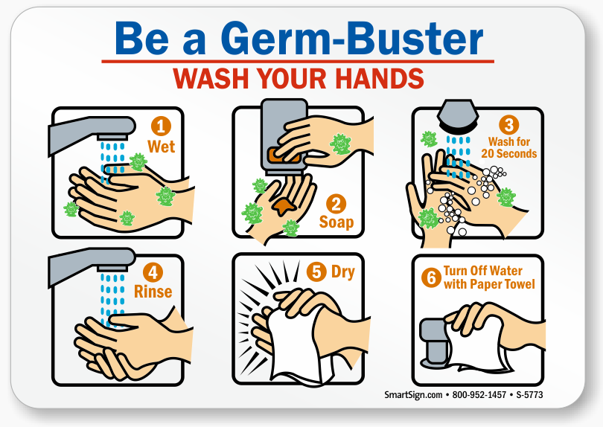
Nowadays, people do everything step by step

Slide 81
Programming is not an exception
A big computational task is usually cut into many smaller ones.
With input and output assumed to some degrees, what and how to complete the inside of each smaller task is usually independent on any other smaller tasks. In other words, the inside is encapsulated.
Functions/subroutines are used for such smaller tasks or steps.
Normally when we code functions/subroutines, we can focus on the specific small task, forgetting the whole big complicated task.
Functions/subroutines can be unlimitedly re-used and make code well structured.
Additionally, modules are a great help in many respects.
Functions/subroutines can only access their arguments, local variables, and data in the modules whey use.

Slide 82
The general form of functions
[type] function function_name(dummy_argument_list)
! function body (statements)
! function_name is the variable to be assigned new value
! to send back.
return
end function function_name

Slide 83
A function example
real*8 function distance(x1, y1, x2, y2)
real*8 :: x1, y1, x2, y2
distance = sqrt ((x1 - x2)**2 + (y1 - y2)**2)
return
end function distance
program test_30
interface
real*8 function distance(x1, y1, x2, y2)
real*8 :: x1, y1, x2, y2
end function distance
end interface
real*8 :: a1, b1, a2, b2
a1 = 2.3d0; b1 = 5.3d0; a2 = 3.2d2; b2 = 6.3d4
print*, distance(a1, b1, a2, b2)
end program test_30

Slide 84
The return data type can also be written as
function distance(x1, y1, x2, y2)
real*8 :: x1, y1, x2, y2, distance
distance = sqrt ((x1 - x2)**2 + (y1 - y2)**2)
return
end function distance
program test_30
interface
function distance(x1, y1, x2, y2)
real*8 :: x1, y1, x2, y2, distance
end function distance
end interface
real*8 :: a1, b1, a2, b2
a1 = 2.3d0; b1 = 5.3d0; a2 = 3.2d2; b2 = 6.3d4
print*, distance(a1, b1, a2, b2)
end program test_30

Slide 85
Normally, when a function is called
all arguments should be provided in sequence, like
real*8 function my_functioin(ar1, ar2, ar3, … arn)
…
end function my_functioin
aa = my_functioin(act1, act2, act3, … actn)

Slide 86
Argument names can also be used when a function is called
real*8 function my_function(ar1, ar2, ar3, … arn)
…
end function my_function
aa = my_function(act1, act2, arn = act3, … ar3 = actn)
then the argument name is called keyword. Once a keyword argument is used, no more pure positional arguments allowed after it.

Slide 87
Optional arguments in functions
should be declared at the end of argument list
real*8 function my_function(ar1, ar2, ar3, … arn, p1, p2, …, pn)
real*8, optional :: p1, p2, …, pn
if (present(p1)) then
…
end if
…
end function my_function
aa = my_function(act1, act2, act3, … actn, 3.5d0)

Slide 88
Functions as arguments in functions
real*8 function minimum(ar1, ar2, a_function)
real*8 :: ar1, ar2
interface
real*8 function a_function(x)
real*8 :: x
end function a_function
end interface
…
end function minimum
real*8 function pain(x)
real*8 :: x
pain = 72.0d0 + 3.0d0*x + 5.0d0*x**2
end function pain
aa = minimum(10.d0, 100.d0, pain)

Slide 89
Actually
program program_name
…
end program program_name
is also a function, but called the unique main function, starting point of code running.

Slide 90
Subroutines are very similar to functions
but everything is in the argument list including the return variable, then may return many variables.

Slide 91
Subroutine example
real*8 function distance(x1, y1, x2, y2)
real*8 :: x1, y1, x2, y2
distance = sqrt ((x1 - x2)**2 + (y1 - y2)**2)
return
end function distance
subroutine get_distance(x1, y1, x2, y2, distance)
real*8 :: x1, y1, x2, y2, distance
distance = sqrt ((x1 - x2)**2 + (y1 - y2)**2)
return
end subroutine get_distance
aa = distance(a1, b1, a2, b2)
call get_distance(x1, y1, x2, y2, distance)

Slide 92
Argument intent
subroutine get_distance(x1, y1, x2, y2, distance)
real*8, intent(in) :: x1, y1, x2, y2
real*8, intent(out) :: distance
distance = sqrt ((x1 - x2)**2 + (y1 - y2)**2)
return
end subroutine get_distance
real*8, intent(inout) :: aaa, bbb

Slide 93
Modules
can be used to declare global data and other specification statements (like interface block). It can be accessible when a "use" statement of it is coded.
Modules can use other previous modules.

Slide 94
Module example
subroutine print_a_factorial(i)
use factorials
implicit none
integer :: i
print*, factls(i)
end subroutine print_a_factorial
program test_40
use factorials
implicit none
call ini_factorials()
call print_a_factorial(8)
stop
end program test_40
module factorials
implicit none
integer, parameter :: size_of_factls = 10
real*8 :: factls(size_of_factls)
end module factorials
subroutine ini_factorials()
use factorials
implicit none
integer :: i
factls(1) = 1.0d0
do i = 2, size_of_factls
factls(i) = factls(i-1) * i
end do
return
end subroutine ini_factorials

Slide 95
Module, functions, subroutines, and the main function
can contain internal subprograms (functions and/or subroutines), after a
contains
statement.
An internal subprogram automatically has access to all the host's entities, including the ability to call its other internal subprograms.

Slide 96
Module, functions, subroutine, and the main function
subroutine print_a_factorial(i)
use factorials
implicit none
integer :: i
print*, factls(i)
end subroutine print_a_factorial
program test_40
use factorials
implicit none
call ini_factorials()
call print_a_factorial(8)
stop
end program test_40
module factorials
implicit none
integer, parameter :: size_of_factls = 10
real*8 :: factls(size_of_factls)
contains
subroutine ini_factorials()
integer :: i
factls(1) = 1.0d0
do i = 2, size_of_factls
factls(i) = factls(i-1) * i
end do
return
end subroutine ini_factorials
end module factorials

Slide 97
Overloading
A group of functions/subroutines usually of the same functionality but with different dummy argument list of types, can be "renamed" the same in a interface block, although they originally have different names.
module my_renaming
interface the_new_universal_name
function old_name_001(…)
…
function old_name_002(…)
…
function old_name_003(…)
…
end interface the_new_universal_name
end module my_renaming
use my_renaming

Slide 98
Automatic objects
subroutine swap(a, b)
real*8 :: a(:), b(:)
real*8 :: work(size(a))
work = a
a = b
b = work
end subroutine swap
subroutine word_process(word1)
character(len=*) :: word1
character(len=len(word1)) :: word2
…
end subroutine word_process
real*8 :: a(10), b(10)
real*8 :: cc(800), dd(800)
…
call swap(a, b)
call swap(cc, dd)
character(len=20) :: aa1
character(len=436) :: ggt
call word_process(aa1)
call word_process(ggt)

Slide 99
Intrinsic procedures

Slide 100
Elemental numeric functions
abs(a), aimag(z), aint(a), anint(a), ceiling(a),
cmplx(x [,y]), floor(a), int(a), nint(a), real(a)
conjg(z), dim(x, y), max(a1, a2 [, a3, …]),
min(a1, a2 [, a3, …]), mod(a, p),
modulo(a, p), sign(a, b)

Slide 101
Elemental mathmatical functions
acos(x), asin(x), atan(x), atan2(y, x), cos(x), cosh(x),
exp(x), log(x), log10(x), sin(x), sinh(x), sqrt(x), tan(x),
tanh(x)

Slide 102
Character-integer conversions
achar(i), char(i), iachar(c), ichar(c)

Slide 103
String-handling functions
len(string)
adjustl(string), adjustr(string),
index(string, substring [, back])
len_trim(string), scan(string, set [, back])
verify(string, set [, back])
repeat(string, ncopies)
trim(string)

Slide 104
Array operations
dot_product(vector_a, vector_b)
matmul(matrix_a, matrix_b)
all(mask), any(mask), count(mask)
maxval(array), minval(array),
product(array), sum(array)
allocated(array)
lbound(array [, dim]), ubound(array [, dim])
shape(array), size(array [, dim])
transpose(matrix)

Slide 105
Time
call date_and_time([date] [, time] [, zone] [, values])
call system_clock([count] [, count_rate] [, count_max])
call cpu_time(time)

Slide 106
Random numbers
call random_number(harvest)
call random_seed([size] [put] [get])

Slide 107
Input/output and external files

Slide 108
Keyboard input and terminal output
read(*, *) variables
print*, variables
write(*,*) variables

Slide 109
External files
unit_number = 25
open(unit_number, file = '…/file1.dat')
read(unit_number, *) variables
close(unit_number)
open(unit_number, file = '…/file2.dat')
write(unit_number, *) variables
close(unit_number)

Slide 110
read/write formats
read(unit_number, 10) x, y, z
write(unit_number, 10) x, y, z
10 format(3e20.12)
or
read(unit_number, '(3e20.12)') x, y, z
write(unit_number, '(3e20.12)') x, y, z

Slide 111
read/write formats
read(unit_number, '(a, i8, f20.12)') x, y, z
write(unit_number, '(a, i8, f20.12)') x, y, z
Many formats, inquiries, and various operations can be done on formatted, unformatted, direct-access files.

Slide 112

Application example: $π$ calculation

Slide 113

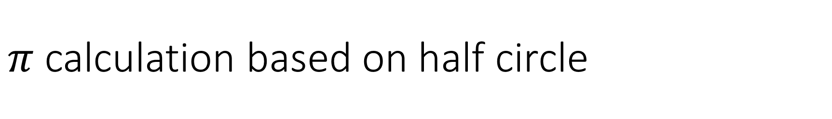
$π$ calculation based on half circle
$$π=\frac{half_circle}{r}$$

Slide 114

$π$ calculation based on half circle
$$π≈\frac{\sum{chords}}{r}$$

Slide 115
$π$ calculation based on half circle
$$π≈\frac{\sum{chords}}{r}$$

Slide 116
$π$ calculation based on half circle
$$π≈\frac{\sum{chords}}{r}$$

Slide 117
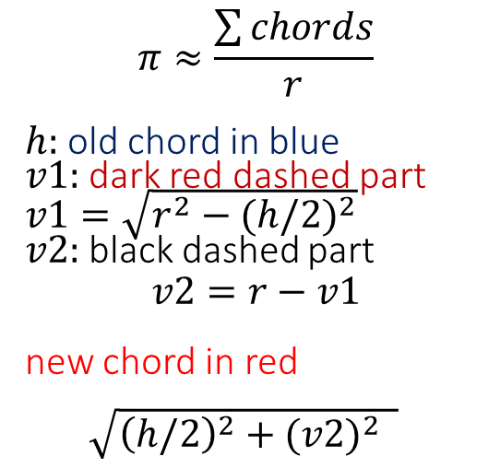
$π$ calculation based on half circle
$$π≈\frac{\sum{chords}}{r}$$
$h:$old chord in blue
$v1:$dark red dashed part $v1=\sqrt{r^{2}−{(h/2)}^{2}}$
$v2:$black dashed part
$$v2=r−v1$$
new chord in red
$\sqrt{{\left(h/2\right)}^{2}+{(v2)}^{2} }$

Slide 118

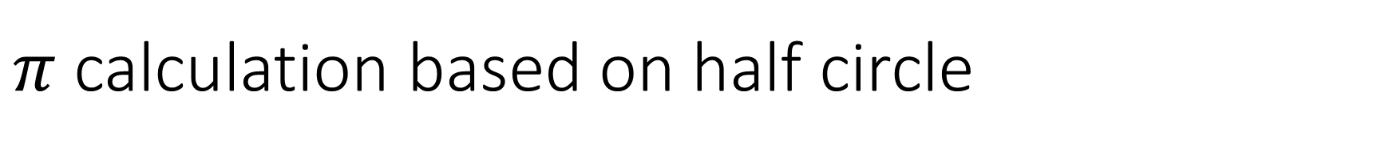
$π$ calculation based on half circle
MODULE BASIC_DATA_MDL
IMPLICIT NONE
REAL*8, PARAMETER :: RADIUS = 1.0D0
REAL*8, PARAMETER :: RADIUS_SQUIRED = RADIUS ** 2
REAL*8, PARAMETER :: REQUIRED_ACCURACY = 1.0D-12
END MODULE BASIC_DATA_MDL
REAL*8 FUNCTION NEXT_CHORD(CHORD_TRIED)
USE BASIC_DATA_MDL
REAL*8 :: CHORD_TRIED, HALF, VT1, VT2
HALF = CHORD_TRIED/2
VT1 = SQRT(RADIUS_SQUIRED - HALF * HALF)
VT2 = RADIUS - VT1
NEXT_CHORD = SQRT(HALF * HALF + VT2*VT2)
END FUNCTION NEXT_CHORD
$$π=\frac{\sum{chords}}{r}$$
$h:$old chord in blue
$v1:$dark red dashed part $v1=\sqrt{r^{2}−{(h/2)}^{2}}$
$v2:$black dashed part
$$v2=r−v1$$
new chord in red
$\sqrt{{\left(h/2\right)}^{2}+{(v2)}^{2} }$

Slide 119
$π$ calculation based on half circle
MODULE INTERFACE_MDL
INTERFACE
REAL*8 FUNCTION NEXT_CHORD(CHORD_TRIED)
REAL*8 :: CHORD_TRIED
END FUNCTION NEXT_CHORD
END INTERFACE
END MODULE INTERFACE_MDL

Slide 120

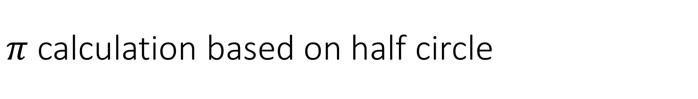
$π$ calculation based on half circle
$π=\frac{\sum{chords}}{r}$ r=1.0
PROGRAM PI_CALCULATION
USE BASIC_DATA_MDL
USE INTERFACE_MDL
INTEGER :: EFFORT
REAL*8 :: CHORD, NUMBER_OF_CHORDS, PREVIOUS_PI, CURRENT_PI, RELATIVE_ERROR
EFFORT = 1; CHORD = SQRT(RADIUS_SQUIRED + RADIUS_SQUIRED)
NUMBER_OF_CHORDS = 2.0D0
PREVIOUS_PI = 8.0D10; CURRENT_PI = CHORD * NUMBER_OF_CHORDS / RADIUS
RELATIVE_ERROR = ABS(CURRENT_PI - PREVIOUS_PI) / CURRENT_PI
WORKING_HARD: DO
EFFORT = EFFORT + 1; CHORD = NEXT_CHORD(CHORD)
NUMBER_OF_CHORDS = 2.0D0 * NUMBER_OF_CHORDS
PREVIOUS_PI = CURRENT_PI; CURRENT_PI = CHORD * NUMBER_OF_CHORDS / RADIUS
RELATIVE_ERROR = ABS(CURRENT_PI - PREVIOUS_PI) / CURRENT_PI
IF(RELATIVE_ERROR < REQUIRED_ACCURACY) EXIT WORKING_HARD
END DO WORKING_HARD
PRINT*, EFFORT, CURRENT_PI, PREVIOUS_PI
END PROGRAM PI_CALCULATION

Slide 121
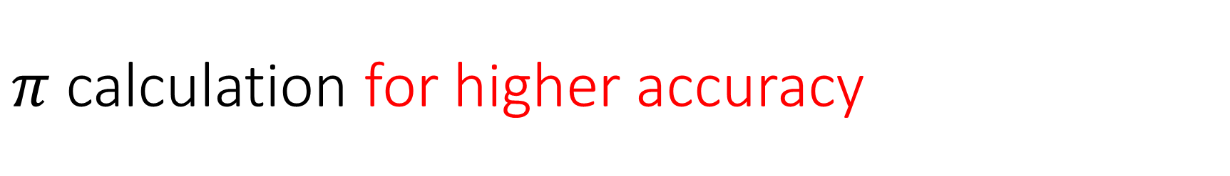
$π$ calculation for higher accuracy
Change all real*8 into real*16 and
REQUIRED_ACCURACY = 1.0D-12 into 1.0D-32

Slide 122
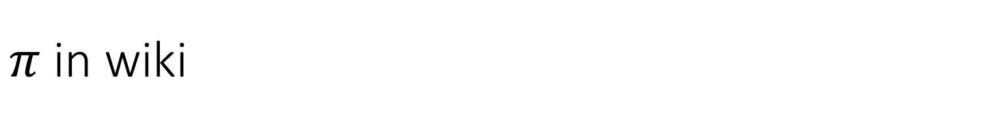
$π$ in wiki
https://en.wikipedia.org/wiki/Pi
The first 50 decimal digits are 3.14159265358979323846264338327950288419716939937510

Slide 123
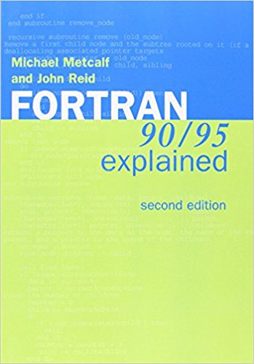
References
http://j3-fortran.org/
http://j3-fortran.org/doc/year/10/10-007r1.pdf

Slide 124
Thank you very much
for your attention!
Have a nice day!

