Slide 1

Community Detection Using Unsupervised Machine Learning Techniques on COVID-19 Dataset
Laxmi Chaudhary and Buddha Singh
STAT 388/488, Spring 2024
Presentation Prepared By: Emil Cacayan

Slide 2
Motivation and Background: COVID-19
Most salient pandemic since the Spanish Flu
Epidemiological techniques have been bivariate in nature and smaller in scope.
Exploratory bivariate analysis, studies of biochemistry and pathology, focus on the end user/patient.
SARS-CoV-2 pandemic allowed for the use and further development of multivariate unsupervised learning techniques on highly dimensional and collinear datasets.
Goal: Proof of concept for separating countries based on similarity of different statistics taken for COVID-19.

Slide 3
General Workflow: PCA and K-Means Clustering
Authors hope to use (now essentially archetypical) exploratory analysis workflow PCA and K-Means clustering.
Spread and axes of PCA may be non-symmetrical.
Main drawback is K-Means clustering is started under random starting conditions.
Authors did not take this into consideration – analysis could have benefitted from cross-validation and/or bootstrapping.
Both methods still easily affected by outliers – authors could have benefited from influence analysis to fine tune clustering.

Slide 4
PCA
PCA is popular for a few reasons:
Reduction of computational overhead for subsequent analysis (clustering tasks, regression, etc.)
Reducing to orthogonal axes of greatest variance tends to reduce noise.
Correlation between principal components and variables allows for selection for features salient to data variance.
Reduction of collinearity in variables by transformation into uncorrelated variables.
Datasets generated from epidemiology of COVID-19 pandemic is highly dimensional and potentially highly collinear.
Requires assumption that correlation between variables is linear.
Also susceptible to outliers or noisy data.

Slide 5
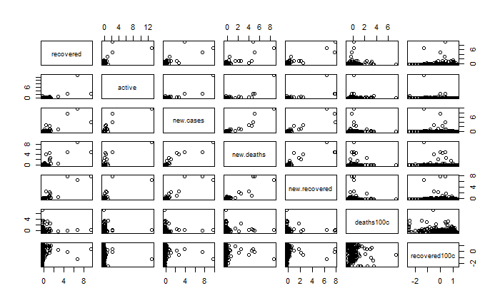
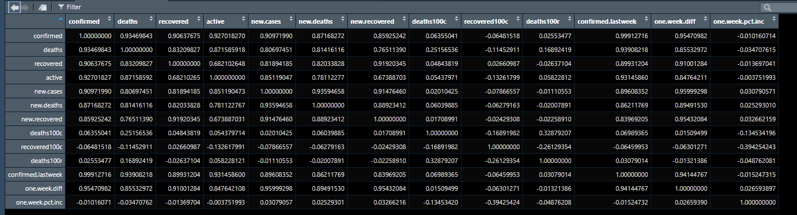

Slide 6
K-Means Clustering
Unsupervised optimization problem which minimizes within cluster variance.
Number of centroids selected via sum of squares error for each centroid, elbow method utilized.
K-Means clustering is easily interpretable – further analysis finding which principal components contribute the most to clusters might hint at underlying structure implied by clustering.

Slide 7
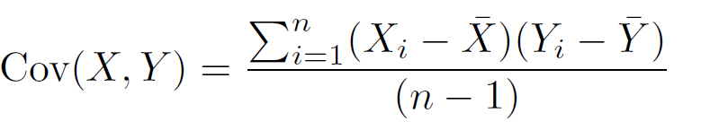
PCA Algorithm
Standardize the dataset.
Generate a covariance matrix based on continuous variables.
Generate eigenvalues and eigenvectors of the dataset.
Select an appropriate number of principal components based on proportion of variance explained
Authors chose number of PC’s that (meaningfully) get as close to a PVE of 1 (8 were obtained).
Output the new dimension-reduced dataset.

Slide 8
K-Means Clustering Algorithm
Choose K (elbow method) – obtained K = 6
Construct K communities by assigning data points to nearest randomly generated centroid.
Update centroids by calculating means of clusters.
Iterate until no datapoint is reassigned to another community (convergence)

Slide 9
The Dataset - Introduction
Obtained from Johns Hopkins Coronavirus Resource center using a scraping tool (exported as .csv)
Authors conducted analysis from January 22nd, 2020 to August 15th, 2020.
Data scraped includes information from January 22, 2020 to March 10, 2023.

Slide 10
The Dataset (cont.)
n = 187 countries across 15 variables (13 continuous)
Country/Region
Confirmed: Number of confirmed cases.
Deaths: Number of COVID-19 deaths.
Active: The number of active cases (on day recorded).
New Cases: The number of new cases (on day recorded).
New Deaths: The number of new deaths (on day recorded).
Deaths / 100 Cases: The number of deaths per one hundred cases.
Recovered / 100 Cases: The number of recoveries per one hundred cases.
Deaths / 100 Recovered: The number of deaths that occurred per 100 recovered cases.
Confirmed Last Week: The number of cases confirmed the previous week.
1 Week Change: the change in the number of cases over the course of the week.
1 Week % Increase: The previous variable scaled to a percentage.
Who Region: The region the country belongs to.

Slide 11
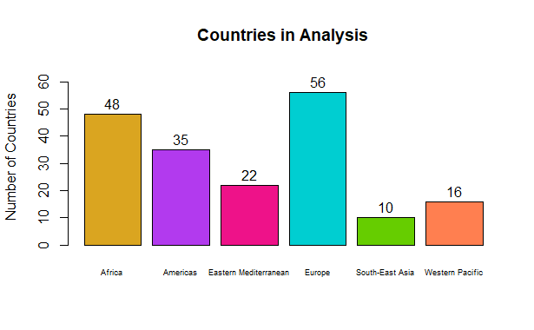
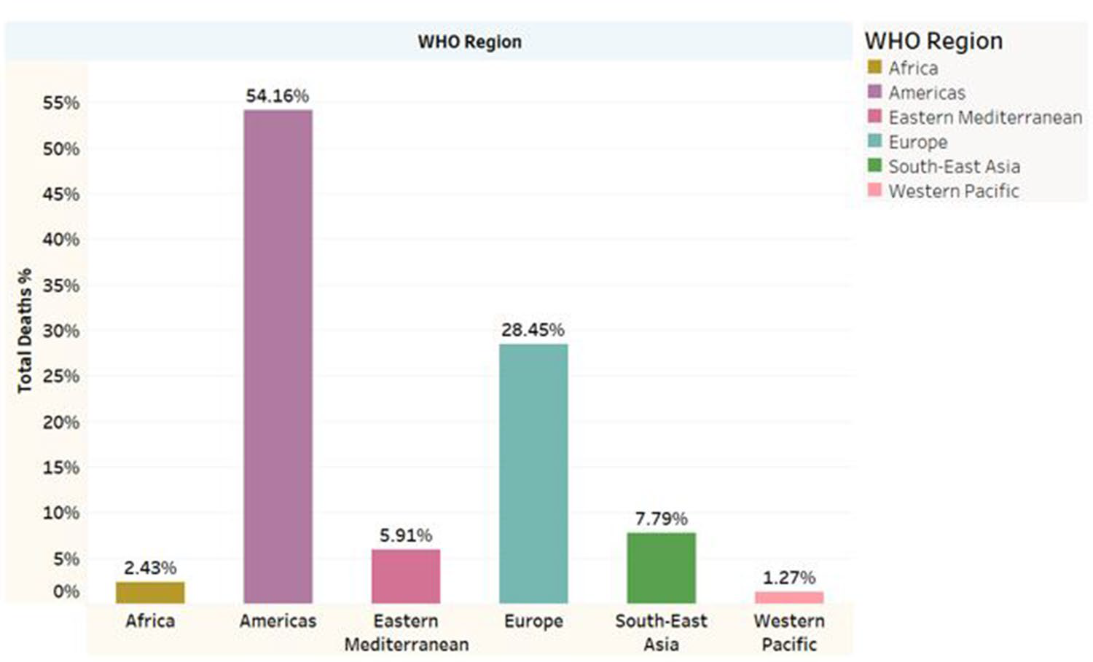
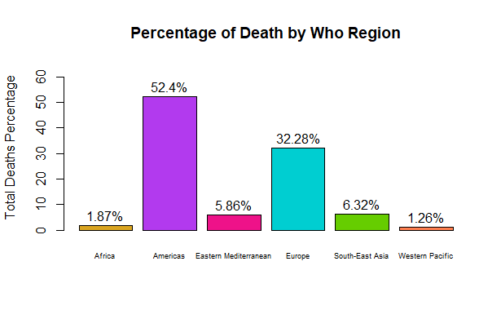

Slide 12
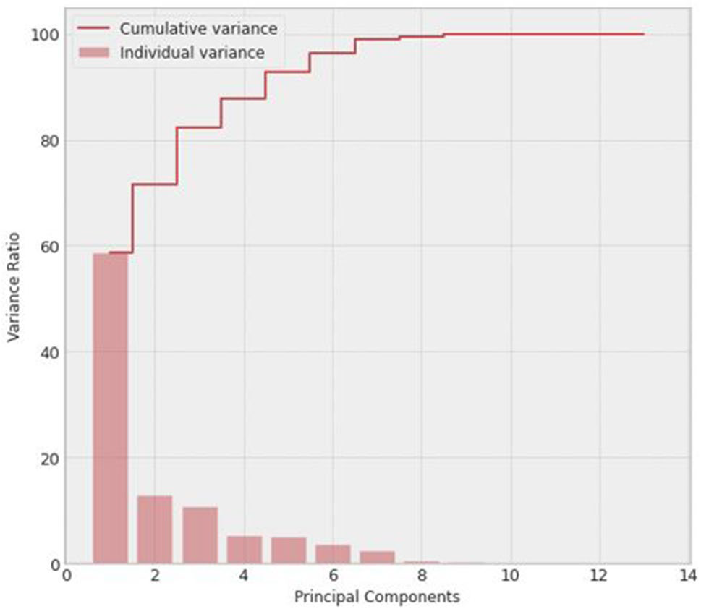
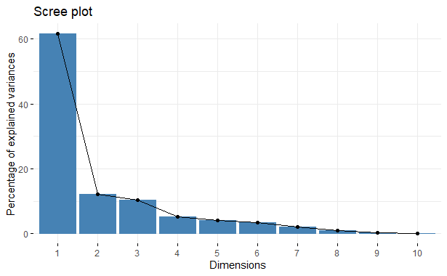
PCA: Selection of Number of Principal Components

Slide 13
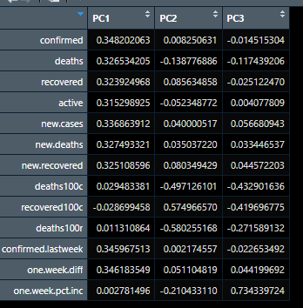
Analysis of Loadings (First 3 PC’s)
First principal component could be a principal component containing information about the current state of the pandemic.
Second principal component contains information about “deaths”.
Third principal component could be a “new measurements” principal component.

Slide 14
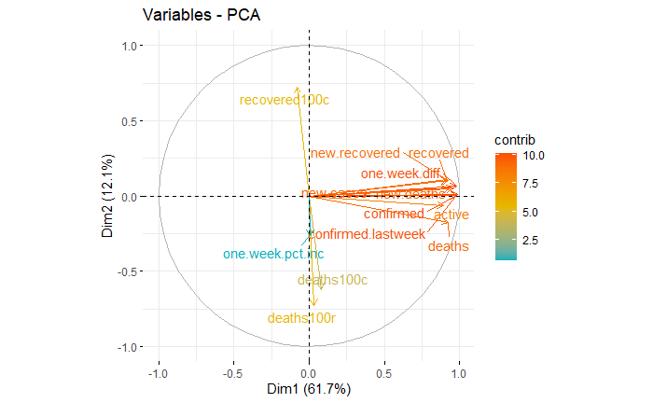
Biplot of First Two PC’s

Slide 15
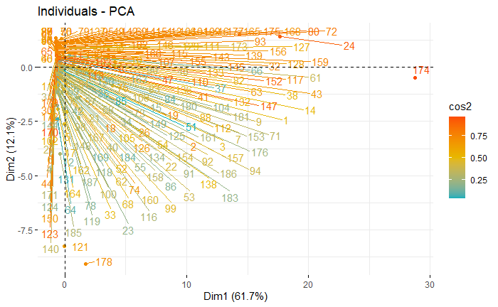
Individuals Biplot of First 2 PC’s
174 – USA
168 - UK

Slide 16
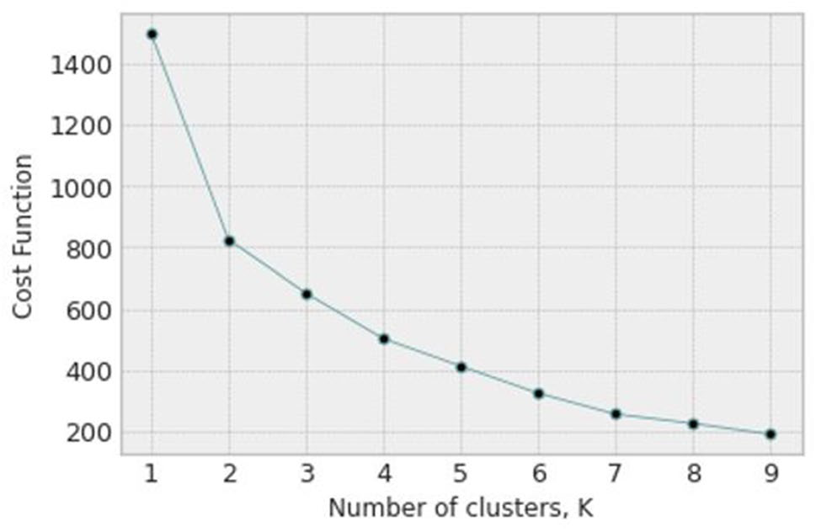
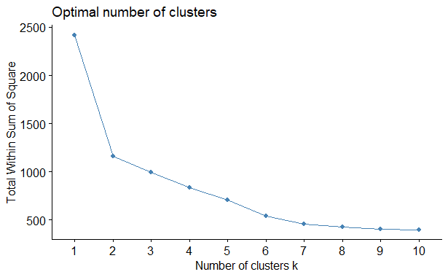
Elbow Plots for K-Means Clustering

Slide 17
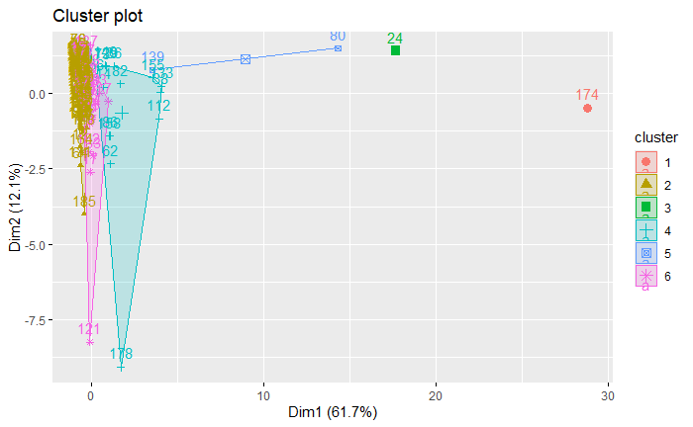
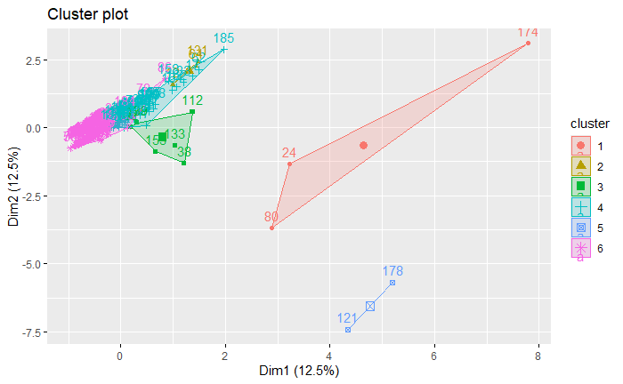

K-means Clustering

Slide 18
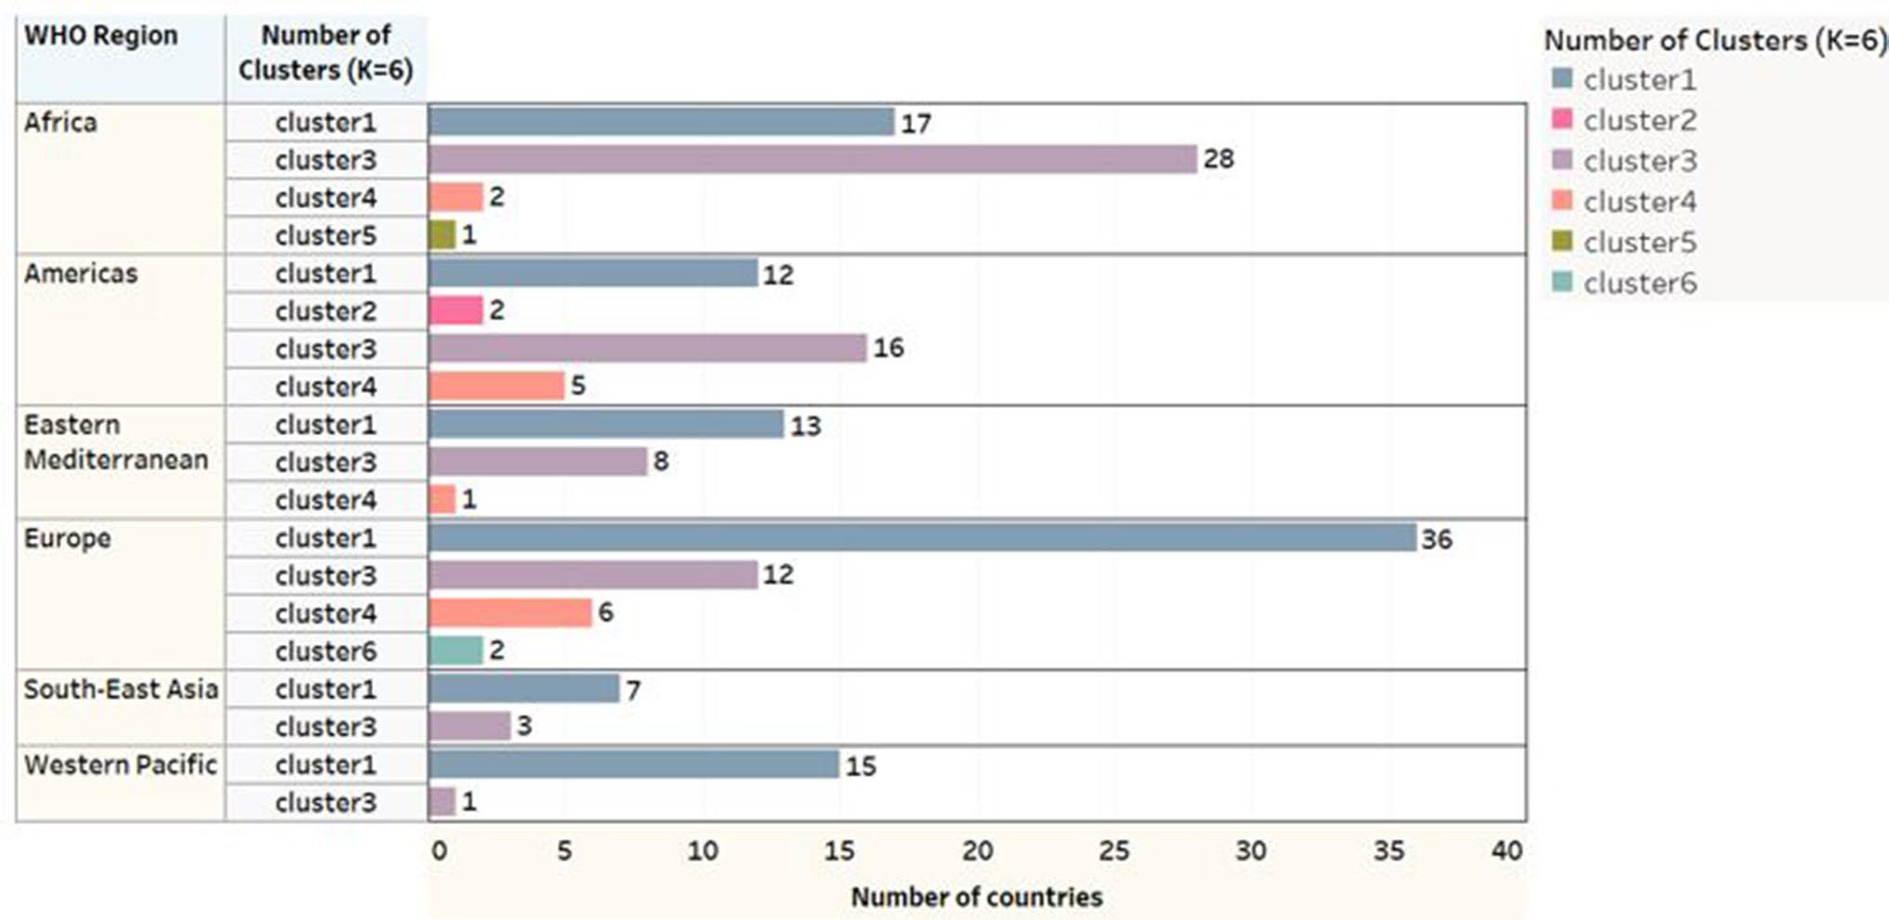
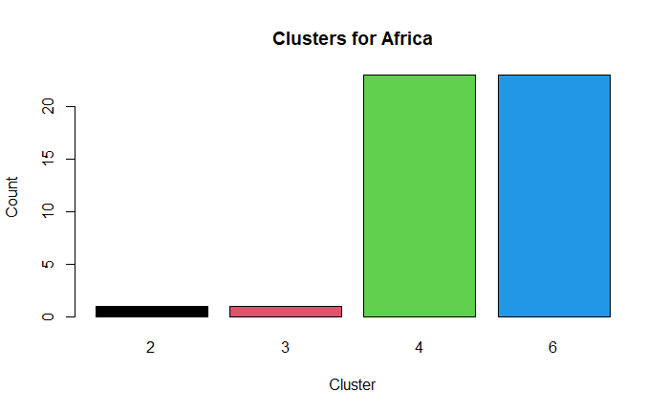
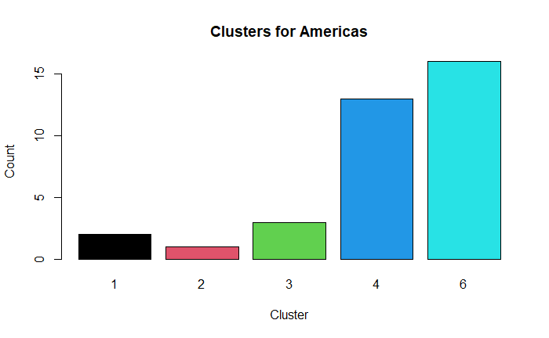
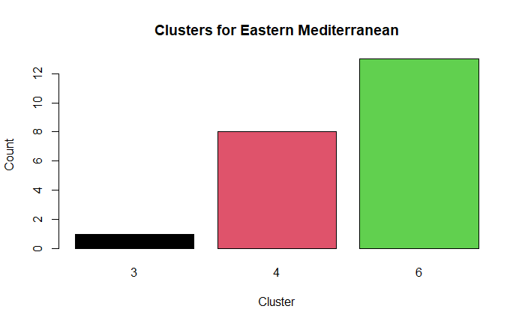
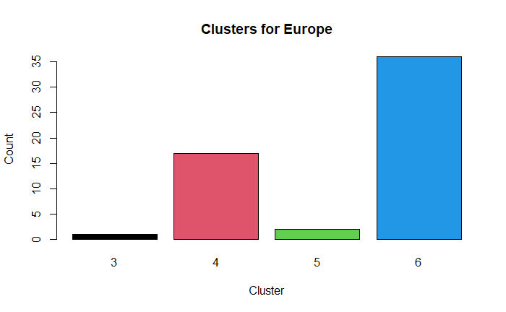
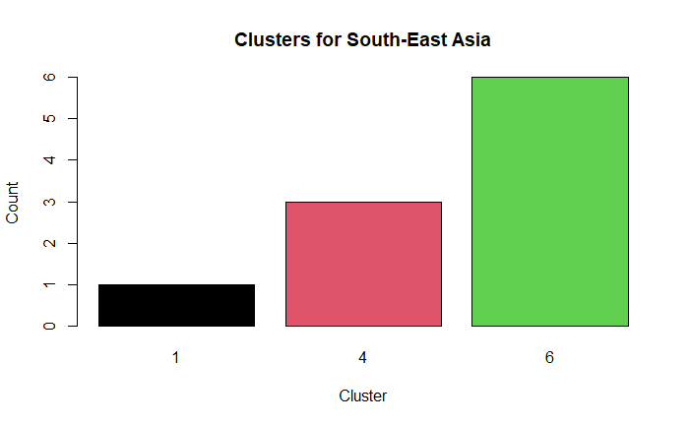
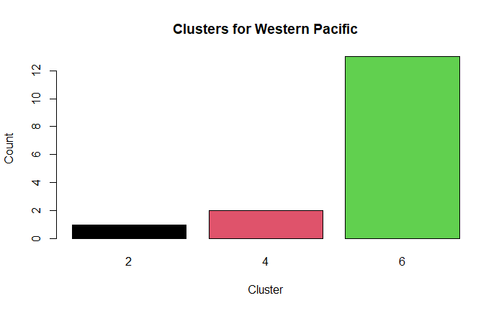
Comparisons of Clustering (with PCA)

Slide 19
Further Exploration of Dataset
Visualization of the dataset and clustering on a world map?
Implementation of bootstrapping and/or cross-validation of K-Means clustering (not much documentation on implementation is available but it has been done)?

Slide 20
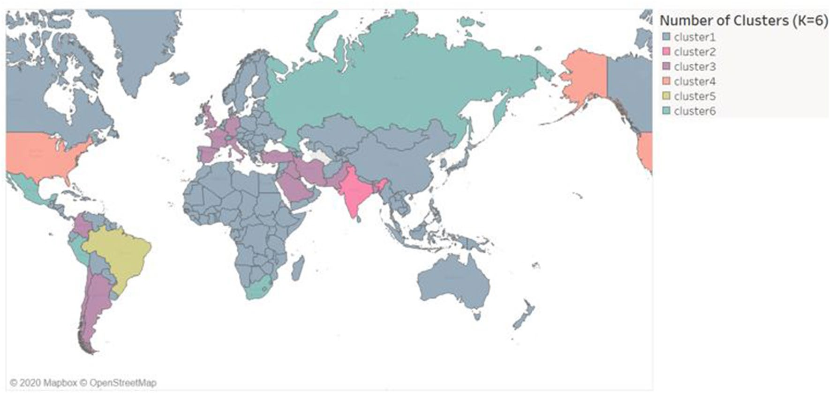
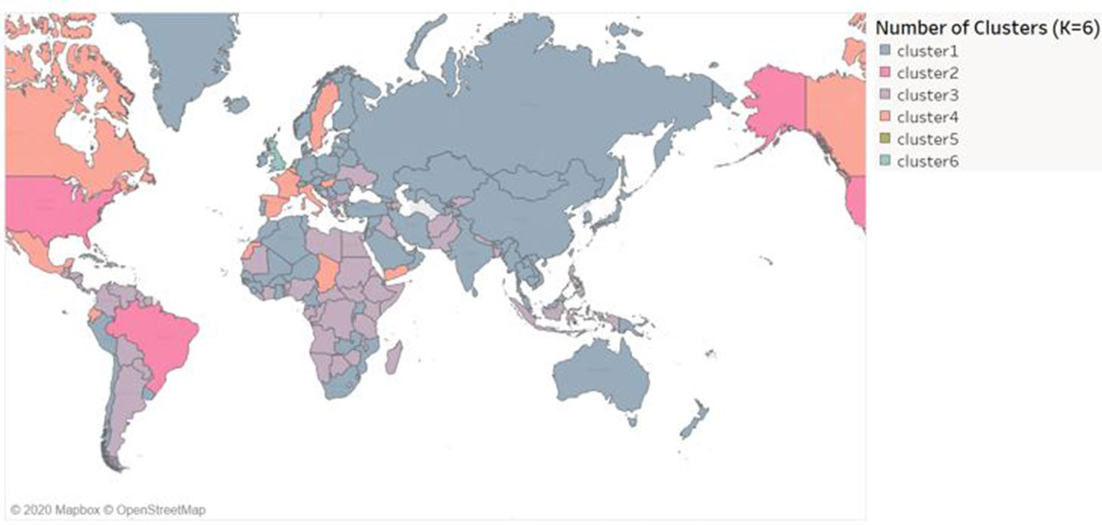

Slide 21
Further Exploration of Dataset (cont.)
Further exploration of scaling/data dispersion?
Hypothesis testing on clustering for importance of variables (are significant variables in PCA without the clustering the same as variables found to be highly correlated with the first principal component)?
Is using as many PC’s as the authors did necessary?

Slide 22
Conclusion
The COVID-19 pandemic has introduced very high dimensional data that (at the time of the publication of this paper) requires much more exploration.
PCA and K-means are easily interpretable.
PCA and scaling can improve the resolution and minimization of within cluster variance, but both are still susceptible to noise and outliers.
Further assessment of the reproducibility and stability of the K-means clustering is required.
While paper left out information about the interpretation of the PCA, the first 3 PC’s showed variables that contributed significantly to the variance in the dataset, and transformations of the dataset using the transformations of the first 3 principal components could be useful for making decisions.

Slide 23
References
Chaudhary, L., & Singh, B. (2021). Community detection using unsupervised machine learning techniques on COVID-19 dataset. Social network analysis and mining, 11(1), 28. https://doi.org/10.1007/s13278- 02100734-24
https://github.com/imdevskp/covid_19_jhu_data_web_scrap_and_cleaning

