Slide 1
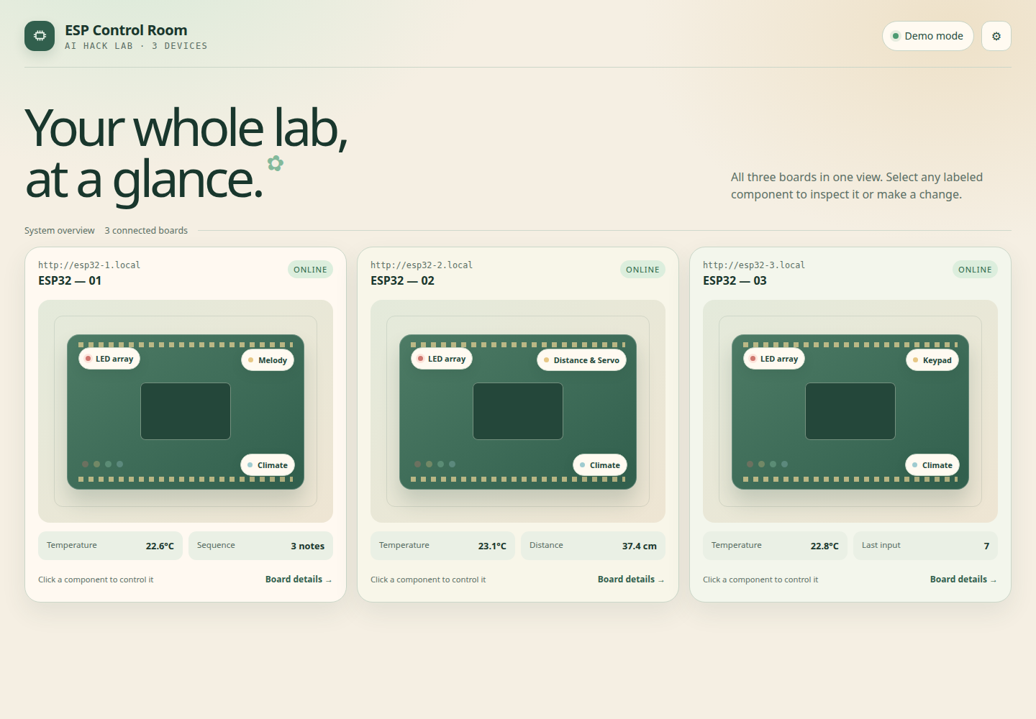
01
WEBSITE OVERVIEW
One control room for
three ESP32 boards.
Monitor each device, open a component, and make changes from a single browser dashboard.
LIVE + DEMO MODES
1
At-a-glance status
1
Connectivity, temperature and each board’s headline reading.
2
Direct component access
2
Select LED, climate, or a board-specific module without hunting through menus.
3
Local-network control
3
Configure board addresses and send commands over the same Wi-Fi network.
System overview — three connected boards
Actual dashboard view

Slide 2
02
CORE CAPABILITIES
Each board adds a focused interaction.
SHARED: CLIMATE + 4-COLOR LED ARRAY
Shared monitoring and LED controls stay consistent across all three devices.
ESP32 — 01
ESP32 — 02
ESP32 — 03
SOUND + COMPOSITION
MOTION + DISTANCE
INPUT MONITORING
Build melodies on a C3–B5 piano
Read ultrasonic distance in centimeters
Show the key currently being held
Set note length, dotted notes and ties
Move the servo from 0° to 180°
Remember the most recent keypad input
Play, pause, edit, copy and save tunes
Release the servo directly from the UI
Refresh live readings every five seconds
From observation to action
1 See status
2 Select component
3 Control or read

