Slide 1
Midterm Exam Preparation

Slide 2
Exercise 1
Indicate whether the first function of each of the following pairs has a smaller, same, or larger order of growth (to within a constant multiple) than the second function.
n(n + 1) and 2000n²
100n² and 0.01n³
log₂ n and ln n
2^{n−1} and 2^{n}
(n− 1)! and n!

Slide 3
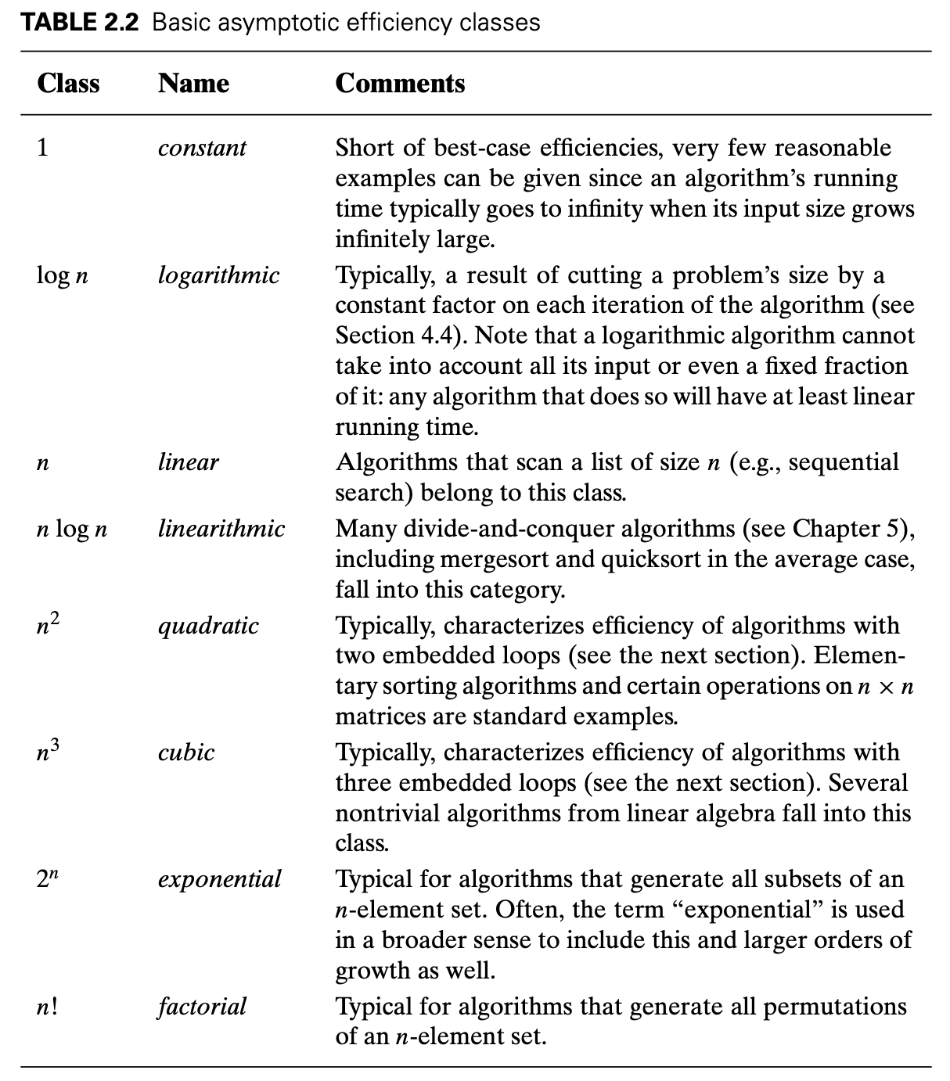
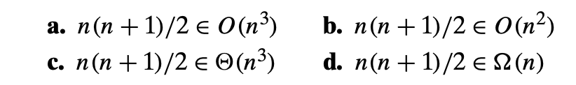
Exercise 2
Use the informal definitions of O, Ω ,𝛩 band to determine whether the following assertions are true or false.

Slide 4
Exercise 3
List the following functions according to their order of growth from the lowest to the highest:

Slide 5
Exercise 4
For each of the following algorithms, indicate(i) a natural size metric for its inputs, (ii) its basic operation, and (iii) whether the basic operation count can be different for inputs of the same size:
computing the sum of n numbers
computing n!
finding the largest element in a list of n numbers

Slide 6
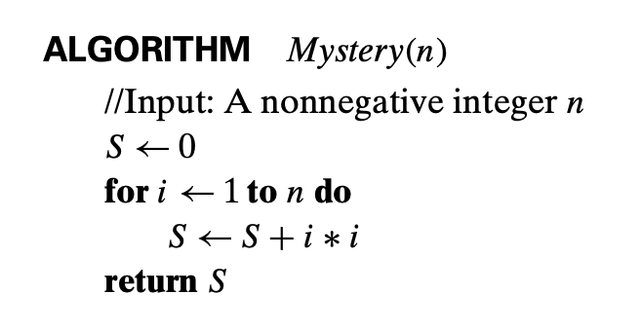
Exercise 5
Consider the following algorithm.
What is its basic operation?
How many times is the basic operation executed?
What is the efficiency class of this algorithm?

Slide 7
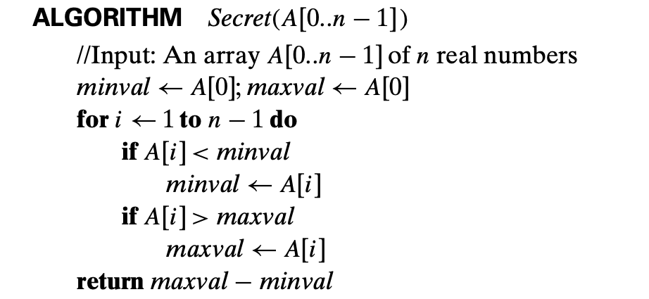
Exercise 6
Consider the following algorithm.
What is its basic operation?
How many times is the basic operation executed?
What is the efficiency class of this algorithm?

Slide 8
Exercise 7
Consider the definition-based algorithm for adding two n × n matrices.
What is its basic operation?
How many times is it performed as a function of the matrix order n?
As a function of the total number of elements in the input matrices?
Algorithm MatrixAddition(A[0..n-1], B[0..n-1])
Input: Matrices A and B of size n × n
Output: Matrix C of size n × n such that C[i][j] = A[i][j] + B[i][j]
for i ← 0 to n - 1 do
for j ← 0 to n - 1 do
C[i][j] ← A[i][j] + B[i][j]
return C

Slide 9
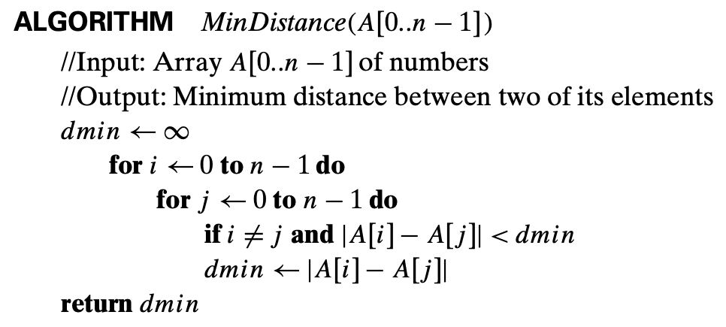
Exercise 8
Given the algorithm below to finding the distance between the two closest elements in an array of numbers, answer the following questions.
What’s the basic operation?
Write a summation that represents the number of times the basic operation is executed.
Solve the summation and find the function which represents the number of times the basic operation is executed. Show your work.
Classify the function above into one of the standard complexity classes using Θ-notation.

Slide 10
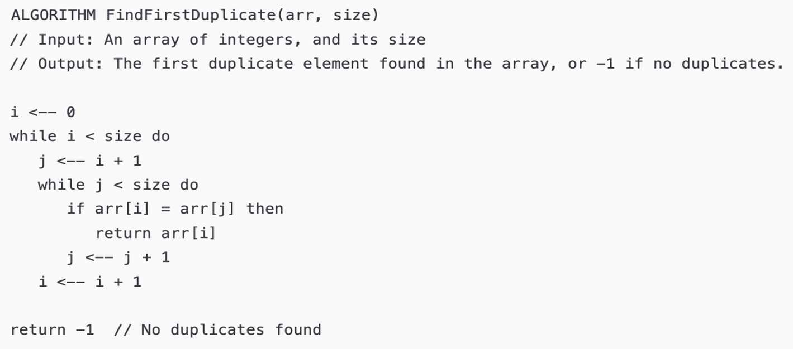
Exercise 9
Given the algorithm below to finding the distance between the two closest elements in an array of numbers, answer the following questions.
What’s the basic operation?
Write a summation that represents the largest number of times the basic operation is executed.
Solve the summation and find the function which represents the largest number of times the basic operation is executed. Show your work.
Classify the function above into one of the standard complexity classes using Θ-notation.

Slide 11
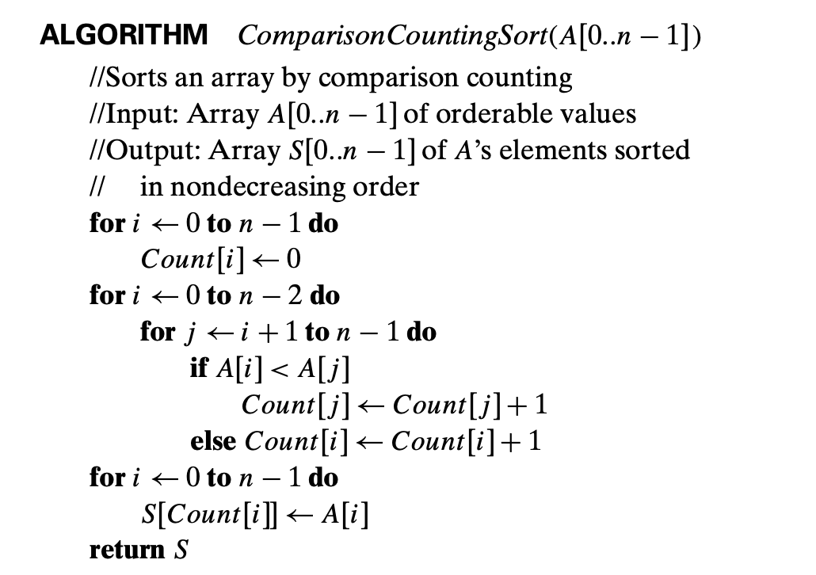
Exercise 10
Consider the following algorithm for sorting an array: for each element, it counts how many elements are smaller than it and uses this count to place the element in its correct position in the sorted array. Analyze the efficiency of this algorithm.

Slide 12
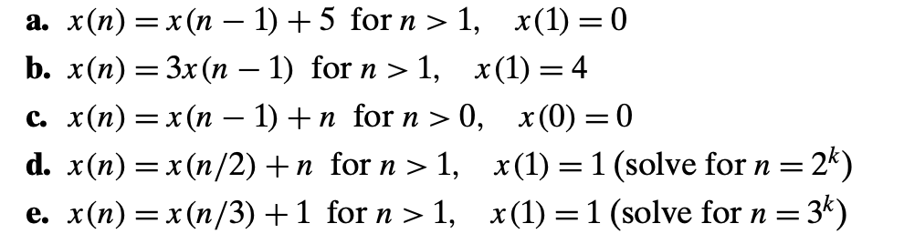
Exercise 11
Solve the following recurrence relations.

Slide 13
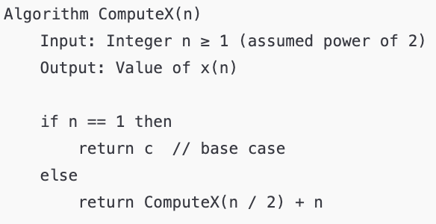
Exercise 12
Consider the following recursive algorithm.
What’s the basic operation?
Write a recurrence relation that represents the number of times the basic operation is executed.
Solve the recurrence relation using backward substitution and find the function which represents the number of times the basic operation is executed. Show your work.
Classify the function above into one of the standard complexity classes using Θ-notation.

