Slide 1
Event-driven Infrastructure
Michael Place
mp@saltstack.com
@cachedout
Core Engineering
SaltStack

Slide 2
Question-Driven Presentation
WARNING: This talk may leave you with more questions than answers.
(Hopefully, that’s a good thing.)

Slide 3
Automation brought us new toolchains.
DevOps brought us new culture.
What now?

Slide 4
Three Pillars of Distributed Computing
The ability for the system to be aware of the existence and capability of its member nodes.
The ability to co-ordinate tasks between those nodes.
Inter-process communication which can connect (almost) any node in the system to another.

Slide 5
What are the properties of a message bus?
A data model
A command set
A messaging infrastructure

Slide 6
Message Buses for Ops
Monitoring
Configuration management
ChatOps
Auto-scale
Lambda
Provisioning

Slide 7
Message Buses for Dev
Almost anything that connects various layers of an appliction stack has a message bus of some kind
Sometimes these are streaming
Sometimes they’re just set up and torn down on demand.

Slide 8
Question:
What possibilities emerge when these siloed streams of events are shared with each other?

Slide 9
What does (most) automation look like right now?
Packaged workflows
  We take a series of steps and we list them out and then we go and do those steps, with, hopefully a little bit of abstraction and error control.
  Much of the time, these workflows are initiated by lazy humans.
  Despite our best-efforts, these can still be very brittle because one thing we’re not very good at is understaning the state of a system before automation runs on it. We make a lot of assumptions, even today.

Slide 10
This doesn’t feel much like programming.

Slide 11
Event-driven Programming
A programming paradigm in which the flow of the program is determined by events such as user actions (mouse clicks, key presses), sensor outputs, or messages from other programs/threads.
Event-driven programming is the dominant paradigm used in graphical user interfaces and other applications that are centered on performing certain actions in response to user input.

Slide 12
Examples of Event Driven Programming
JavaScript
  node.js
Most GUI applications on the desktop
Pretty much any user interface on iOS

Slide 13
3 Principles of Event Driven Programming
A set of functions which handle events. Depending on the implementation these can be blocking or non-blocking.
A mechanism for binding the registered functions to events.
A main loop (or loops, if you’re brave) which constantly polls for new events and calls the maching event handler(s) when a reigstered event is received.

Slide 14
Traditional Criticisms of Event-Driven Programming
One one hand, there is imperative programming
  Writing procedures to performs steps in a particular order.
On the other hand, we have declarative programming
  Describing the intended state of a system without explicitely describing the steps to achieve that state.

Slide 15
Criticisms continued
Highly asynchronous code can be difficult to troubleshoot
It takes a mindshift to think about imperative and declarative approaches melded into one. This can create some confusion.
It can be challenging to translate procedural workflows into something event-driven.

Slide 16
Event-driven Programming Advantages
It’s easy to find natural dividing lines for unit testing infrastructure.
It’s highly composeable.
It allows for a very simple and understandable model for both sides of the DevOps bridge.
Both purely procedural and purely imperative approaches get brittle as they grow in length and complexity.
It’s one good way to model systems that need to be both asynchronous and reactive.

Slide 17
High-speed event bus
+
Event-driven programming
==
Event-driven infrastructure

Slide 18
Principles of Event-Driven Automation
Events originate from applications and from systems.
Filters exist to sort these events and apply rules to them.
As rules are met, registered actions occur.

Slide 19
Disadvantages of an Event-Driven Approach
Possible tight coupling between the event schema and the consumers of the schema.
Message loss
Reasoning about “blocking” operations might becoming more difficult.
Testing

Slide 20
Advantages of Event-Driven Appoach
Distributed, scalable and loosly coupled between systems.
A “DevOps” automation backplane for system
Does more than just configure/provision systems at their birth. Allows for more complete lifecycle management.
Provides an immediate, common programmable layer on top of existing automation/deployment systems.

Slide 21
Fine then. How do we build one?

Slide 22
Flow
An event is emitted on the event bus
It flows to a manager
The manager checks to see if the event matches a registered handler
If so, the a series of rules are checked
For each set of rules which are matched, an action is undertaken.

Slide 23
The moving pieces
Event bus transport
Telemetry
Actors
Reactors

Slide 24
Building Event Buses

Slide 25
Concerns for the bus
MUST handle
  Security
  Reliability
  Serialization
MAY handle
  An easy set of interfaces for send/receive, with libraries for languages shared by Dev and Ops
  Multiple architecture patterns
  Message filtering
  Message routing

Slide 26
Message bus topology
Pub/sub
  1-M
  Most implementations are brokered, which means they are loosly coupled. (i.e. the sender does not know or care) about the status of the recipient.
  There are unbrokered implementations such as Data Distribution Service (over IP multicast) which exist, but they are (for the most part) not widely deployed.
Push/pull
  Is client/server but typically is a 1-1 relationship instead of 1-M
Fan-out
  Useful for creating a queue of workers through which jobs must be distributed.

Slide 27
Off the shelf messaging
ZeroMQ
RabbitMQ
Celery
ActiveMQ
JBoss messaging
Apache Qpid
StormMQ
Apache Kafka
Lambda
Redis
SaltStack

Slide 28
Telemetry
The ability for applications to emit events onto the bus.
Should be light and easy enough that it’s simple to port into any language.
Should be lightweight messaging. Not the place for pushing enormous amounts of data around.

Slide 29
#/usr/bin/env python
import zmq
import os
import socket
import time
import core.framer
# Create a context
ctx = zmq.Context()
# Our tag
tag = '/client/load/silver'
while True:
# Frame it up. (Uses msgpack)
event = framer.pack(tag, {'cur_load': os.getloadavg()})
socket = ctx.socket(zmq.PUSH)
socket.connect('tcp://localhost:2001')
socket.send(event)
socket.close()
time.sleep(1)

Slide 30
Building Reactors

Slide 31
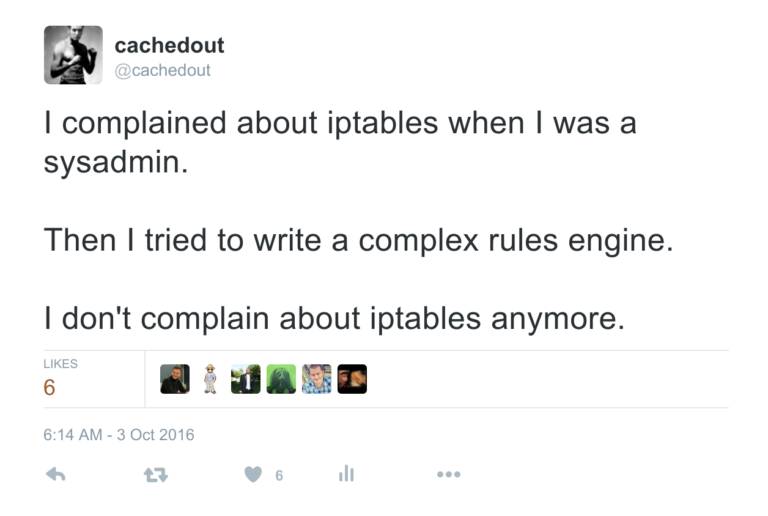

Slide 32
Decision Engines
A decision engine registers events which occur on the bus to actions which need to be performed.
Can be as simple or as complex as one wants.
The DevOps idea, here, is though to create a shared abstraction for these rules.

Slide 33
# Example configuration for very basic demo
# This configuration maps simple event tags to actions
#
# If we receive a high load alert, print an alert and reconfig a LB
/client/load/*:
reactions:
- reactions.printer.event_printer
register:
- register.aggregate.register
rules:
- rules.simple.gt:
register: register.aggregate.avg
threshold: 20
period: 10
reactions:
- reactions.eventer.fire_event:
tag: '/reconfig/lb'
data:
some_reconfig_data: 'dummy_data'

Slide 34
Actors
Actors are simply what is run as a result of an event matching a given rule.
Possibilities
  Call to external service
  Configuation management call
  Code running locally

Slide 35
https://github.com/cachedout/eventdriventalk

Slide 36
Review
To build scalable systems, we need to adopt the lessons of distributed computing
We can migrate from simple human-initiated workflows to reactive, programmable systems.
Event buses are pretty good. Let’s build more of those.

Slide 37
Questions?
Mike Place
@cachedout
mp@saltstack.com

