Slide 1

PR OBLEM | OPPORTUNITY | COMPANY | PR OJECT | COMPETITION | TEAM | RECOGNITION | CUSTOMERS 1
^{Getting Started with SaltStack}
Mike Place | Core Engineering | @cachedout
© 2016 SALTSTACK

Slide 2
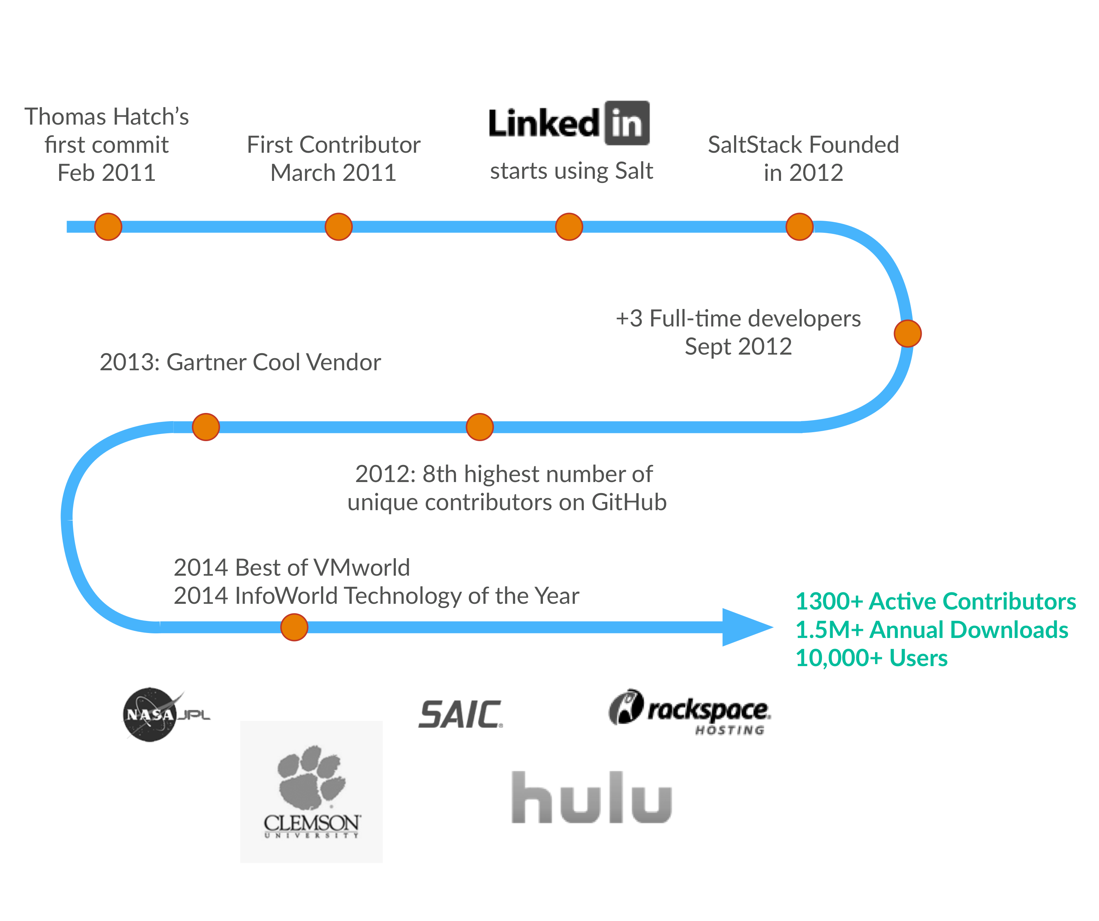
Where Did SaltStack Come From
© 2015 SALTSTACK

Slide 3
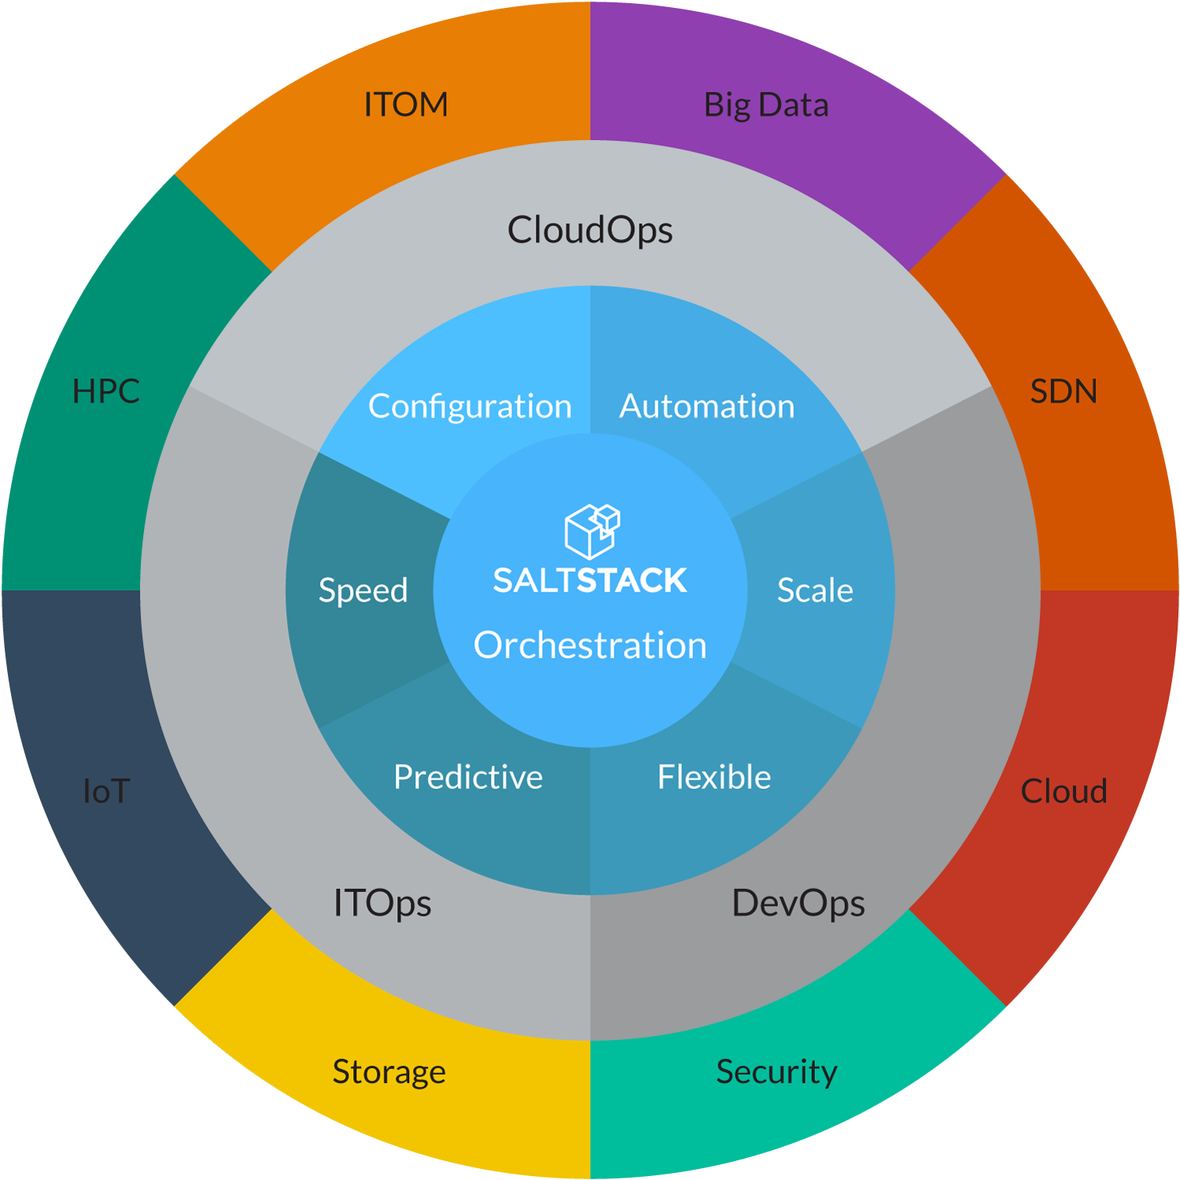

Why do I need it?
Mmm Tasty!
SaltStack is systems management software built for cloud, Web scale, complex data center infrastructure and enterprise IT.
SaltStack software provides predictive infrastructure orchestration, combined with native configuration management, to address a massive market opportunity.

Slide 4

Why do I need it?
SaltStack… because robots should have all the crap jobs by now!
Extremely flexible
Extremely extensible
Highly modular
Easy to customize
Scalable
Secure
Remote Execution Framework

Slide 5


Remote Execution 101
Make it go!
Basic Remote Execution:
$ ssh charles@myhost “ls /home/charles”
some_file.txt
Multiple hosts:
$ for h in myhost1 myhost2 myhost3;
> do ssh charles@myhost “ls /home/charles”;
> done

Slide 6
Remote Execution 101
Make it do!
What about hundreds of hosts?
With different login credentials on some?
What if I need to do something with the output?
And I need to do this many times?

Slide 7
Remote Execution 101
and going…
How about a script?
#!/bin/bash
# Make sure your SSH config (~/.ssh/config) is setup!
command=$1
host_list=$2
for h in host_list; do
ssh “$h” “$command”
done
# FIXME: Add output handling
# FIXME: Add error handling
# FIXME: Add logging
# TODO: FIND A BETTER WAY TO DO THIS!!!

Slide 8
Remote Execution 101
and doing…
We need a script that can handle:
Executing arbitrary commands
… on one or more remote hosts
… with a sane way to get the output (STDOUT? Write a file? Text Output? JSON? YAML???)
… and graceful error handling
… and logging
… and authentication
… everything else I haven’t thought of yet!

Slide 9
Remote Execution 101
The Realization Sets In…
We only want to run a command if the host is in a particular state…
The command is different for some hosts because they have a different OS
We need to configure host X before we configure host Y
We want to generate a file from a template, using data from an external database
We need to keep that external data secret

Slide 10

Say What?
You want me to maintain a 5,000 line BASH script?

Slide 11
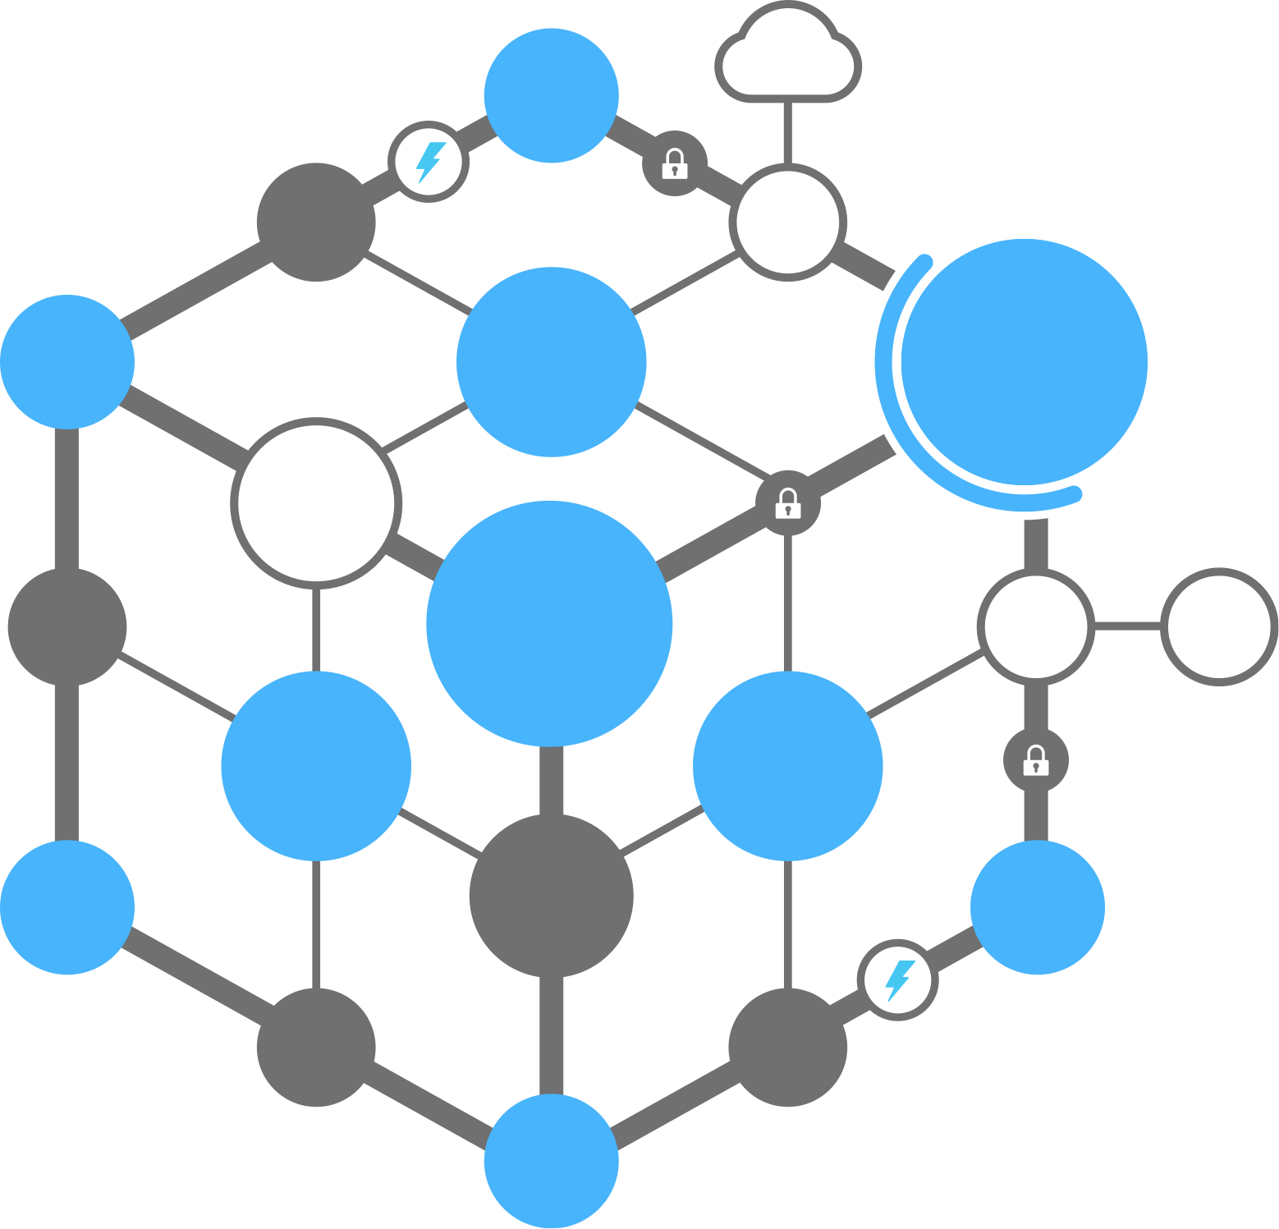













Public Cloud
SaltStack Basics
ØMQ
SSH
Physical
DevOps
CloudOps
Virtual
SSL
Master
Syndic
ITOps
Command
& Control
Beacons
AES
Config &
State
Abstraction layer
Minions
Multi-
master
OS
Reactor
3rd Party
Integrations
CMDB
Pillars
Curve
File server
Grains
Apps
Containers
Code
RAET

Slide 12

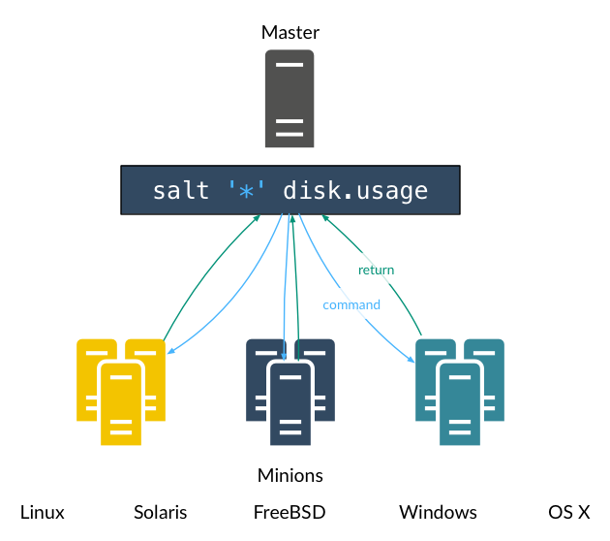
Execution Modules
Notes:
Mark:
Same command for all supported OSs
Components of the command:
salt target module.function arguments
100s of modules

Slide 13
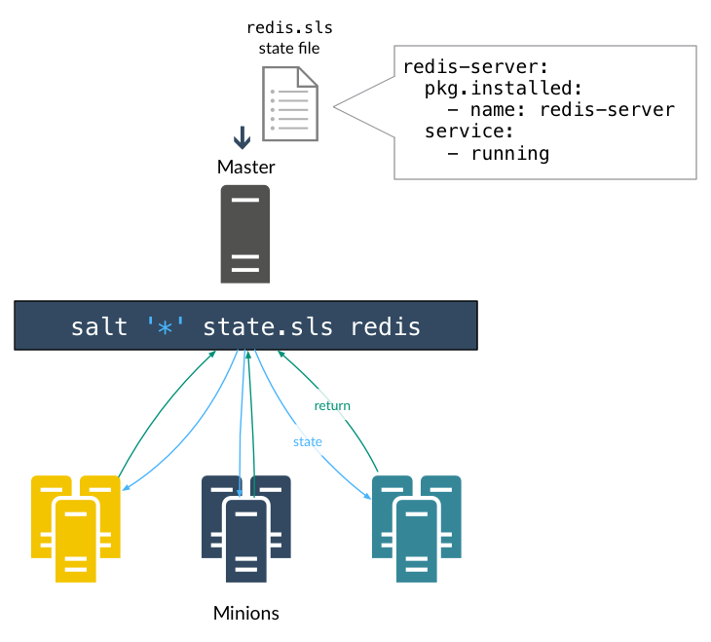
States
Notes:
Nicole:
You describe your configs (states) and salt applies them
Changes are not made unless needed
Declarative and imperative ordering

Slide 14
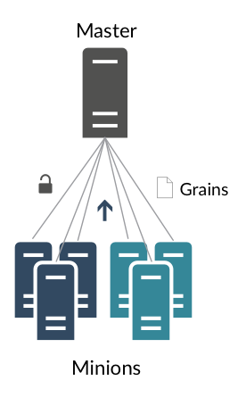
Grains
Notes:
Mark:
Data about Minion Stored on Minion
Automatically Configured like OS, Memory, IP Address
Statically Set like machine role, location
Target Machines
State Application
Dynamically create objects

Slide 15
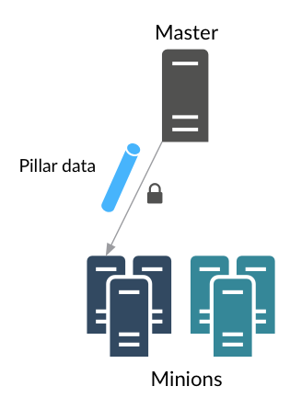
Pillar
Notes:
Mark:
Date visible to only the targeted minion. Stored in a folder on the Master that is not visible to other minions.
Never put on disk on the minion (cached in memory)
Used to deliver passwords, login credentials, other minion-specific data
For example, if you want to assign a new hostname to a minion after it connects, you could place the new hostname in pillar.

Slide 16
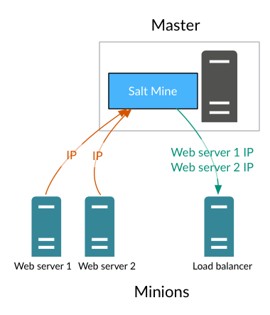
Mine
Notes:
Mark:
Data on a minion that is accessible to other minions
For example, one minion might need an IP address from another minion
old notes in case you need them:
Information about Minions for Minions
Via Salt.modules.mine
Example
sl_ubu:
- nginx-rproxy:
minion:
mine_functions:
network.ip_addrs:
interface: eth0
grains:
roles: rproxy

Slide 17
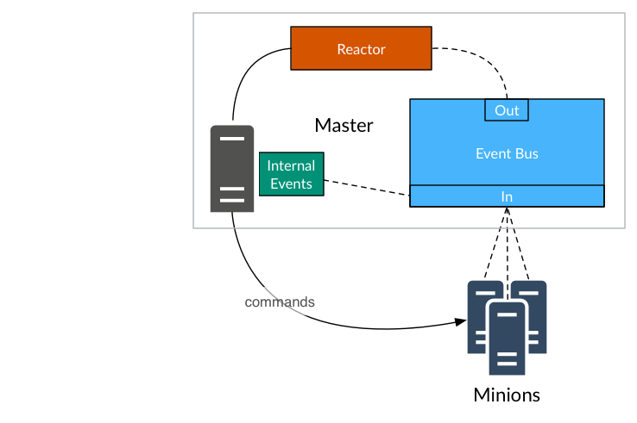
Reactor
Notes:
Nicole:
Event system
Salt uses this internally - when things happen an event is sent to the event bus
Event Bus - open system used to notify salt and other systems about operations
Events are dictionaries: Info about the event
Every event dict has a tag (tags used for top-level filtering events - fast!)
Reactor Combines Event System and Command Execution
You can create custom events and take action/trigger new events when events occur
Simple Example:
Minion Starts:
Clean out /tmp/ directory
Sync Custom Grains
Cloud Reactions:
EC2 Autoscale Events
Integrates with mine, runners, returners, etc.
Reactor sessions:
Introduction to the SaltStack Reactor for Event-Driven Infrastructure (Joseph Hall & Ken Johnson)
Thursday 10:45
Many more from reactor use cases to advanced reactor topics

Slide 18
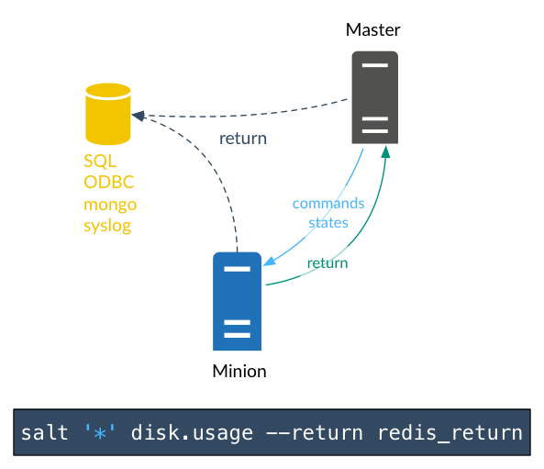
Returners
Notes:
Nicole:
Salt default: minion sends data back to master, but really anything can be done with this data
Enter Returners:
Sends job results to an external system
Database: Redis, MongoDB, MySQL
Syslog
Lots of them! ~ 25-30
Specified in the command, or set in master or minion config
Can be sent from minion, or master (2014.7.0)
If you have 200 minions, you probably don’t want them all connecting to DB so you’d use a Master returner. For syslog, it is designed to have all the systems connect so minion returners are fine.
Sessions:
Implementing MapReduce Workflows with SaltStack (Ed Lane & David Hilton from Verio)
Today @ 1:45

Slide 19
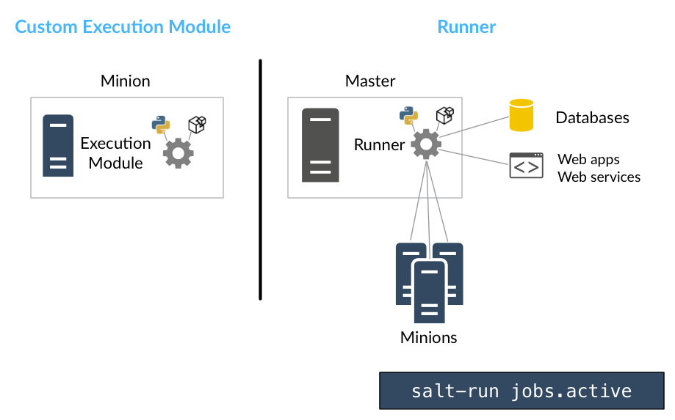
Custom Modules & Runners
Notes:
Nicole:
Custom Execution Modules & States:
Custom operations on minions
Manage and deploy internal apps (devOps)
Written in Python - easily deployed via the master
_modules, _states
Runners:
Basic Level: Command Execution for the Master
Run on Master with salt-run
Simple client call or complex application
Lots! ~25 (cache, cloud, pillar, fileserver)
Jobs runner: salt-run jobs.active (lists active jobs)
Have full power of python and Salt
Used to connect to external systems, update web pages, call web services
Sessions:
Extending SaltStack with Custom Execution and Runner Modules (Colton Myers & Dave Boucha)
Tomorrow 11:45

Slide 20

More Information
http://saltstack.com/training/
https://www.youtube.com/user/SaltStack
http://salt.readthedocs.org/en/latest/
http://salt.readthedocs.org/en/latest/ref/modules/all/index.html
http://salt.readthedocs.org/en/latest/ref/states/all/index.html
https://github.com/saltstack
Mark Hopper, Solution Consultant
801-506-6994| mhopper@saltstack.com
Katarri Washington, Account Executive
801-305-3330| katarri@saltstack.com
Notes:
A key component of migrating to Softlayer is having the ability to manage multi-cloud environments

Slide 21




Thank You!
801.207.7440
www.saltstack.com
3400 N. Ashton Blvd. Suite 110
Lehi, UT 84043
@SaltStackInc

