Slide 1

42
Trump twitter sanity checker

Slide 2




Team

Slide 3




Influencers

Slide 4


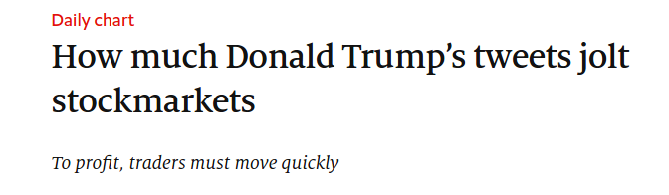
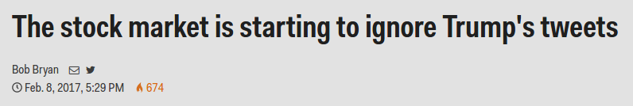
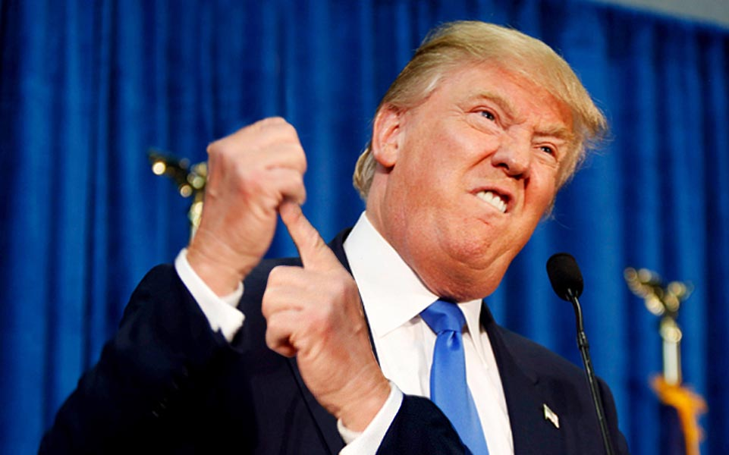
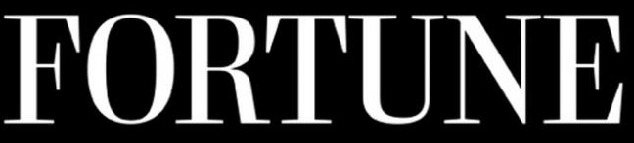

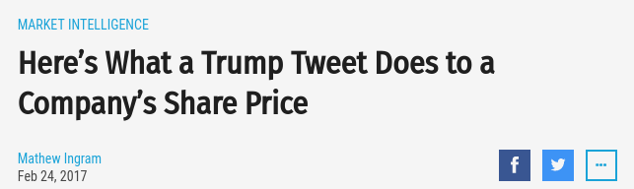
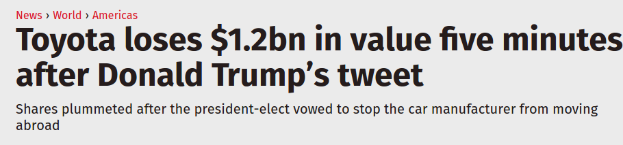
Why this matters

Slide 5
Question
Can this person’s tweet influence stock prices?

Slide 6
Workflow
Pull tweets
Stock data
Sentiment analysis
Pre-process returns
ML
Coefficient of determination

Slide 7



Data collection
tweetpy
30000 Trump tweets

Slide 8
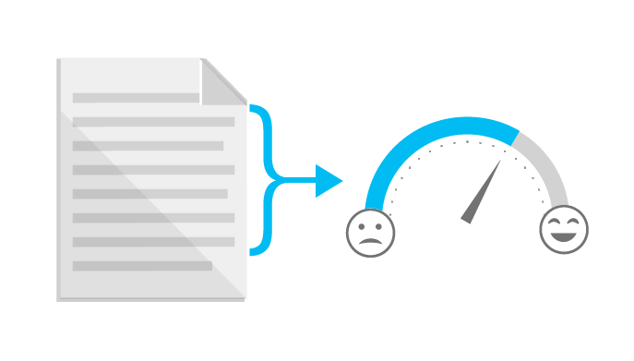
Sentiment analysis
Microsoft Cognitive services: text analytics API

Slide 9
Pre-process data
Sentiment Analysis
Convert into feature vector tweet using MS cognitive services
Stock prices
Interpolate missing data (i.e. Saturday, Sundays)
Convert to Log Return values
Remove unpredictable events ( > 3 sigmas )
For training data
Concat 3 of them using as described in [Mittal et al, Stock price prediction using twitter sentiment analysis].

Slide 10
Feedback about Azure ML Studio
Python integration (network connection on VM, ability to install non-native modules, better log messages, only pass dataframes?)
Hard to decipher errors (Microsoft.Numerics.AFxLibraryException ?)
Scarce online support
Where is dropout for Neural Networks?

Slide 11
Availability
https://github.com/cachemoi/42

Slide 12
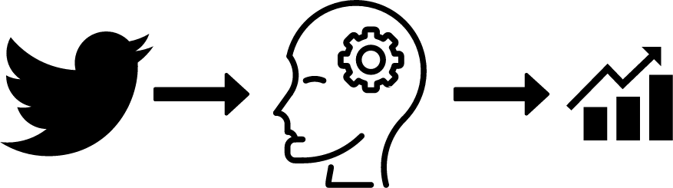
Conclusion

