Slide 1
Midterm Presentation
Benjamin Uy, Rithik Kulkarni, Colby Cress
CSC 442 (001)
Notes:
Benjamin

Slide 2
Team Composition
Benjamin Uy (applied math)
Github, final touches to modified dataset
Rithik Kulkarni (comp sci)
Cleaning/wrangling (score and production countries)
Colby Cress (comp sci)
Cleaning/wrangling (genre), duplicate observations
Notes:
Benjamin

Slide 3
Datasets and Motivations
Movie/shows from Netflix and Hulu
title, show type, description, release year, age certification, runtime, genres, production countries, seasons, imdb score, imdb votes, tmdb popularity, tmdb score
Unit of observation: Movie/show on Netflix/Hulu between May and July 2022.
Film appreciation and interest in watch analytics
Notes:
Rithik

Slide 4
Cleaning, Merging, Wrangling
Merging:
Concatenated Hulu and Netflix datasets into one dataframe
Cleaning, Wrangling:
Updated genres to store only first value
Sorted production_countries
Created average_score to replace imdb_score, tmdb_score
Converted type, age_certification, genres to categorical
Converted seasons, imdb_votes from float to int
Notes:
Colby, deal with duplicate observations

Slide 5
Modified Dataset
Unit of observation kept the same
11 variables, modifications to 3
title | genre
type | production_countries
release_year | seasons
age_certification | imdb_votes
runtime | tmdb_popularity
average_score
Notes:
Ben

Slide 6
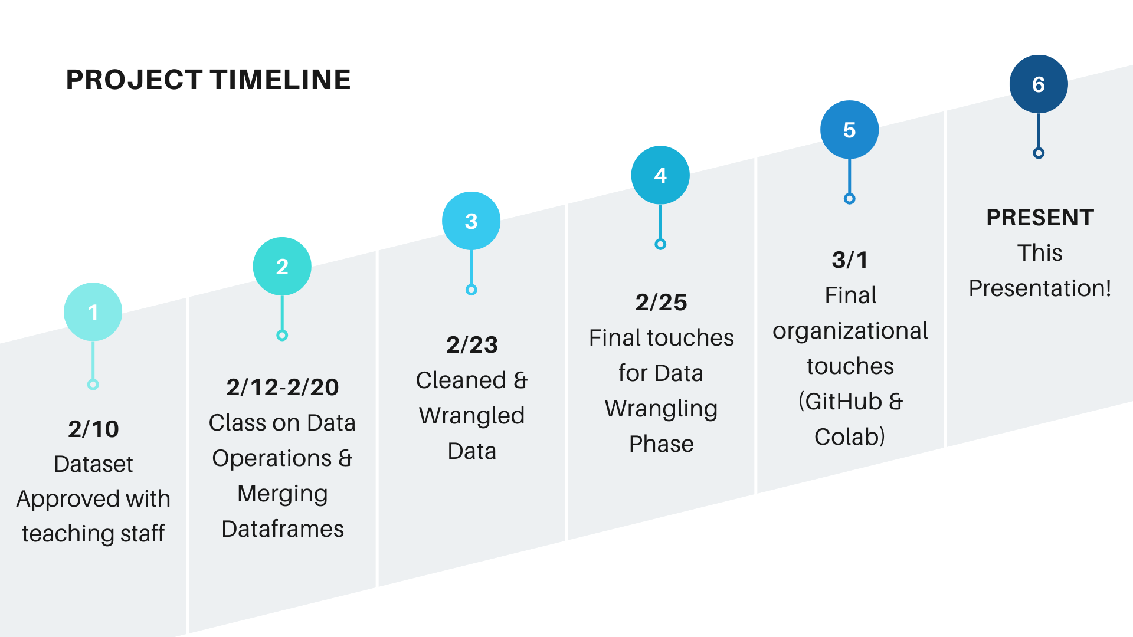
Timeline
2/10 Meeting with TA
2/12 - 2/20 Class on data operations, merged dataframes
2/23 Cleaned + wrangled data
2/25 Data wrangling, submission of HW 5b
3/1 - 3/2 Final touches
Notes:
Rithik

Slide 7
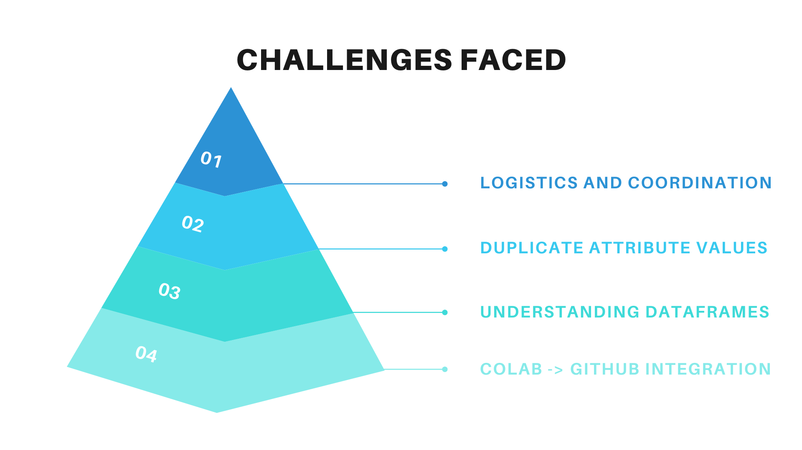
Challenges
Logistics and coordination
Duplicates
Understanding dataframes
Colab != Collaborative
Notes:
Colby

Slide 8
No Exploratory Analysis?
Over the break, individually conduct EDA
Regroup and review our findings
Bivariate analysis of popularity and all other features
Potential connection between title and popularity
Notes:
Ben

Slide 9
Next Steps
Implement title characteristics as features for use in EDA
Word count, punctuation, number of vowels
EDA conducted individually
Awaiting future instructions
Notes:
Rithik

Slide 10
Resources
https://www.kaggle.com/datasets/victorsoeiro/hulu-tv-shows-and-movies/data?select=titles.csv
https://www.kaggle.com/datasets/victorsoeiro/netflix-tv-shows-and-movies/data?select=titles.csv
Canva Pro for visuals on slides 6, 7
Google Colab
GeeksforGeeks
Notes:
Colby

Slide 11
Questions?
Notes:
Colby

