Slide 1
CRISP-DM Cross Industry Standard Process for Data Mining

Slide 2
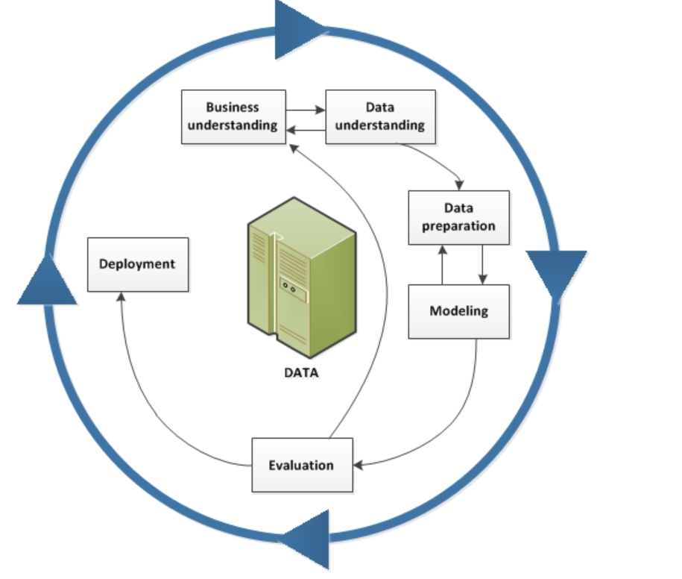
Ciclo de vida de mineria de Datos

Slide 3

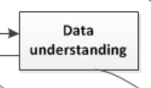

Slide 4
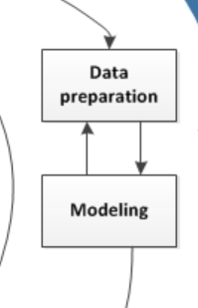

Slide 5
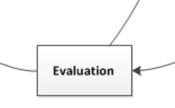

Slide 6
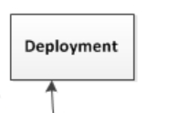

Slide 7
Participantes:
Jimena Badilla
Nicole Cubero
Christian Acuna
Haffet Calderon

