Slide 1



Group Project-
Green Survey
GROUP1

Slide 2

Catalogue
01
Team Introduction
02
Project Introduction
03
Project Realization

Slide 3
01
Team Introduction

Slide 4
Team introduction
GUO Jiayi
LI Xiaoyu
Designer
Researcher
01
Project Manager
Developer
Researcher
02
LI Yixuan
LIU Xiaoxuan
03
Designer
Researcher
04
Marketer
Researcher
WANG Ziyue
Marketer
Researcher
ZHU Ziwei
05
06
Developer
Researcher

Slide 5
02
Project Introduction

Slide 6
Project Introduction
INFORMATION SEARCH
01
Target consumers
College students
Architects
corporate information department
Target consumers’needs
High efficiency
Objectivity
Unity
Extensive
02
03
Competitors
Qualtrics
Type form
199it
Survey monkey
Competitors’offers
Questionnaire templates
Sample services
Online test
Low cost
04

Slide 7
Project introduction
SLOGAN
Click and get connected.
One clicks to connect the investigator and the subject. A simple and interesting mobile survey that covers the entire category of survey experience.

Slide 8
Project Introduction
ANALYZE MARKET SITUATION
Our weaknesses
Strengths
Weaknesses
Our strengths
We are facing labor shortage and our customer services might need to improve.
We offer full consulting services and detailed guidance services.
Our questions are various and highly selective.
Market opportunities
Threats
Threats
Online research is widely used and has become the most popular research method.
Opportunities
There are many other survey companies in the market offer more comprehensive services with even lower prices.

Slide 9
Project Introduction
IDENTIFY TARGET
For those who do not have enough budget:
We would provide them a free trial period and monthly subscriptions.
College
students
Small
businesses
Other
individualusers

Slide 10
Project introduction
SET THE PROMISE
The characteristics and the value provided to users
Common messages
online surveys convey
Convenience: A convenient way for users to participate from anywhere with an internet connection at any time.
Flexibility: The flexibility to respond to questions at their own pace.
Quicker Data Collection: Be disseminated to large numbers of people quickly and easily.
Analytical Capabilities: A built-in analytical tools, which allow for easy data analysis and reporting.
Personalization: Be customized to meet specific requirements and needs of the user.
The message conveyed by an online survey will depend on the goals and objectives of the survey, and how the data collected will be used to inform decision-making.
However, online surveys can be a powerful communication tool for conveying a range of messages related to transparency, inclusivity, and using data to improve processes and outcomes.

Slide 11
Project introduction
DISTRIBUTION POLICY
1
2
3
collaborate with third-party data providers
Gradually shift to independent sales.
collaborate with professional service organizations.
Due to our small team and low initial visibility, we will collaborate with third-party data providers.
Wait for the later development of business and products, and then we can gradually shift to independent sales.
They need to regularly conduct large-scale questionnaire survey projects, which can become important channels and sources of income.

Slide 12
Project introduction
DEFINE COMMUNICATION POLICY
Display ads or Pay-per-click (PPC) ads
The most direct way
Twitter, Facebook and so on
Email marketing
Social-media marketing
Paid advertising
SEO
Influencer marketing
Improving the visibility of the online survey on search engines
Credible endorsements to influence marketing

Slide 13
03
Project Realization

Slide 14
Project realization
SWOT Analysis
SWOT
Strengths
Weaknesses
Opportunities
Threats
Strengths: Flexible and easy to manage、Quick response capability、High employee motivation.
Weaknesses: Limited resources、Insufficient management experience、Weak technical foundation.
Opportunities: Start-up is less difficult、Generalization of data application、Large customer and market demand、Timeliness and personalization.
Threats: Challenges to credibility and security、Problems with data、Few financing channels.

Slide 15
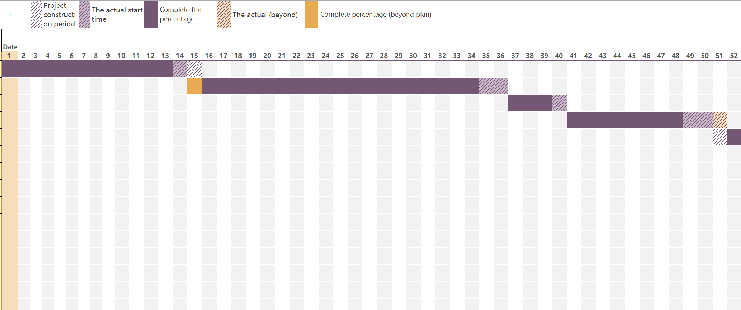
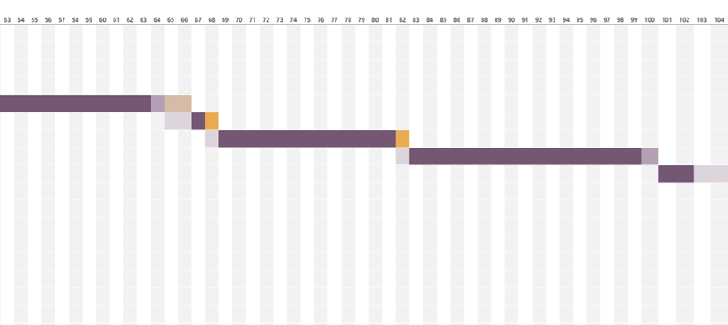
Project realization
GANTTE Analysis
The GANTT chart of waterfall model
A
此处输入您的标题
B
此输入您的标题
C
此处输入您的标题

Slide 16
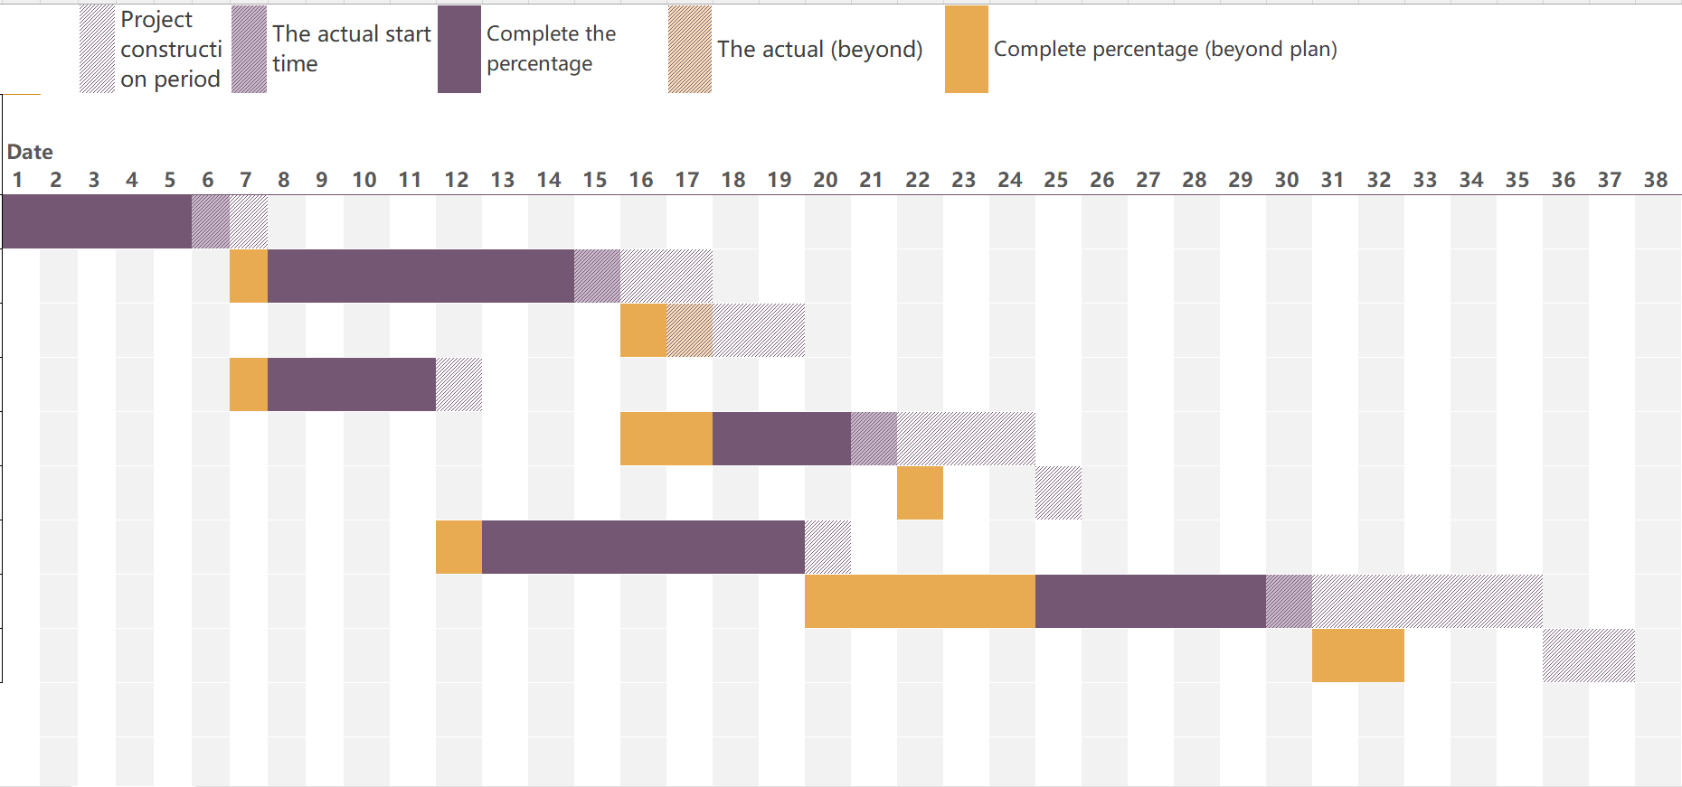
Project realization
GANTTE Analysis
The GANTT chart of Kanban's model
A
此处输入您的标题
B
此输入您的标题
C
此处输入您的标题

Slide 17
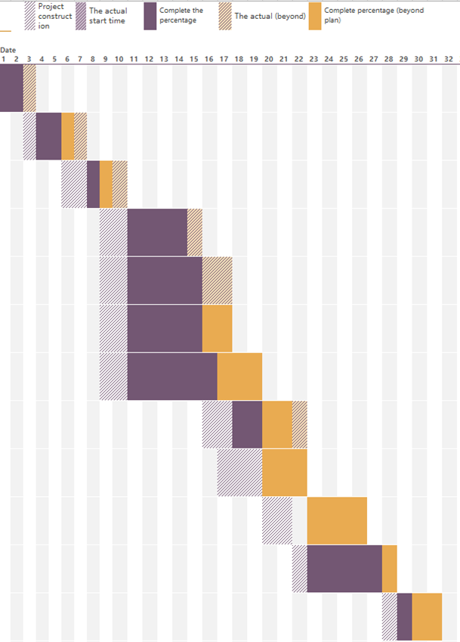
Project realization
GANTTE Analysis
A
此处输入您的标题
The GANTT chart of our project
B
此输入您的标题
C
此处输入您的标题

Slide 18
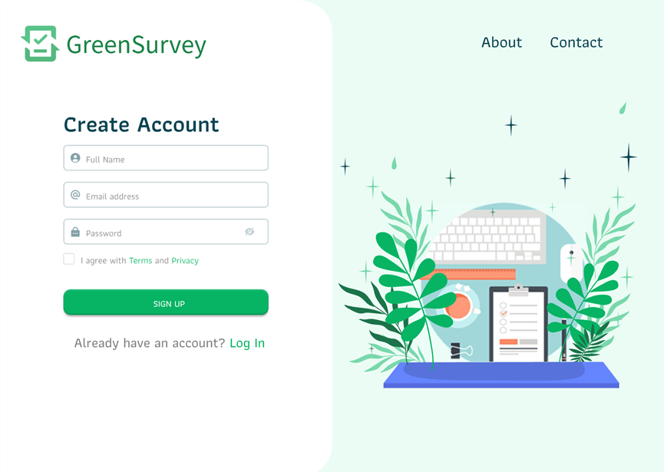

Project realization
DESIGN AN ATTRACTIVE VISUAL IDENTITY
Efficient logo:
请在此处输入您的文本或者复制您的文本粘贴到此处，请在此处输入您的文本或者复制您的文本粘贴到//www.ppter8.com
Landing Page

Slide 19
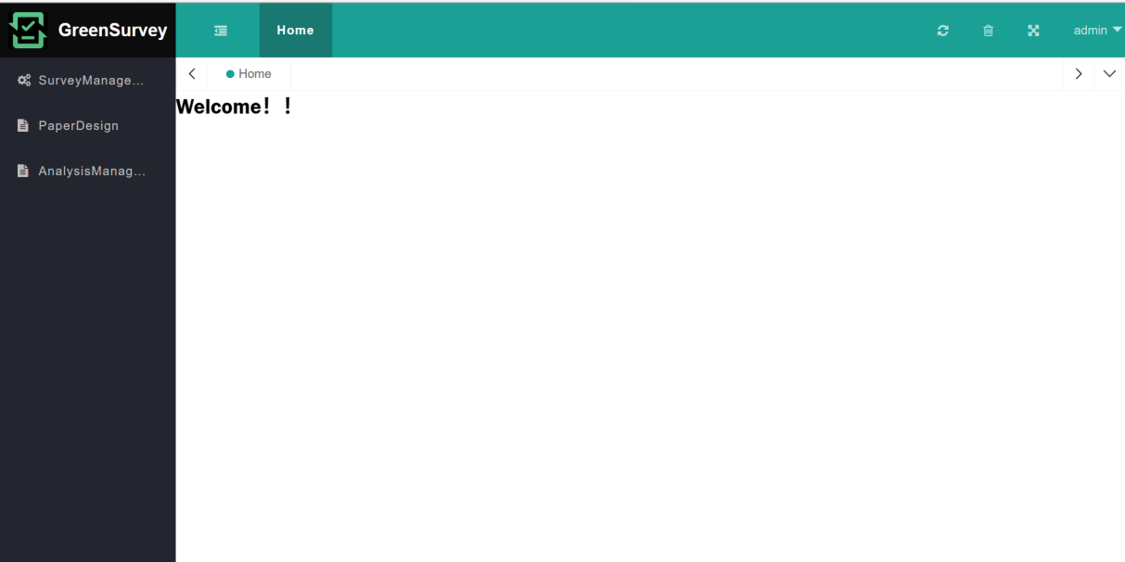
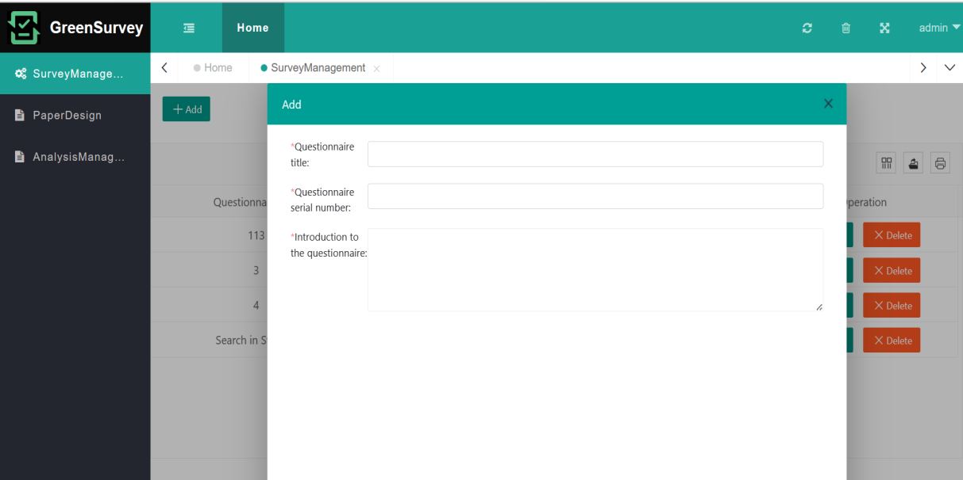
Project realization
DESIGN AN ATTRACTIVE VISUAL IDENTITY
Survey Editor:
请在此处输入您的文本或者复制您的文本粘贴到此处，请在此处输入您的文本或者复制您的文本粘贴到//www.ppter8.com
Home page
New questionnaire

Slide 20
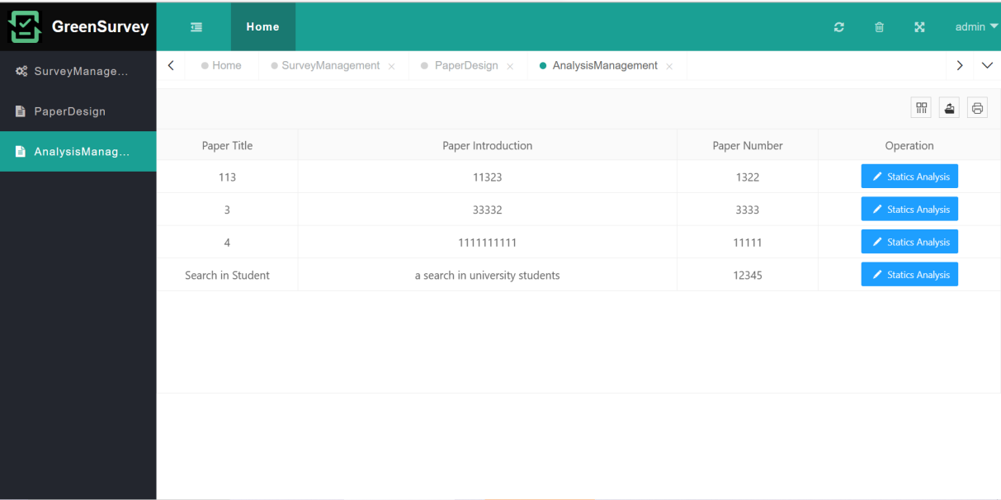
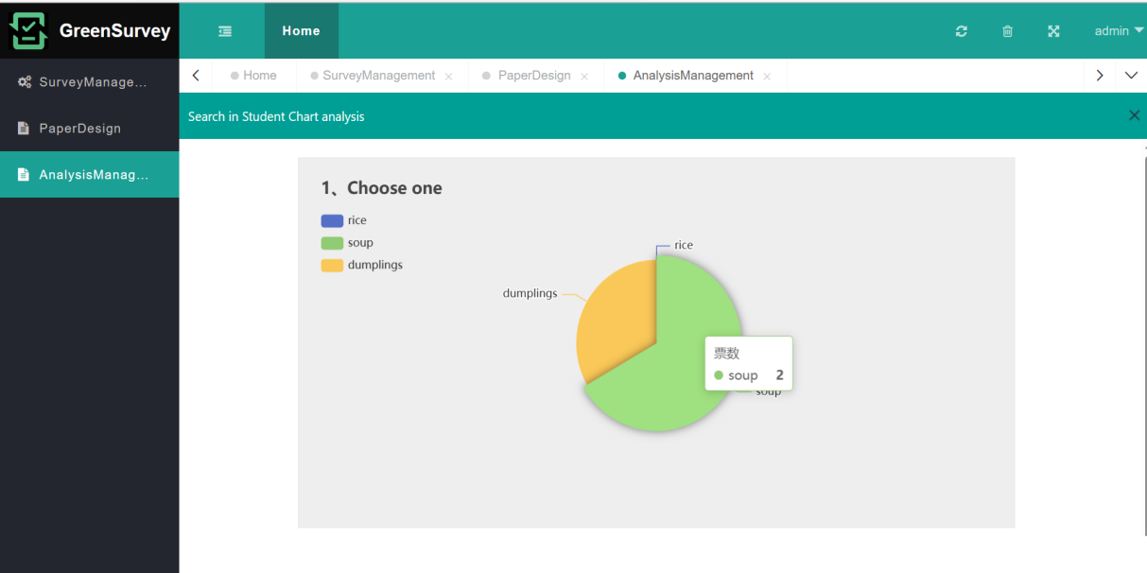
Project realization
DESIGN AN ATTRACTIVE VISUAL IDENTITY
Survey Analyzer:
请在此处输入您的文本或者复制您的文本粘贴到此处，请在此处输入您的文本或者复制您的文本粘贴到//www.ppter8.com
Home page
Questionnaire analyze result

Slide 21
Project realization
PRODUCT TESTED
Testing Plan
Testing Content
01
Conduct internal testing
01
Version testing
02
Testing in the circle of acquaintances
02
Strategic testing
Open beta version and publicly promote
03
04
Invite celebrities to evaluate and promote
03
Availability testing

Slide 22
Thanks for listening

