Slide 1
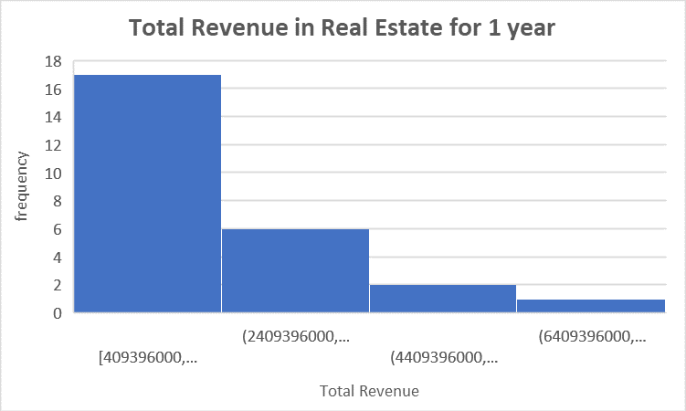
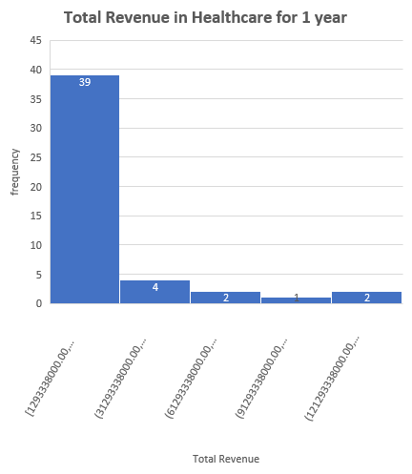
How similar is the total revenue in healthcare and Real Estate in year 1?
Here is a histogram of the Total Revenue in Healthcare and Real Estate in the first year.
One can notice that both histograms are Right skewed which implies that the mean is overestimates the most common values.
The Mean for the Real Estate is about $2.3 billion in the first year while in Healthcare, the mean is $23 billion which is ten times more than the average total revenue in Real Estate. One can conclude from the above information that the healthcare has a higher Total Revenue than in Real Estate in their first year.
The Standard Deviation for the Real Estate is about $1.8 billion which is lower than the Standard deviation in Healthcare which about $37 billion in the first year. That means that Healthcare has higher variability than Real Estate.
The Range in Healthcare is about $14 billion and about $10 billion in Real Estate, which means that Healthcare has higher variability than Real Estate.
Ange Fopa

