Slide 1
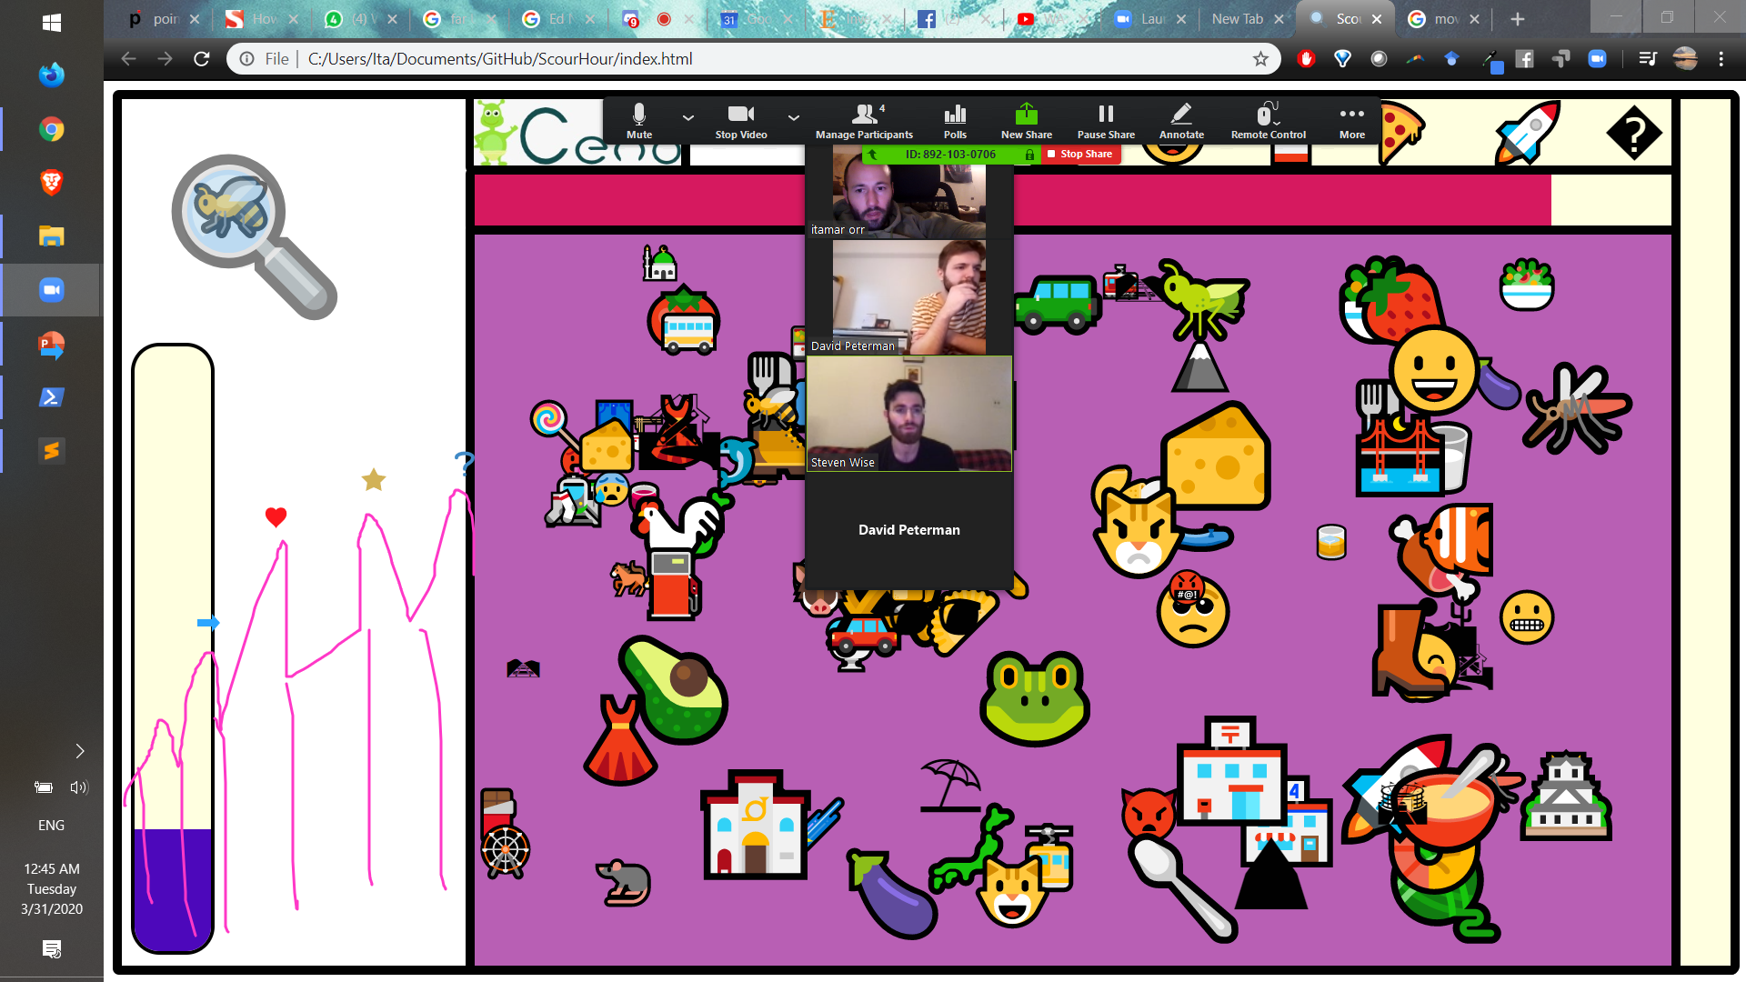
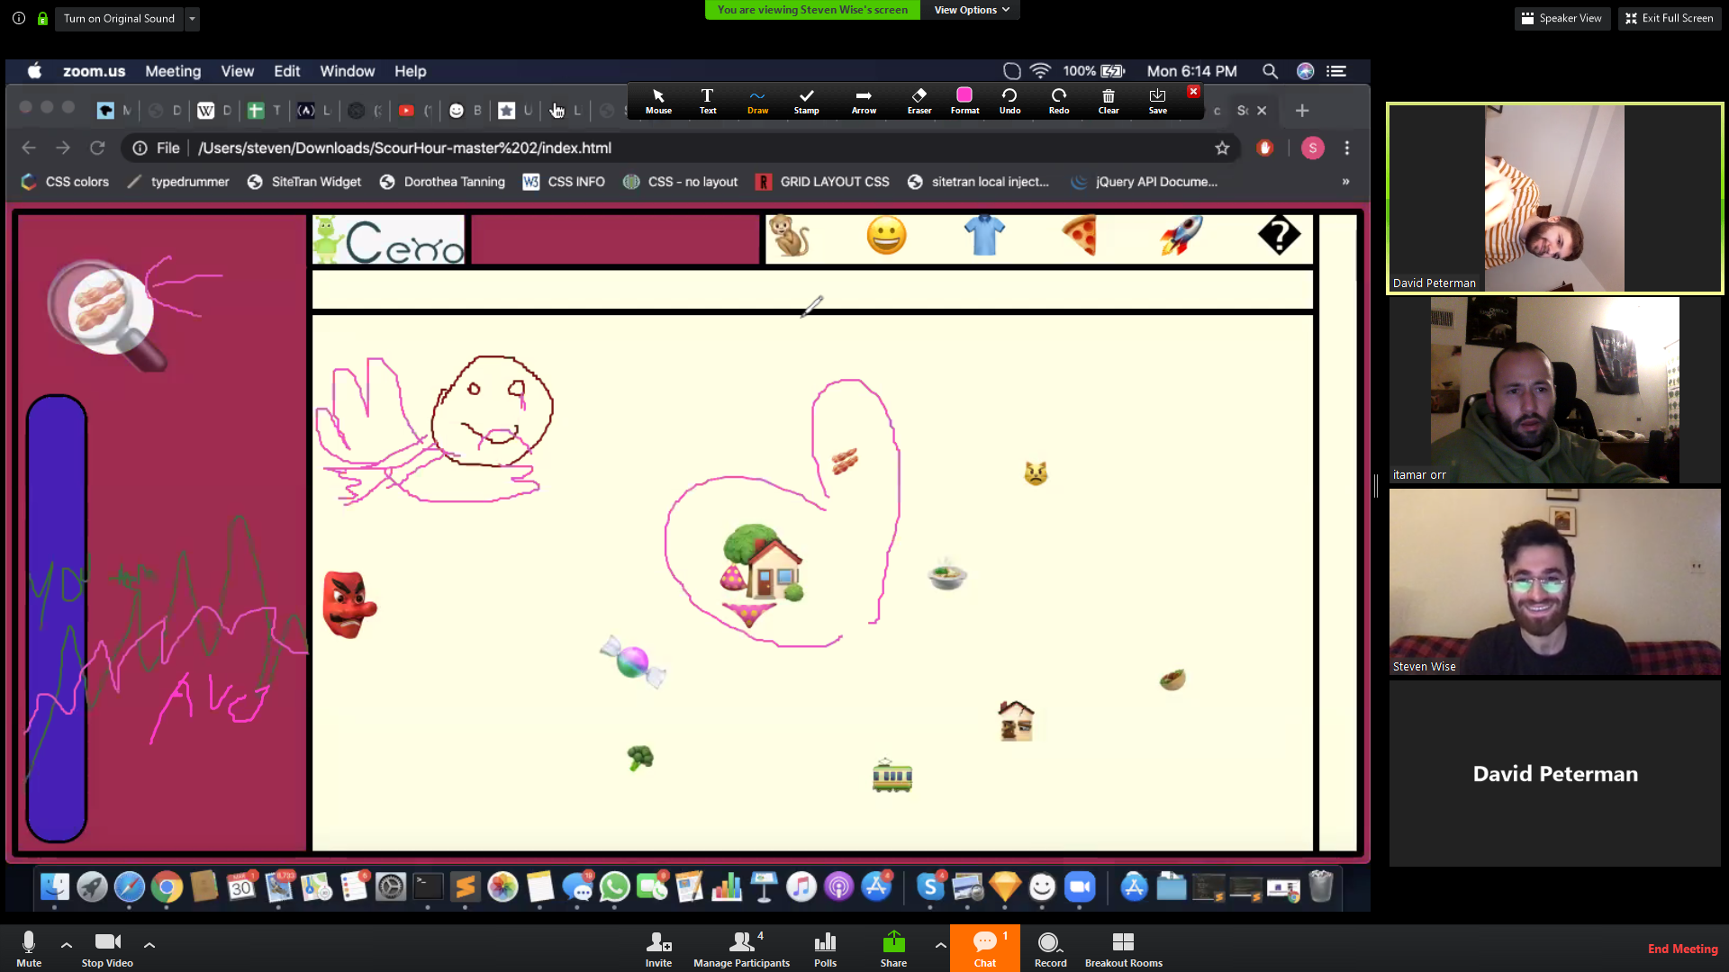
In-game stress indicator
(end game stress by t)
Running graph
(stress by t)
Click time by difficulty
Click time by difficulty by t
Pair online and compete and levels of stress
Time relative (never 100%)
Range of motion as an indicator
Eye tracking – facial expression
Success / stress / amplitude by color
Movement \ amplitude by time / color
Type of emoji’s you won with
Guessing incorrectly { spins up / takes you back]
“the bring it back”
What to do with touchscreens about mouse movement?
Notes: options for different categories (unnecessary? Just animals? After you beat you get new emojis) a bit clogged -> need to be simpler for more focus and fun

Slide 2
Multiplayer
Invitation link \ code integration
It should show you that you are playing against somebody else
Showing the other players mouse (what with mobile?)

