Slide 1
A challenge to the next generation of Phoenix

Slide 2
Blood pressure measurements, half-hourly made automatically over about 5 per day, made by self-measurements, now cover decades

Slide 3
We wish to show first that we are influenced by the earth and the farther sun and galaxy, and have earlier reported not only signatures of the photic day and year but also of non-photics

Slide 4
Non-photics are about-weekly variations, multiples and submultiples, harmonics, about-monthly ones of various origins, lunar and solar, the latter including the rotation of the earth around its axis, a 27-day period

Slide 5
Transyears are "years" longer than a calendar year, slightly by a few weeks (near-transyears) and by several months (far-transyears)

Slide 6
Against this background, we show herein that modulations by a half-year of the earth and of transyears by the solar wind and of shorter than half-yearly changes in solar flares depend on time of day being apparent only at night

Slide 7
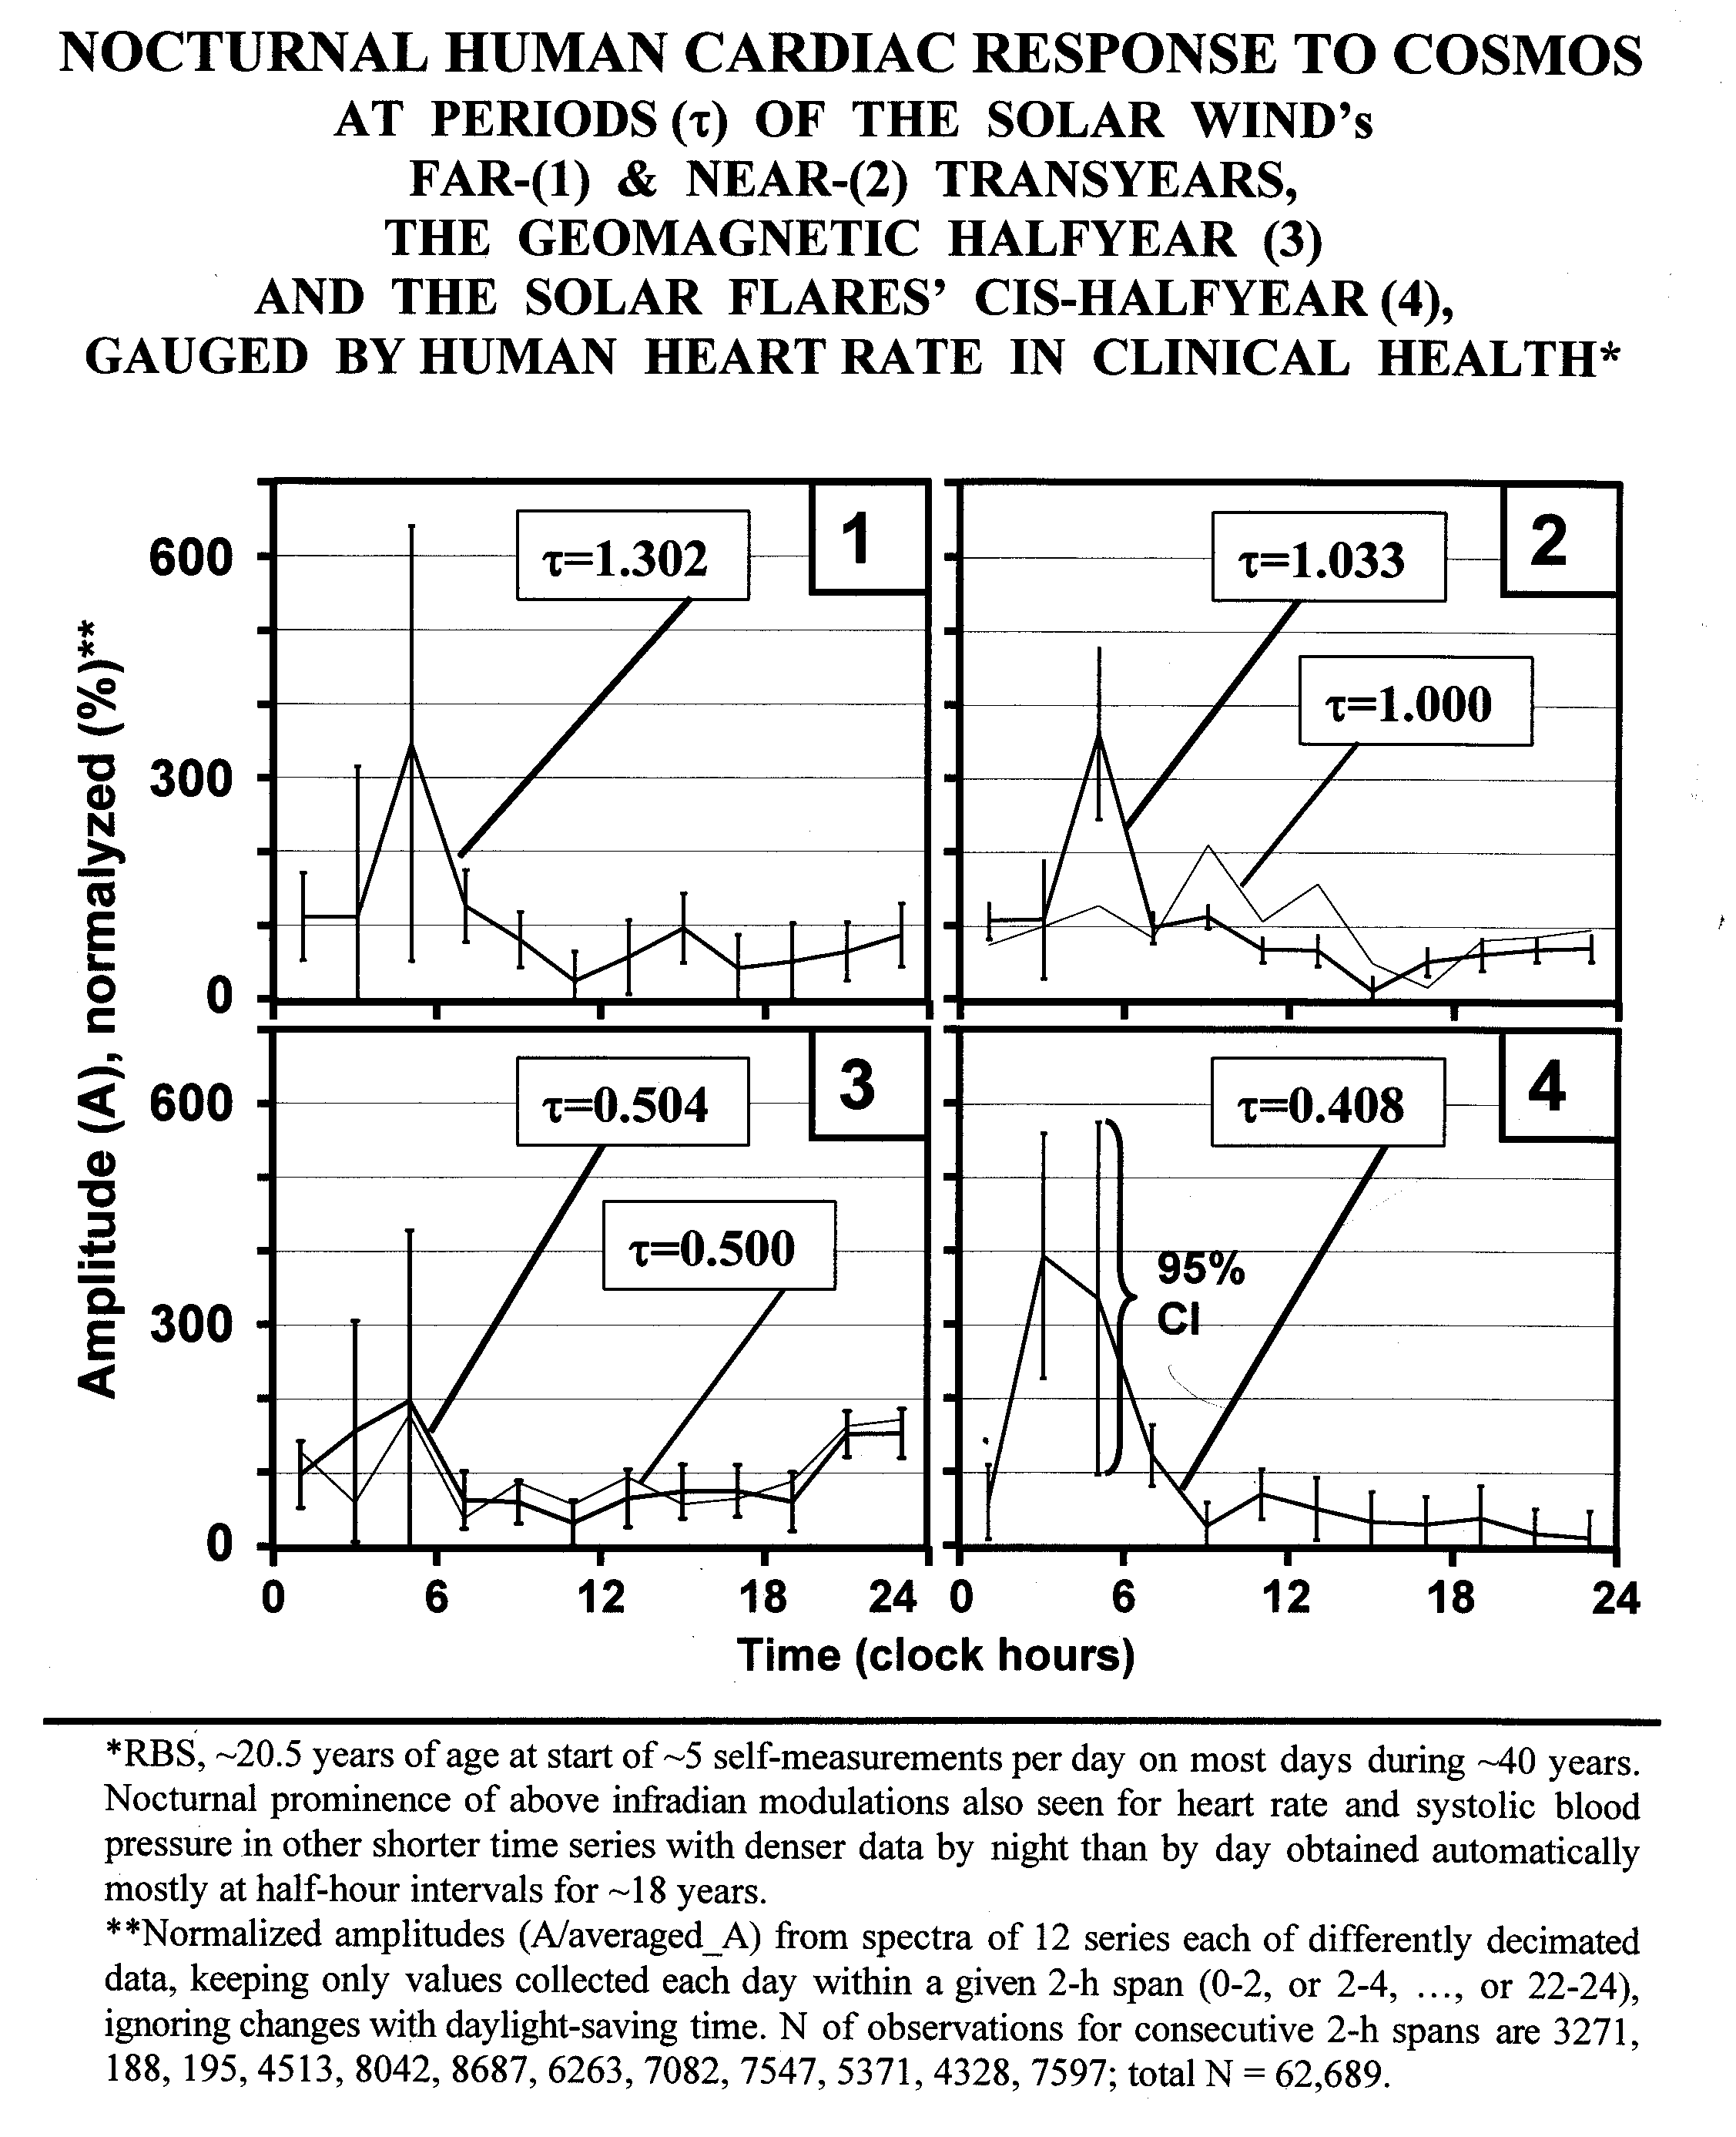

Slide 8
This finding is to be qualified by the numbers of measurements at each time of day which differ from 2-hour interval to 2-hour interval, as seen at the bottom of the slide

Slide 9
Germaine then analyzed a time series with more measurements in the middle of the night when the previous time series were sparse

Slide 10
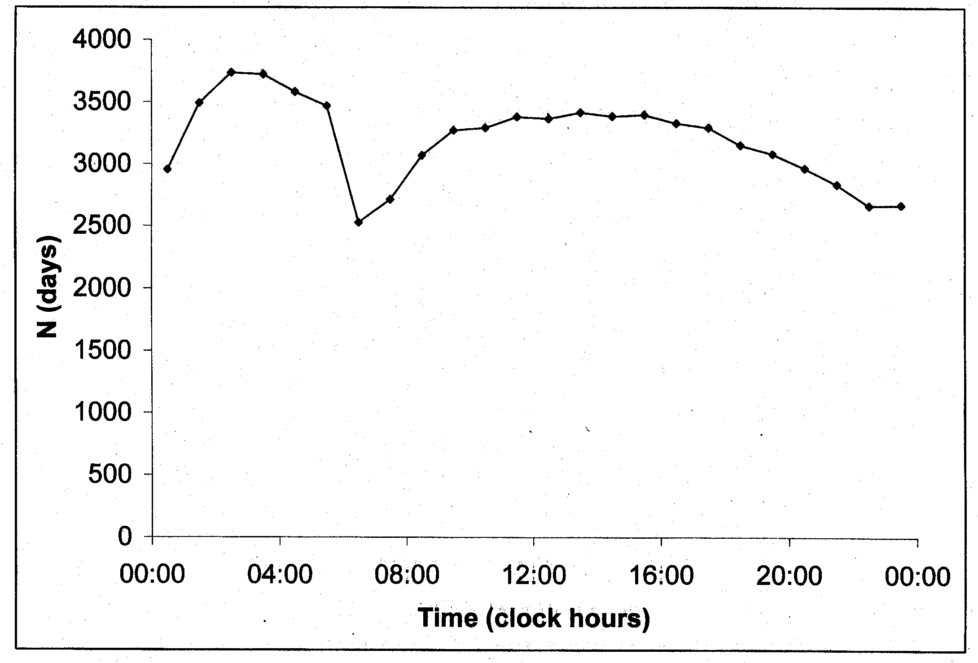

Slide 11
At least a far-transyear of 1.5 year length and a 1-year component are seen to be prominent by night in this case as well, when spectra for different 2-hour spans are summarized

Slide 12
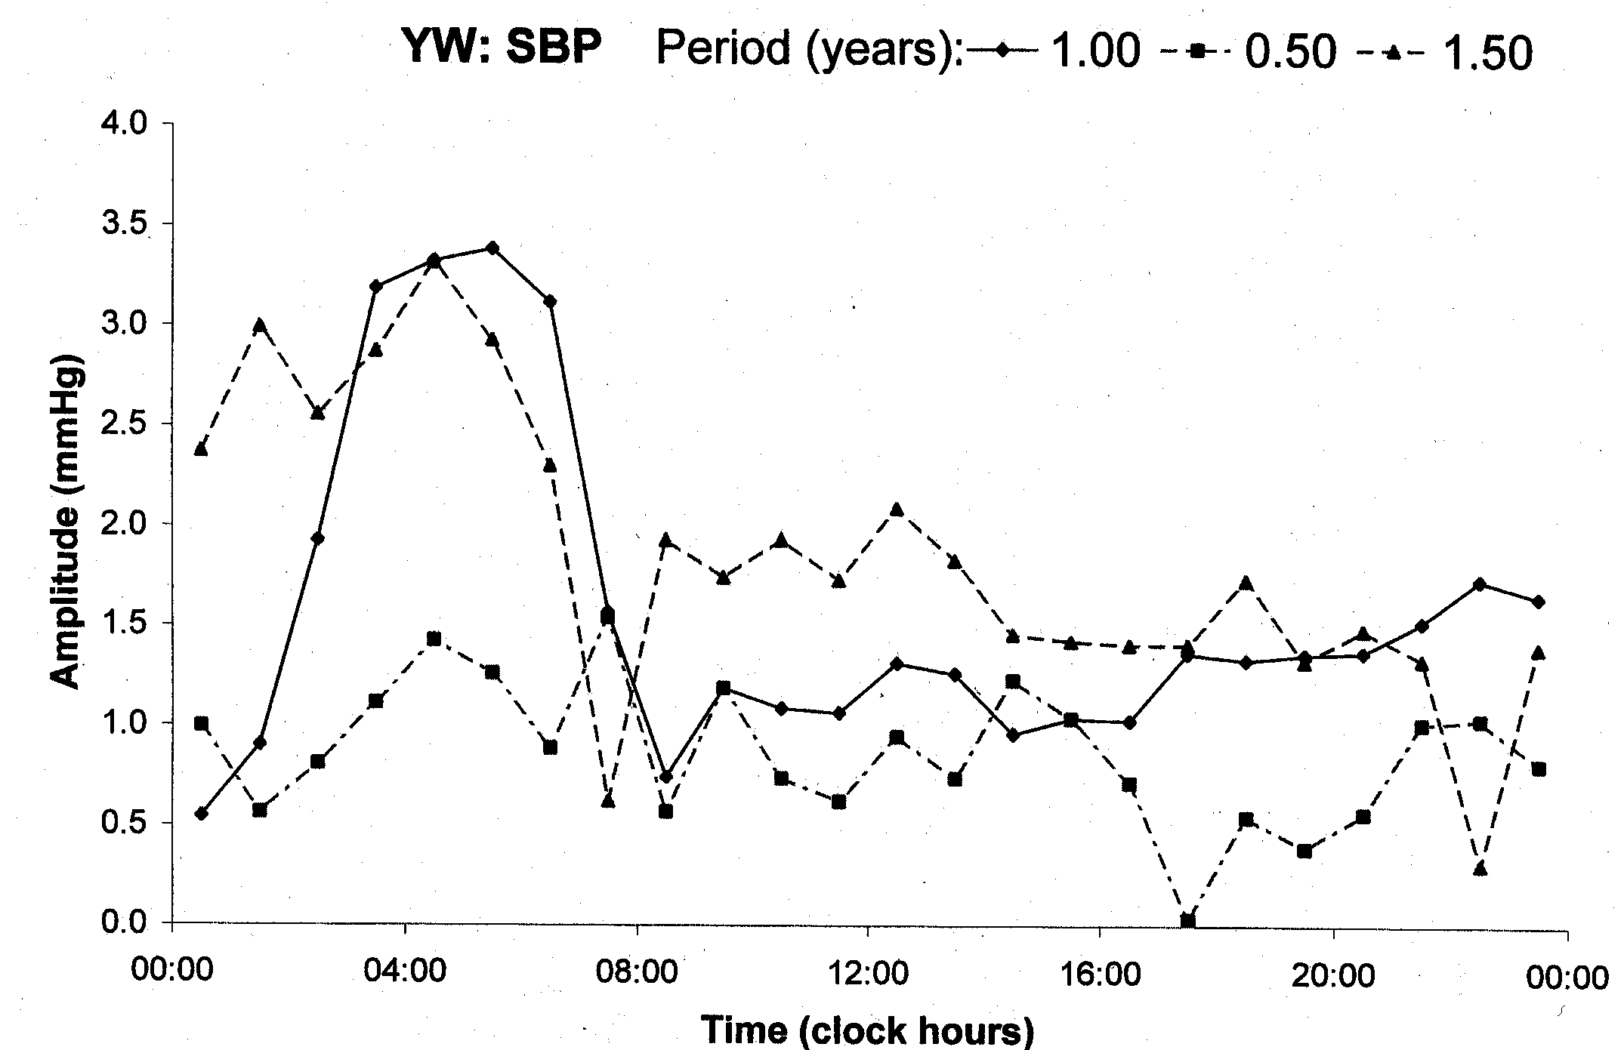

Slide 13
Again, the dashed line summarizing data between 02:30 and 05:30 is seen to have sharp peaks, notably at transyears, and at other time series show smaller peaks

Slide 14
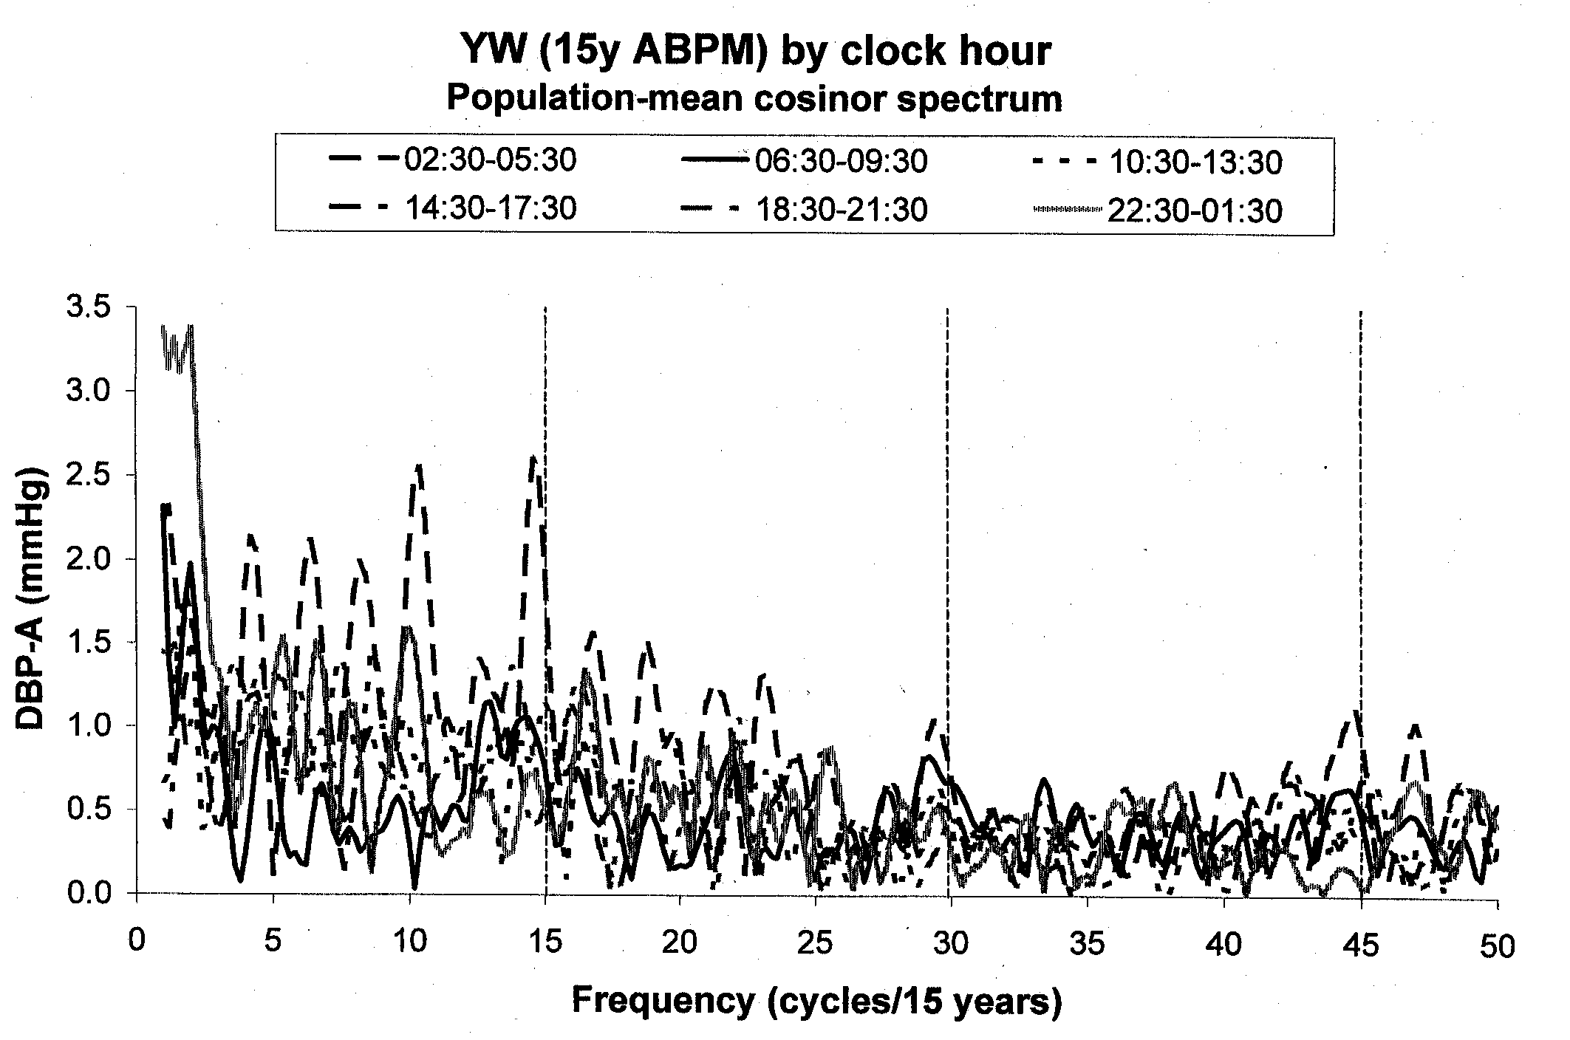

Slide 15
Summary
The graph plotting modulations by infradians of the circadian system revealing peaks only at night shows two facts that are new to the scientific community at large

Slide 16
We are modulated immeasurably in our circulation by the cosmos. This modulation occurs by night when evidence is available that a mediator of the effects of the cosmos, of seemingly other than heat and light, reveal

Slide 17
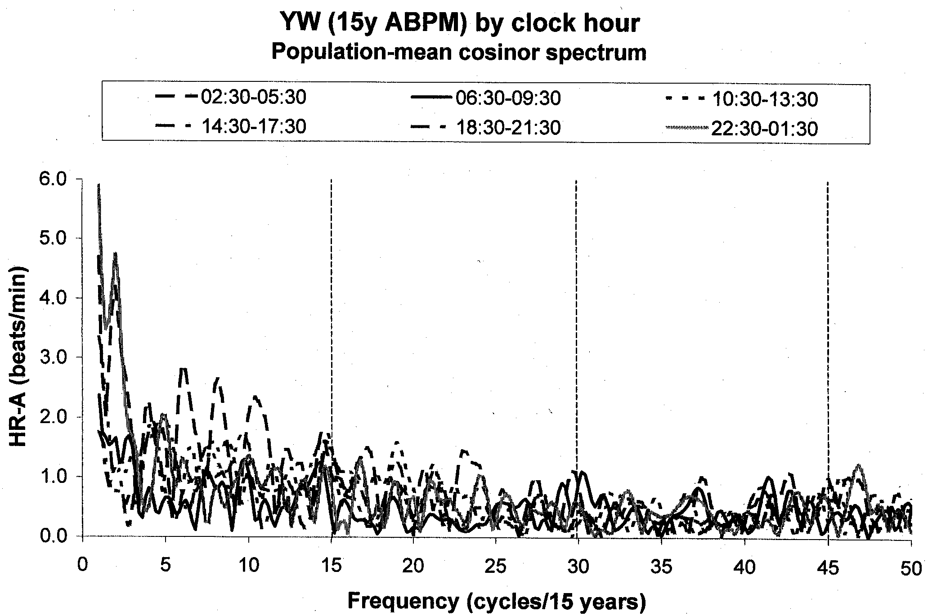

Slide 18
We can only imagine that someday we may not only heat when it is cold, but shield when certain effects upon us, rather than temperature and light, act upon us, as shown herein

Slide 19
What is implication for Phoenix? Equally important, as compared to stroke prevention, is everyone's well-being. New challenges thus arise that can be visualized, discussed and even tackled concomitantly with other software problems, while reason says one step at a time

