Slide 1
Architectural Overview & Requirements Brainstorm
Phoenix Ambulatory Blood Pressure Monitor
© 2005 Christopher J. Adams
Copying and distribution of this page is permitted in any medium, provided this notice is preserved

Slide 2
Table of Contents
5 minutes of requirements (skip)
30 seconds of constraints (skip)
Major subsystem interfaces
Diary subsystem (skip)
Analysis software subsystem (skip)
Device subsystem (requirements only — skip architecture)

Slide 3
Requirements
Collects a week of blood pressure measurements
Inexpensive
Unobtrusive
Easy to use

Slide 4
Requirement
Week of Measurements
Records measurements at least every half hour for at least 7 days
Measures systolic and diastolic blood pressure
Measures heart rate
Measures physical activity
Measures blood flow

Slide 5
Requirement
Inexpensive
Price is not a barrier to using the monitor
Less expensive than:
  Blood pressure cuff
  Wrist watch (<$50)
  “Two bushels of yams” (<$10)
    3rd-world friendly

Slide 6
Requirement
Unobtrusive
When in place
  Patient can forget about it — not be aware of it
  No more encumbering than
    wrist watch
    band-aid
    piece of jewelry
Usable wherever the patient is, such as at home or at work when allowed
  Not just for hospital, clinic or doctor's office

Slide 7
Requirement
Easy to Use
Better than devices with blood pressure cuffs:
  Easier to use
  Equally accurate
Patient:
  Should be able to ignore it, but
  Can determine whether functioning normally
  Can observe a blood pressure and heart rate measurement
Automatic — measurements taken regardless of patient behavior
Allows manually initiated measurements

Slide 8
Constraints
Open-source
  Major impact on design
    Must be buildable by fluid, virtual organization
    Developers have major say in content
    3rd-party components must pass licensing constraints

Slide 9
Recap
5 minutes of requirements
30 seconds of constraints
Major subsystem interfaces ⇐
Diary subsystem
Analysis software subsystem
Device subsystem

Slide 10
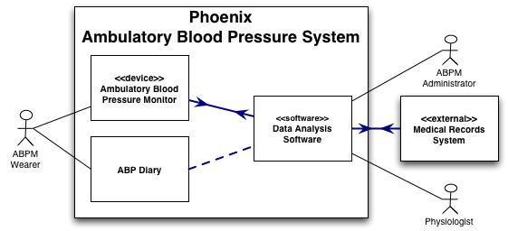
Major Subsystems & Interfaces
Monitor measures the Wearer
Wearer records observations in the Diary
Administrator & Physiologist use Data Analysis Software to assess the data collected by the Device
Diary influences the interpretation of the data
Clinical settings: data stored in Medical Record Systems

Slide 11
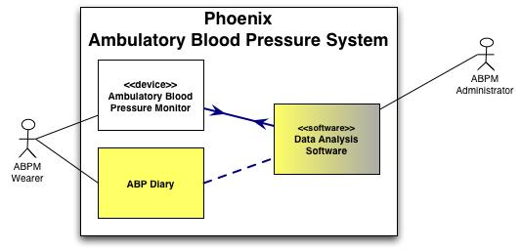
Diary Subsystem
Observations influencing diagnosis
Defined content
  Patient identity (new subsystem?)
  Background, demographics
  Daily entries
    Exceptions to background
Multiple formats
  Paper PDA
  …
Integrated device feature
Could be an electronic device ➔ Phoenix ≈ 2+ devices

Slide 12
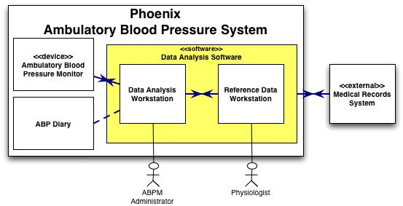
Analysis Software Subsystem
Analysis Workstation
  Handles data for a single wearer
  Nominally a desktop application
  Multiple implementations ⇐
    Clinical Care Support System
    Personal care support tool
Reference Data Workstation used by Chronobiology Center
  Handles data for whole populations
  Could be a distributed or internet application
Analysis Workstation relies on model parameters from Reference Data Workstation

Slide 13
Recap

Slide 14
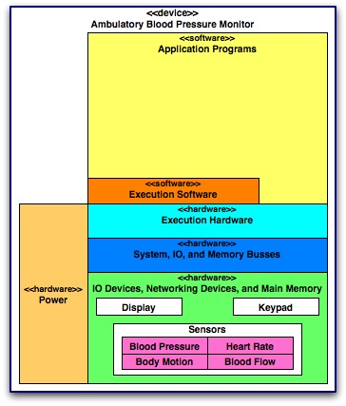
Device Subsystem
Small, wearable computer
Related subprojects:
  Low Power Microprocessor
  Power
    Subsystem must be modular for easy substitution
    thin-film battery would be cool
Real-time embedded software ⇐
Execution software =?
  RTOS? OS? No OS?
Functionality may be allocated to multiple, linked devices

Slide 15
Device Subsystem
Display
Keypad
Sensors
  Blood pressure
  Heart rate
  Body motion
  Blood flow
Issues
  Sensor proximity & bundling
  Number of devices

Slide 16
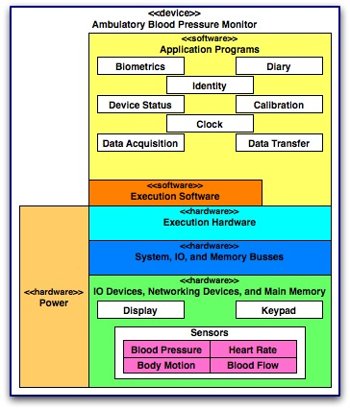
Device Subsystem
Clock
Identity
Diary
Calibration
Device status
Biometrics
Data transfer
Data acquisition

Slide 17
Requirements
Clock
Timestamp every sample
  Include date
  Record in UCT
Display time-of-day for diary recording
  Display precision = 1 minute
  Do not display date
  Display in local time ➔ need timezone
Precision
  Current devices require about 1 minute to take a single measurement
  Sampling Beat-to-beat ➔ 300 beats per min x 25 samples per cycle = 125 samples per sec = 8 msec per sample ➔ precision = 1 msec
Set time, date, and timezone at “initialization”

Slide 18
Requirements
Identity (Onboard/Offboard)

Slide 19
Requirements
Diary (Onboard)

Slide 20
Requirements
Device Status

Slide 21
Requirements
Calibration

Slide 22
Requirements
Biometrics (Onboard)

Slide 23
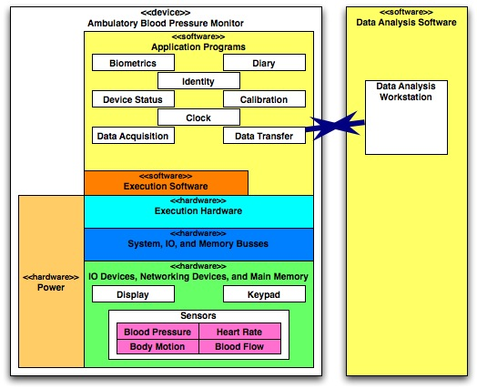
Requirements
Data Transfer—Standards
HL7
IEEE 1073, “Standard for Medical Device Communications”
  Defines “Medical Information Bus”
  May be superceded
ISO/IEEE 11073, “Standards for Point-of-Care Medical Device Communication”

Slide 24
Requirements
Data Transfer—Content

Slide 25
Requirements
Data Acquisition

Slide 26
UI Requirements
Display
Keypad

