Slide 1
Open Source
Medical
Decision Support Systems
(DSS)

Slide 2
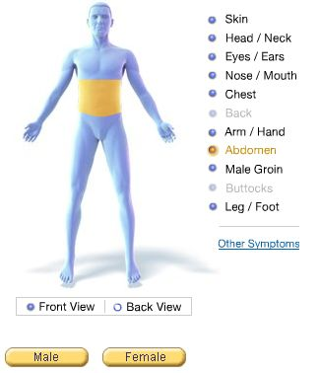
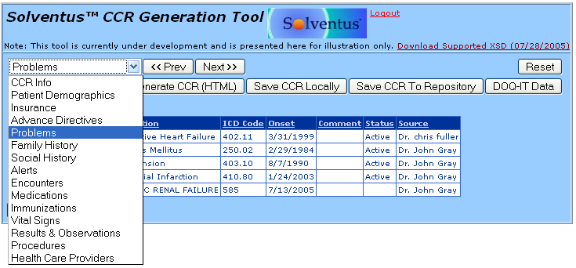
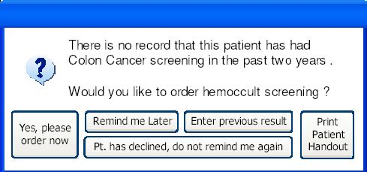
What is a DSS System?
EMR/CIS/HIS (description of patient) + New Symptoms
Decision Support
⇒

Slide 3
What’s the Problem?
Physicians are overwhelmed.
  Insufficient time available for diagnosis and treatment.
  Insufficient time available to stay abreast of latest developments.
    Rate of published study results/medical evidence increasing.
    Typically 17 year lag from discovery to improved patient care.
    Inconsistent application of knowledge leads to poor care.
Some in the third world will never see a physician regardless of their need.

Slide 4
What’s the Problem?
Error rates in the U.S. are high.
  44,000 to 98,000 deaths due to medical error each year.
  2.4 million prescription errors in one year in Massachusetts alone.
  $17 Billion spent on preventable errors per year.
Costs for medical care are increasing rapidly.
  Can we find ways to improve cost versus care?

Slide 5
Existing Medical DSS Systems
70 known proprietary DSS Systems.
  Only 10 of 70 geared towards General Practice.
  All require advanced technical knowledge.
  None allow source access to modify interface to Clinical. Information Systems (CIS).
  Only one is correctable/updateable by end user.
  Developed with little consideration of end users “..thus far the systems have failed to gain wide acceptance by physicians.”
Proprietary attempts to help physicians have failed.
  Cost to generate useful database outside reach of one company.

Slide 6
Proposed Solution
Clinical Decision Support System (DSS).
  More physician quality time with patients for diagnosis and treatment.
  Instant recommendations from an “expert”
  Improved care and accuracy of diagnoses.
    Reduce liability insurance premiums.
    Reduce the number of office visits to resolve conditions.
    Reduce the number of treatments attempted to resolve conditions.
  Partial solution to healthcare in third world countries that may never see a real physician.

Slide 7
Proposed Solution
Clinical Decision Support System (DSS).
  Allows verification of data not easily available for proprietary solutions.
  Allows updates in a timely and peer reviewable (e.g. Guideline International Network or NGC) manner.
  Integration is possible with EMR/CIS/HIS for record keeping and more detailed diagnoses based on regional statistics and past history.
  Reduction in the overall cost per man-hour.

Slide 8
Features of DSS
Describe Condition of Patient using Standards
  Use ASTM committee E31.28 Continuity of Care Record (CCR) Standard or HL7 Clinical Doc Arch.
  Standards approach eases interface with other systems, including proprietary systems.

Slide 9
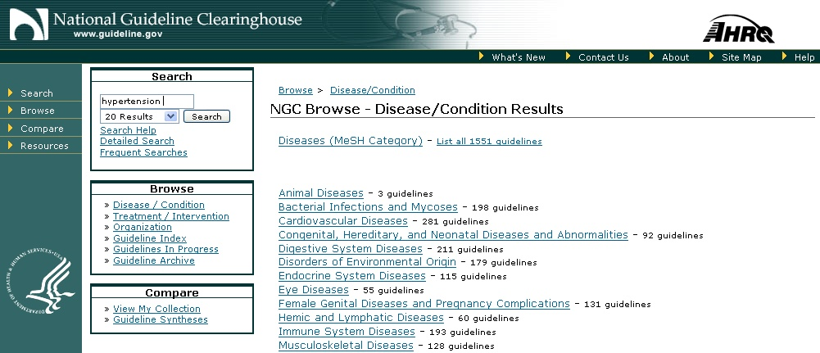
Features of DSS
Describe Clinical Guidelines and Diseases using Standards
  Several standards being considered for harmonization.
    GLIF3 has a lot of support.
  Standards approach eases interface with other systems, including proprietary systems.

Slide 10
Features of DSS
Simplified Graphical User Interface.
  Do for medical decision support systems what web browsers did for the internet, what GUI did for PC’s and PDA’s.
  Usable by anyone, including physicians, nurses and patients.
  Base on open-source info (e.g. visible human project.)

Slide 11
Issues
Privacy concerns/laws.
  No code shared with EMR/CIS/HIS.
  Patient identity not shared with DSS system.
Tremendous amount of data and rules must be incorporated into system.
  National Health Information Technology Coordinator created in 2004 to encourage/fund electronic health initiatives.
Resistance/job fears of clinicians
  Goal is to assist clinicians, not replace them.

Slide 12
Issues
Clinical Trial Hurdles.
  Make recommendations, not diagnoses.
  Disclaimers regarding use.
All past efforts have failed to achieve common usage.
  Include end users (physicians, nurses, schedulers, IT departments) in the design decisions and testing.
  Iterative design approach (i.e. modify based on feedback.)

Slide 13
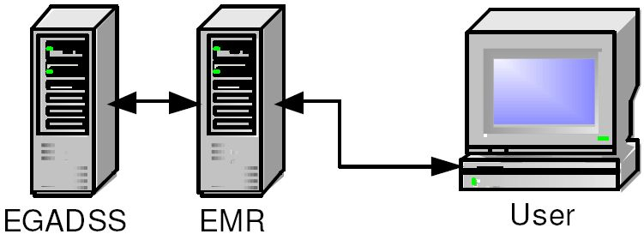


Existing Open Source Example
EGADSS system:
Interfaces with EMR/CIS only.
  - No direct symptom inputs.
Institutional support and funding.
Recommended Modifications:
Add GUI for patient/physician direct access.
Support development of Computer Interpretable Clinical Guidelines (CIG).

Slide 14
Where do we go from here?
Promote open source Computer Interpretable clinical Guideline (CIG) knowledge base development at the federal level with continuing maintenance from AHRQ.
  All 70+ proprietary efforts to develop knowledge bases have failed.
  AHRQ already maintains written clinical guidelines
  AHRQ represents the U.S. for international vetting of clinical guidelines.
  Funding opportunity in upcoming HIT legislation
Form IEEE study group on clinical interfaces and systems.
  Review past analyses of clinical interfaces.
  Work with doctors, nurses, hospitals, HMO’s, etc. to obtain input and feedback.
  Perform human factors studies, if warranted.
  Develop needs statement or software specification for clinical interfaces.

Slide 15
Sources
EGADSS: http://www.egadss.org: Slides 2, 3, 4, 13
Whyatt and Spiegelhalter (http://www.computer.privateweb.at/judith/index.html): Slides 5
OpenClinical (http://www.openclinical.org/home.html): Slides 7
Solventus (http://www.solventus.com/aquifer): Slides 2, 8
Conversations with Dan Smith at ASTM: Slide 8
Agency for Healthcare, Research and Quality/AHRQ (http://www.ahrq.gov/ and http://www.guideline.gov): slide 9, 11
WebMD (http://my.webmd.com/medical_information/check_symptoms): Slide 2, 10

