Slide 1
Test Driven Development Demo
Using COMUnit to drive development of Visual Basic macros in a spreadsheet

Slide 2
Framework
(a.k.a. Test Harness)
All TDD test frameworks (xUnit) include a simple tool to run the tests and report the errors.
The framework typically allows individual tests to be run, or groups of tests to be run.
The framework typically shows details about failures.
The framework typically shows a green/red status bar. (red=test failures)

Slide 3
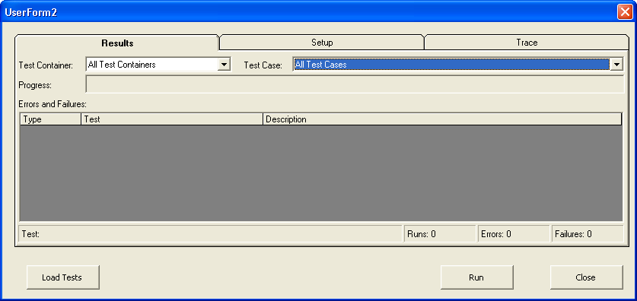
The test execution User Interface

Slide 4
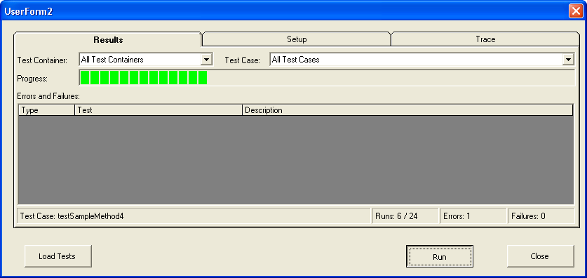
Elements of the test execution
User Interface

Slide 5
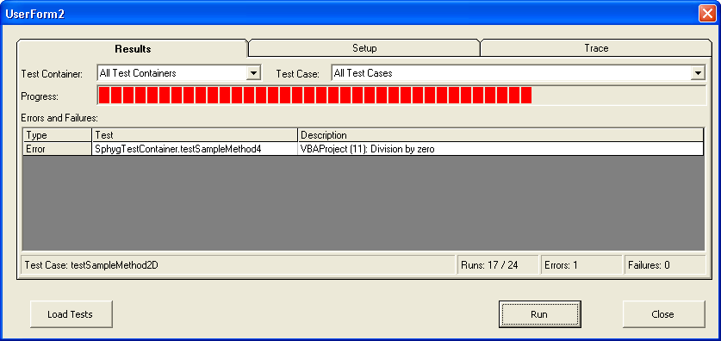
Elements of the test execution
User Interface

Slide 6
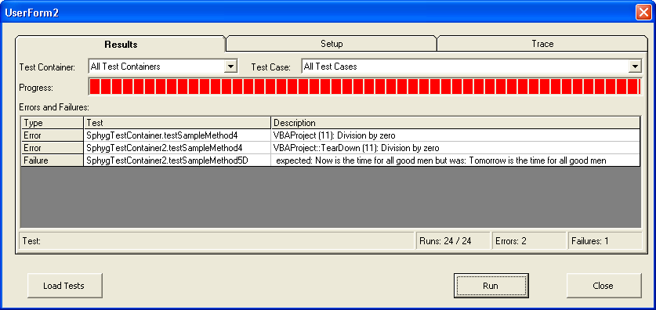
Elements of the test execution
User Interface

Slide 7
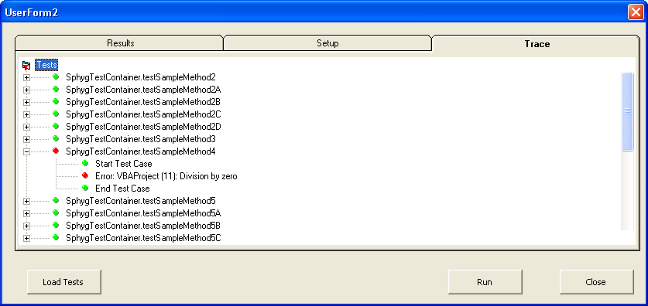
Elements of the test execution
User Interface

Slide 8

The function to be tested
Demo testing part of a standard deviation function in the original spreadsheet code
The calculation is done in two steps, according to a standard deviation formula often used in programs that keep “running sums” as they traverse over data:
  Add up the samples and the sum of samples
  “Finish” the calculation according to this formula:

Slide 9
Getting started
Load the spreadsheet that contains the test functions provided by COMUnit.
Remember the TDD cycle:
  Write a test
  Add the test name to the list of tests to run
  Compile (fails on missing function)
  Write stub for the function to be tested
  Run tests, test fails
  Implement function to be tested
  Run tests again, test passes

Slide 10
The first Test function
Public Sub testFinishStdDevWith3DataPoints(oTestResult As TestResult)
Dim result As Double
' the data points are 7,8,9
result = FinishStdDev(3, 7 + 8 + 9, 49 + 64 + 81)
oTestResult.AssertEqualsDouble 1, result, 0.1
End Sub

Slide 11
Adding test name to list of tests
Public Property Get ITestContainer_TestCaseNames() As Variant()
' TODO: add the names of your test methods as a parameter into the Array() function
ITestContainer_TestCaseNames = Array( _
"testFinishStdDevWith3DataPoints" _
)
End Property

Slide 12
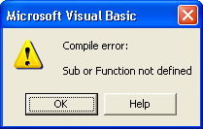
“Compile” fails

Slide 13
Write stub function
    Doesn’t actually compute the return value yet
Function FinishStdDev(N, sumOfSamples, sumOfSquares)
FinishStdDev = 0
End Function

Slide 14
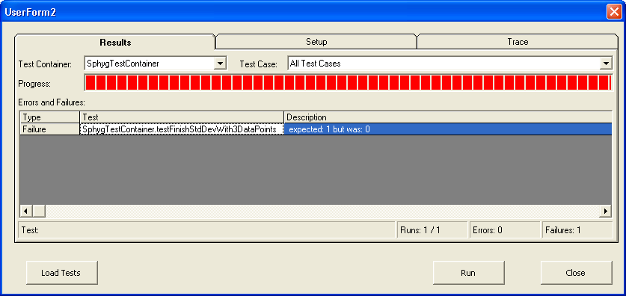
Run tests, test fails

Slide 15
Implement function to be tested
    Here’s the function from the original Sphygmochron spreadsheet. I’m leaving a few lines commented out because we don’t need them yet. (I’m “implementing” the smallest possible bit of the code to make the test pass.)
Function FinishStdDev(N, sumOfSamples, sumOfSquares)
temp = ((N * sumOfSquares) - (sumOfSamples ^ 2)) / (N * (N - 1))
'If temp < 0 Then
' temp = temp * -1
'End If
FinishStdDev = Sqr(temp)
End Function

Slide 16
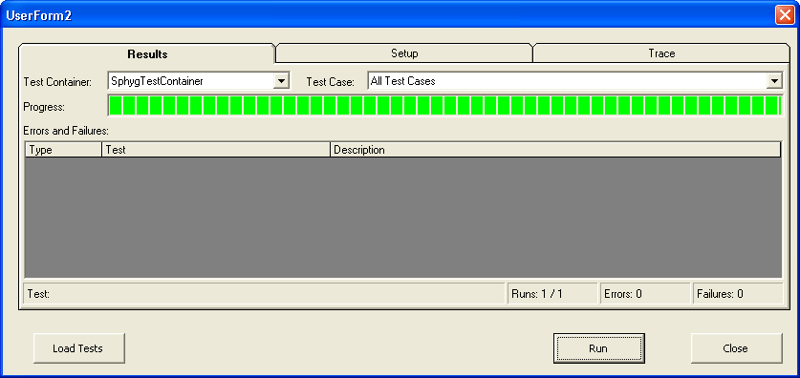
Run tests, test now passes

Slide 17
Write another test
Public Sub testFinishStdDevWith1DataPoint(oTestResult As TestResult)
Dim result as Double
' the data point is 7
result = FinishStdDev(1, 7, 49)
oTestResult.AssertEqualsDouble 0, result, 0.0
End Sub

Slide 18
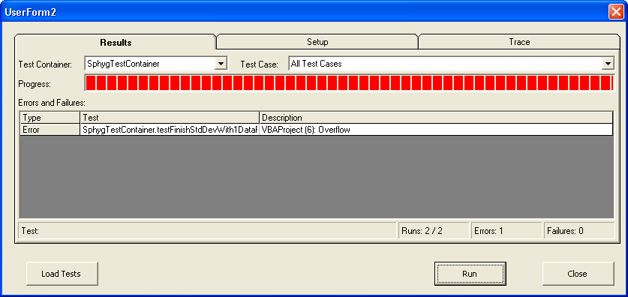
Run new test, it fails

Slide 19
Write code that makes the test run
Function FinishStdDev(N, sumOfSamples, sumOfSquares)
If (N = 1) Then
FinishStdDev = 0
Else
temp = ((N * sumOfSquares) - (sumOfSamples ^ 2)) / (N * (N - 1))
'If temp < 0 Then
' temp = temp * -1
'End If
FinishStdDev = Sqr(temp)
End If
End Function

Slide 20
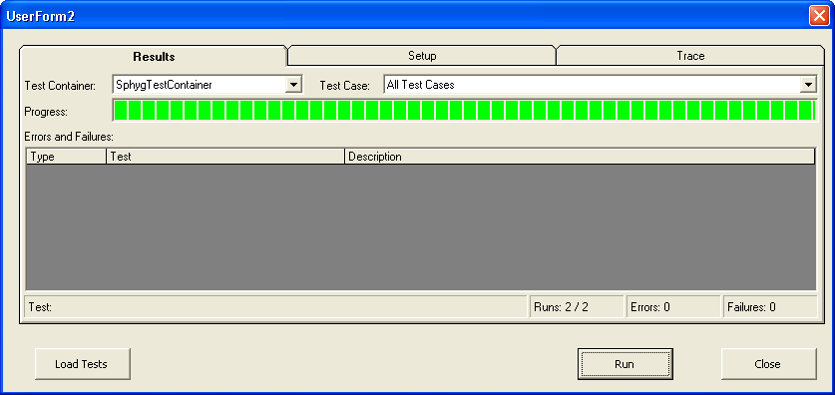
Run (all) tests, new test passes

Slide 21
Example error checking test
Public Sub testFinishStdDevWithBadInputNegativeIntermediateResult(oTestResult As TestResult)
Dim result As Double
On Error GoTo ErrorCheck
' the data points are 1,2,3, the sum of the squares should have been 14, not 5
result = FinishStdDev(3, 6, 5)
oTestResult.AddFailure ("Expected 'invalid input' error, but didn't get it")
Exit Sub
ErrorCheck:
oTestResult.AssertEqualsError Err, 50000
oTestResult.AssertEqualsString "FinishStdDev", Err.Source
oTestResult.AssertEqualsString "Invalid Input", Err.Description
End Sub

Slide 22
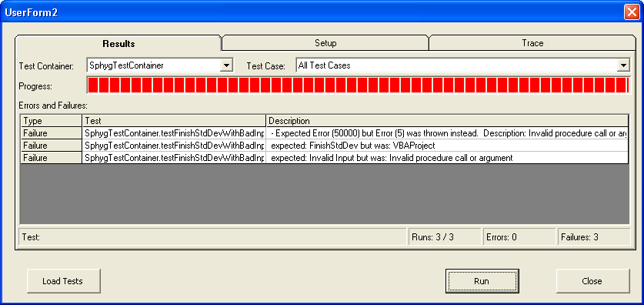
Run tests, error checking test fails

Slide 23
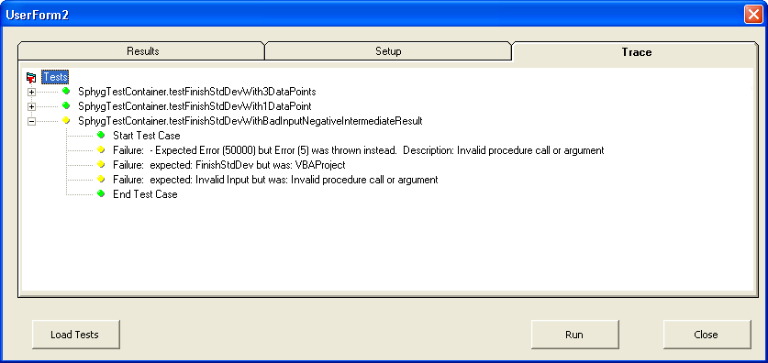
All failures were in the new test

Slide 24
Adding error checking
The original code in the Sphygmochron had that “If Temp < 0” code to prevent the square-root operation from aborting on negative numbers
However, a negative number could never occur there, and it prevented the original programmer from detecting bad input such as in our current test
  We have found two errors (or at least weaknesses) in the original code

Slide 25
Write error checking code
Function FinishStdDev(N, sumOfSamples, sumOfSquares)
If (N = 1) Then
FinishStdDev = 0
Else
temp = ((N * sumOfSquares) - (sumOfSamples ^ 2)) / (N * (N - 1))
'If temp < 0 Then
' temp = temp * -1
'End If
If (temp < 0) Then
Err.Raise 50000, "FinishStdDev", "Invalid Input"
End If
FinishStdDev = Sqr(temp)
End If
End Function

Slide 26

Run tests, error checking test passes

Slide 27
Write a new test
    This test should have worked, but I screwed it up. It was “too hard” to write. The first argument, the number of data points, should have been 5.
Public Sub testFinishStdDevWith5DataPoints(oTestResult As TestResult)
Dim result As Double
' the data points are 2, 4, 6, 8, 10
result = FinishStdDev(3, 30, 2 * 2 + 4 * 4 + 6 * 6 + 8 * 8 + 10 * 10)
oTestResult.AssertEqualsDouble 3.16227, result, 0.0001
End Sub

Slide 28
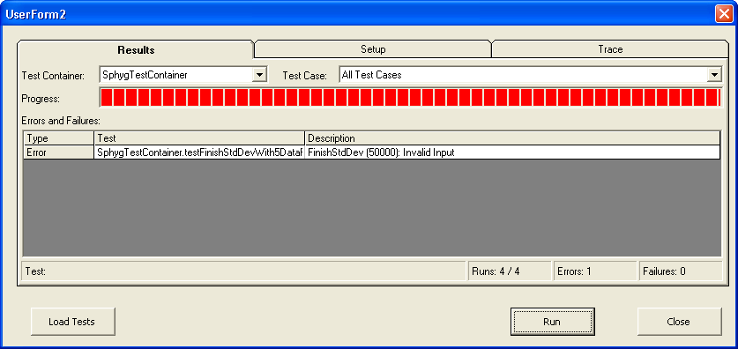
Run tests, newest test fails

Slide 29
Fix the new test
    This test should have worked, but I screwed it up. It was “too hard” to write. The first argument, the number of data points, should have been 5.
Public Sub testFinishStdDevWith5DataPoints(oTestResult As TestResult)
Dim result As Double
' the data points are 2, 4, 6, 8, 10
result = FinishStdDev(5, 30, 2 * 2 + 4 * 4 + 6 * 6 + 8 * 8 + 10 * 10)
oTestResult.AssertEqualsDouble 3.16227, result, 0.0001
End Sub

Slide 30

Run tests, now it passes

Slide 31
Refactor to simplify tests
    Now that all the tests are running, it’s OK to refactor a little bit to make it easier to write and maintain the tests
    I write a utility function to help prepare the arguments to the function being tested
Function utilCallFinishStdDev(inputdata As Variant)
Dim N, sumOfSamples, sumOfSquares
Dim i
N = UBound(inputdata) + 1
sumOfSamples = 0
sumOfSquares = 0
For i = 0 To UBound(inputdata)
sumOfSamples = sumOfSamples + inputdata(i)
sumOfSquares = sumOfSquares + inputdata(i) * inputdata(i)
Next i
utilCallFinishStdDev = FinishStdDev(N, sumOfSamples, sumOfSquares)
End Function

Slide 32
Refactor to simplify tests
    I use the utility function in all the tests possible
    I no longer need the comment telling me what the data points are, to count the points, nor compute either of the sums
    This test is simpler and much easier to get right
Public Sub testFinishStdDevWith5DataPoints(oTestResult As TestResult)
Dim result As Double
' the data points are 2, 4, 6, 8, 10
result = FinishStdDev(5, 30, 2 * 2 + 4 * 4 + 6 * 6 + 8 * 8 + 10 * 10)
result = utilCallFinishStdDev(Array(2, 4, 6, 8, 10))
oTestResult.AssertEqualsDouble 3.16227, result, 0.0001
End Sub

Slide 33
Run tests, it still passes

Slide 34
Another simplification
    Move the “assertion” down into the utility function
Sub utilCallFinishStdDev(inputdata As Variant, expectedResult As Double, oTestResult As TestResult)
Dim N, sumOfSamples, sumOfSquares
Dim i
Dim result As Double
N = UBound(inputdata) + 1
sumOfSamples = 0
sumOfSquares = 0
For i = 0 To UBound(inputdata)
sumOfSamples = sumOfSamples + inputdata(i)
sumOfSquares = sumOfSquares + inputdata(i) * inputdata(i)
Next i
result = FinishStdDev(N, sumOfSamples, sumOfSquares)
oTestResult.AssertEqualsDouble expectedResult, result, 0.0001
End Sub

Slide 35
Another simplification
    The test itself gets very simple. In fact, all of the “positive” tests for the FinishStdDev function become one line long.
Public Sub testFinishStdDevWith5DataPoints(oTestResult As TestResult)
Dim result As Double
result = utilCallFinishStdDev(Array(2, 4, 6, 8, 10))
oTestResult.AssertEqualsDouble 3.16227, result, 0.0001
End Sub
Public Sub testFinishStdDevWith5DataPoints(oTestResult As TestResult)
utilCallFinishStdDev Array(2, 4, 6, 8, 10), 3.16227, oTestResult
End Sub

Slide 36
Run tests, it still passes

Slide 37
Wrap-up
I took 4 lines of code from the original Sphygmochron code and made it a testable function
I found a divide-by-zero error, an apparently unnecessary and poorly-coded “absolute value” function, and a missed opportunity for detecting bad input data, all in what we thought were 4 correct lines of code
Refactoring tests gave me a very easy (1-line) mechanism to use to write future tests for this function
If any future programmer changes the function, my tests prevent from breaking functionality that I know is important today
TDD enabled me to do this by encouraging thinking about valuable test cases before implementing the parts of the function

