Slide 1
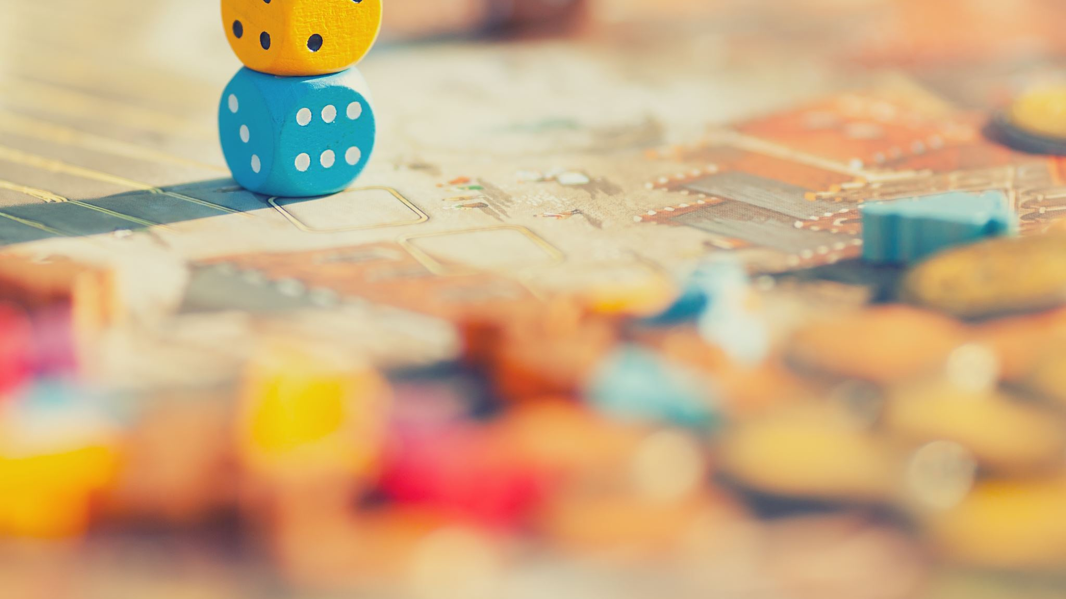
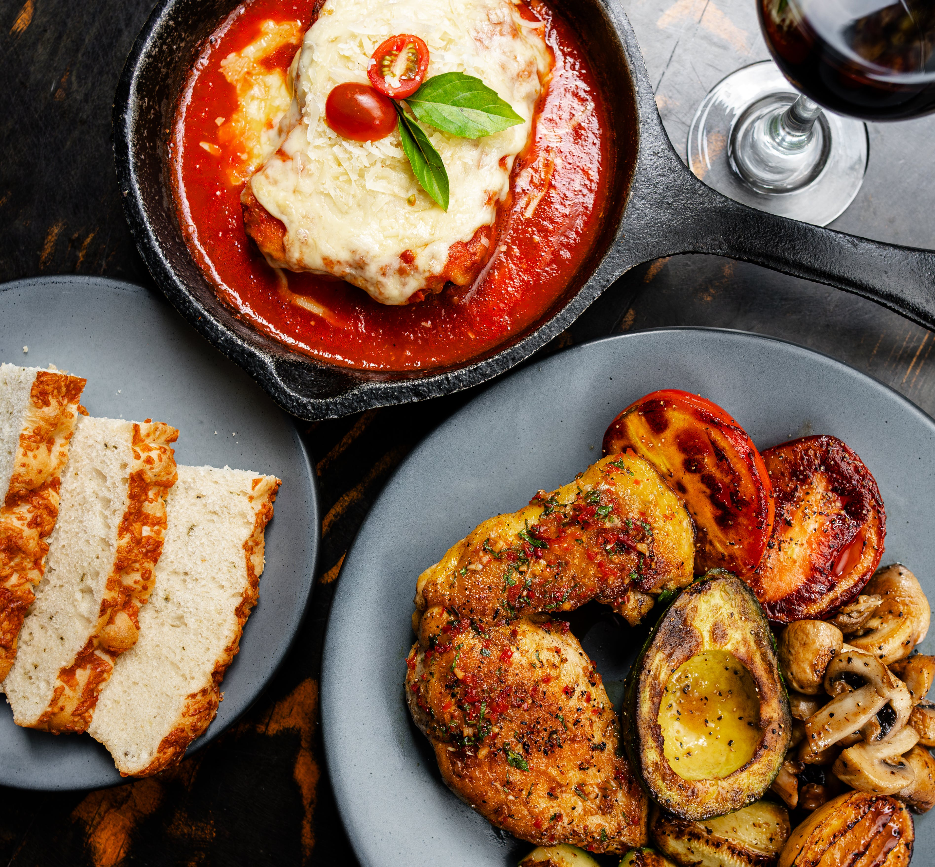
Commercial Games Design EA board game presentation
Game genre: Card game
SHAPE ID:237031820

Slide 2
Key topics
Marketing targets
Where am I plan on using my product
Mailing overseas measures(High diploma game design)
Materials of choice and reasons
Extra possible gamemode(s)
Appearance improvement
Overseas customers needs investigation

Slide 3
Name of Game
Ingredient Match

Slide 4
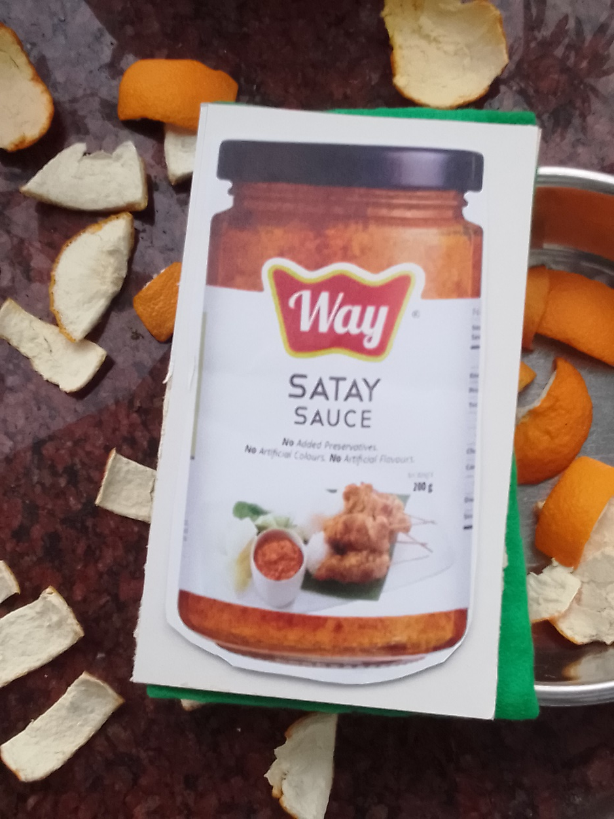
Gameplay Preview
The host pick randomly a name of a dish, participants has to guess what might be used to make it.

Slide 5
Overall Gameplay
This cardset consists 30 cards, they should be all printed only with images to maximize the recognition as it was meant to be publicize to the globe

Slide 6
Marketing targets
I am planning promote my products to all resident or overseas hongkong customers. To those has moved outside of china district, It might be hard to let themselves exposed to Chinese cuisines.

Slide 7
The beginning of the idea
I am planning promote my products to all resident or overseas hongkong customers. To those has moved outside of china district, It might be hard to let themselves exposed to Chinese cuisines.

Slide 8

Current targets of promotion
I once joined a society workers committee, many members there have similar situation and needs, If I can get it finalize I will let them try it, They too has to obtain a skill or two to gain advantage

Slide 9
Promotion measures in foreign land
I intent to let this card set used by those who frequently use kitchens. Consider they want to make things clean, I need to find a better material for these cards. Because they would like a tool being durable as it will be easier to handle.

Slide 10
Promotion measures in foreign land
I am currently organizing a kickstarter campaign. Since exchange rate between HK and UK is 1:10, I think it’s advisable to reduce the investment of time and resources, so that the price would be more friendly.

Slide 11
All involved materials
I wanted to choose the orange cloth as the back. But it might a little too rough. So I choose green cloth which is smoother.

Slide 12
Ideal Form of products
I would like my card can be made with better paper, which posses better experience

Slide 13
Extra possible gamemodes
This game can be played reversibly, the host can assemble a series of cards, participants can create a possible dish.
Doing so can garner their awareness of compatibility between foods.

Slide 14
Test Play Session
TEST PLAY SESSION

