Slide 1
Blockchain Application for Electronic Voting
Javier Mantilla
Supervised by Daniel Cregg
Dr. John French
Dr. Brian McGinley

Slide 2
Overview
Project Overview
System Design/Technologies
System Design/Architecture
System Evaluation
Conclusions

Slide 3
Project Overview
Context
Blockchain has gained a lot of attention thanks to Bitcoin.
There has been research on blockchain applications beyond crytpocurrencies.
Traditional voting systems are susceptible to corruption.
Objectives/Goals
Learn about blockchain technology.
Achieve the process of compiling, deploying and interacting with smart contracts.
To evaluate the application of blockchain as service to implement a distributed electronic voting system.

Slide 4







System Design
Technologies

Slide 5
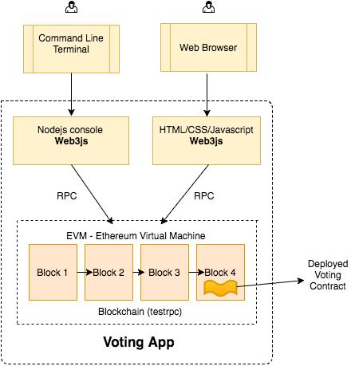





System Design
Architecture

Slide 6
System Evaluation
Lack of an acceptable transaction rate of Ethereum.
Private Ethereum blockchain is very susceptible to desynchronise.
Miners node need large resources (CPU, RAM, H.D.D).
Setting a private network in AWS with a NAT-gateway node is not trivial.
Hard to debug, the miner must be on and the blockchain synchronized

Slide 7
Conclusions
Use of blockchain for political elections are still regarded with distrust by end users and security experts.
Baby steps approach: first implementations on small and/or private elections.
A new market for smart contract auditing.
Have achieved the originals goals, except one:
Create a custom blockchain for voting in C++.
Why re-invent the wheel?
Over ambitious goal.

