Slide 1

Leap Control for Google Maps
JAVIER MANTILLA
G00329649

Slide 2
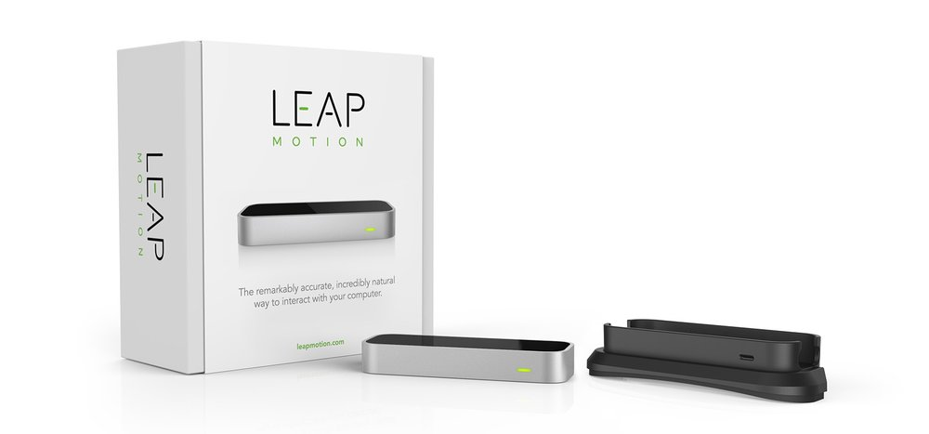
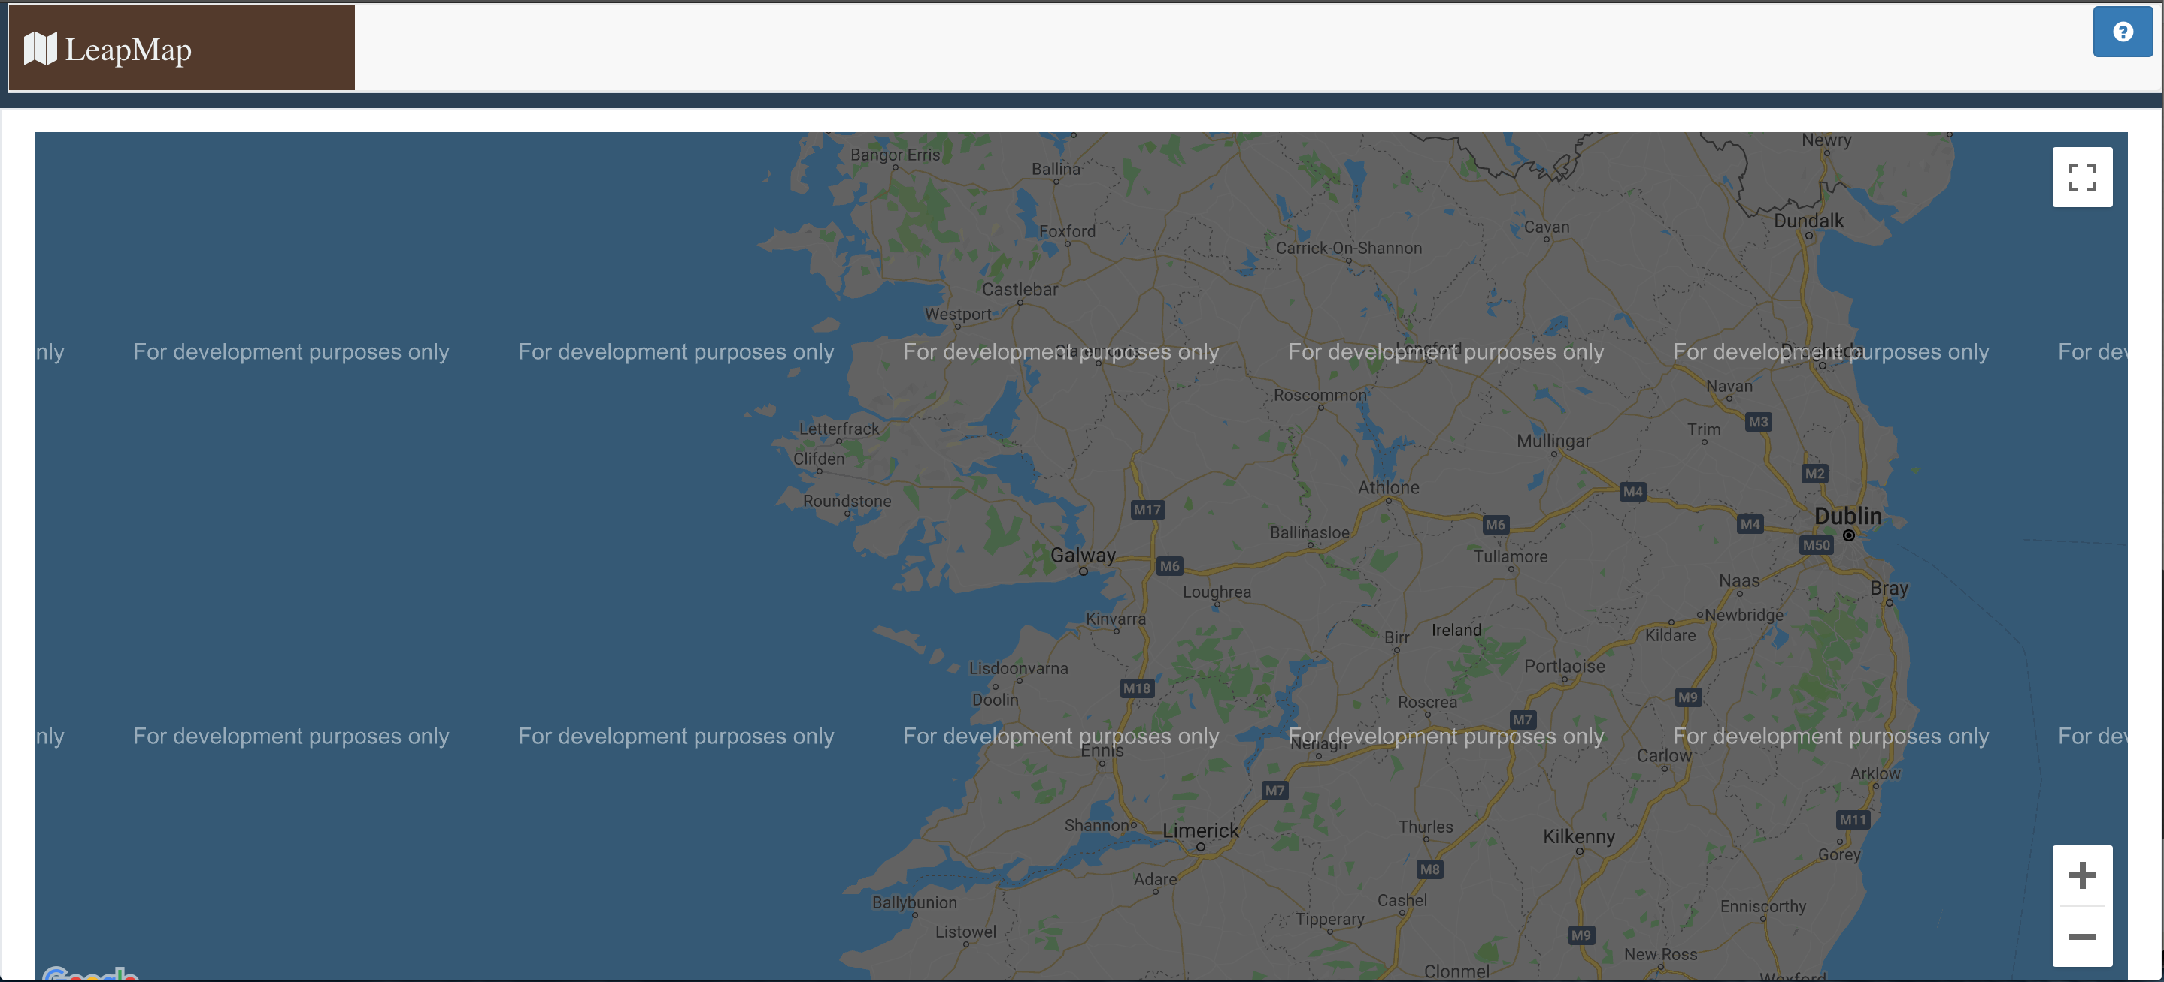

THE PROJECT
LeapMap

Slide 3
LeapMap

Slide 4
The Application
The project allows a user to navigate Google Maps with only hand motions inside a web browser.

Slide 5




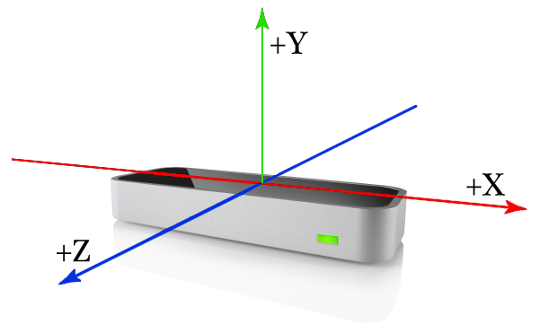
The Application
APIs
ARCHITECTURE / TECHNOLOGIES
LeapJS Motion API
Google Maps API
Front end
Test/Debugging

Slide 6




Functionality
Gestures
Move the pointer on the map
Closing hand into a fist and moving it allows panning the map
Index tap: zoom in
Middle finger tap: zoom out

Slide 7
Difficulties
Not very accurate with complex gestures like swipe and circle. Also true for screenTap.
Where is the interaction box? Hands too close, too far.
Frame object break down. Big object.
High load on CPU.
Google Maps license key$.

Slide 8


Future Development
Link Google Maps markers to screenTap gesture.
Click on existing markers.

Slide 9
THANKS
THE END

