Slide 1
STOCK EXCHANGE MATCHING ENGINE
Javier Mantilla
G00329649

Slide 2
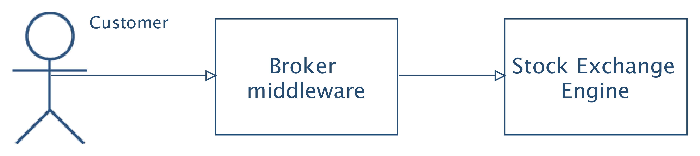
USAGE

Slide 3
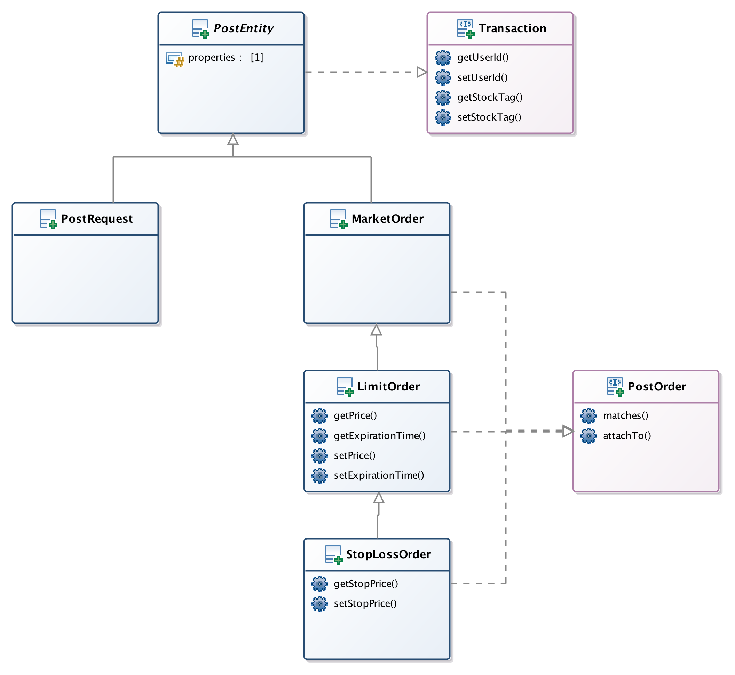
CLASS DIAGRAM

Slide 4
ARCHITECTURE
Third Party Applications
Spring REST API
Order Book Service
DB
Order Events Store/Queue

Slide 5
LEARNING OUTCOMES
Acquired knowledge about stock exchanges
Equity’s price settlement
Rules of the stock exchange
Challenging project
No stock exchange API
Requirement gathering
Data structures (thread safe)
Maps
Queues
OO concepts (Inheritance, Polymorphism & Encapsulation)
Unit tests (very useful!)

