Slide 1
Discrete-Time Event Simulation

Slide 2
Discrete-Time Event Simulation
Imitation of a real system as a sequence of events
State
Collection of variable that describe the system at a point in time
Events
Actions that trigger change in state
Clock
Variable that tells the current simulation time

Slide 3












Events and States
Arrival
Arrival
Arrival
Departure
Departure
Arrival
$$E_{1}$$
$$E_{2}$$
$$E_{3}$$
$$E_{4}$$
$$E_{5}$$
$$E_{6}$$
clock =
0
2
5
6
8
11
14
state
3
(# of customers in the system)
2
2
2
1
1
0
$$E_{1}$$
$$E_{2}$$
$$E_{3}$$
$$E_{4}$$
$$E_{5}$$
$$E_{6}$$
clock =
0
2
5
6
8
11
14
Clock hops between events

Slide 4






Events and States
Event Queue
Data structure that holds future events that will occur
Linked List
sorted in time of events
P₁
P₂
P₃
P₁
P₂
P₄
Arrival
Arrival
Arrival
Departure
Departure
Arrival
$$E_{1}$$
$$E_{2}$$
$$E_{3}$$
$$E_{4}$$
$$E_{5}$$
$$E_{6}$$
clock =
0
2
5
6
8
11
14
Ready Queue
P₃
P₂
P₁
P₃
Server
P₂
P₁
P₃
P₂
STATE
P₁
P₄
P₃

Slide 5
Simulation
Initialization
state
time/clock
end condition
initial events
Run simulation
Output report

Slide 6
Simulation
Initialization
Run simulation
Output report
Get time elapsed since last event
while ( ! end_cond ) {
set clock to next event;
switch (event_type) {
case type_1:
type_1_handler(); break;
case type_2:
type_2_handler(); break;
……
}
delete this event that has been handled;
}
old_clock = clock;
time_elapsed = clock – old_clock;
What to do when this kind of event happens

Slide 7
Simulation
Initialization
Run simulation
Output report
May be part of the initialization function or the event handlers functions
Print to terminal v.s. Write to a file

Slide 8
A Simple Example
A single sequence of arrivals, FCFS (FIFO)
Events
ARR
DEP
Can be int, e.g., #define ARR 0
State
bool serverIdle
int readyQueueCount
struct event { int type; float time; event* nextEvent; }
In our simulation, we often use seconds, milliseconds, etc. instead of CPU clock ticks as the unit of time

Slide 9

A Simple Example
eq_head
ARR
t
Init () {
clock = 0;
serverIdle = true;
readyQueueCount = 0;
event* eq_head = NULL; // event queue head
t = …… ;
sched_event (ARR, t, eq_head);
}
We can get t by the current clock + an interarrival time X, and we assume X is a random variable following an Exponential Distribution, given the average arrival rate $λ$ or the average interarrival time $\frac{1}{λ}$.
schedule_event (ARR, t, eq_head) {
event* e = new event (ARR, t);
insert e to the linked list headed at eq_head while keep the linked list still sorted w.r.t. time. (similar to insertion sort)
}

Slide 10
A Simple Example
arr_handler(e) {
if serverIdle == true {
serverIdle = false;
sched_event(DEP,clock+s,…);
}
else
readyQueueCount++;
sched_event(ARR,clock+a,…);
}
Service time s is a random variable following Exponential Distribution.
We know how to randomly generate it, given the average service time.
Run () {
while ( ! end_cond ) {
event* e = get_next_event();
clock = e->time;
switch (e->type) {
case ARR:
arr_handler(e); break;
case DEP:
dep_handler(e); break;
}
delete e from the event queue;
}
}
Interarrival time a is a random variable following Exponential Distribution.
We know how to randomly generate it, given the average interarrival time.
dep_handler(e) {
if readyQueueCount == 0
serverIdle = true;
else {
readyQueueCount--;
sched_event(DEP,clock+s,…);
}
}

Slide 11
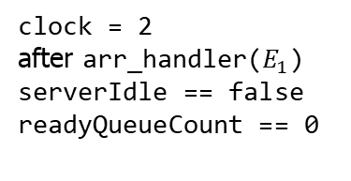
Event Queue
Arrival
Arrival
Arrival
Departure
Departure
Arrival
$$E_{1}$$
$$E_{2}$$
$$E_{3}$$
$$E_{4}$$
$$E_{5}$$
$$E_{6}$$
clock =
0
2
5
6
8
11
14
eq_head
clock = 0
after Init()
serverIdle == true
readyQueueCount == 0
ARR
2
eq_head
ARR
5
DEP
8
clock = 2
after arr_handler($E_{1}$)
serverIdle == false
readyQueueCount == 0

Slide 12
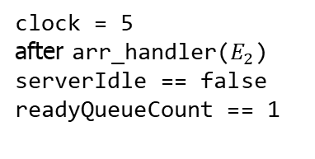
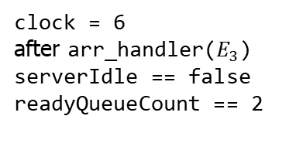
Event Queue
Arrival
Arrival
Arrival
Departure
Departure
Arrival
$$E_{1}$$
$$E_{2}$$
$$E_{3}$$
$$E_{4}$$
$$E_{5}$$
$$E_{6}$$
clock =
0
2
5
6
8
11
14
eq_head
clock = 5
after arr_handler($E_{2}$)
serverIdle == false
readyQueueCount == 1
ARR
6
DEP
8
eq_head
clock = 6
after arr_handler($E_{3}$)
serverIdle == false
readyQueueCount == 2
DEP
8
ARR
14

Slide 13
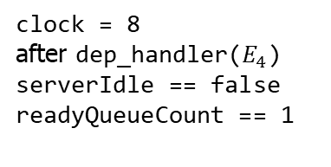
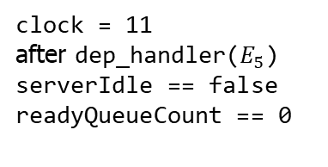
Event Queue
Arrival
Arrival
Arrival
Departure
Departure
Arrival
$$E_{1}$$
$$E_{2}$$
$$E_{3}$$
$$E_{4}$$
$$E_{5}$$
$$E_{6}$$
clock =
0
2
5
6
8
11
14
eq_head
clock = 8
after dep_handler($E_{4}$)
serverIdle == false
readyQueueCount == 1
DEP
11
ARR
14
eq_head
some t
that
t<14
DEP
ARR
14
clock = 11
after dep_handler($E_{5}$)
serverIdle == false
readyQueueCount == 0
Or
eq_head
some t
that
t>14
ARR
14
DEP

Slide 14
Beyond the Simple Example
Create process (customer) struct
E.g., struct process { int id; float arrivalTime; float serviceTime; float remainingServiceTime; int priority; …… }
Expand the event struct
E.g., struct event { int type; float time; event* nextEvent; process* p; …… }
Instead of bool serverIdle, using process* server pointing to the process being serviced, NULL indicates idle
Instead of int readyQueueCount, using a FIFO queue (or more general, a priority queue) of processes (pointers to processes)
Update the handler functions accordingly
Possible preemption in arrival handler
Other events and their handlers
E.g., timeout, priority change, …

