Slide 1
Transcriptional response to polyethylene glycol-coated graphene oxide-erlotinib in nasopharyngeal carcinoma cell line
Caden McQuillen
5/25/23

Slide 2
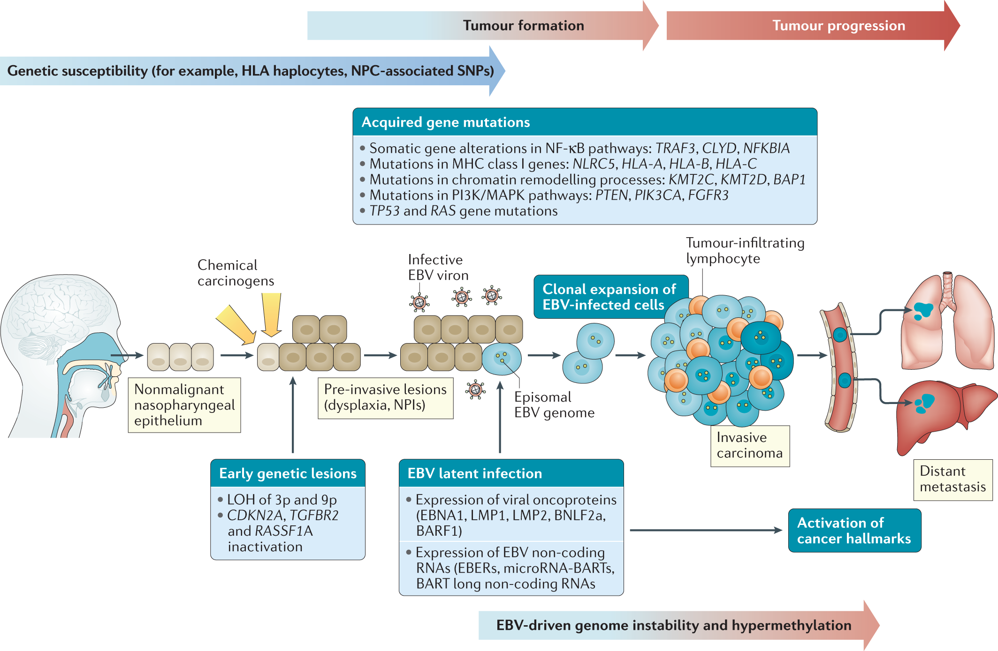
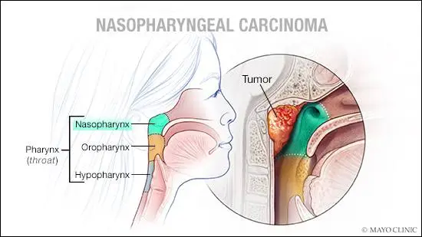
Nasopharyngeal Carcinoma (NPC)
https://newsnetwork.mayoclinic.org/discussion/living-with-cancer-nasopharyngeal-carcinoma/
Wong, K.C.W., Hui, E.P., Lo, KW. et al. Nasopharyngeal carcinoma: an evolving paradigm.Nat Rev Clin Oncol 18, 679–695 (2021).

Slide 3
Initially vague symptoms makes early detection difficult
Lump in the neck
Hearing loss
Tinnitus
Stuffy nose
Nosebleeds
Headaches
Double vision
Hoarse voice

Slide 4
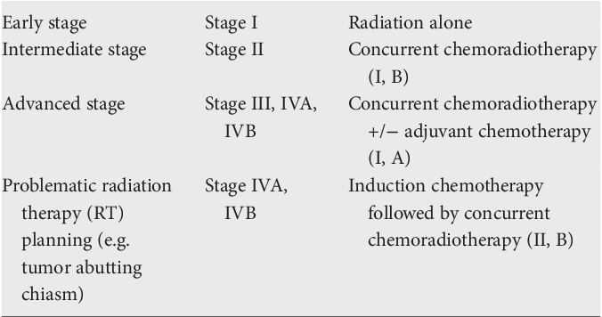
NPC highly curable in early stages
Chan AT, Grégoire V, Lefebvre JL, Licitra L, Hui EP, Leung SF, Felip E; EHNS–ESMO–ESTRO Guidelines Working Group. Nasopharyngeal cancer: EHNS-ESMO-ESTRO Clinical Practice Guidelines for diagnosis, treatment and follow-up. Ann Oncol. 2012 Oct;23 Suppl 7:vii83-5.

Slide 5
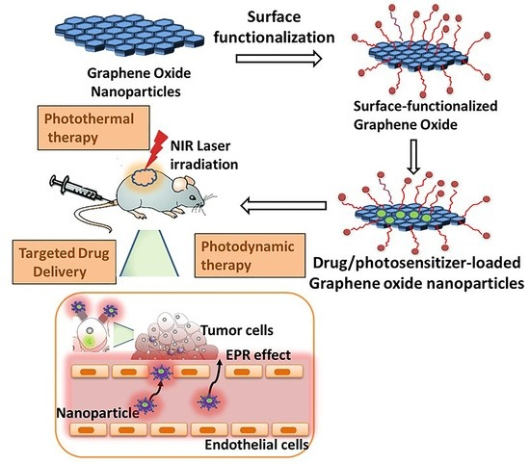
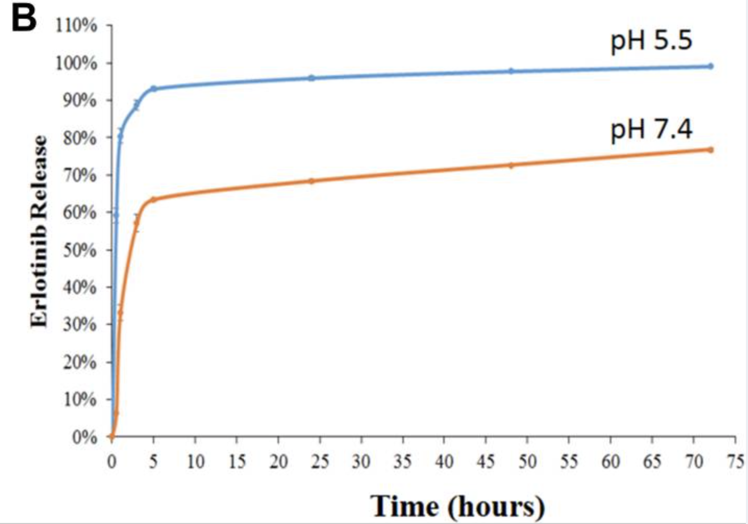
Graphene based drug delivery
Sharma, H.; Mondal, S. Functionalized Graphene Oxide for Chemotherapeutic Drug Delivery and Cancer Treatment: A Promising Material in Nanomedicine. Int. J. Mol. Sci. 2020, 21, 6280.
Lan MY, Hsu YB, Lan MC, Chen JP, Lu YJ. Polyethylene Glycol-Coated Graphene Oxide Loaded with Erlotinib as an Effective Therapeutic Agent for Treating Nasopharyngeal Cancer Cells. Int J Nanomedicine. 2020 Oct 7;15:7569-7582

Slide 6
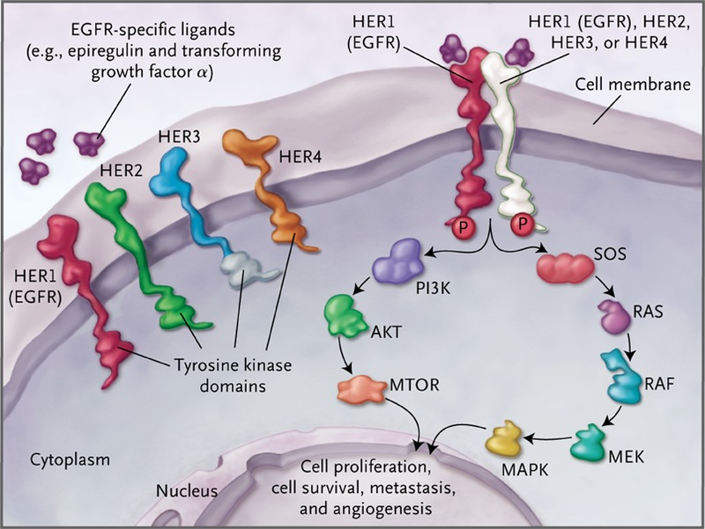
Erlotinib targets EGFR
polyethylene glycol-coated graphene oxide (GO-PEG) +
Erlotinib = (GO-PEG-Erlotinib) = (GPE)
Bulk RNA-seq on NPC cell lines +/- GPE
Cataldo VD, Gibbons DL, Pérez-Soler R, Quintás-Cardama A. Treatment of non-small-cell lung cancer with erlotinib or gefitinib. N Engl J Med. 2011 Mar 10;364(10):947-55.

Slide 7
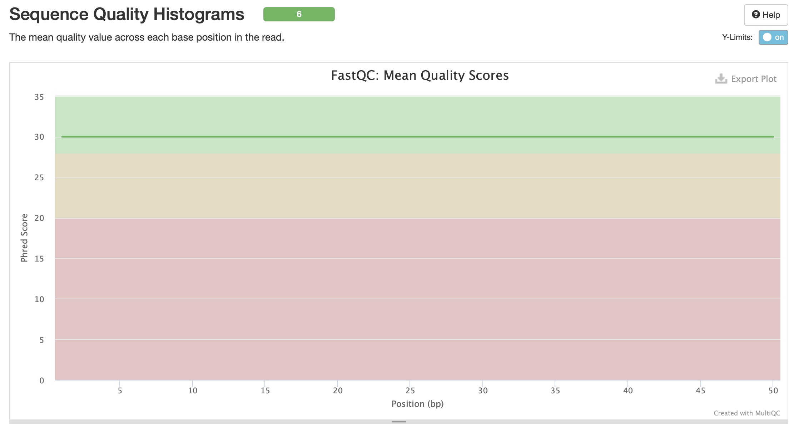
BGISEQ fastq files have identical phred scores?

Slide 8
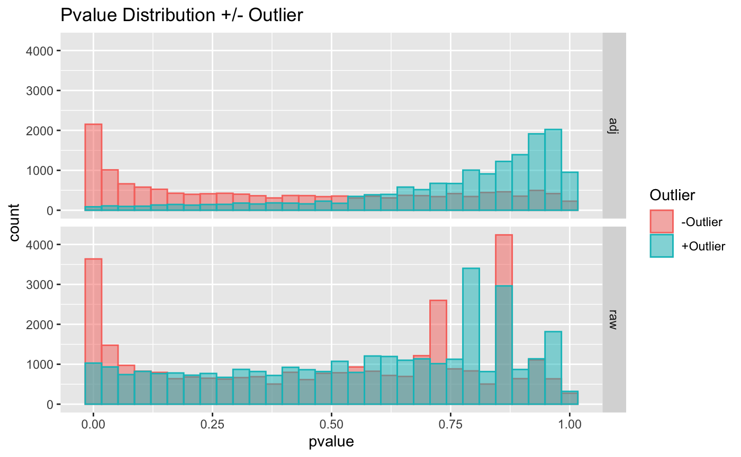
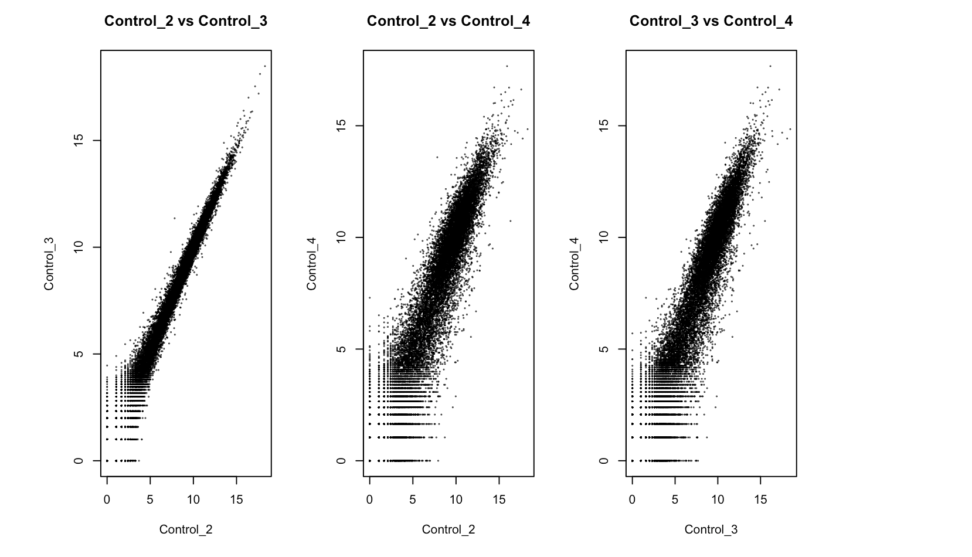
Control 4 sample is potential outlier

Slide 9
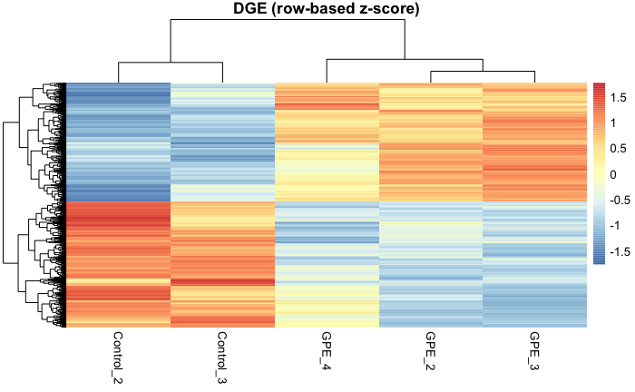
GPE drives distinct transcriptional response

Slide 10
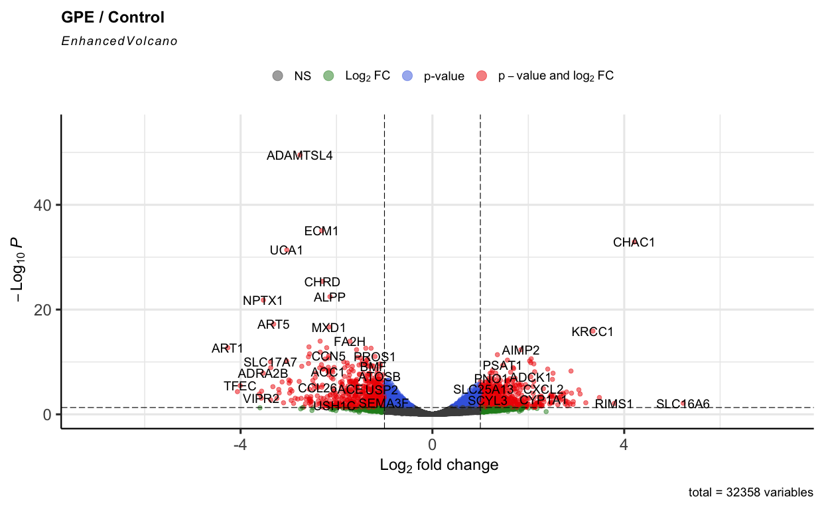
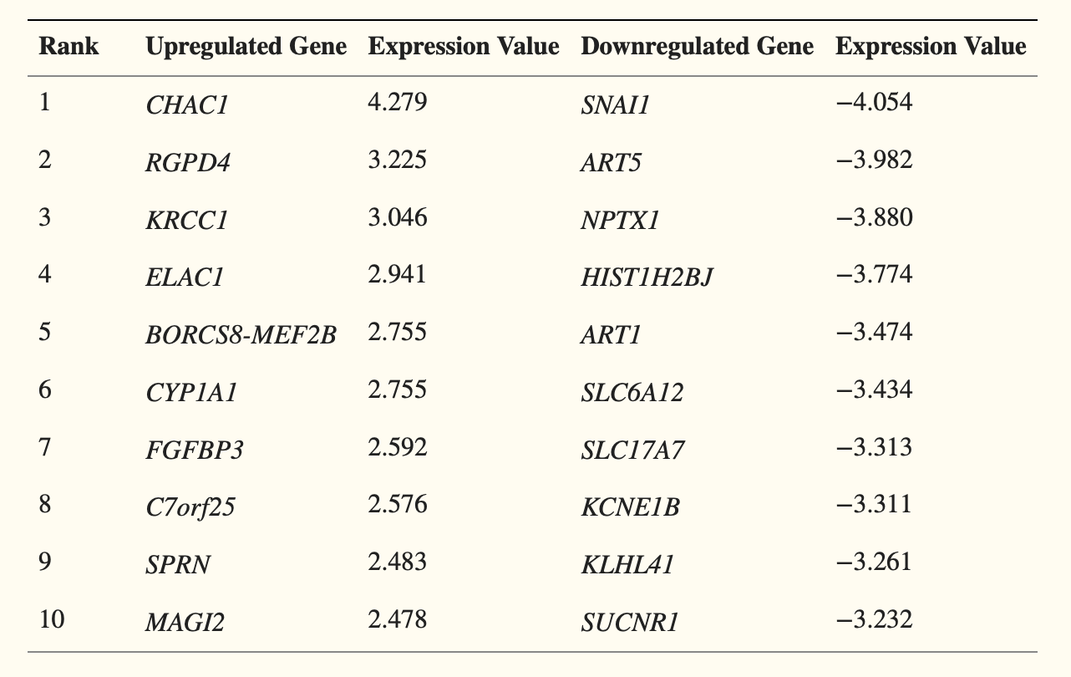
Some top DEGs are consistent
Original Study DEG total: 1455
My DEG total (w/o Control 4) : 205
My DEG total (w/ Control 4) : 62

Slide 11
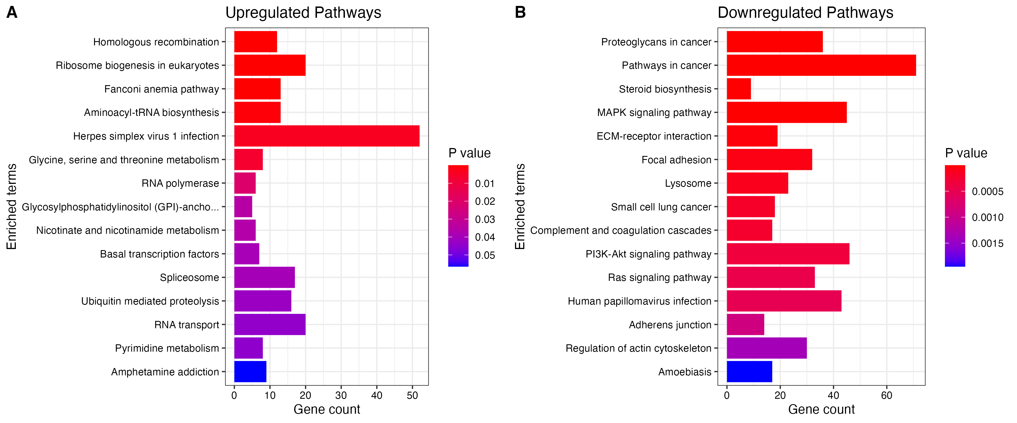
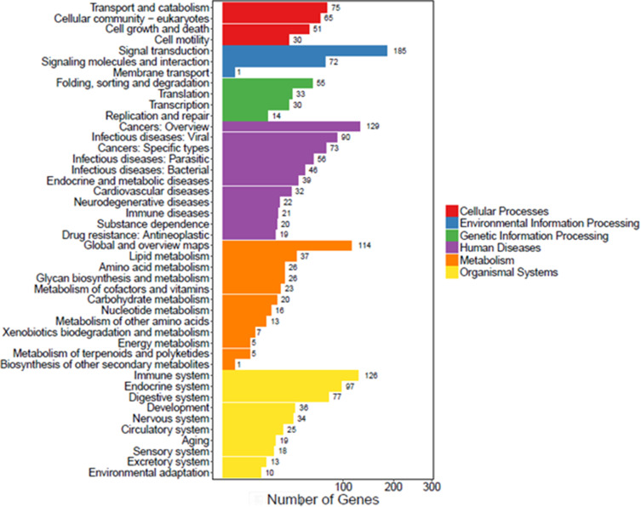
EGFR pathways are downregulated

Slide 12
Method Comparison
Original Study:
“Bowtie2 & HISAT to map clean reads to reference genes and genome”
“DEseq2 method to screen out differentially expressed genes between two groups”
“enrichment analyses were based on the KEGG pathway database”
Genome, GTF, QC steps, parameters used, package versions: ???
My analysis:
STAR, GRch38, Gencode v43, Feature Counts, Control 4 removed, DEsseq wald test, KEGG 2021 separated by up/down regulated

Slide 13
Limitations and future directions
Small number of replicates which was exacerbated by potential outlier sample
In vivo drug delivery efficiency still underdetermined
Bulk RNA-seq without selection for successful uptake of drug
Identical in vitro experiment with greater n
Follow up in vivo experiment to test drug delivery efficiency

Slide 14
Acknowledgements

