Slide 1
NYPD Shootings
Incident Report

Slide 2
Outline
The Dataset
Visualization
Modeling
​Bias Recognition
Conclusions​

Slide 3
The dataset
The data used for this analysis contains information pertaining to NYPD shooting incidents as made available on data.gov.

Slide 4
Analysis Features
Identifying
Victim Related
Date of the incident
Time of the incident
Borough
Did the incident result in a murder?
Victim age group
Victim gender
Victim race

Slide 5
PRIMARY GOALS
Purpose of the Analysis

Slide 6
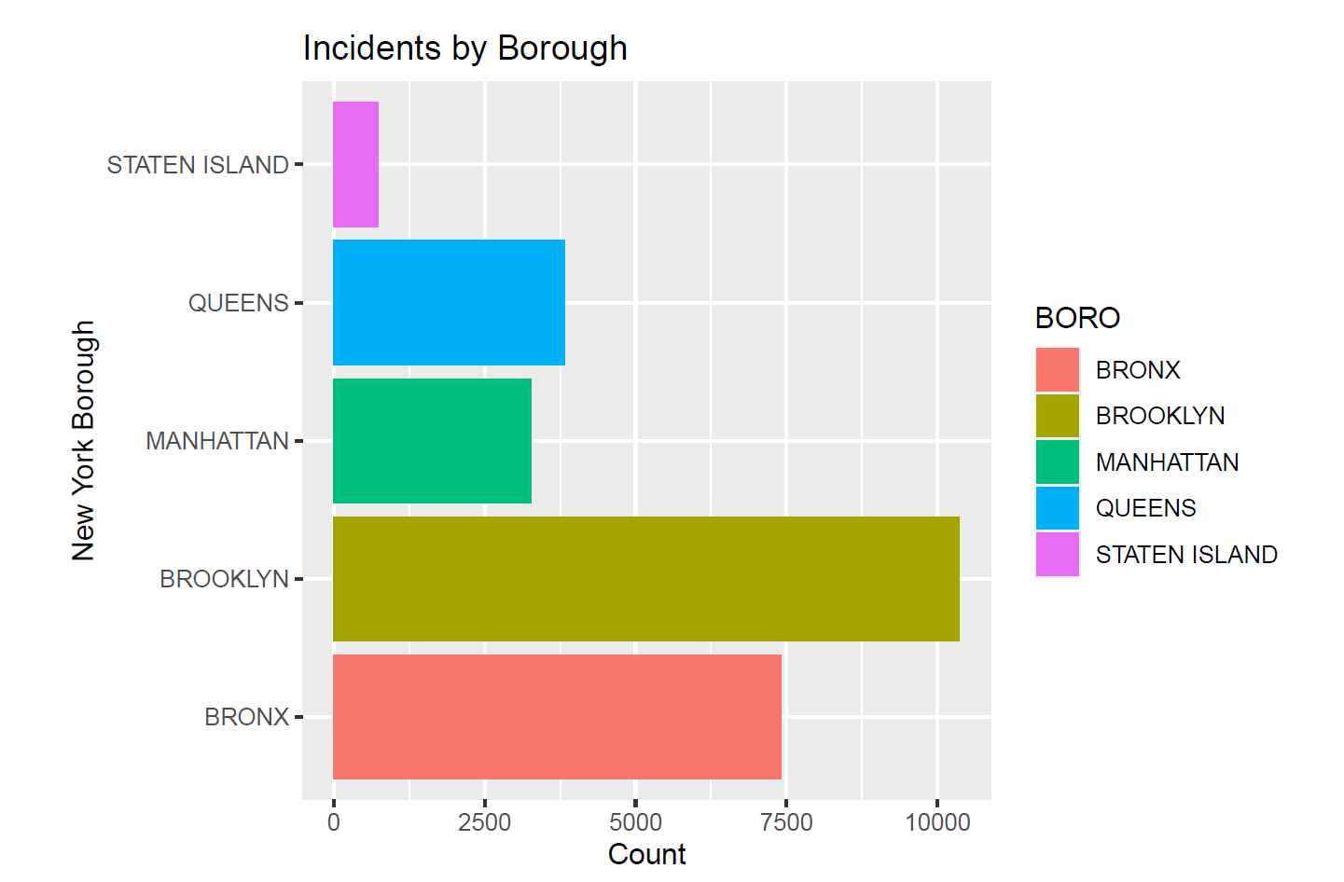
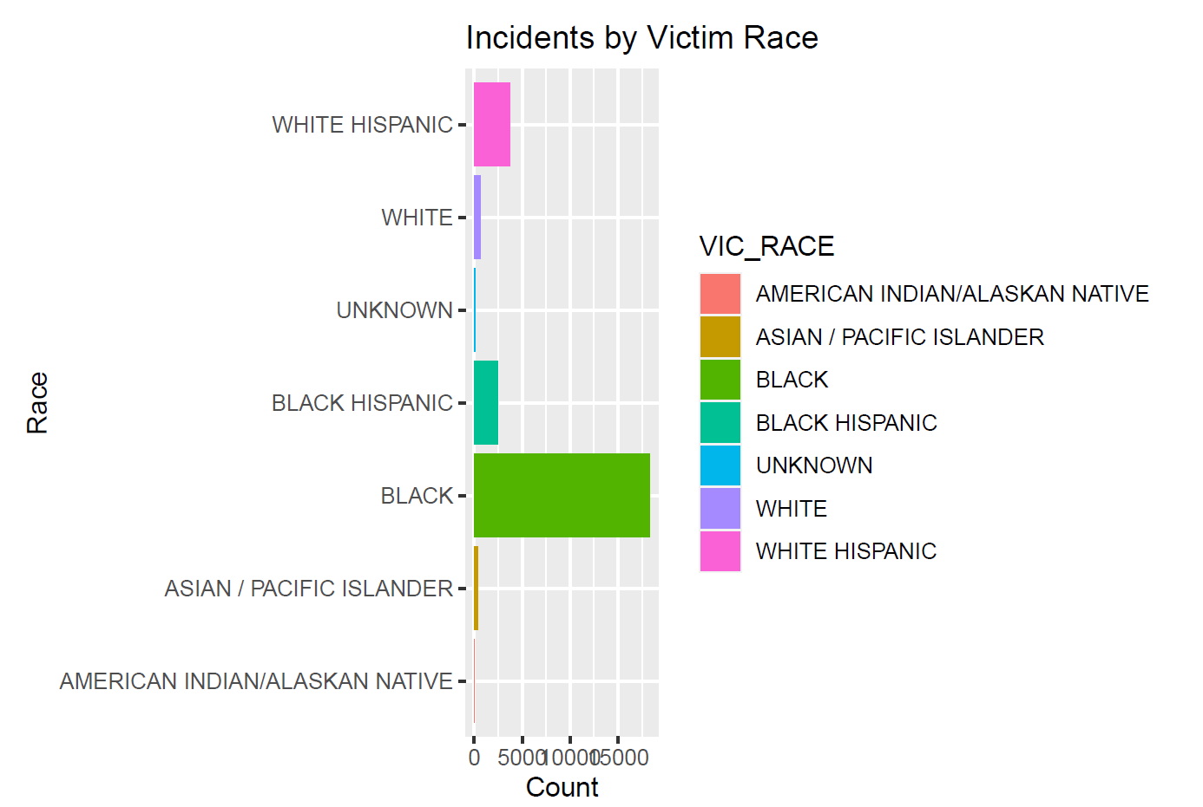
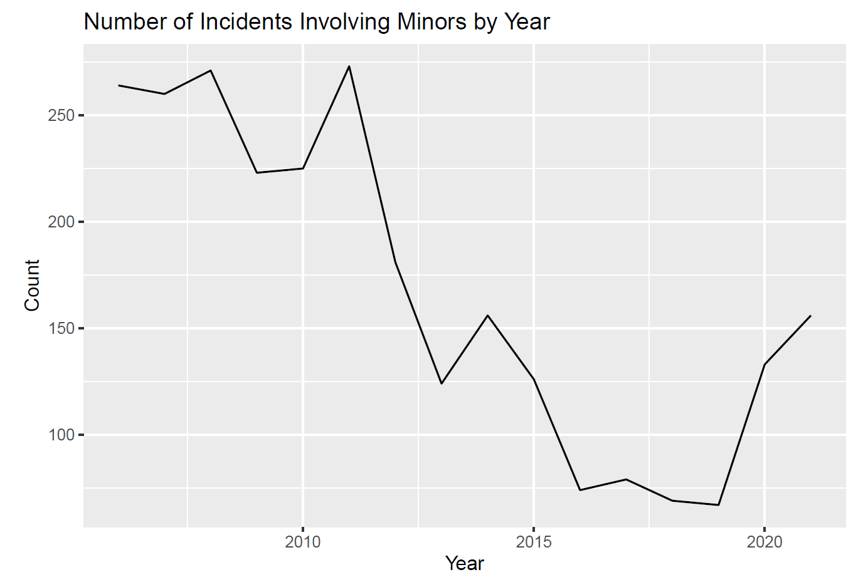
Visualization
2020 Census Population:
Brooklyn: 2.7 million
Queens: 2.4 million
Manhattan: 1.7 million
The Bronx: 1.5 million
Staten Island: 0.5 million

Slide 7
Modeling
Model 1: Age Group Simple Linear Regression
Compared minors to other age groups
Ages 18-24, 25-44 significantly more likely to be victimized
Elderly significantly less likely to be victimized
Model 2: Race Simple Linear Regression
Compared Asian/Pacific Island to other races
African Americans and Latinos significantly more likely to be victimized
Other races marginal in incidence counts

Slide 8



Bias Recognition
Investigator
People of Color
Men
Potential for any inherent biases I may have to shape the analysis
Data indicates people of color are far more likely to be victim of a shooting
Data indicates that men are far more likely to be victim of shooting

Slide 9
Conclusions
People of color, particularly African-Americans and Latinos, are more likely to be victims then other ethnicities
Men are more likely to be victims than women
The number of minors victimized has been reduced to nearly half from that of the late 2000s

