Slide 1
Optimizing Learning Strategies: Evaluating the Impact of Active vs. Passive Learning on Student Engagement and Comprehension
Achinthya Sreedhar, Chaitali Deshmukh, Kendall Sims, Neha Shastri

Slide 2

Introduction
Motivation
- Optimize educational practices to enhance student learning experiences
- Provide evidence-based insights for educators to determine effective teaching approaches
Goal
Our experiment seeks to explore how active learning can be applied beyond STEM fields to improve student engagement and learning outcomes in diverse educational settings.

Slide 3

Research Question
Does active learning lead to higher student engagement and perceived preparedness as compared to passive learning?
Null Hypothesis
There is no difference in the effect between active and passive learning: Students who participate in active learning report similar levels of perceived preparedness and classroom engagement as those who participate in passive learning.

Slide 4
Experimental Design
Unit of Randomization: Student-level
Project Timeline:
Pre-Experiment Survey: Participants completed a survey assessing key covariates
Learning Experience: Assigned to either passive or active learning
Post-Experiment Survey: Measured engagement, understanding, and preparedness
Distribution Channel: Qualtrics survey QR codes were given in class and emailed to participants
Control
Passive Learning (Notes)
Treatment
Active Learning
(Quiz)

Slide 5
Variables
Covariates
Outcome Variables
Gender
(Male, Female, Other)
Post Class Recall
Prior Exposure to Case Study
(Yes/No)
Post Class Participation
Self-Assessed Knowledge in Causality
(Scale: 0-100)
Pre Class Understanding of Material
Self-Assessed Likelihood to Participate in Class
(Scale: 0-100)

Slide 6
Data Collection
Method of Collection
Number of Responses
- Access was restricted to MSBA students and the professor to ensure participant eligibility and prevent external responses
- Collected responses through Qualtrics surveys
- 92 students participated
- 60% completed the Pre-Class Survey
- Only 40% completed the Post-Class Survey

Slide 7
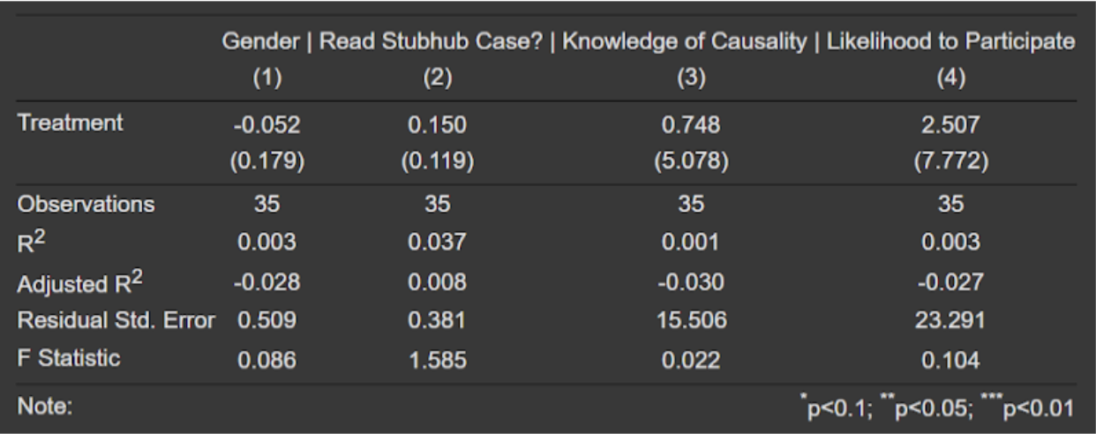
Randomization Method
Balance Check Using Regression
We used stratified random assignment with gender-based blocking
P-Value = 0.12
Randomization was properly conducted
Z-Test

Slide 8
Power Analysis
The target effect size for our three outcome variables was 10%
Outcome Variable | Sample Size Used | Sample Size Needed
Post Class Recall | 35 | 128
Post Class Participation | 35 | 183
Pre Class Understanding of Material | 55 | 344
Power analysis revealed that our experiment was underpowered, indicating an insufficient sample size to reliably detect the desired effect.

Slide 9
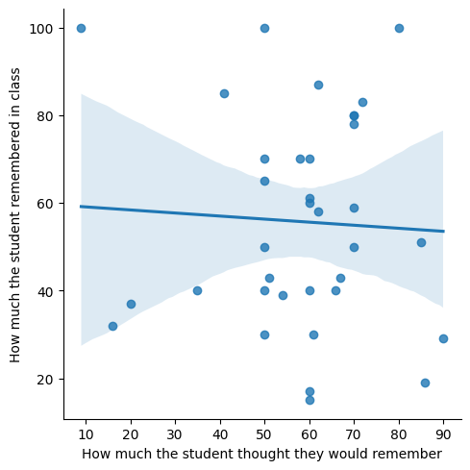
EDA
Comparison of Student Completion Rates for the Initial Survey
Response Bias
 | Percent of Complete Surveys | Percent of Incomplete Surveys
Read the Case | 83% | 17%
Didn’t Read the Case | 65% | 35%

Slide 10
ATE
Outcome Variable | ATE | P-Value
Post Class Recall | -2.65 | 0.75
Post Class Participation | 4.34 | 0.71
Understanding of Material | 5.03 | 0.20
The p-values for all outcome variables exceed 0.05, indicating that the ATE is not statistically significant.

Slide 11
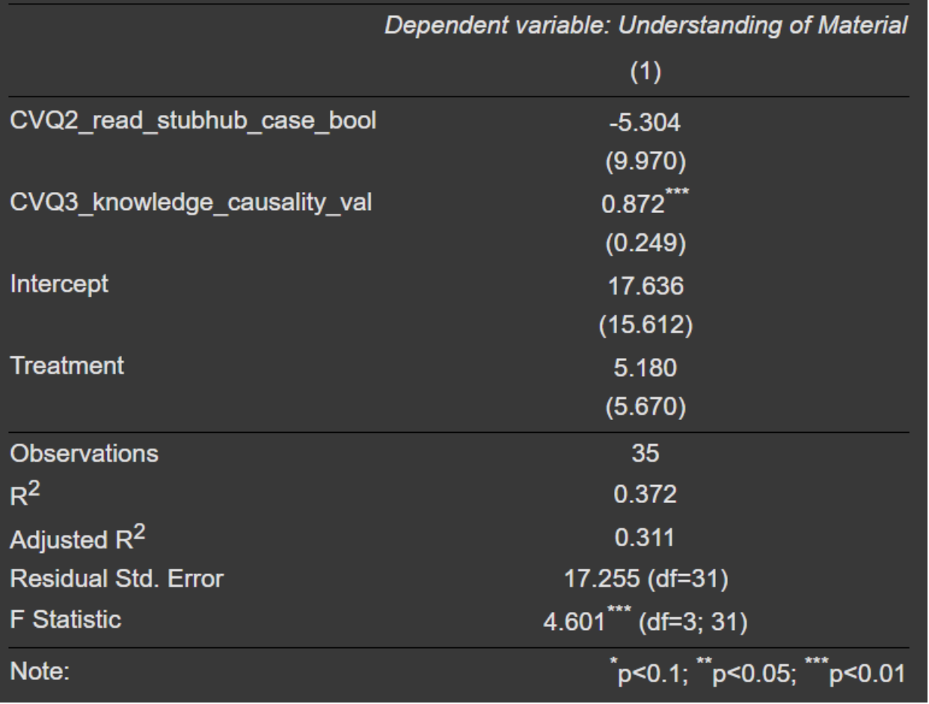
Understanding of Material ~ Treatment + Covariates
Prior knowledge of the subject (causality in this case) significantly enhances students' understanding

Slide 12
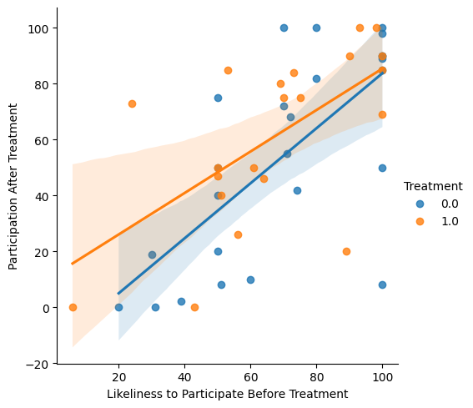
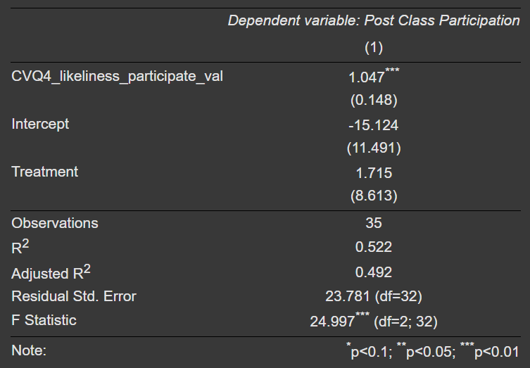
Class Participation ~ Treatment + Likeliness to Participate

Slide 13
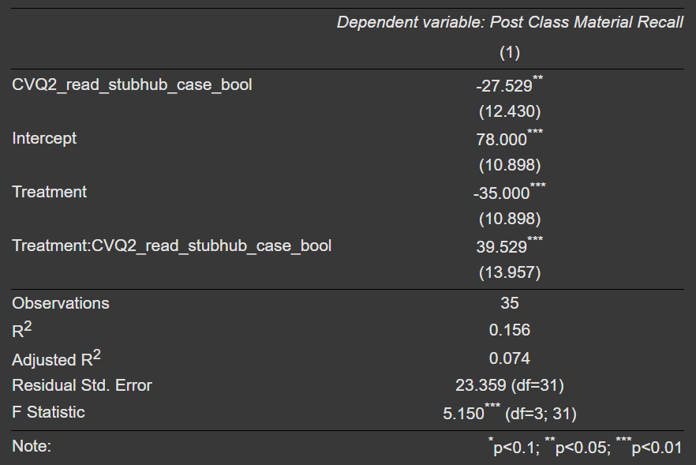
Post Class Recall ~ Treatment * Read StubHub Case
Students who read the case beforehand performed better in the treatment group.

Slide 14
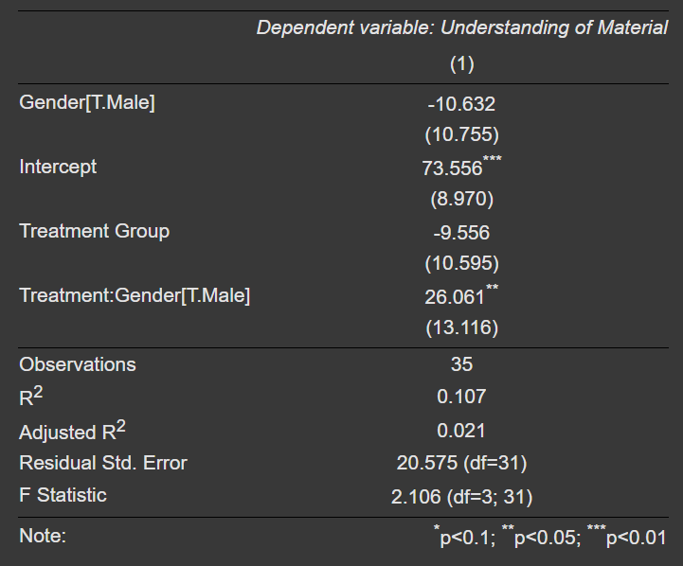
Understanding of Material ~ Treatment * Gender
Heterogeneous Treatment Effect
Effect on Female: -9.6
Effect on Male: -9.6 + 26**
= 16.4

Slide 15
Limitations
Limited Participant Pool
Non-Compliance & Survey Completion
Low Post-Class Survey Completion
Time Constraints and Survey Fatigue
Discrepancy Between Expected and Actual Recall

Slide 16
Business Insights
Educator Insights: Provide evidence-based recommendations on the most effective teaching approaches.
Workplace Training: Implement interactive learning tools to enhance employee engagement and knowledge retention.
Corporate Onboarding: Use active learning methods, such as quizzes and simulations, to improve new hire training effectiveness.
Marketing Strategies: Leverage interactive content (e.g., quizzes, gamification) to increase customer engagement and brand retention.

Slide 17
Conclusion
Overall Effect
Gender Role
Future Steps
No significant overall effect, but outcomes varied by gender and prior case reading.
Male students benefited more, while those who skipped reading struggled with recall but participated more.
Tailoring interactive methods to student characteristics can improve effectiveness.

