Slide 1
ACGP Timesheets App Instructions
Capt Paul Kirvan

Slide 2
User Guide
This guide will give a basic overview of how to use the ACGP Timesheets App
The guide is divided into three main segments, which correspond to the main working areas of the app
Attendance Area
Aircraft Area
Timesheet / Record Area

Slide 3
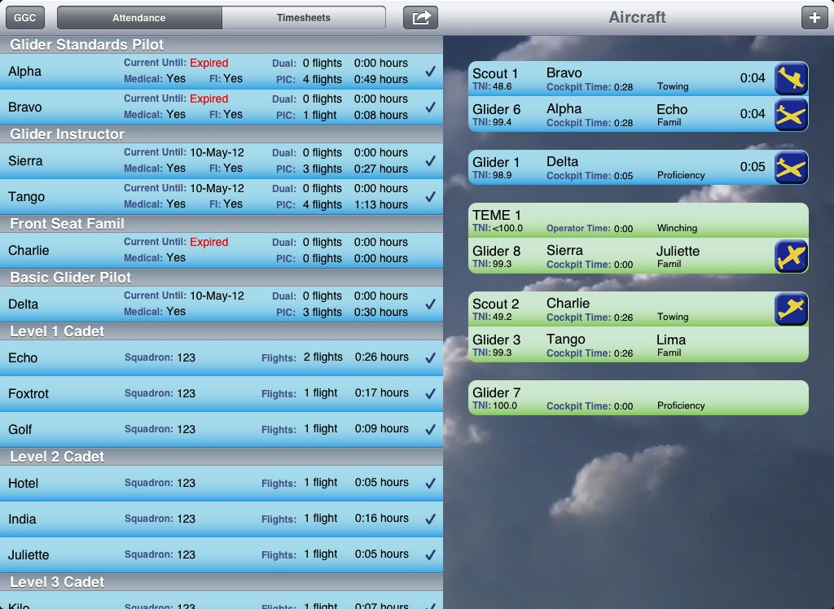
Attendance Area
The attendance area is found the left side of the app, in the same space as the ‘timesheet area’
Select the Attendance button at the top left to toggle to the attendance screen
The ‘timesheet area’ will be described later in the manual

Slide 4
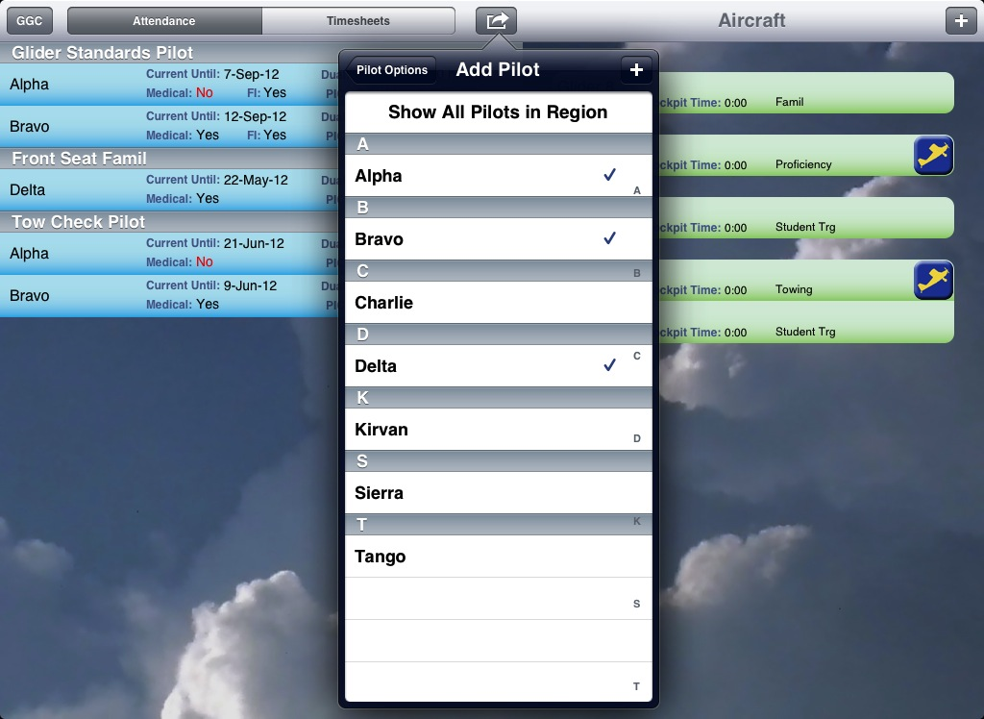
Attendance Area
Touch ‘Sign in Pilot’ in the top centre menu
Touch the pilot’s name to sign them in
Press the [+] to add new names
In the pop-over, swipe to ‘Inactivate’ a pilot so they do not show up in the menu. Adding a new pilot with the same name and birthday will reactivate them

Slide 5
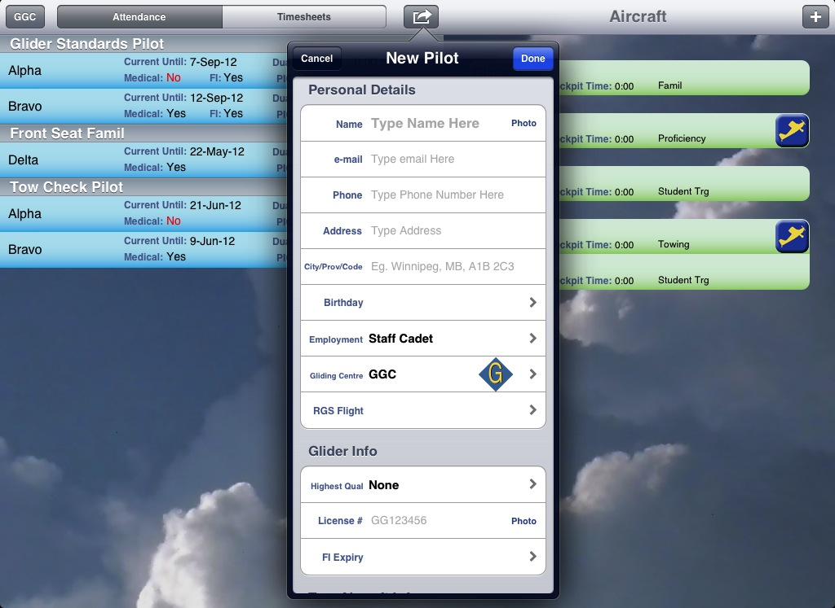
Attendance Area
When a new pilot is added the only mandatory info is the
name
highest glider qual and/or highest scout qual, and
employment type
For a staff member to be able to run the winch, their qualification must be recorded in the ‘Other Quals’ section
Information and Quals can be updated at any time by touching on the pilot’s strip
Most of the other data fields are to support future PTR functionality. The app cannot currently be used in place of a PTR.

Slide 6
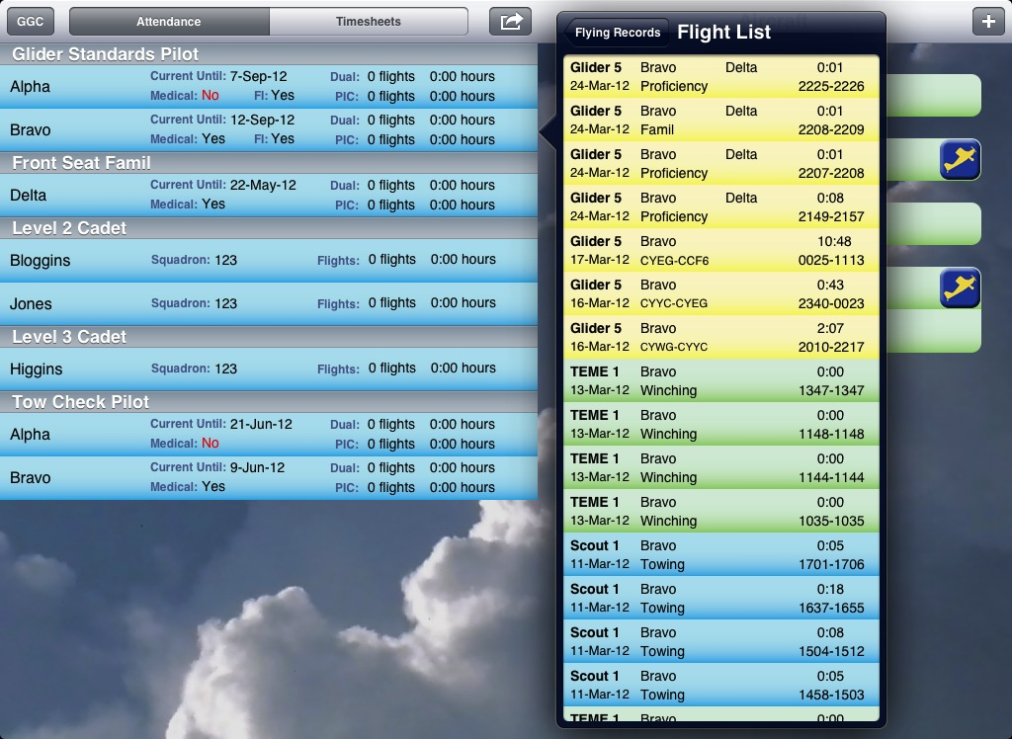
Attendance Area
Touching a pilot’s strip will open a pop-over with areas to edit information and quals.
At the bottom of the pop over, selecting ‘Flight List’ shows all of the flights and winch launches a pilot has completed
Similarly, selecting ‘Attendance Records’ shows their attendance

Slide 7
Attendance Area Notes
When a pilot leaves, swipe to sign them out
Signing pilots out allows the app to record their time in and out and whether it was a session or not
In turn, this allows the app to keep track of your paid days used
If a pilot is not signed out by midnight, the app will assume they left at 1730
Filling out the ‘employment type’ is very important because this is used to calculate paid days as well as cadet attendance stats

Slide 8
Attendance Area Notes
If an email address is added for a pilot, whenever the ‘Email Pilot Logs’ feature is used they will receive an email with their flight times, provided they had flown on the day in question
The birthday field is not ‘mandatory’ but it is recommended to distinguish between pilots with identical names (eg. Smith)
The currency dates that are displayed take into account ACGP currency rules as well as TC currency rules (5 flights PIC in six months). They do NOT include APC requirements nor launch method specific currency requirements

Slide 9
Attendance Area Notes
It is possible to take a picture using the iPad camera that will appear next to the person’s name to facilitate identification for new staff members
It is not recommended that you take photos of licenses and medicals as the iPad is not authorized for PTR use at this time
If squadron officers are flown, they should be added as ‘guests’, not as cadets. This ensures the ‘cadets flown’ statistics will be accurate.
All of the cadets can be signed out at once, but caution is recommended as there is no easy way to reverse this
Entire summer camp flights can be easily signed in/out

Slide 10
Aircraft Area
Each aircraft is represented by a strip on the right hand side of the screen
Blue strips represent airborne aircraft, green strips are aircraft on the ground

Slide 11
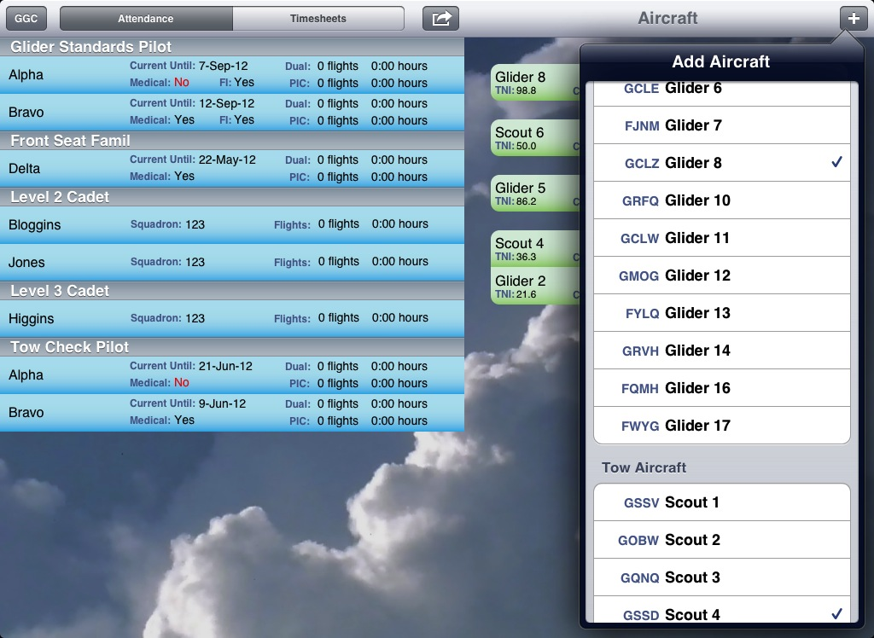
Aircraft Area
Touch the + to add aircraft or winches to the field
Aircraft or winches can be removed by using the swiping gesture
They must first be ‘unhooked’ from other aircraft. Tap on either the glider or the launch vehicle, then select ‘Unhook’ in the pop-over menu

Slide 12
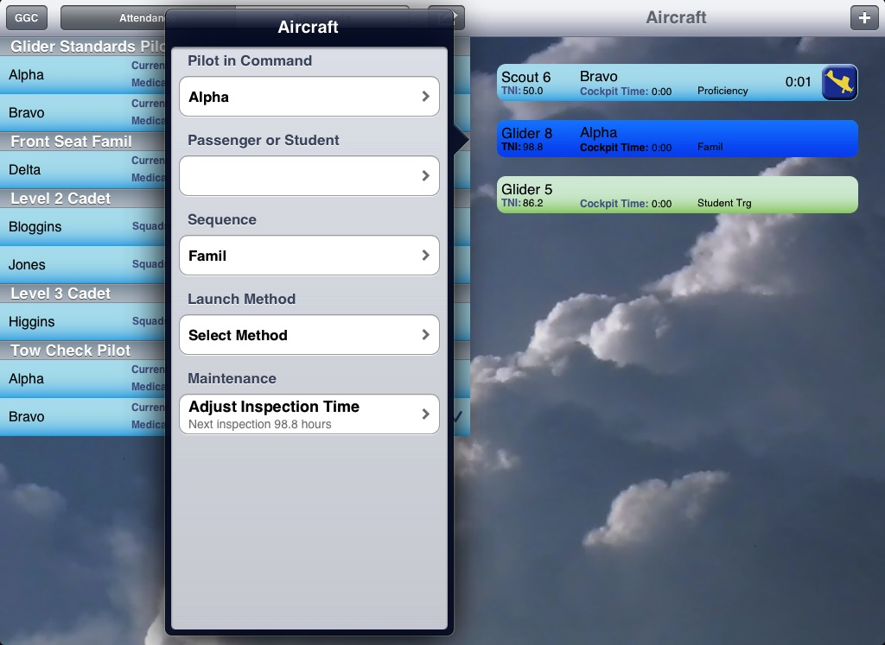
Aircraft Area
Touch the aircraft strip to select the pilot, passenger, and sequence
Choosing a launch method will “hook up” the glider to the launch vehicle
If you hook a glider to the wrong launch vehicle, tap on either the glider or tow plane/ winch, then select ‘Unhook’ in the pop-over menu

Slide 13
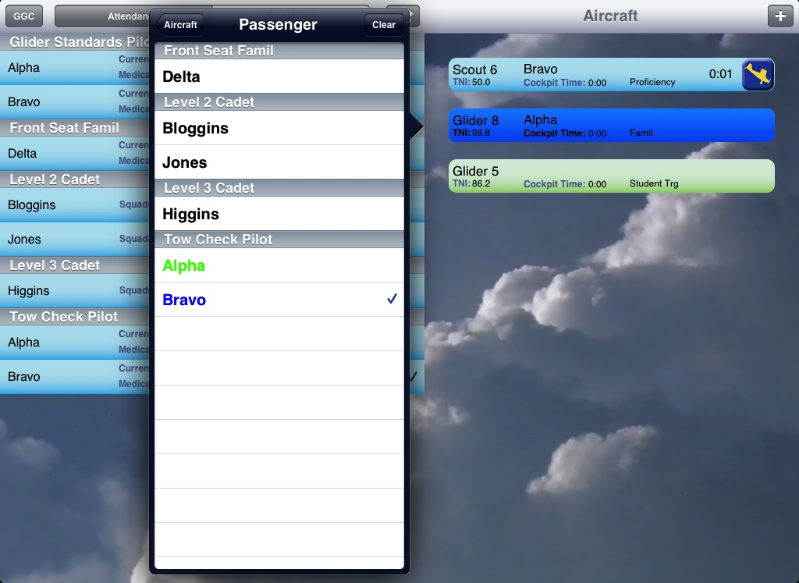
Aircraft Area
When selecting pilots and passengers, names appearing in green mean the pilot is in a non-airborne aircraft. Names that appear in blue mean the pilot is currently flying
For passengers, a check mark indicates the person has been flown at least once during the current day

Slide 14




Aircraft Area
Press or to begin recording times when an aircraft takes off
Press or to finish recording times when an aircraft lands
These actions automatically generate timesheet records

Slide 15
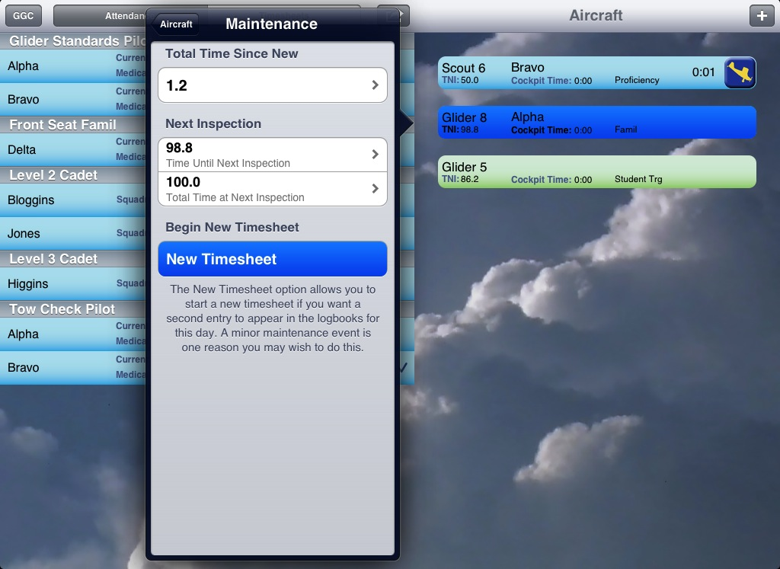
Aircraft Maintenance Area
The airplane maintenance area is found by clicking on the aircraft strip to access the pop-over.
The ‘maintenance’ button is found at the bottom of the pop-over

Slide 16
Aircraft Maintenance Area
In this screen, the the TTSN, TNI, and TTNI can be manually adjusted
The ‘New Timesheet’ option will log all future flights as a separate journey log entry. This is for when you have snags or maintenance during the day.
The ‘New Timesheet’ option should not be used routinely (eg. the app will automatically print the timesheets on multiple pages if needed, no intervention is required)

Slide 17
Aircraft Area Notes
The ‘PIC cockpit time’ resets when the pilot has been on the ground more than 25 minutes. It only looks at the most recent flights where the pilot has acted as the PIC. Dual flights are not considered in this calculation
The PIC time and TNI are color coded and will progressively turn yellow, orange and then red as the PIC approaches 2.5 hours in the cockpit or the aircraft approaches 0 hours TNI
The TNI for the winch is approximate, since the app cannot know exactly how long the winch has been running. More accurate times can be manually entered
The ‘Apache counter’ and ‘Bandit counter’ appear during student training. This only counts the number of student training flights done for students in that flight. This is similar to the ‘x-board’ used at RGS (PRA). It does not count proficiency flights, fam flights, or anything else

Slide 18
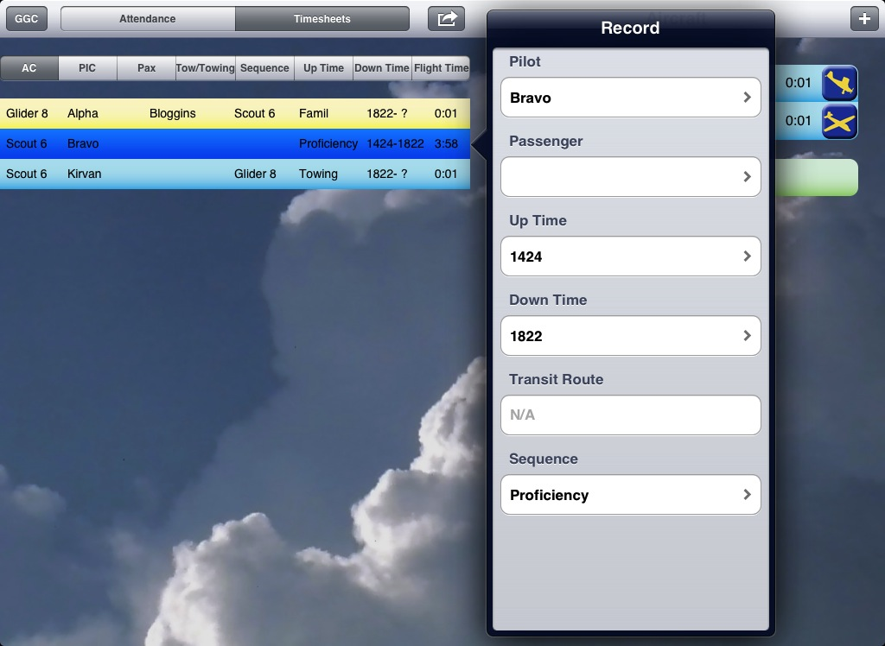
Timesheets Area
The timesheet / record area is found on the left side of the iPad
It is in the same area as ‘attendance’ and is accessed by selecting the ‘Timesheets’ toggle button

Slide 19
Timesheets Area
Records automatically appear as aircraft strips are taken off and landed in the ‘Aircraft Area’
Touching a completed flight opens a pop-over which allows the details of the flight to be edited.
A flight that is currently airborne can be edited by touching the aircraft strip in the ‘Aircraft Area’
Records can be deleted by using the ‘swipe to delete’ gesture. If you delete a glider flight, it will also delete the associated record for the launch vehicle. Similarly, if the record for a launch vehicle is deleted, the associated glider record is also deleted.

Slide 20
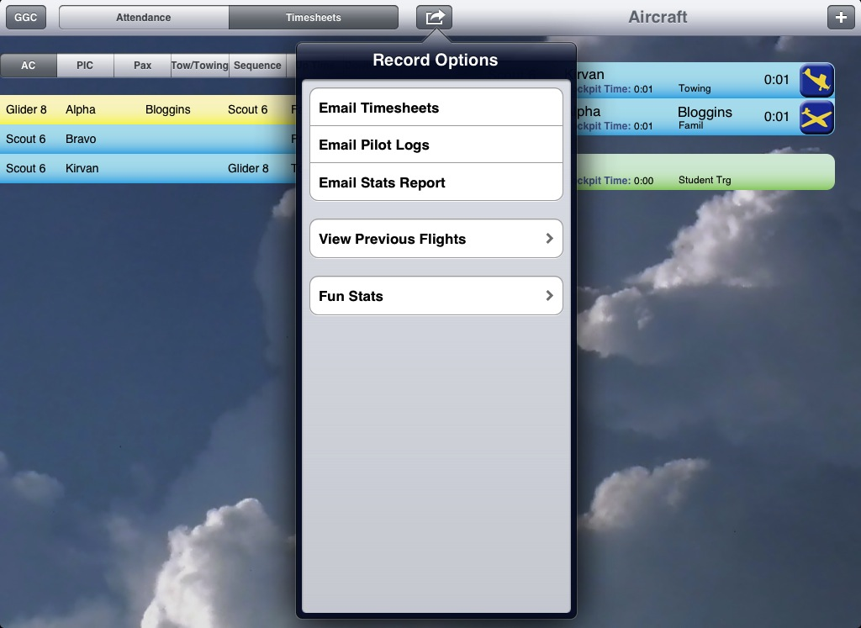
Timesheets Area
The app greatly reduces the work needed complete mandatory reports
At the end of the day the timesheets can be emailed and printed
If winch launch was used, at the end of the day the app will request the actual winch TNI. What is shown during the day is only an estimate
At the end of the weekend the stats report can be easily emailed to maintenance and air ops.
A list of new quals awarded must be submitted to air ops periodically. The app does not do this automatically.

Slide 21
Timesheets Area Notes
Records can be sorted several ways (eg. to sort first by name and then by flight time, simply touch the name header then the flight time header). The iPad will remember previous sort settings.
During transit flights the iPad will attempt to log the route using GPS. If it is not accurate or if the iPad was not brought on the flight it can be manually recorded.

Slide 22
Timesheets Area Notes
Viewing Previous Days
Records from previous days are read only, so it is important to be sure everything is right before the end of the day!
Records from previous days can be viewed and emailed. This works the same way as when timesheets and pilot logs are emailed at the end of the current day.

Slide 23
Other Odds and Ends
If you land the wrong airplane, you may shake the iPad to undo the mistake
Times are displayed in the current local time zone. If the flight has crossed time zones, all flight records will display times in the time zone the iPad is currently located in.

Slide 24
FAQ Answers
You CAN switch to other apps while using the Timesheets app. You can even turn the iPad off, or force quit the app, and when you go back into it everything will still be there. However, the more time you spend using apps on the iPad the faster the battery will run out.

Slide 25
iPad Care
The iPad will go to sleep if Temperature >35˚C
This can occur at ambient temperature as low at 25˚C if the screen is left open in direct sun for too long
Do not store below -20˚C to avoid battery damage (go with -10˚C to be on the safe side)
Don’t let it get wet
Turn the screen off using the ‘lock button’ when the iPad is not in use to ensure the battery lasts all day
To maintain a healthy battery, use it for at least 10 hours per month (ie. One complete charge cycle), even in the off season. That said, the batteries are only designed for 1000 recharging cycles, so don’t overuse it
Source: apple.com/batteries & apple.com/iPad

