Slide 1
Hindi
Breathy Consonants
adapted from slides by Sharon Hargus and Valerie Freeman

Slide 2
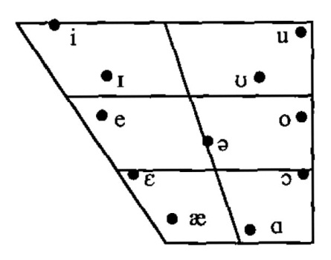
Hindi Vowels
“All of these vowels except [æ] also have distinctively nasal counterparts.” (Ohala, 2010:101)
Ohala, Manjari (2010). Hindi. In International Phonetic Association (eds.), Handbook of the International Phonetic Association (pp. 100-103). Cambridge: Cambridge University Press.

Slide 3
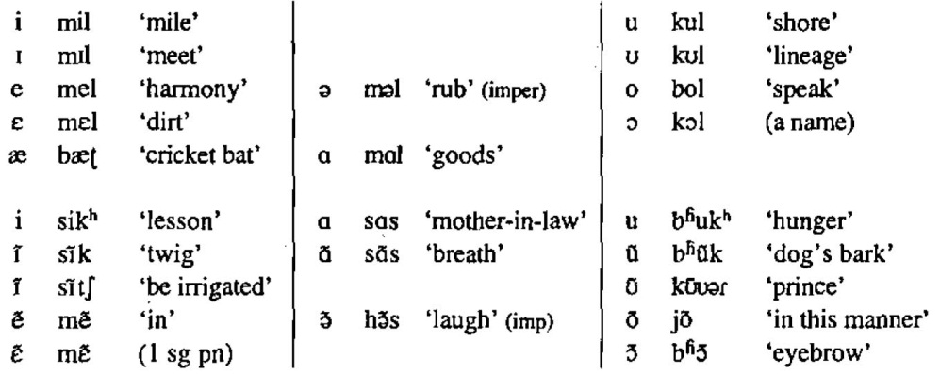
Hindi Vowel Listening Practice
Notes:
pn = pronoun
1 sg = first person singular (I, me)

Slide 4
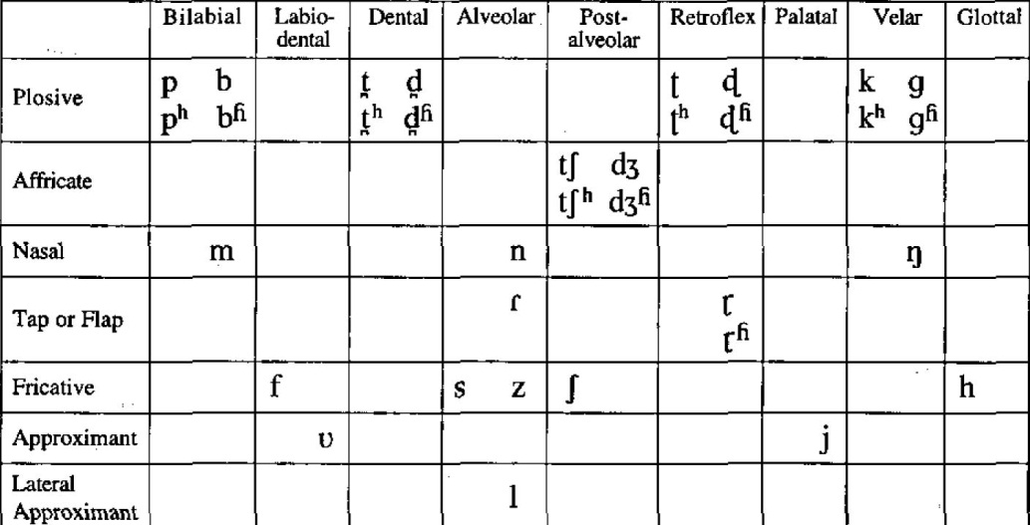
Hindi Consonants
http://corpus.linguistics.berkeley.edu/acip/vowels/chapter12/hindi.html
http://www.paulmeier.com/consonants/
Notes:
I would definitely add the retroflex /ɳ/ and maybe /ɲ/?

Slide 5

Hindi Transcription
‘address’ (n.) [pət̪ɑ]
‘beat’ (n.) [t̪ɑl]
‘big’ [bəɽɑ]
‘branch’ [ɖɑl]
‘brow’ [b^{ɦ}ɑl]
‘gait’ [ʧɑl]
‘glimmer’ [ʤ^{ɦ}əl]
‘hair’ [bɑl]
‘increase’ (imp.) [bəɽ^{ɦ}ɑ]
‘knife blade’ [p^{h}ɑl]
‘knife edge’ [d̪^{ɦ}ɑɾ]
‘lentil’ [d̪ɑl]
‘lumber shop’ [ʈ^{h}ɑl]
‘net’ [ʤɑl]
‘nurture’ [pɑl]
‘platter’ [t̪^{h}ɑl]
‘postpone’ [ʈɑl]
‘shield’ [ɖ^{ɦ}ɑl]
‘to make…agree’ [pəʈɑ]
‘tree bark’ [ʧ^{h}ɑl]

