Slide 1
Ibibio
Lexical tone and length contrasts
adapted from slides by Sharon Hargus and Valerie Freeman

Slide 2
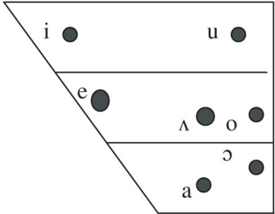
Ibibio Vowels and Tones
Vowels
Tones
High [dá] ‘stand’
Low [dà] ‘mate, friend’
Urua, E.-A. E. (2004). Ibibio. Journal of the International Phonetic Association, 34, 105-109.
Notes:
View in Praat to see pitch difs

Slide 3
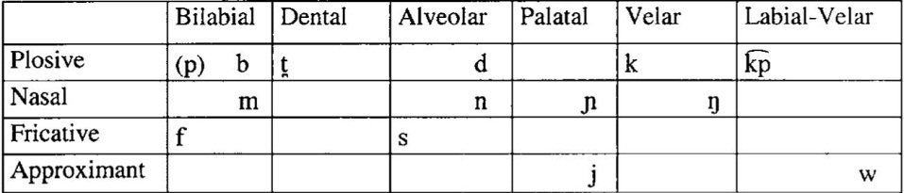
Ibibio Consonants
k͡pá ‘die’
“The bilabial plosives, [p] and /b/, occur in complementary distribution and do not contrast.”
“Plosives are weakened in intervocalic position as follows: [p, b] →[β]; t, d → [ɾ]; k → [R] ∼ [ɰ] (where [R] is used as the voiced uvular tap and [ɰ] the voiced velar approximant).”
Urua, E.-A. E. (2004). Ibibio. Journal of the International Phonetic Association, 34, 105-109.

Slide 4
Ibibio Length Contrasts
[jòmó] ‘be noisy’
[jòmːó] ‘boo at’
[nèm] ‘be delicious’
[nèːm] ‘crack palm kernel’

Slide 5
Ibibio Transcription
1. ‘be afraid of’ [bàːk]
2. ‘be alive’ [dù]
3. ‘be clean’ [sáná]
4. ‘be early’ [bàk]
5. ‘be named’ /kèt̪é/ [kèɾé]
6. ‘bite’ [dóm]
7. ‘bite many things’ [dóːm]
8. ‘cane’ [ɔ́bɔ̀ŋ]
9. ‘console’ [wéŋ]
10. ‘give’ [nɔ̀]
11. ‘go’ [kàá]
12. ‘goat’ [ébót]
13. ‘lock’ [kɔ̀p]
14. ‘marry’ [dɔ́]
15. ‘mosquito’ [ɔ́bɔ́ŋ]
16. ‘move a bit further’ [sànːá]
17. ‘scoop food’ [kɔ́p]
18. ‘sell’ [ɲàm]
19. ‘there’ [dó]
20. ‘think’ /két̪é/ [kéɾé]
Notes:
View on Praat: 8. cane (HL) vs 15. mosquito (HH) & 5. be named (LH) vs 20. think (HH)

