Slide 1

MockingBird
A BASIC TOPIC-FOCUSED MULTI-DOCUMENT SUMMARIZATION SYSTEM
Daniel Campos, Sicong Huang, Shunjie Wang, Simola Nayak, and Hayley Luke

Slide 2
Structure
Related Reading
System Overview
Data Prep and Process
Content Selection
Information Ordering
Content Realization
Results
Good and Bads
Future work

Slide 3

Related Readings
Gunes Erkan and Dragomir R. Radev. 2004. Lexrank: Graph-based lexical centrality as salience in text summarization. J. Artif. Int. Res., 22(1):457–479
Jahna Otterbacher, Gunes Erkan, and Dragomir R. Radev. 2009. Biased lexrank: Passage retrieval using random walks with question-based priors. Inf. Process. Manage., 45(1):42–54.
Jeffrey Pennington, Richard Socher, and Christopher D.Manning. 2014. Glove: Global vectors for word rep-resentation. InEMNLP
Reimers, Nils and Iryna Gurevych. “Sentence-BERT: Sentence Embeddings using Siamese BERT-Networks.” EMNLP/IJCNLP (2019).

Slide 4
Summarization Pipeline
Content Selection:
Biased LexRank
Information Ordering
Document Cluster
Ordered Sentences
Sentence Selection
Summary
Sort Chronologically
ItraSentence Similarity
Sentences
Sentence-Topic Similarity
Content Realization
Power Method
Data Input and Processing
Config

Slide 5
Data Prep and Process
Data
ACQUAINT and ACQUAINT2 corpora
Parse XML files
Custom Classes
Sentence parse with spacy

Slide 6

Content Selection
Modified Biased LexRank Graph Approach
Build a similarity graph
Nodes are sentences
Edges are inter-sentence similarity
Cosine distance of sentence embeddings
Bias for query topic
Power Iteration

Slide 7

WordVector Cosine Similarity
To calculate the inter-sentential and topic-sentencial similarity
Minimum threshold is 0.3
Drop stop words, non nouns, nothing (using spacy)

Slide 8

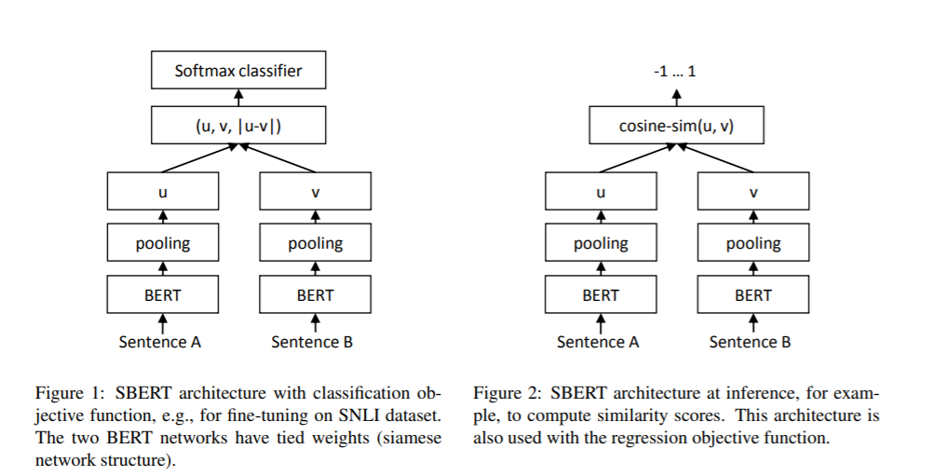
Sentence Representation
Explored average word vectors, TF-IDF, Siamese BERT-Network
Explored using 🤗 Transformers library for sentence representation
Use the embedding of [cls] token
Doesn’t work too well. Solution use SBERT(finetuned BERT style model focused on representing sentence similarity) trained on SNLI and MultiNLI
Surprisingly Transformer based model does not outperform peers!

Slide 9
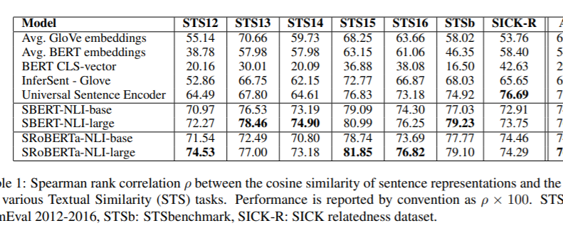

Slide 10
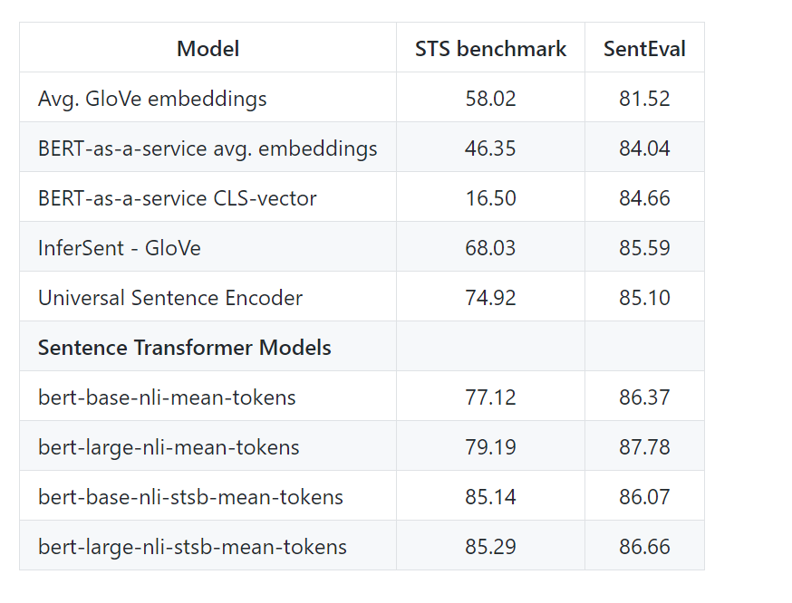
Sentence Embeddings

Slide 11
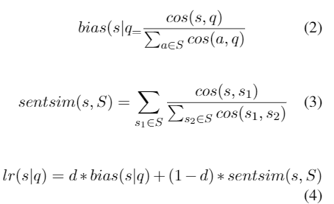
Biased Lexrank
Getting the LexRank for a given sentence s in topic t:
D is how much importance the topic has(0.7 for our experiments)
S is all possible sentences

Slide 12
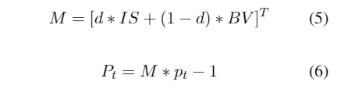
Power Iteration
Use LexRank to calculate probability for each sentence. Start with uniform probability
Iterate using equation 1 until converge(epsilon value 0.3 for us)
The final probability distribution is a rank of how salient sentences are.

Slide 13
Sentence Selection
Iterative approach
Sort sentences by Lexrank score
Select sentences that do make summary over 100 words
Select sentences that do not have > 0.6 cosine similarity to sentence in summary

Slide 14
Information Ordering
Reverse Chronological Order

Slide 15
Content Realization
Use information as presented in Info Ordering

Slide 16
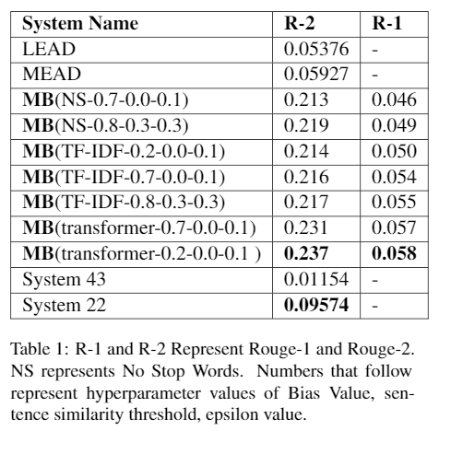
Results
Outperforms Nutshell outperforms LEAD but not MEAD baseline!
Transformer based sentence representations not much better than TF-IDF or word vector methods

Slide 17
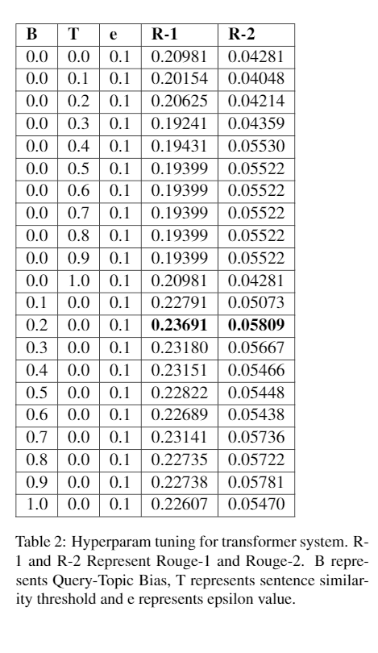
Results Hyperparam tuning

Slide 18
Error Analysis
Document Parsing Continues to be an Issue
, scene of an earlier school shooting, reach out to those in Littleton, Colo
'' Columbine Principal Frank DeAngelis called the gathering ``the end of a nightmare
'' The response is most visible in metropolitan Denver, radiating outward from the high school and adjacent Clement Park, which has become a mourner's Lourdes
The nation and the world have joined in grieving for the students of Columbine, Gore said
``Behind you, scarred but still standing, is Columbine High School,'' Gov
Authorities believe Columbine students Eric Harris and Dylan Klebold carried out the massacre and then killed themselves
Biased LexRank seems to favor 1st lines in the document
Soedjono said that he has assigned junior Attorney General to carry out the investigation
JAKARTA (JP): Attorney General Soedjono C
Soedjono made his statement in an apparent attempt to correct some media reports that he had met foreign lawyers hired by Soeharto
Ghalib Monday said he would ask former President Soeharto to sign a letter of authorization that would enable the investigation team to probe Soeharto's overseas wealth
"Yes, Soeharto will receive the team soon," Tanjung said
The United Development Party faction earlier asked for a separate decree to contain investigation into Soeharto, officials, former officials and their families
Systems favor long sentences(see above)
System favors quotes.

Slide 19
What Worked
Git
Pull Requests
Slack
Patas/Condor
Spacy/Python
Hyperparameter tuning

Slide 20

What didn’t Work
Hard to start working when many parts are intertwined
Transformer based system is slow to run for little time improvements.

Slide 21
Future work
Text preprocessing and stemming
BetTEr use of LMs
Information ordering improvements
Content realization
Hyperparam Tuning

