Slide 1

MockingBird
A BASIC TOPIC-FOCUSED MULTI-DOCUMENT SUMMARIZATION SYSTEM
Daniel Campos, Sicong Huang, Shunjie Wang, Simola Nayak, and Hayley Luke

Slide 2
Structure
Related Reading
System Overview
Data Prep and Process
Content Selection
Information Ordering
Content Realization
Results
Good and Bads
Future work

Slide 3

Related Readings
Gunes Erkan and Dragomir R. Radev. 2004. Lexrank: Graph-based lexical centrality as salience in text summarization. J. Artif. Int. Res., 22(1):457–479
Jahna Otterbacher, Gunes Erkan, and Dragomir R. Radev. 2009. Biased lexrank: Passage retrieval using random walks with question-based priors. Inf. Process. Manage., 45(1):42–54.
Jeffrey Pennington, Richard Socher, and Christopher D.Manning. 2014. Glove: Global vectors for word rep-resentation. InEMNLP
Reimers, Nils and Iryna Gurevych. “Sentence-BERT: Sentence Embeddings using Siamese BERT-Networks.” EMNLP/IJCNLP (2019).

Slide 4
Summarization Pipeline
Content Selection:
Biased LexRank
Information Ordering
Document Cluster
Ordered Sentences
Sentence Selection
Summary
Sort Chronologically
ItraSentence Similarity
Sentences
Sentence-Topic Similarity
Content Realization
Power Method
Data Input and Processing
Config

Slide 5
Data Prep and Process
Data
ACQUAINT and ACQUAINT2 corpora
Parse XML files
Custom Classes
Sentence parse with spacy

Slide 6

Content Selection
Modified Biased LexRank Graph Approach
Build a similarity graph
Nodes are sentences
Edges are inter-sentence similarity
Cosine distance of sentence average word embeddings
Various methods dropping stop words, and non nouns.
Bias for query topic
Power Iteration

Slide 7

WordVector Cosine Similarity
To calculate the inter-sentential and topic-sentencial similarity
Minimum threshold is 0.3
Drop stop words, non nouns, nothing (using spacy)

Slide 8
WordVector Cosine Similarity
Explore using Transformers library for sentence representation
Use the embedding of [cls] token
Doesn’t work too well. Solution use SBERT(finetuned bert style model focused on representing sentence similarity) trained on SNLI and MultiNLI

Slide 9
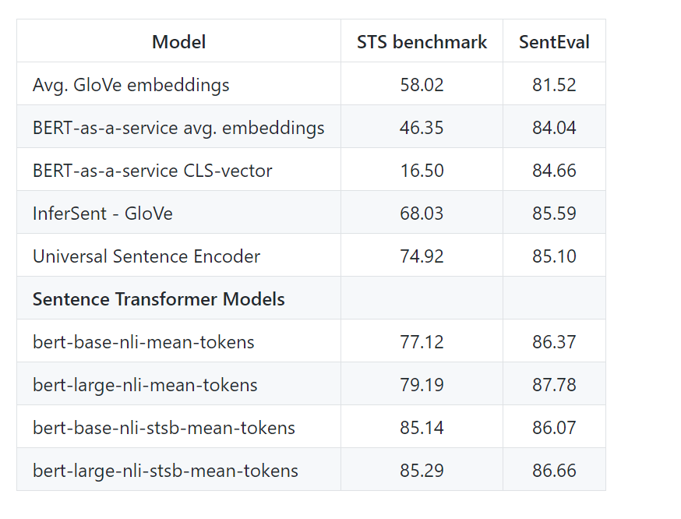
Sentence Embeddings

Slide 10
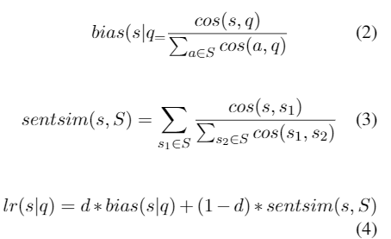
Biased Lexrank
Getting the LexRank for a given sentence s in topic t:
D is how much importance the topic has(0.8 for our experiments)
S is all possible sentences

Slide 11
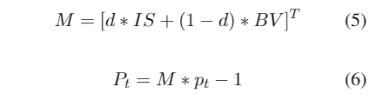
Power Iteration
Use LexRank to calculate probability for each sentence. Start with uniform probability
Iterate using equation 1 until converge(epsilon value 0.3 for us)
The final probability distribution is a rank of how salient sentences are.

Slide 12
Sentence Selection
Iterative approach
Sort sentences by Lexrank score
Select sentences that do make summary over 100 words
Select sentences that do not have > 0.6 cosine similarity to sentence in summary

Slide 13
Information Ordering
Reverse Chronological Order

Slide 14
Content Realization
Use information as presented in Info Ordering

Slide 15
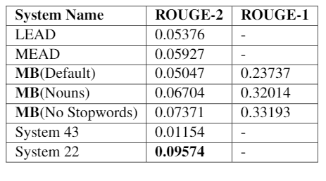
Results
Outperforms Nutshell outperforms LEAD and MEAD baseline!
No Stop Words is best method.

Slide 16
What Worked
Git
Pull Requests
Slack
Patas/Condor
Spacy/Python

Slide 17

What didn’t Work
Hard to start working when many parts are intertwined
Division of labor was difficult
Division initially based on component which meant data input and content selection had major lifting.

Slide 18
Future work
Text preprocessing and stemming
Transformer based tokenization?
Information ordering improvements
Content realization
Hyperparam Tuning

