Slide 1

MockingBird
A BASIC TOPIC-FOCUSED MULTI-DOCUMENT SUMMARIZATION SYSTEM
Daniel Campos, Sicong Huang, Shunjie Wang, Simola Nayak, and Hayley Luke

Slide 2
Structure
Readings for D4
Data Prep and Process Improvements
Content Selection Recap
Information Ordering Recap
Attempted Content Realization Improvements
Results
Good and Bads
Future work

Slide 3

Readings for D4
Regina Barzilay and Kathleen R. McKeown. September 2005. “Sentence Fusion for Multidocument News Summarization.” Computational Linguistics.
Katja Filippova. August 2010. “Multi-sentence compression: finding shortest paths in word graphs.” COLING 2010, pages 322-330.

Slide 4
Recap: System overview
Summarization Pipeline
Content Selection:
Biased LexRank
Information Ordering
Document Cluster
Ordered Sentences
Sentence Selection
Summary
Sort Chronologically
Intra-Sentence Similarity
Sentences
Sentence-Topic Similarity
Content Realization
Power Method
Data Input and Processing
Config

Slide 5
Data Prep and Process
Improve sentence tokenization by using spaCy
Remove bylines
Remove questions

Slide 6

Content Selection
(Recap)
Modified Biased LexRank Graph Approach
Build a similarity graph
Nodes are sentences
Edges are inter-sentence similarity
Cosine distance of sentence embeddings
Bias for query topic
Power Iteration

Slide 7
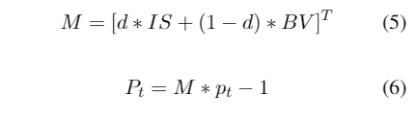
Power Iteration
(Recap)
Use LexRank to calculate probability for each sentence. Start with uniform probability
Iterate using equation 1 until converge(epsilon value 0.3 for us)
The final probability distribution is a rank of how salient sentences are.

Slide 8
Sentence Selection (Recap)
Iterative approach
Sort sentences by Lexrank score
Select sentences that do make summary over 100 words
Select sentences that do not have > 0.6 cosine similarity to sentence in summary

Slide 9
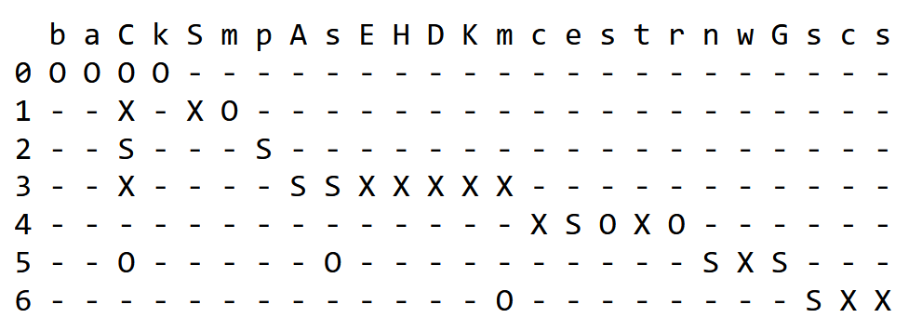
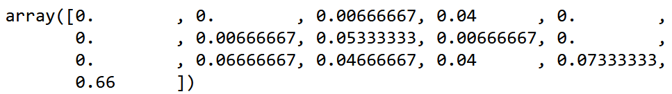
Information Ordering (Recap)
Entity grid and feature vectors (Barzilay and Lapata, 2008)
Using spaCy pre-trained models for identifying nouns (entities) and their dependency tags (for identifying subject, object, etc.)
Vectorize using bigram transitions in {S, O, X, –}² as features.

Slide 10
Information Ordering (Recap)
Training and decoding
SVM^{rank} (Joachims, 2006)
80 random documents from TAC 2009 human-created model summaries
Up to 20 permutations for each document, pair each permutation with gold ordering, ~1600 pairs in total.
Create entity grids and vectorize
For prediction, provide a number of candidate orderings, one of which is chronological ordering, and rank them using trained SVM ranking model.

Slide 11
Content Realization: Attempted Solution
Attempted Improvements: Content Realization
Remove cruft not caught by preprocessing: bylines, datelines captions, stray tags - redundant
- Redundancy = inefficiency
Parse candidate sentences and remove gratuitous modifiers
- Problematic for “forcibly” (some not gratuitous)
- Especially problematic for “high chance”
Shrink long sentences
+ Improvements in readability at first
- Contrastive relations lost for some cc’s

Slide 12
Content Realization: Attempted Solution
procedure split_large_sentences(cutoff, sentence_collection):
new_collection = []
for sentence in sentence_collection:
tokens = tokenize(sentence)
if len(tokens) > cutoff:
sent_parse = parse(sentence)
if sent_parse contains ‘cc’ and sent_parse.int(‘ROOT’):
split_index = sent_parse.index(‘cc’)
sent1 = sentence(tokens[0:split_index])
sent2 = sentence(tokens[(split_index + 1):len(tokens)])
new_collection += sent1, sent2
else:
new_collection += sentence
else:
new_collection += sentence
return new_collection

Slide 13
Content Realization: Attempted Solution
procedure trim_modifiers(sentence_collection):
for sentence in sentence_collection:
newsent = “”
pos_tags = pos_tag(sentence)
tokens = tokenize(sentence)
for i=[0:len(tokens)]:
if !(pos_tags[i] in [‘amod’,’advmod’]):
newsent.append(tokens[i])
sentence = newsent

Slide 14
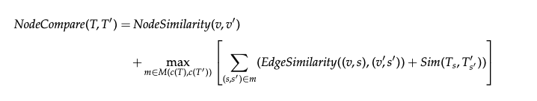
Content Realization: Potential Improvement
Recycling information ordering entity grid to obtain fusion matrix (Barzilay and McKeown, 2005)
Using tree similarity in order to find which sentences to fuse:

Slide 15
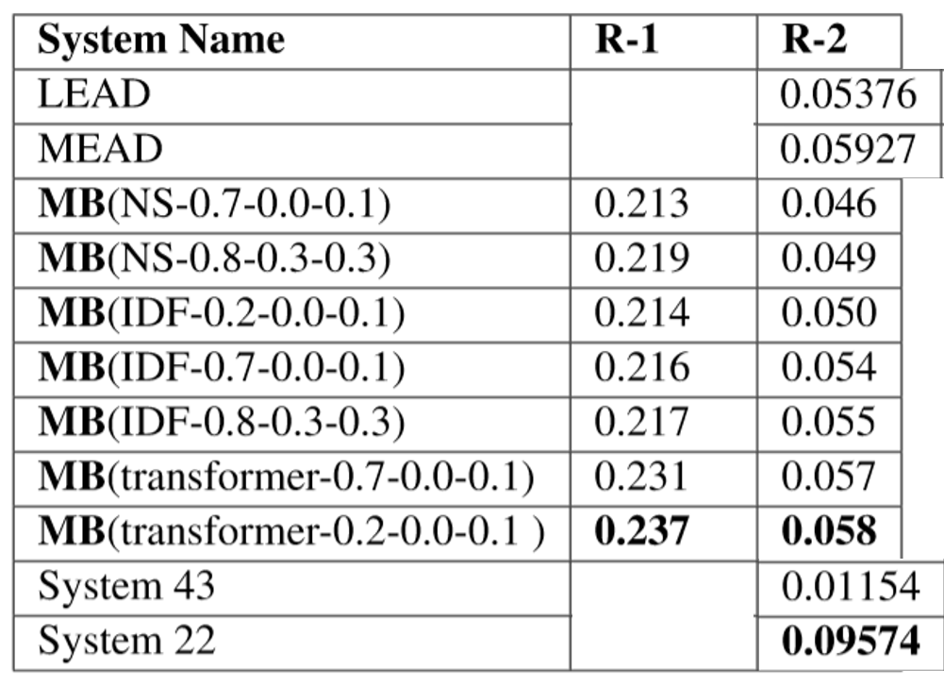
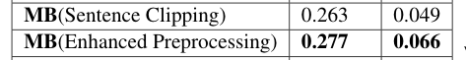
Results
Outperforms Nutshell outperforms LEAD and MEAD baselines.
Transformer based sentence representations not much better than IDF or word vector methods

Slide 16
Results: Parsing + Shrinking
Sample output:
And the emergence of botnets has alarmed not computer security experts, but specialists who created the Internet infrastructure.
We 're looking at the data.
This is good for the Internet infrastructure, Sclavos said.
Sclavos said VeriSign, which operates two of the root servers that manage Internet traffic, has an obligation to stay of and widespread Internet attacks.
This, the Internet 's traffic cops, known as routers, would n't have to keep track of every sensor, improving efficiency.
The Internet was designed there were computers connecting to it.

Slide 17
R
Results: Parsing + Shrinking, continued
Rouge-1 and Rouge-2 F-measure worse than doing neither, but Rouge-1 precision improved. Naively hacking nodes did not help...
1 ROUGE-1 Average_R: 0.22926 (95%-conf.int. 0.21593 - 0.24185)
1 ROUGE-1 Average_P: 0.30906 (95%-conf.int. 0.29394 - 0.32292)
1 ROUGE-1 Average_F: 0.26265 (95%-conf.int. 0.24911 - 0.27583)
--------
1 ROUGE-2 Average_R: 0.04315 (95%-conf.int. 0.03607 - 0.05051)
1 ROUGE-2 Average_P: 0.05750 (95%-conf.int. 0.04851 - 0.06691)
1 ROUGE-2 Average_F: 0.04920 (95%-conf.int. 0.04136 - 0.05749)

Slide 18
Results: Improved Preprocessing
(What we went with)
1 ROUGE-1 Average_R: 0.26515 (95%-conf.int. 0.24862 - 0.28082)
1 ROUGE-1 Average_P: 0.29155 (95%-conf.int. 0.27591 - 0.30637)
1 ROUGE-1 Average_F: 0.27717 (95%-conf.int. 0.26114 - 0.29209)
--------------
1 ROUGE-2 Average_R: 0.06330 (95%-conf.int. 0.05261 - 0.07398)
1 ROUGE-2 Average_P: 0.06911 (95%-conf.int. 0.05776 - 0.08000)
1 ROUGE-2 Average_F: 0.06595 (95%-conf.int. 0.05507 - 0.07654)

Slide 19
Error Analysis
Document Parsing Continues to be an Issue
, scene of an earlier school shooting, reach out to those in Littleton, Colo
'' Columbine Principal Frank DeAngelis called the gathering ``the end of a nightmare
'' The response is most visible in metropolitan Denver, radiating outward from the high school and adjacent Clement Park, which has become a mourner's Lourdes
The nation and the world have joined in grieving for the students of Columbine, Gore said
``Behind you, scarred but still standing, is Columbine High School,'' Gov
Authorities believe Columbine students Eric Harris and Dylan Klebold carried out the massacre and then killed themselves
Biased LexRank seems to favor 1st lines in the document
Soedjono said that he has assigned junior Attorney General to carry out the investigation
JAKARTA (JP): Attorney General Soedjono C
Soedjono made his statement in an apparent attempt to correct some media reports that he had met foreign lawyers hired by Soeharto
Ghalib Monday said he would ask former President Soeharto to sign a letter of authorization that would enable the investigation team to probe Soeharto's overseas wealth
"Yes, Soeharto will receive the team soon," Tanjung said
The United Development Party faction earlier asked for a separate decree to contain investigation into Soeharto, officials, former officials and their families
Systems favor long sentences (see above)
System favors quotes
Naive approach reduced readability and took away informative adjectives as well

Slide 20




What Worked
Git
Slack
Spacy/Python
Pickle Checkpointing
Pull Requests

Slide 21

What didn’t Work
Sentence compression and parsing worsened ROUGE-2 scores.
Gratuitous modifier removal worsened readability in some cases
Patas had issues from time to time, making it difficult to test needed components at times

Slide 22



Possible Extensions
BETTER USE OF LMS
INFORMATION ORDERING IMPROVEMENTS
TRANSFORMER MODELS
coref resolution + smoother CR

