Slide 1
Content Realization: Linguistic Quality
Ling 573
Systems and Applications
May 12, 2020

Slide 2
Roadmap
Readability and linguistic quality:
Corpus study and analysis
Automatic evaluation
Improvements for MDS

Slide 3
Evaluation
Shared tasks:
Take content as primary evaluation measure
ROUGE, Pyramid, (manual) Responsiveness
Linguistic quality also part of formal evaluation

Slide 4
Evaluation
Shared tasks:
Take content as primary evaluation measure
ROUGE, Pyramid, (manual) Responsiveness
Linguistic quality also part of formal evaluation
TAC “Readability”:
Scored manually on 5-point Likert scale
Aims to capture readability, fluency
Independent of summary content

Slide 5
What is “Readability”?
According to TAC,
Assessors consider (and rate 1-5) each of:
Grammaticality:
No fragments, datelines, ill-formed sentences, etc

Slide 6
What is “Readability”?
According to TAC,
Assessors consider (and rate 1-5) each of:
Grammaticality:
No fragments, datelines, ill-formed sentences, etc
Non-redundancy:
No unnecessary repetition: includes content, sentences, or full NPs when pronoun is better

Slide 7
What is “Readability”?
According to TAC,
Assessors consider (and rate 1-5) each of:
Grammaticality:
No fragments, datelines, ill-formed sentences, etc
Non-redundancy:
No unnecessary repetition: includes content, sentences, or full NPs when pronoun is better
Referential clarity:
Both presence/salience of antecedents, relevance of items

Slide 8
What is “Readability”?
According to TAC,
Assessors consider (and rate 1-5) each of:
Grammaticality:
No fragments, datelines, ill-formed sentences, etc
Non-redundancy:
No unnecessary repetition: includes content, sentences, or full NPs when pronoun is better
Referential clarity:
Both presence/salience of antecedents, relevance of items
Focus:
Only content related to summary
Coherence: “Well-structured”

Slide 9
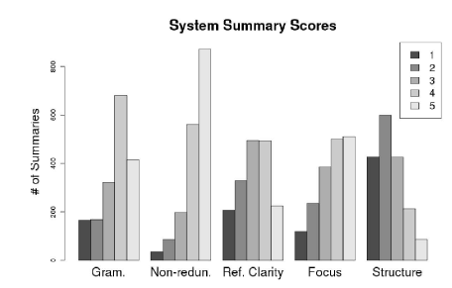
Score Distributions

Slide 10
What is “Readability”? II
Definition subsumes many phenomena, errors
What types of errors do these systems make?
What errors, issues are reflected in the scores?

Slide 11
What is “Readability”? II
Definition subsumes many phenomena, errors
What types of errors do these systems make?
What errors, issues are reflected in the scores?
LQVSumm (Friedrich et al, 2013)
Annotate linguistic “violations” in automatic summaries
TAC2011 data: ~2000 “peer” summaries
Categorize and tabulate
Assess correlation with Readability scores

Slide 12
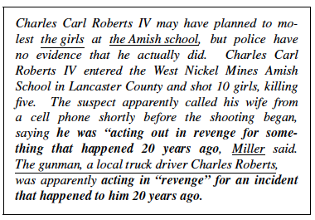
Example
Friedrich et al, 2013, p. 1591, Fig. 1

Slide 13
Violation Categories
Entity mentions:
Affect coreference and readability

Slide 14
Violation Categories
Entity mentions:
Affect coreference and readability
FM_EXPL: First mention w/o explanation
SM+EXPL: Subsequent Mention w/explanation

Slide 15
Violation Categories
Entity mentions:
Affect coreference and readability
FM_EXPL: First mention w/o explanation
SM+EXPL: Subsequent Mention w/explanation
DNP_REF: Definite NP w/o previous mention
INP+REF: Indefinite NP w/ previous mention

Slide 16
Violation Categories
Entity mentions:
Affect coreference and readability
FM_EXPL: First mention w/o explanation
SM+EXPL: Subsequent Mention w/explanation
DNP_REF: Definite NP w/o previous mention
INP+REF: Indefinite NP w/ previous mention
PRN+MISSA: Pronoun w/missing antecedent
PRN+MISSLA: Pronoun w/misleading antecedent

Slide 17
Violation Categories
Entity mentions:
Affect coreference and readability
FM_EXPL: First mention w/o explanation
SM+EXPL: Subsequent Mention w/explanation
DNP_REF: Definite NP w/o previous mention
INP+REF: Indefinite NP w/ previous mention
PRN+MISSA: Pronoun w/missing antecedent
PRN+MISSLA: Pronoun w/misleading antecedent
ACR_EXPL: Acronym w/o explanation

Slide 18
Violation Categories
Clausal level:
Arbitrary spans – up to sentence level

Slide 19
Violation Categories
Clausal level:
Arbitrary spans – up to sentence level
INCOMPLSN: Incomplete sentence
INCLDATE: included dateline info
OTHRUNGR: other ungrammatical

Slide 20
Violation Categories
Clausal level:
Arbitrary spans – up to sentence level
INCOMPLSN: Incomplete sentence
INCLDATE: included dateline info
OTHRUNGR: other ungrammatical
NOSEMREL: No semantic relation b/t sentences
NODISREL: Discourse relation doesn’t fit

Slide 21
Violation Categories
Clausal level:
Arbitrary spans – up to sentence level
INCOMPLSN: Incomplete sentence
INCLDATE: included dateline info
OTHRUNGR: other ungrammatical
NOSEMREL: No semantic relation b/t sentences
NODISREL: Discourse relation doesn’t fit
REDUNINF: Redundant information

Slide 22
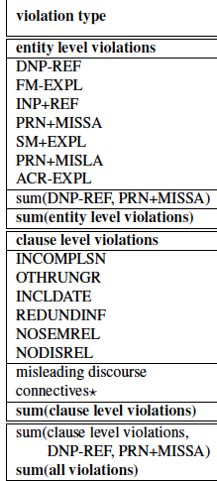
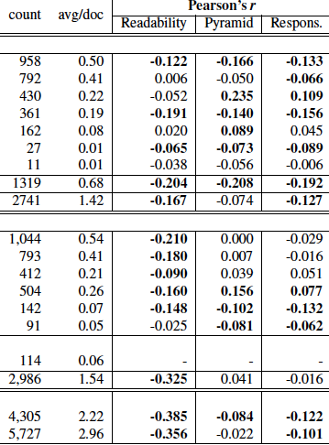
Friedrich et al, 2013, p. 1596, Tab. 2

Slide 23
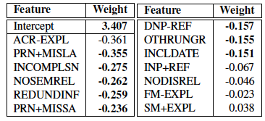
Further Analysis
Linear model investigates the relationship of particular errors to readability
Friedrich et al, 2013, p. 1596, Tab. 3

Slide 24
Further Analysis
Linear model investigates the relationship of particular errors to readability
Most significant factors: Missing/Misleading refs, fragments, redundant content, poor coherence
Total # of errors well-correlated with system ranks
Friedrich et al, 2013, p. 1596, Tab. 3

Slide 25
Automatic Evaluation of Linguistic Quality
Motivation:
No focus on linguistic quality

Slide 26
Automatic Evaluation of Linguistic Quality
Motivation:
No focus on linguistic quality b/c no way to tune to it
Everyone uses ROUGE b/c you can tune
Explicitly tuned in many ML models

Slide 27
Automatic Evaluation of Linguistic Quality
Motivation:
No focus on linguistic quality b/c no way to tune to it
Everyone uses ROUGE b/c you can tune
Explicitly tuned in many ML models
Alternative strategies:
Micro: Learn to predict component scores
Macro: Learn to predict overall readability score
Intuitively: error count (LQVSumm) predicts well, but…

Slide 28
Automatic Evaluation of Linguistic Quality
Motivation:
No focus on linguistic quality b/c no way to tune to it
Everyone uses ROUGE b/c you can tune
Explicitly tuned in many ML models
Alternative strategies:
Micro: Learn to predict component scores
Macro: Learn to predict overall readability score
Intuitively: error count (LQVSumm) predicts well, but…
Errors manually derived

Slide 29
Micro-Quality Prediction
(Pitler et al, 2010) via SVM ranking
Evaluate multiple measures aimed to model LQ

Slide 30
Micro-Quality Prediction
(Pitler et al, 2010) via SVM ranking
Evaluate multiple measures aimed to model LQ
General word choice, sequence:

Slide 31
Micro-Quality Prediction
(Pitler et al, 2010) via SVM ranking
Evaluate multiple measures aimed to model LQ
General word choice, sequence: Language Models
Reference form:

Slide 32
Micro-Quality Prediction
(Pitler et al, 2010) via SVM ranking
Evaluate multiple measures aimed to model LQ
General word choice, sequence: Language Models
Reference form:
Named Entities:
Modifiers for 1st mention of PERSON
Proportion of summary NER first mentions originally non-first

Slide 33
Micro-Quality Prediction
(Pitler et al, 2010) via SVM ranking
Evaluate multiple measures aimed to model LQ
General word choice, sequence: Language Models
Reference form:
Named Entities:
Modifiers for 1st mention of PERSON
Proportion of summary NER first mentions originally non-first
NP syntax: POS, phrase tags in NPs

Slide 34
Micro-Quality Prediction
(Pitler et al, 2010) via SVM ranking
Evaluate multiple measures aimed to model LQ
General word choice, sequence: Language Models
Reference form:
Named Entities:
Modifiers for 1st mention of PERSON
Proportion of summary NER first mentions originally non-first
NP syntax: POS, phrase tags in NPs
Local coherence devices:
Count of demonstratives, pronouns, definite descriptions, and sentence initial discourse connectives

Slide 35
Micro-Quality Prediction
Evaluate multiple measures aimed to model LQ
Continuity:

Slide 36
Micro-Quality Prediction
Evaluate multiple measures aimed to model LQ
Continuity:
For each cohesive device, are sentences adjacent in source?
Position and confidence of antecedents of pronouns
Max, min, and average cosine similarity b/t sentences

Slide 37
Micro-Quality Prediction
Evaluate multiple measures aimed to model LQ
Continuity:
For each cohesive device, are sentences adjacent in source?
Position and confidence of antecedents of pronouns
Max, min, and average cosine similarity b/t sentences
Sentence fluency:
Shallow syntax features correlated w/MT quality

Slide 38
Micro-Quality Prediction
Evaluate multiple measures aimed to model LQ
Continuity:
For each cohesive device, are sentences adjacent in source?
Position and confidence of antecedents of pronouns
Max, min, and average cosine similarity b/t sentences
Sentence fluency:
Shallow syntax features correlated w/MT quality
Coh-Metrix:
Set of psycholinguistically-based coherence feats, LSA sim

Slide 39
Micro-Quality Prediction
Evaluate multiple measures aimed to model LQ
Continuity:
For each cohesive device, are sentences adjacent in source?
Position and confidence of antecedents of pronouns
Max, min, and average cosine similarity b/t sentences
Sentence fluency:
Shallow syntax features correlated w/MT quality
Coh-Metrix:
Set of psycholinguistically-based coherence feats, LSA sim
Word coherence: cross-sentence word cooccurrence patterns
Entity coherence

Slide 40
Micro-Quality Prediction
Evaluate multiple measures aimed to model LQ
Continuity:
For each cohesive device, are sentences adjacent in source?
Position and confidence of antecedents of pronouns
Max, min, and average cosine similarity b/t sentences
Sentence fluency:
Shallow syntax features correlated w/MT quality
Coh-Metrix:
Set of psycholinguistically-based coherence feats, LSA sim
Word coherence: cross-sentence word cooccurrence patterns
Entity coherence: via Entity-grids (Brown toolkit)

Slide 41
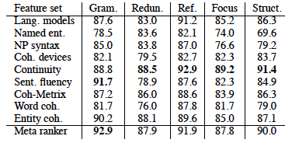
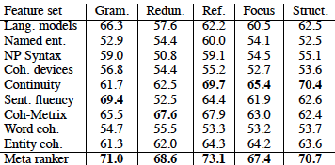
Results
System level
Summary level
Pitler et al, 2010, p. 550, Tab 2; p. 551, Tab 3

Slide 42
Findings
Overall accuracies quite good

Slide 43
Findings
Overall accuracies quite good
Systems overall easier to rank than particular input
Smooths variance, larger sample

Slide 44
Findings
Overall accuracies quite good
Systems overall easier to rank than particular input
Smooths variance, larger sample
Continuity related features best across components
Ensemble of ordering, coref, cosine similarity cues
Though LSA-based system detects redundancy well

Slide 45
Findings
Overall accuracies quite good
Systems overall easier to rank than particular input
Smooths variance, larger sample
Continuity related features best across components
Ensemble of ordering, coref, cosine similarity cues
Though LSA-based system detects redundancy well
Specifically tuned fluency scorer works on fluency

Slide 46
Macro-Quality Prediction
(Lin et al, 2012) Downloadable
High-level idea:
Discourse version of entity grid
Columns: entities (same head)
Rows: sentences
Cell values: PDTB Discourse Relation.Arg# tuples

Slide 47
Macro-Quality Prediction
(Lin et al, 2012) Downloadable
High-level idea:
Discourse version of entity grid
Columns: entities (same head)
Rows: sentences
Cell values: PDTB Discourse Relation.Arg# tuples
Variants:
Inter-cell sequence frequencies
+ Additional tuples: {Non--}Explicit.Relation.Arg#
+ Intra-cell “sequences”

Slide 48
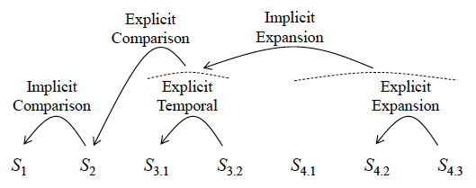
(Lin et al, 2012; p. 1010; Fig 1,2; Tab 2
S₁: Japan normally depends heavily on the Highland Valley and Cananea mines as well as the Bougainville mine in Papua New Guinea.
S₂: Recently Japan has been buying copper elsewhere.
S_{3.1}:But as Highland Valley and Cananea begin operating,
S_{3.2}: they are expected to resume their roles as Japan’s suppliers.
S_{4.1}: According to Fred Demler, metals economist for DBL, New York,
S_{4.2}: “Highland Valley has already started operating
S_{4.3}: and Cananea is expected to do so soon.”
S# | Copper | Cananea | operat | depend | ..
S₁ | Nil | Comp.A1 | Nil | Comp.A1
S₂ | Comp.A2 Comp.A1 | Nil | Nil | Nil
S₃ | Nil | Comp.A2 Temp.A1 Exp.A1 | Comp.A2 Temp.A1 Exp.A1 | nil
S₄ | Nil | Exp.A1 | Exp.A1 Exp.A2 | nil

Slide 49
Results
Very strong correlations w/manual readability score
Beats prior predictors
Measure | Pearson | Spearman
Rouge-2 | 0.7524 | 0.3975
TAC system 6 | 0.8194 | 0.4937
DiscRelGrid | 0.8556 | 0.6593
DiscRelGrid + Explicit tags + Within cell transitions | 0.8666 | 0.7122

Slide 50
Content Realization: Referring Expressions

Slide 51
Referring to People in News Summaries
Intuition:
Referring expressions common source of errors
References to people prevalent in news data, summaries
Information status constrains realization
Targeted rewriting can improve readability

Slide 52
Referring to People in News Summaries
Intuition: (Nenkova, ‘08; Siddarthan et al, 2011)
Referring expressions common source of errors
References to people prevalent in news data, summaries
Information status constrains realization
Targeted rewriting can improve readability
Approach:
Exploit information status distinctions
Automatically identified
Use to guide rule-based generation of referring expressions

Slide 53
Challenges

Slide 54
Challenges
Lack of training data:
No summary data labeled for information status
Readers sensitive to referring expressions
Prior work on NP rewriting has shown mixed results
Some improvement, some failures
Relies on potentially errorful coref, other processing

Slide 55
NP Rewrite: very good example
While the British government defended the arrest, it took no stand on extradition of Pinochet to Spain, leaving it to the courts.
While the British government defended the arrest in London of former Chilean dictator Augusto Pinochet, it took no stand on extradition of Pinochet to Spain, leaving it to British courts.

Slide 56
NP Rewrite: mixed example
Duisenberg has said growth in the euro area countries next year will be about 2.5 percent, lower than the 3 percent predicted earlier.
Wim Duisenberg, the head of the new European Central Bank, has said growth in the euro area countries next year will be about 2.5 percent, lower than just 1 percent in the euro-zone unemployment predicted earlier.

Slide 57
Information Status
Build on three key distinctions:
Discourse-new vs discourse-old:
First mention handling vs others
Hearer-new vs hearer-old:
Distinguish well-known individuals from others
Don’t waste space describing well-known individuals
Major vs minor character:
Salience of the person in the event

Slide 58
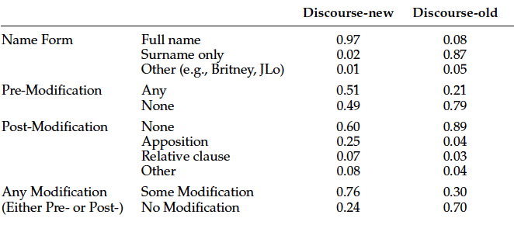
Corpus Analysis
Assess relation between:
information status and referring expressions
Siddharthan et al, 2011, p. 818, Table 1

Slide 59
Generating Discourse-New/Old
If discourse-new,
If the NP head is a person name,
If appears with pre-modifier in text, write as:
Longest pre-modifier + full name
Else if it appears with an apposition modifier
Add that to the reference
Else don’t rewrite
Else use surname only

Slide 60
Generating Discourse-New/Old
If discourse-new,
If the NP head is a person name,
If appears with pre-modifier in text, write as:
Longest pre-modifier + full name
Else if it appears with an apposition modifier
Add that to the reference
Else don’t rewrite
Else use surname only
Significantly preferred over original forms

Slide 61
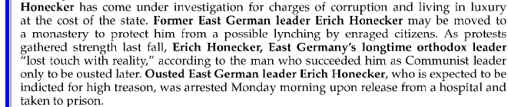
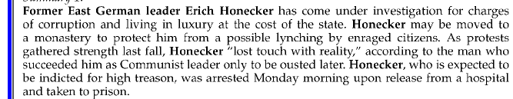
Example Rewrite
Siddharthan et al, 2011, p. 818, Table 1

Slide 62
Hearer & Salience
Discourse-new status:

Slide 63
Hearer & Salience
Discourse-new status:
Obvious from summary
How do we establish hearer or major/minor status?

Slide 64
Hearer & Salience
Discourse-new status:
Obvious from summary
How do we establish hearer or major/minor status?
Categorize based on human summaries (gold)
Specifically by their referring expressions:
Hearer-old (i.e. familiar)
Title/role+surname or unmodified fullname
Major:
Referred to by name in some human summary of topic
258 major/3926 minor by data

Slide 65
Training & Application
Trained classifiers to recognize – using features in docset
H-New/Old: F-measure: 0.75 on both classes
Major/Minor: F: Major: 0.6; Minor: 0.98
All significantly better than baseline

Slide 66
Training & Application
Trained classifiers to recognize – using features in docset
H-New/Old: F-measure: 0.75 on both classes
Major/Minor: F: Major: 0.6; Minor: 0.98
All significantly better than baseline
Create rules based on classification to:
Use names (only) for major characters (o.w. common)
Exclude post-modifiers for hearer-old, tune for new
Include titles for initial mentions
Include affiliation premodifiers based on hearer/salience

Slide 67
Evaluation
Created (nearly) deterministic rule set
Based on information status classification
To rewrite referring expressions in extractive summaries
Evaluated in paired preference tests over:
Original Extractive and Rewritten Summaries
Where a preference was expressed,
Rewritten summaries rated as more coherent
Extractive rated as more informative

Slide 68
Evaluation
Created (nearly) deterministic rule set
Based on information status classification
To rewrite referring expressions in extractive summaries
Evaluated in paired preference tests over:
Original Extractive and Rewritten Summaries
Where a preference was expressed,
Rewritten summaries rated as more coherent
Extractive rated as more informative
Why? Rewrite rules generally shrink rather than add content

Slide 69
Summary
Can identify particular correlates of readability scores
Can automatically predict linguistic quality scores
Build systems that focus on frequent violations
Yield systematic improvements in linguistic quality

