Slide 1

MockingBird
A BASIC TOPIC-FOCUSED MULTI-DOCUMENT SUMMARIZATION SYSTEM
Daniel Campos, Sicong Huang, Shunjie Wang, Simola Nayak, and Hayley Luke

Slide 2

Related Readings

Slide 3

System Overview

Slide 4
Data Prep and Process

Slide 5
Content Selection
Modified Biased LexRank Graph Approach
Build a similarity graph
Nodes are sentences
Edges are inter sentence similarity
Cosine distance of sentence average word embeddings
Various methods dropping stop words, and non nouns.
Bias for query topic
Power Iteration

Slide 6
WordVector Cosine Similarity
To calculate the inter-sentential and topic-sentencial similarity
##Add equation here
Minimum threshold is 0.2
Drop stop words, non nouns, nothing (using spacy)

Slide 7
Biased Lexrank
Getting the LexRank for a given sentence s in topic t:
D is how much importance the topic has
S is all possible sentences

Slide 8
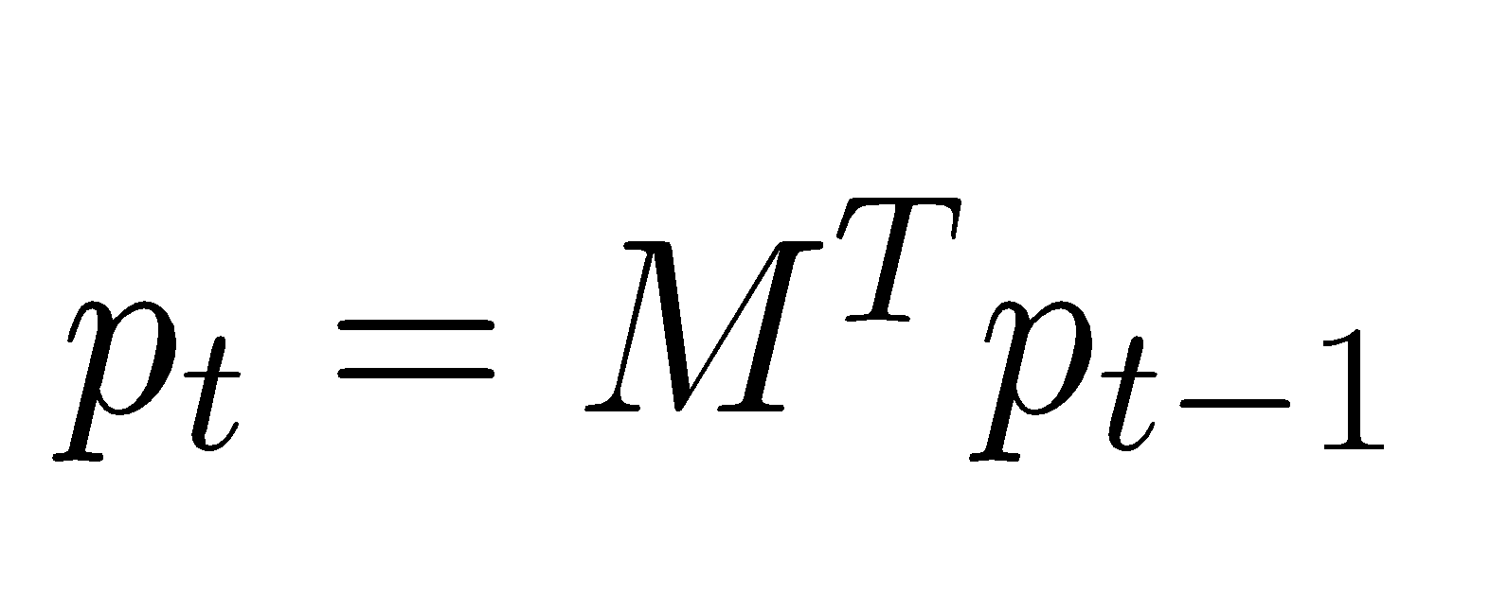
Power Iteration
Use LexRank to calculate probability for each sentence. Start with uniform probability
Iterate using equation 1 until converge(epsilon value 0.15 for us)
The final probability distribution is a rank of how salient sentences are.
Equation 1:

Slide 9
Sentence Selection
Iterative approach
Sort sentences by Lexrank score
Select sentences that do make summary over 100 words
Select sentences that do not have > 0.6 cosine similarity to sentence in summary

Slide 10
Information Ordering
Newest First?

Slide 11
Content Realization
Use information as presented in Info Ordering

Slide 12
Results
Model | ROUGE-1 | ROUGE-2 | Average ROUGE
LEAD(Baseline)
MEAD(Baseline
Mockingbird
Mockingbird(Nouns Only)
Mockingbird(No StopWords

Slide 13
What Worked
Git
Pull Requests
Slack

Slide 14
What didn’t Work
Hard to start working when many parts are intertwined
Division of labor

Slide 15
Future work
Text preprocessing and stemming
Transformer based tokenization?
Information ordering improvements
Content realization

