Slide 1

MockingBird
A BASIC TOPIC-FOCUSED MULTI-DOCUMENT SUMMARIZATION SYSTEM
Daniel Campos, Sicong Huang, Shunjie Wang, Simola Nayak, and Hayley Luke

Slide 2
Structure
New Related Readings for D3
Data Prep and Process Improvements
Content Selection Improvements
Information Ordering Initial Implementation
Content Realization Visions
Results
Good and Bads
Future work

Slide 3

New Related Readings for D3
Reimers, Nils and Iryna Gurevych. “Sentence-BERT: Sentence Embeddings using Siamese BERT-Networks.” EMNLP/IJCNLP (2019).
Regina Barzilay and Mirella Lapata. 2008. Modeling local coherence: An entity-based approach.Computational Linguistics, 34(1):1–34.
Thorsten Joachims. 2002. Optimizing search engines using clickthrough data. KDD '02: Proceedings of the eighth ACM SIGKDD international conference on Knowledge discovery and data mining. 133–142
Thorsten Joachims. 2006. Training linear svms in linear time. In Proceedings of the 12th ACM SIGKDD international conference on Knowledge discovery and data mining, KDD ’06, pages 217–226, New York, NY, USA. AC

Slide 4
Summarization Pipeline
Content Selection:
Biased LexRank
Information Ordering
Document Cluster
Ordered Sentences
Sentence Selection
Summary
Sort Chronologically
ItraSentence Similarity
Sentences
Sentence-Topic Similarity
Content Realization
Power Method
Data Input and Processing
Config

Slide 5
Data Prep and Process
Improve sentence tokenization by using spaCy
Further cleaning of unneeded symbols
Normalizing quotation marks

Slide 6

Content Selection
Modified Biased LexRank Graph Approach
Build a similarity graph
Nodes are sentences
Edges are inter-sentence similarity
Cosine distance of sentence embeddings
Bias for query topic
Power Iteration

Slide 7

WordVector Cosine Similarity
To calculate the inter-sentential and topic-sentencial similarity
Minimum threshold is 0.3
Drop stop words, non nouns, nothing (using spacy)

Slide 8

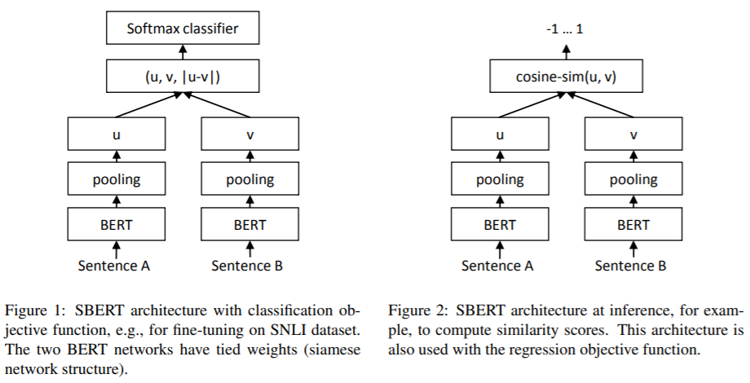
Sentence Representation
Explored averaged word vectors, IDF, Siamese BERT-Network
Explored using 🤗 Transformers library for sentence representation
Use the embedding of [CLS] token
Doesn’t work too well. Solution use SBERT (fine-tuned BERT style model focused on representing sentence similarity) trained on SNLI and MultiNLI
Surprisingly, Transformer-based model does not outperform peers!

Slide 9
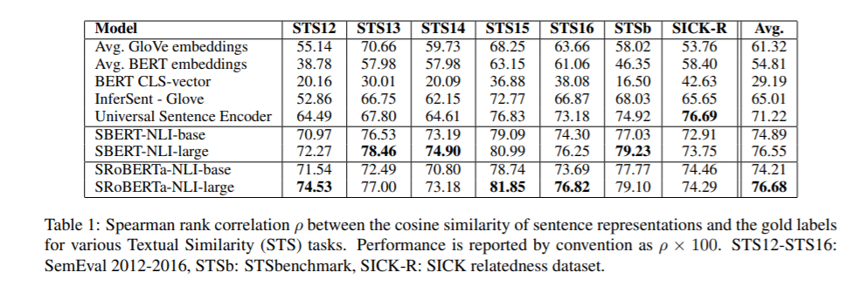

Slide 10
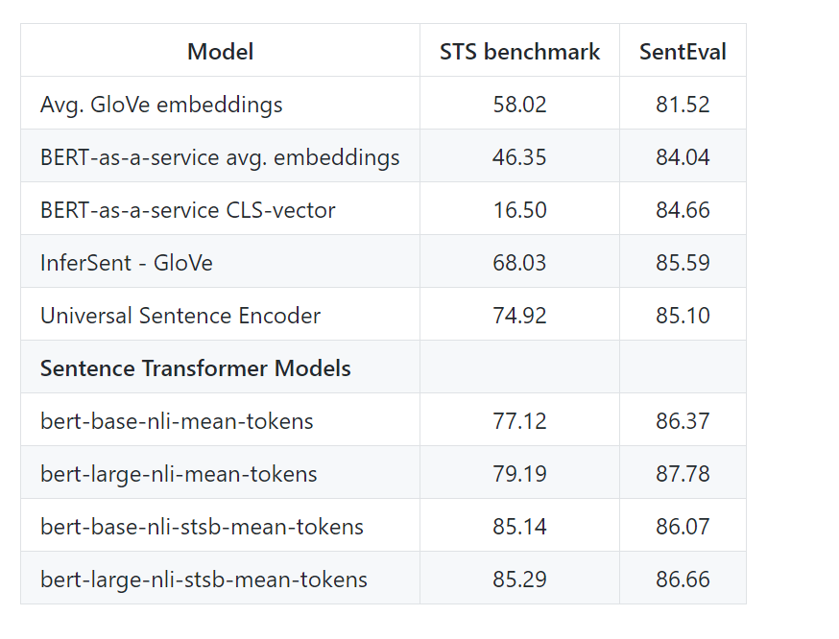
Sentence Embeddings

Slide 11
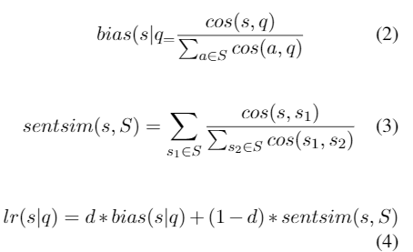
Biased Lexrank
Getting the LexRank for a given sentence s in topic t:
D is how much importance the topic has(0.7 for our experiments)
S is all possible sentences

Slide 12
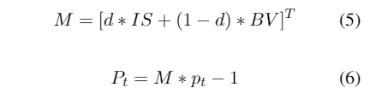
Power Iteration
Use LexRank to calculate probability for each sentence. Start with uniform probability
Iterate using equation 1 until converge(epsilon value 0.3 for us)
The final probability distribution is a rank of how salient sentences are.

Slide 13
Sentence Selection
Iterative approach
Sort sentences by Lexrank score
Select sentences that do make summary over 100 words
Select sentences that do not have > 0.6 cosine similarity to sentence in summary

Slide 14
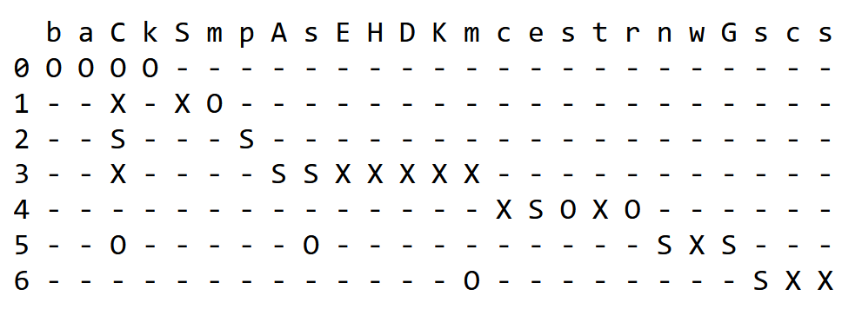
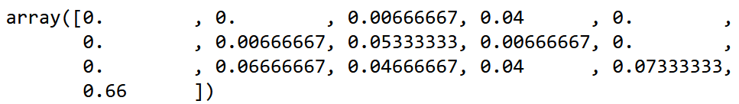
Information Ordering
Entity grid and feature vectors (Barzilay and Lapata, 2008)
Using spaCy pre-trained models for identifying nouns (entities) and their dependency tags (for identifying subject, object, etc.)
Vectorize using bigram transitions in {S, O, X, –}² as features.

Slide 15
Information Ordering
Training and decoding
SVM^{rank} (Joachims, 2006)
80 random documents from TAC 2009 human-created model summaries
Up to 20 permutations for each document, pair each permutation with gold ordering, ~1600 pairs in total.
Create entity grids and vectorize
For prediction, provide a number of candidate orderings, one of which is chronological ordering, and rank them using trained SVM ranking model.

Slide 16
Future Improvements: Content Realization
Remove cruft not caught by preprocessing: bylines, datelines, captions, stray tags
Parse candidate sentences and remove gratuitous modifiers
Sentence fusion (Barzilay and McKeown 2005)
Log information status of entities and create hierarchy based on abbreviation

Slide 17
Conciseness
One way to ensure conciseness is to remove gratuitous adjectives and adverbs.
Simple heuristic:
Parse sentence
Prune adjectives and adverbs from tree
Sentence Fusion Grid (Barzilay and McKeown, 2005)
Notes:
Potential pitfalls include adverbs like forcibly

Slide 18
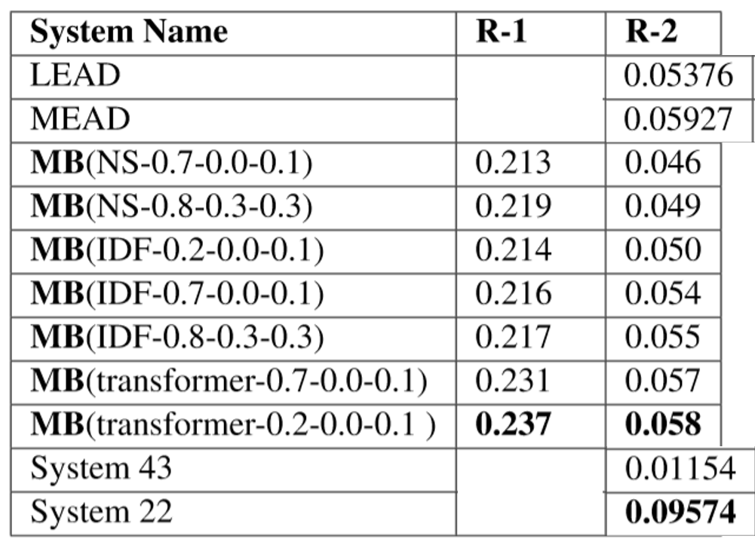
Results
Outperforms Nutshell outperforms LEAD but not MEAD baseline!
Transformer based sentence representations not much better than IDF or word vector methods

Slide 19
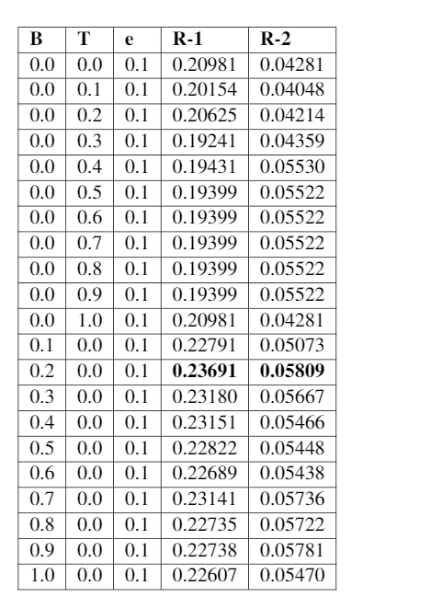
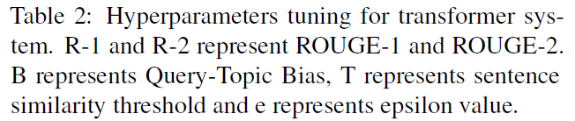
Results: Hyperparam Tuning

Slide 20
Error Analysis
Document Parsing Continues to be an Issue
, scene of an earlier school shooting, reach out to those in Littleton, Colo
'' Columbine Principal Frank DeAngelis called the gathering ``the end of a nightmare
'' The response is most visible in metropolitan Denver, radiating outward from the high school and adjacent Clement Park, which has become a mourner's Lourdes
The nation and the world have joined in grieving for the students of Columbine, Gore said
``Behind you, scarred but still standing, is Columbine High School,'' Gov
Authorities believe Columbine students Eric Harris and Dylan Klebold carried out the massacre and then killed themselves
Biased LexRank seems to favor 1st lines in the document
Soedjono said that he has assigned junior Attorney General to carry out the investigation
JAKARTA (JP): Attorney General Soedjono C
Soedjono made his statement in an apparent attempt to correct some media reports that he had met foreign lawyers hired by Soeharto
Ghalib Monday said he would ask former President Soeharto to sign a letter of authorization that would enable the investigation team to probe Soeharto's overseas wealth
"Yes, Soeharto will receive the team soon," Tanjung said
The United Development Party faction earlier asked for a separate decree to contain investigation into Soeharto, officials, former officials and their families
Systems favor long sentences (see above)
System favors quotes

Slide 21





What Worked
Git
Slack
Patas/Condor
Spacy/Python
Hyperparameter tuning
Pull Requests

Slide 22

What didn’t Work
Hard to start working when many parts are intertwined
Transformer based system is slow to run for little time improvements.

Slide 23





Future work
TEXT PREPROCESSING AND STEMMING
BETTER USE OF LMS
INFORMATION ORDERING IMPROVEMENTS
HYPERPARAM TUNING
CONTENT REALIZATION

