Slide 1
http://github.com/cadmium-red/WebFundamentals-Teamwork http://harduni.lmarkov.com

Slide 2

Hardcore university
Web-fundamentals teamwork, team cadmium-red
SoftUni, October 2014

Slide 3
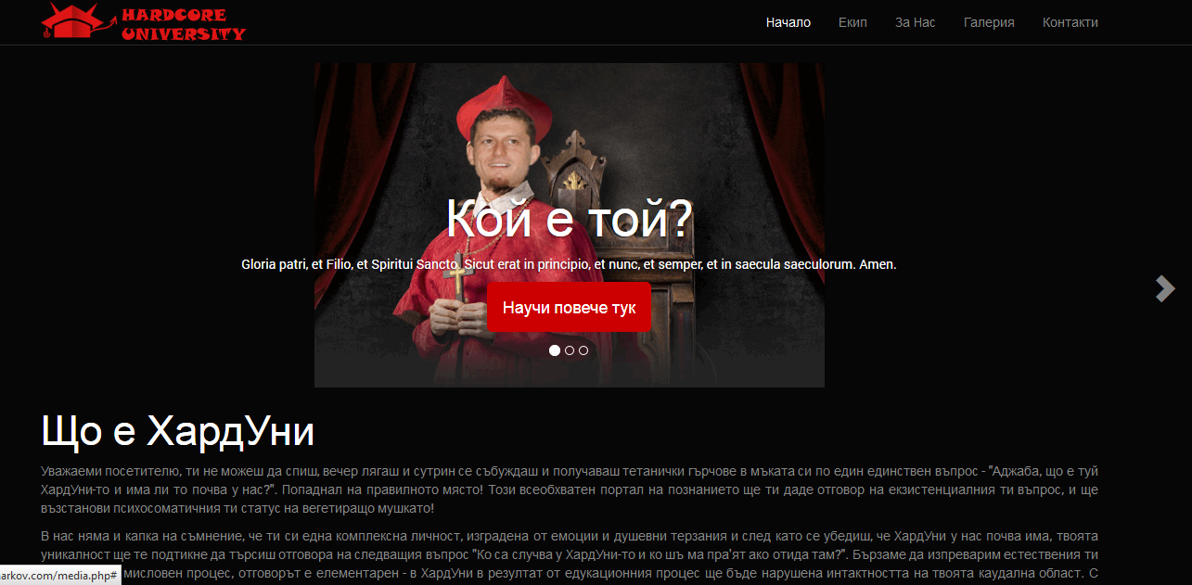
Project name and purpose
Name – “Hardcore University”

Slide 4
Cadmium Red MEMBERS
Lyubomir Markov (lmarkov)
Petar Marinov (Pe6o601)
Krastyo Krastev (krastevkrs)
Stoyan Kafaliev (stoyan93)

Slide 5

Tools and resources
GitHub
KickStart, Bootstrap
JavaScript
PHP
Facebook, Skype

