Slide 1
Spam Emails Classification: a comparison between Machine Learning and Deep Learning techniques
Andrea Cadoni

Slide 2
Content
Related Work
The dataset
Proposed Method
Results
Conclusions

Slide 3
Related Works
Sharma, Priti, and Uma Bhardwaj. ”Machine Learning based Spam E-Mail Detection.” International Journal of Intelligent Engineering & Systems 11.3 (2018).
A. Harisinghaney, A. Dixit, S. Gupta and A. Arora, ”Text and image based spam email classification using KNN, Naïve Bayes and Reverse DBSCAN algorithm,” 2014
Faris, Hossam, Ibrahim Aljarah, and Ja’far Alqatawna. ”Optimizing feedforward neural networks using krill herd algorithm for e-mail spam detection.” 2015 IEEE Jordan conference on applied electrical engineering and computing technologies (AEECT), 2015.

Slide 4
The Dataset
48 continuous real [0,100] attributes of type word_freq_WORD
6 continuous real [0,100] attributes of type char_freq_CHAR]
1 continuous real [1,...] attribute of type capital_run_length_average
1 continuous integer [1,...] attribute of type capital_run_length_longest
1 continuous integer [1,...] attribute of type capital_run_length_total.
Statistics about the Emails
57 features
4601 instances
1 attribute label → 0/1 (No/Yes)

Slide 5
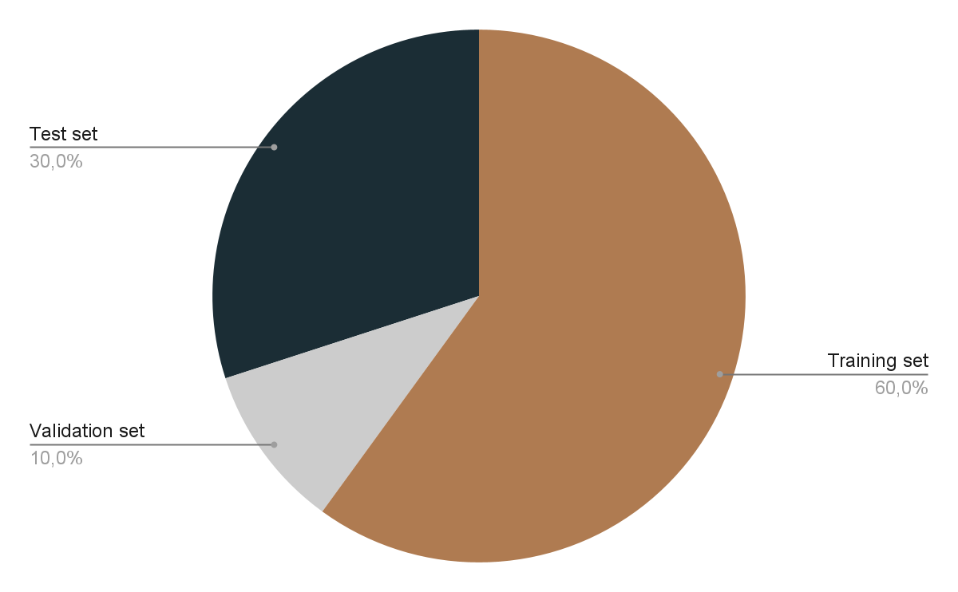
Proposed Method: train-val-test

Slide 6
Proposed Method
Machine Learning:
Support Vector Machines
RandomForest Classifier
Decision Tree Classifier
AdaBoost
Logistic Regression

Slide 7
Proposed Method
Deep Learning:
Multi Layer Perceptron without Dropout added
Multi Layer Perceptron with Dropout added

Slide 8
Results: Machine Learning
Algorithm used | Accuracy | Elapsed Time (s)
SVM (kernel RBF) | 0.902 | 0.837
Decision Tree | 0.895 | 0.156
Random Forest (1 feature) | 0.849 | 0.106
Random Forest (8+ features) | 0.922 | 0.115
AdaBoost | 0.934 | 0.810
Logistic Regression | 0.907 | 0.179

Slide 9
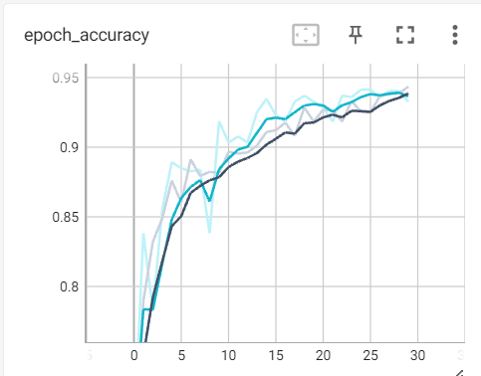
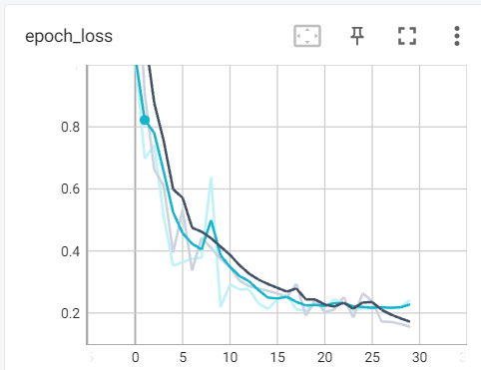
Results: Deep Learning (no Dropout)

Slide 10
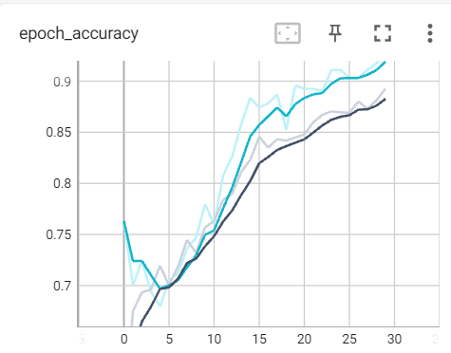
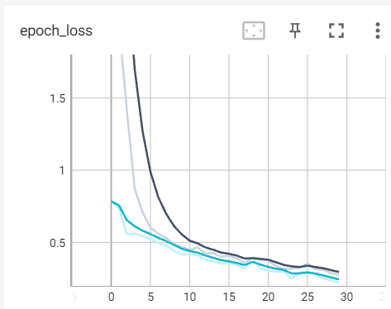
Results: Deep Learning (with Dropout)

Slide 11
Conclusions
Accuracy
Machine Learning | Deep Learning
0.934 (AdaBoost) Test set | 0.944 Train set
 | 0.933 Val set

