Slide 1
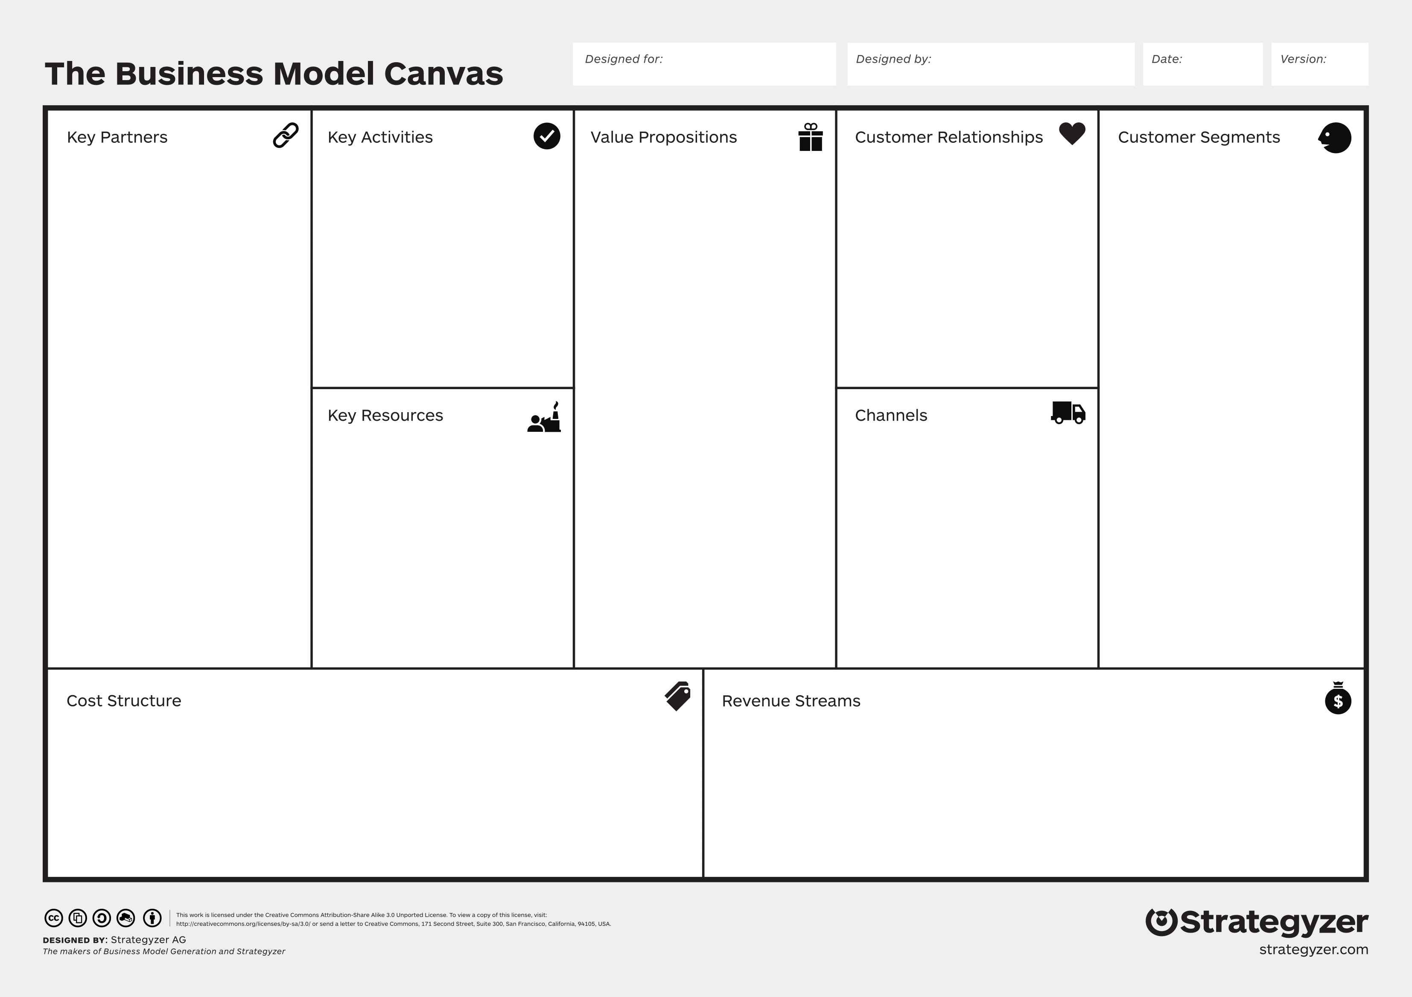
osvcad
Guillaume Florent
18 SEP 2017
1.0
Rennes Metropole /
FEDER
Solution development
Complex hardware
products modelling
Online forums
Fablabs, communities,
individuals
(free customers)
CNRS
Community building
Website / blog
PythonOCC project
Marketing
Collaborative and
versionning infrastructure
Trade shows
Small and medium
hardware production
businesses
(paying customers)
Hosting service
Integrated platform
for complex hardware
products modelling
(collaborative and
versionned)
Like-minded
communities
Parts suppliers
Development skills
Online / platform service
Community
github
Hosting
Development costs
Professional / private project hosting
Hosting
Consulting / Custom solutions
Marketing / Support
Parts supplier ads / commisions

