Slide 1
SonarQube (Code Analysis Tool)

Slide 2
Agenda
Code Analysis
Code Review

Slide 3
Code Review Issues
Time Consuming
Boring
Maybe “Rubber Stamping”

Slide 4
Code Review Tools
List of widely used tools:
    SONAR
    PMD
    FINDBUGS
    Javadoc

Slide 5
What Is Sonar?
Sonar is an open source platform for continuous inspection of code quality.
Supports languages: Java, C/C++, Objective-C, C#, PHP, Flex, Groovy, JavaScript, Python, PL/SQL, COBOL, etc. (note that some of them are commercial)
Can also be used in Android development.
https://en.wikipedia.org/wiki/SonarQube

Slide 6
How to Configure Sonar?
To Configure Sonar We required SonarQube and Sonar-Runner
    SonarQube for Sonar Server (we run StartSonar.bat file located at …\sonarqube-X.X.X\bin\windows-x86-32/64).
    Sonar-Runner to deploy application code with sonar (for this exercise first we create a file called “sonar-project.properties”).

Slide 7
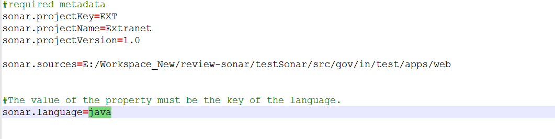
Sonar-project.properties

Slide 8
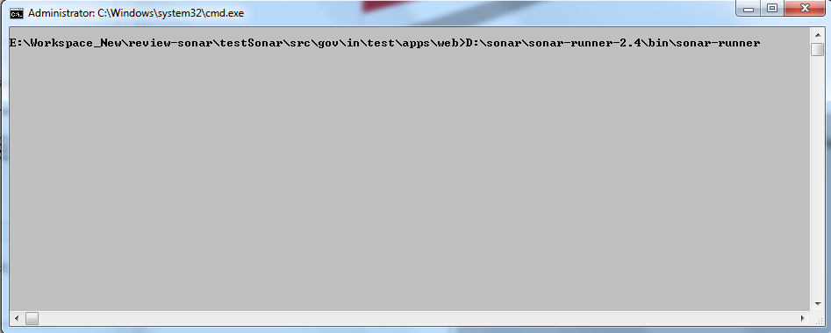

Slide 9
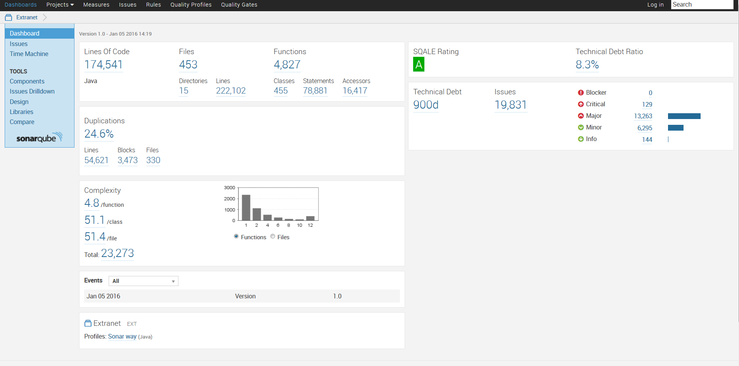
Sonar Application Dashboard

Slide 10
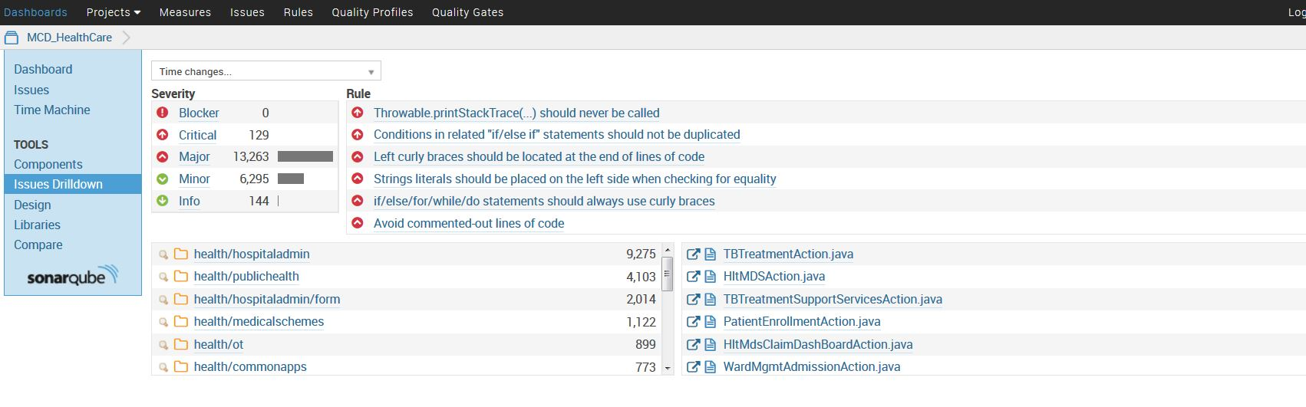

Slide 11
Sonar Rules to Drilldown your Code
There are five types of Severity.
    Blocker
    Critical
    Major
    Minor
    Info

Slide 12
Rules for Critical
Throwable.printStackTrace(...) should never be called
Conditions in related "if/else if" statements should not be duplicated

Slide 13
Rules for Major
Left curly braces should be located at the end of lines of code
Strings literals should be placed on the left side when checking for equality
if/else/for/while/do statements should always use curly braces
Statements should be on separate lines
Right curly brace and next "else", "catch" and "finally" keywords should be located on the same line
Collection.isEmpty() should be used to test for emptiness
Methods should not be empty

Slide 14
Rules for Minor
Useless imports should be removed
String literals should not be duplicated
Magic numbers should not be used

Slide 15
Thank You

