Slide 1

ELK
Ealasticsearch Logstash &Kibana

Slide 2
Agenda
Introduction of ELK
Elasticsearch Basic concepts
Elasticsearch Advanced Topics
Elasticsearch Cluster setup
Logstash
Kibana

Slide 3
ELK ElasticSearch, Logstash & Kibana

Slide 4
What is ELK ?
Elasticsearch for deep search and data analytics.
Logstash for centralized logging, log enrichment and parsing.
Kibana for powerful and beautiful data visualizations.
Elasticsearch, along with Logstash and Kibana, provides a powerful platform for indexing, searching and analyzing your data

Slide 5
Why we need to recommend ELK?
The ELK stack provides a set of utilities and applications
Each one serving a distinct purpose.
It enables you to search all your logs in a single location.
All these are Open source tools.
Elasticsearch collects and stores logs, Logstash indexes the logs, and Kibana 4, a web interface, is used to view and search the logs already indexed.

Slide 6
Why people are choosing ELK?
Easier to manage and monitor at scale
Flexible architecture, integration with hadoop among others
Less cost comparatively other alternatives
Built by Devops for devops
It will bring all your logs

Slide 7
Where are customers coming from?
Facebook, Twitter, GitHub, NetFlix
Most of the ecommers customers buying elastic search
Job search sites

Slide 8

(Storage, index & search)

Slide 9
Elasticsearch
It is a search engine not a search tool in a box.
Open source search and analytics engine.
Distributed and scalable search engine
Designed for Horizontal scaling replication, fail over, Load balancing.
Easy management & easy to use API
Based on Lucene
Hiding Lucene complexity by exposing all services
HTTP, JSON, REST
Works with all technologies.
Fast search.

Slide 10
How Elasticsearch works?
Shards & Replica
Elasticsearch provides the ability to subdivide your index into multiple pieces called shards.
Single instance of Luceneon a node
Can be primary or replica
Index
An index is a collection of documents that have somewhat similar characteristics.
Like a database within a relational database
Nodes
A node is a single server that is part of your cluster
Keeps a copy of the index

Slide 11
Benefits of Elasticsearch
Full text search
Elasticsearch builds distributed capabilities on top of Apache Lucene to provide the most powerful full- text search capabilities available
Store complex real world entities in Elasticsearch as structured JSON documents
All fields are indexed by default.
Elasticsearch is API driven.
Action can be performed using a simple RESTful API using JSON over HTTP
Client libraries are available for many programming languages.

Slide 12
Benefits of Elasticsearch cont….
Real-time Data
.All data is immediately made available for search and analytics
Interactively search, discover, and analyze to gain insights.
Massively Distributed
Elasticsearch allows you to start small and scale horizontally as you grow.
Can easily add more nodes in cluster.
Cluster automatically take advantage of the extra hardware.
It supports Thousands of nodes.

Slide 13
Benefits of Elasticsearch cont….
High Availability
.Elasticsearch clusters are resilient.
It will detect new or failed nodes, and reorganize and rebalance data automatically, to ensure that your data is safe and accessible
Multitenancy
A cluster may contain multiple indices that can be queried independently or as a group.
Index aliases allow filtered views of an index.

Slide 14
Installation & Configuration
Download binaries from below location
https://www.elastic.co/downloads/elasticsearch
Windows users should unzip the zip package
Linux users un-tar the tar file
tar -xvf elasticsearch-2.2.1.tar.gz
Go into the bin directory as follows:
cd elasticsearch-2.2.1/bin
Ready to start our node and single cluster by running below command
elasticsearch.bat (for windows)
elasticsearch.sh (for Linux)
[2016-03-23 16:27:13,442][WARN ][bootstrap ] jvm uses the client vm, make sure to run `java` with the server vm for best performance by adding `-server` to the command line
[2016-03-23 16:27:13,827][INFO ][node ] [Wyatt Wingfoot] version[2.2.0], pid[7748], build[8ff36d1/2016-01-27T13:32:39Z]
[2016-03-23 16:27:13,827][INFO ][node ] [Wyatt Wingfoot] initializing ...
[2016-03-23 16:27:14,426][INFO ][plugins ] [Wyatt Wingfoot] modules [lang-expression, lang-groovy], plugins [], sites []
[2016-03-23 16:27:14,468][INFO ][env ] [Wyatt Wingfoot] using [1] data paths, mounts [[Data (D:)]], net usable_space [281.2gb], net total_space [367.8gb], spins? [unknown], types [NTFS]
[2016-03-23 16:27:14,469][INFO ][env ] [Wyatt Wingfoot] heap size [989.8mb], compressed ordinary object pointers [unknown]
[2016-03-23 16:27:16,687][INFO ][node ] [Wyatt Wingfoot] initialized
[2016-03-23 16:27:16,688][INFO ][node ] [Wyatt Wingfoot] starting ...
[2016-03-23 16:27:17,260][INFO ][transport ] [Wyatt Wingfoot] publish_address {127.0.0.1:9300}, bound_addresses {127.0.0.1:9300}, {[::1]:9300}
[2016-03-23 16:27:17,270][INFO ][discovery ] [Wyatt Wingfoot] elasticsearch/6WjfAZBfTsaDtCBGQ2NQew
[2016-03-23 16:27:21,345][INFO ][cluster.service ] [Wyatt Wingfoot] new_master {Wyatt Wingfoot}{6WjfAZBfTsaDtCBGQ2NQew}{127.0.0.1}{127.0.0.1:9300}, reason: zen-disco-join(elected_as_master, [0] joins received)
[2016-03-23 16:27:21,402][INFO ][gateway ] [Wyatt Wingfoot] recovered [0] indices into cluster_state
[2016-03-23 16:27:21,810][INFO ][http ] [Wyatt Wingfoot] publish_address {127.0.0.1:9200}, bound_addresses {127.0.0.1:9200}, {[::1]:9200}
[2016-03-23 16:27:21,811][INFO ][node ] [Wyatt Wingfoot] started

Slide 15
Exploring Cluster Health Check
We can use to see how our cluster is doing? By using curl Http/REST API calls.
To do cluster health check by using “_cat” API.
Request:
curl 'localhost:9200/_cat/health?v'
Response:
epoch timestamp cluster status node.total node.data shards pri relo init unassign pending_tasks max_task_wait_time active_shards_percent 1458805207 13:10:07 elasticsearch yellow 1 1 11 11 0 0 11 0 - 50.0%
Request:
curl 'localhost:9200/_cat/indices?v'
Response:
health status index pri rep docs.count docs.deleted store.size pri.store.size
yellow open .kibana 1 1 2 0 9kb 9kb
yellow open logstash-2016.03.23 5 1 263 0 465.5kb 465.5kb
yellow open cat 5 1 0 0 795b 795b
Note : Health represents with different colours
Not all primary Nodes are up and running.
Primary Nodes are up and running but not all replicas are active
Primary Nodes are up and running , Replicas also active

Slide 16
What is Document
It refers to the root object that is serialized into JSON and stored in Elasticsearch under a unique ID.
Document contains not only data, it contains meta data.
Index : An index like a database in a relational database. It stores data
Type : The class of object that the document represents
ID : Unique identifier of the Object
Sample data syntax:
curl -X<REST Verb> <Node>:<Port>/<Index>/<Type>/<ID>

Slide 17
Index Operations
Perform index operations by using below pattern
curl -X<REST Verb> <Node>:<Port>/<Index>/<Type>/<ID>
Create an Index
curl -XPUT localhost:9200/customer?pretty
curl -XPUT localhost:9200/customer/external/1?pretty' -d '
{
"name": "John Doe"
}
View/Query an Index
curl -XGET 'localhost:9200/customer/external/1?pretty'
Delete an Index
Ex: curl -XDELETE localhost:9200/customer?pretty

Slide 18
Modifying Data sets
In addition being able to index, we can do update the documents. Elasticsearch does not actually update the document content. It will deletes old document and then indexes a new document with updated data.
Original:
curl -XPOST localhost:9200/customer/external/1?pretty' -d '
{
"name": "John Doe"
}
Update:
curl -XPOST localhost:9200/customer/external/1?pretty' -d '
{
"name": "John Doe" ,
“age”:20
}

Slide 19
Batch Processing
It also provides the ability to perform all type of operations like index, update document in batches by using “_bulk”
Ex1:
curl -XPOST localhost:9200/customer/external/1?pretty' -d '
{"index":{"_id":"1"}}
{"name": "John Doe" }
{"index":{"_id":"2"}}
{"name": "Jane Doe" }
Ex2:
curl -XPOST localhost:9200/customer/external/1?pretty' -d '
{"update":{"_id":"1"}}
{"doc": { "name": "John Doe becomes Jane Doe" } }
{"delete":{"_id":"2"}}

Slide 20
Data Exploring by using search
There are 2 basic ways to run searches:
Search parameter through the REST request URI
Search through the REST Request body.
Ex1:
Search through request parameters
curl -XPOST localhost:9200/customer/_search?q=*&pretty' -d '
Ex2:
Search through request body
curl -XPOST localhost:9200/customer/_search?pretty' -d '
{
"query": { "match_all": {} }
}

Slide 21
Query Language
Elasticsearch provides a JSON-style domain-specific language that you can use to execute queries. This is referred as Query DSL.
Executing basic query search :
curl -XPOST localhost:9200/customer/_search? pretty' -d
{
"query": { "match_all": {} },
"_source": ["account_number", "balance"]
}
curl -XPOST localhost:9200/customer/_search? pretty' -d
{
"query": { "match": { "account_number": 20 } }
}
Executing Filters :
curl -XPOST localhost:9200/customer/_search?pretty' -d '
{
"query": {
"bool": {
"must": { "match_all": {} },
"filter": {
"range": {
"balance": {
"gte": 20000,
"lte": 30000
}
}
} } } }

Slide 22
Query Language cont…
Elasticsearch provides a JSON-style domain-specific language that you can use to execute queries. This is referred as Query DSL.
Executing Aggregations :
curl -XPOST localhost:9200/customer/_search?pretty' -d '
{
"size": 0,
"aggs": {
"group_by_state": {
"terms": {
"field": "state"
}
}
}
}

Slide 23
Advanced topics - Elasticsearch
Cluster setup
Cluster APIs
CAT API
Indices API
Search API
Modules

Slide 24
Elasticsearch Cluster
Elasticsearch operates in a distributed environment, It will scale as per your needs. It supports Vertical scaling and Horizontal scaling.
It knows how to manage multiple nodes to provide scale and high availability. Application does not need to care about it.
A node is a running instance of Elasticsearch, while a cluster consists of one or more nodes with the same cluster.name that are working together to share their data and workload.
Single Node Cluster
One node in the cluster is elected to be the master node.
Cluster
Node 1 - Master

Slide 25
Add an Index
A shard is a low level worker unit that holds all the data in the index.
A shard can be either primary shard or a replica shard. Each document in your index belongs to a single primary shard.
Think shards as container of data. Documents are stored in shards, shards are allocated to nodes.
As cluster grows or shrinks, Elasticsearch automatically migrate shards between nodes So that cluster remains balance
Single Node Cluster
One node in the cluster is elected to be the master node.
Cluster
P1
P2
P3

Slide 26
Two node cluster
Running a single node means that you have single point of failure.
When we run second node on same machine, it automatically discovers and joins the cluster as long as it has the same cluster name.
It creates all primary and replica shards are allocated
If any one of node failed, all of our data will be intact
Two Node Cluster
Cluster
Node 1
Node 2
P0
P1
P2
R0
R1
R2
health status index pri rep docs.count docs.deleted store.size pri.store.size
green open customer 5 1 0 0 1.5kb 795b
Primary Nodes are up and running , Replicas also active

Slide 27
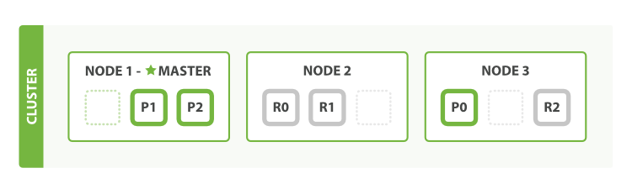
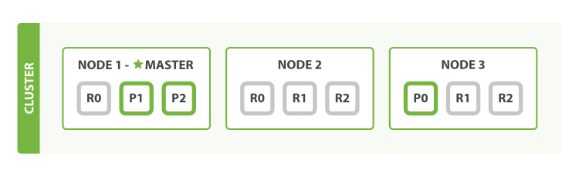
Horizontal clustering
Scaling as the demand for application grows.
if we want to scale our search to more than six nodes?
PUT /blogs/_settings
{
"number_of_replicas" : 2
}

Slide 28
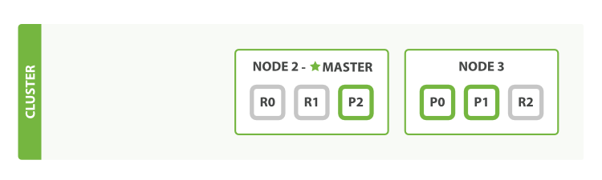
Failover mechanism
Elasticsearch can cope when node fail
Cluster after killing one node (Master)
index shard prirep state docs store ip node
employee 1 p STARTED 0 159b 127.0.0.1 Mongoose
employee 1 r STARTED 0 159b 127.0.0.1 Typhoid
employee 1 r UNASSIGNED
employee 2 r STARTED 0 159b 127.0.0.1 Mongoose
employee 2 p STARTED 0 159b 127.0.0.1 Typhoid
employee 2 r UNASSIGNED
employee 0 p STARTED 0 159b 127.0.0.1 Mongoose
employee 0 r STARTED 0 159b 127.0.0.1 Typhoid
employee 0 r UNASSIGNED

Slide 29

(Data Collection)

Slide 30
Logstash
Logstash is a flexible, open source data collection, enrichment, and transportation pipeline.
Logstash can dynamically unify data from disparate sources and normalize the data into destinations of your choice
Logstash is designed to efficiently process a growing list of log, event, and unstructured data sources for distribution into a variety of outputs, including Elasticsearch.
Developed by Jorden sissel.
Jorden needed something that could handle a peak of 20000 messages per second

Slide 31
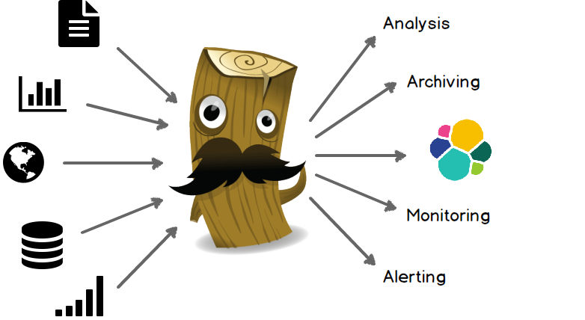
Logstash
Logstash loves data, Logstash welcomes data of all shapes and sizes.
Over 200 plugins available, and have the flexibility of creating and contributing your own

Slide 32
Benefits of Logstash
It is easy to setup, scalable and easy to extend.
Easy integration with connectors to common infrastructure.
Data can collect from any source.
Ex: Mobile devices, social data, ecommerce, log data, News articles, Web trend data
It handles all types of logging data
Ex: apache logs, syslog, windows event logs
Transform HTTP Requests into events (Web)
Ex: Consume from web service firehoses like Twitter, Webhook support for GitHub, JIRA
Data stores & Streams
Ex: Relational database or No SQL store with JDBC, streams from messaging queues like Kafka, RobiitMQ, ZeroMQ
Sensors & IoT
Ex: Connected vehicles, health care sensors & other industry specific applications
Logstash -> elastic search(instantly analyse) -> Kibana (Actionable insights)

Slide 33
Logstash Pipelines
The Logstash event processing pipeline has three stages:
Input – It consumes the data from a source & Inputs generate events.
Filter – Modify the data as you specify. It is a optional plugin
Output – Write the data to a destination or ship them else where
Input
Filter
Output
Logstash Instance
Mandatory
Optional
Input Plugin
Output Plugin
Filter Plugin

Slide 34
Inputs
Some of the more commonly-used inputs are:
File - Reads from a file on the filesystem, much like the UNIX command tail -0F.
Syslog - listens on the well-known port 514 for syslog messages and parses according to the RFC3164 format.
Beats - Process events sent by Filebeat
Redis - Reads from a redis server, using both redis channels and redis lists.
Twitter - Reads events from the Twitter Streaming API
JDBC - This plugin was created as a way to ingest data in any database with a JDBC interface into Logstash
Stream - This input will read events from a Kafka topic

Slide 35
Filters
Filters are intermediary processing devices in the Logstash pipeline:
grok - Add information about geographical location of IP addresses.
parse unstructured log data into something structured and queryable.
mutate - Perform general transformations on event fields.
We can rename, remove, replace, and modify fields in your events.
drop - Drop an event completely
Ex: debug events
clone - Make a copy of an event, possibly adding or removing fields.
geoip - Reads events from the Twitter Streaming API
Note : Combine filters with conditionals to perform an action on an event if it meets certain criteria.

Slide 36
Outputs
Outputs are the final phase of the Logstash pipeline. An event can pass through multiple outputs, but once all output processing is complete, the event has finished its execution.
Commonly used outputs:
File - Write event data to a file on disk.
elasticsearch - Send event data to Elasticsearch.
graphite - Send event data to graphite.
statsd - Send event data to statsd, a service that "listens for statistics, like counters and timers.

Slide 37
Logstash Configuration
Logstash configuration files to specify these plugins and defines what each plugin is doing
Logstash configuration file defines your Logstash pipeline.
When you start a Logstash instance, use the “-f <path/to/file>” option to specify the configuration file that defines that instance’s pipeline.
Ex : bin/logstash -f logstash-simple.conf
The following text represents the skeleton of a configuration pipeline:
# The # character at the beginning of a line indicates a comment. Use
# comments to describe your configuration.
input {
}
# The filter part of this file is commented out to indicate that it is
# optional.
# filter {
#
# }
output {
}

Slide 38
Logstash Configuration cont….
To verify the configuration file
Ex : bin/logstash -f logstash-simple.conf --configtest
Each section contains the configuration options for one or more plugins.
input {
file {
path => "/var/log/messages"
type => "syslog"
}
file {
path => "/var/log/apache/access.log"
type => "apache"
}
}
input { stdin { } }
filter {
grok {
match => { "message" => "%{COMBINEDAPACHELOG}" }
}
date {
match => [ "timestamp" , "dd/MMM/yyyy:HH:mm:ss Z" ]
}
}
output {
elasticsearch { hosts => ["localhost:9200"] }
stdout { codec => rubydebug }
}
If you specify multiple filters, they are applied in the order of their appearance. the configuration file that defines that instance’s pipeline.

Slide 39
Logstash example
input { stdin { } }
filter {
grok {
match => { "message" => "%{COMBINEDAPACHELOG}" }
}
date {
match => [ "timestamp" , "dd/MMM/yyyy:HH:mm:ss Z" ]
}
}
output {
elasticsearch { hosts => ["localhost:9200"] }
stdout { codec => rubydebug }
}
Create logstash configuration file
Verify logstash configuration file
Ex : bin/logstash -f logstash-simple.conf --configtest
Run logstash with created configuration file
Ex : bin/logstash -f logstash-simple.conf
Entered given line in logstash command line
Dec 23 12:11:43 louis postfix/smtpd[31499]: connect from unknown[95.75.93.154]
Dec 23 14:42:56 louis named[16000]: client 199.48.164.7#64817: query (cache) 'amsterdamboothuren.com/MX/IN' denied
Dec 23 14:30:01 louis CRON[619]: (www-data) CMD (php /usr/share/cacti/site/poller.php >/dev/null 2>/var/log/cacti/poller-error.log)
Dec 22 18:28:06 louis rsyslogd: [origin software="rsyslogd" swVersion="4.2.0" x-pid="2253" x-info="http://www.rsyslog.com"] rsyslogd was HUPed, type 'lightweight'.

Slide 40
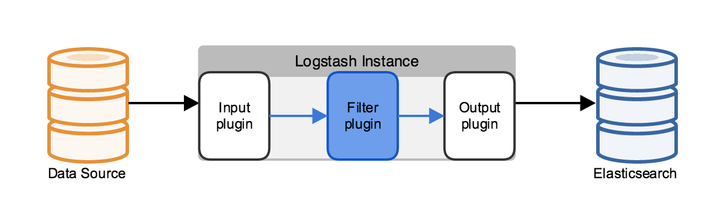
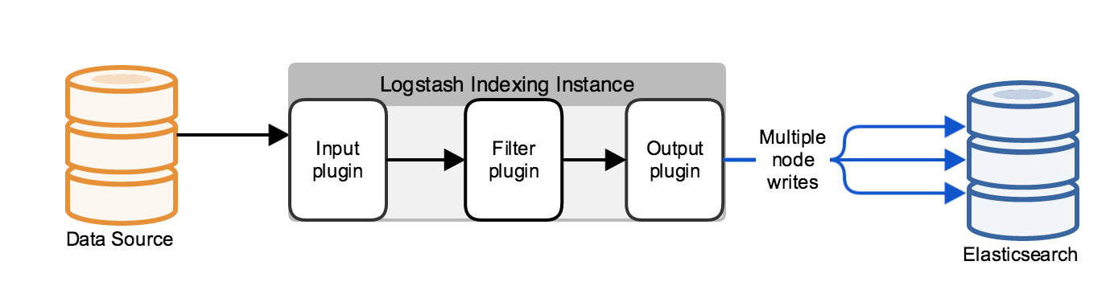
Logstash Deployment
Simple deployment structure of Logstash
Logstash configuration & Elasticsearch with cluster management

Slide 41
Logstash Deployment with High availability
Logstash High availability

Slide 42

(Visualization)

Slide 43
Kibana
It is an open source analytics and visualization platform designed to work with Elasticsearch.
You can easily perform advanced data analysis and visualize your data in a variety of charts, tables, and maps
Makes it easy to understand large volumes of data.
Kibana makes it easy to understand large volumes of data.
It enables to create and share dynamic dashboards that display changes to Elasticsearch queris.
No code, No infrastructure required.

Slide 44
Installation & Configuration
To get Kibana up and running:
Download the Kibana 4 binary package for your platform.
Extract the .zip or tar.gz archive file.

Slide 45
Create Dashboard by 5 steps
Loaded sample data set into your Elasticsearch installation.
Define index pattern by using Settings tab
.Use the Discover functionality to explore your data
Set up some Visualizations to graphically represent your data
Assembled visualizations into a Dashboard

Slide 46
Step 1 - Load sample data into Elasticsearch
Download any sample data set from net or create sample data in json format.
Sample data with different types:
shakespeare.json.
accounts.zip
logs.jsonl.gz
Sample data formats are defined in below format
Shakespeare | Accounts | Log
{ "line_id": INT, "play_name": "String", "speech_number": INT, "line_number": "String", "speaker": "String", "text_entry": "String", } | { "account_number": INT, "balance": INT, "firstname": "String", "lastname": "String", "age": INT, "gender": "M or F", "address": "String", "employer": "String", "email": "String", "city": "String", "state": "String" } | { "memory": INT, "geo.coordinates": "geo_point" "@timestamp": "date" }
Use the Elasticsearch _bluk API to load the data sets with following commands
curl -XPOST 'localhost:9200/bank/account/_bulk?pretty' --data-binary @accounts.json
curl -XPOST 'localhost:9200/shakespeare/_bulk?pretty' --data-binary @shakespeare.json
curl -XPOST 'localhost:9200/_bulk?pretty' --data-binary @logs.jsonl

Slide 47
Step 1 -Load sample data into Elasticsearch
Another way of inserting data to Elasticsearch is through Logstash.
We need to write the configuration file to insert the data to elasticsearch.as shown in the logstash.
input {
file {
path => "C:\Users\MS00364000\dt.log"
start_position => beginning
}
}
filter {
grok {
match => [ "message", "%{TIME:time}"]
overwrite => ["message"]
}
date {
match => ["time", "YYYY-MM-DD HH:mm:ss,SSS"]
}
}
output {
elasticsearch {
hosts => "localhost:9200"
}
}

Slide 48
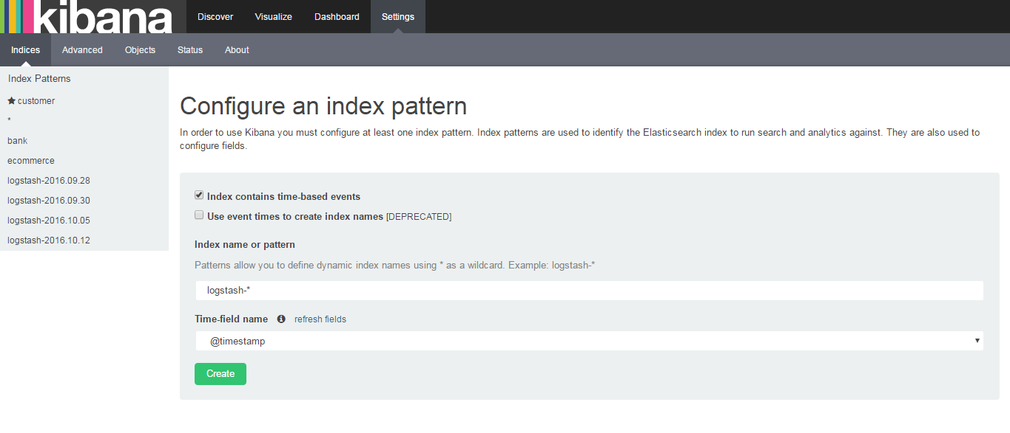
Step 2 - index pattern by using Settings tab
Open a browser and navigate to http://localhost:5601
Click the Settings tab, then indices tab.
We need to add the Indexwhich is added to elasticsearch to Kibana for visulaization,Use create button to finalize the index name which you want to define graphically present
Provide dynamic Index name
Ex: Account or logstash-*

Slide 49
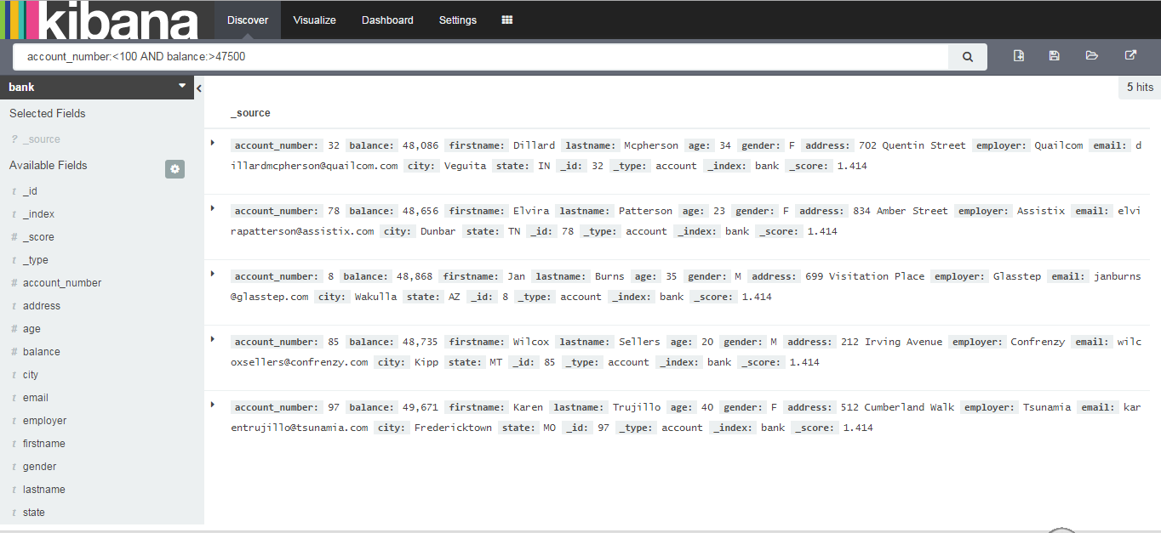
Step 3 - Discovering data
Open a browser and navigate to http://localhost:5601
Once the index is added we can search data using search Tab
Click the Discover tab.
Search string or use * for all data
Choose Index which you want to show visualization

Slide 50
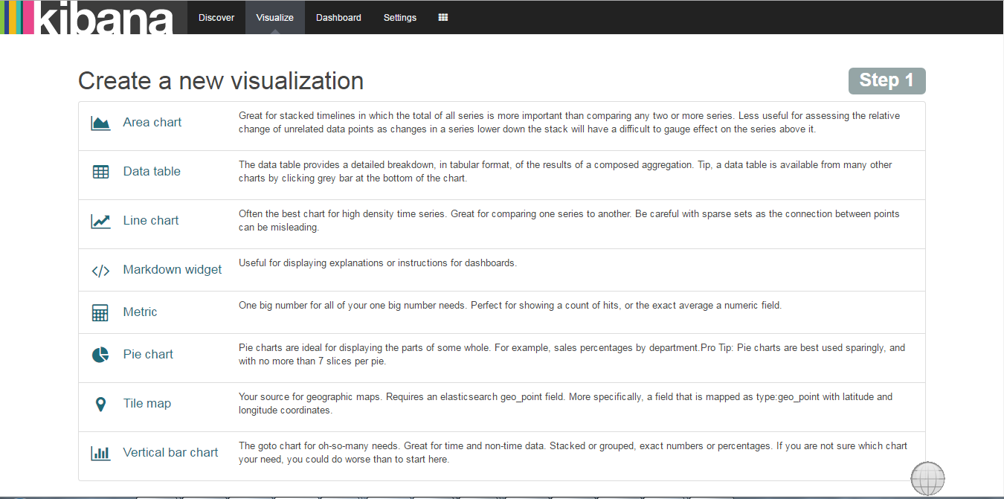
Step 4 – Setup Visualizations
Open a browser and navigate to http://localhost:5601
Click the Visualization tab and choose any one type of option.
If you choose pie chart

Slide 51
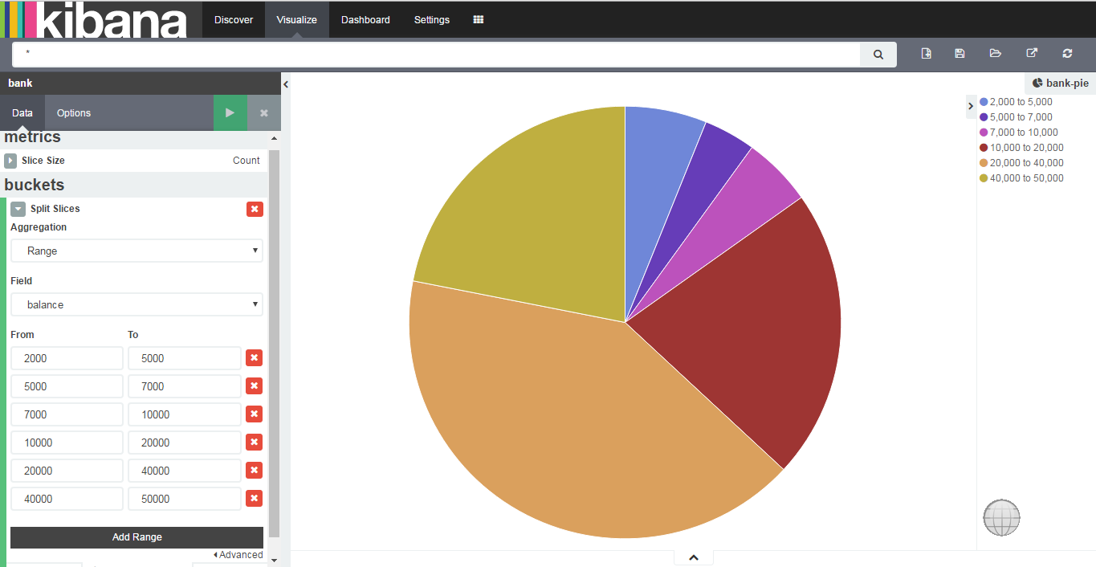
Step 4 – Setup Visualizations cont…
Click on Pie chart, then From a new search.
After created the pie chart we can save visualization by using save button
Save visualization
Choose split slices and select range with balance field

Slide 52
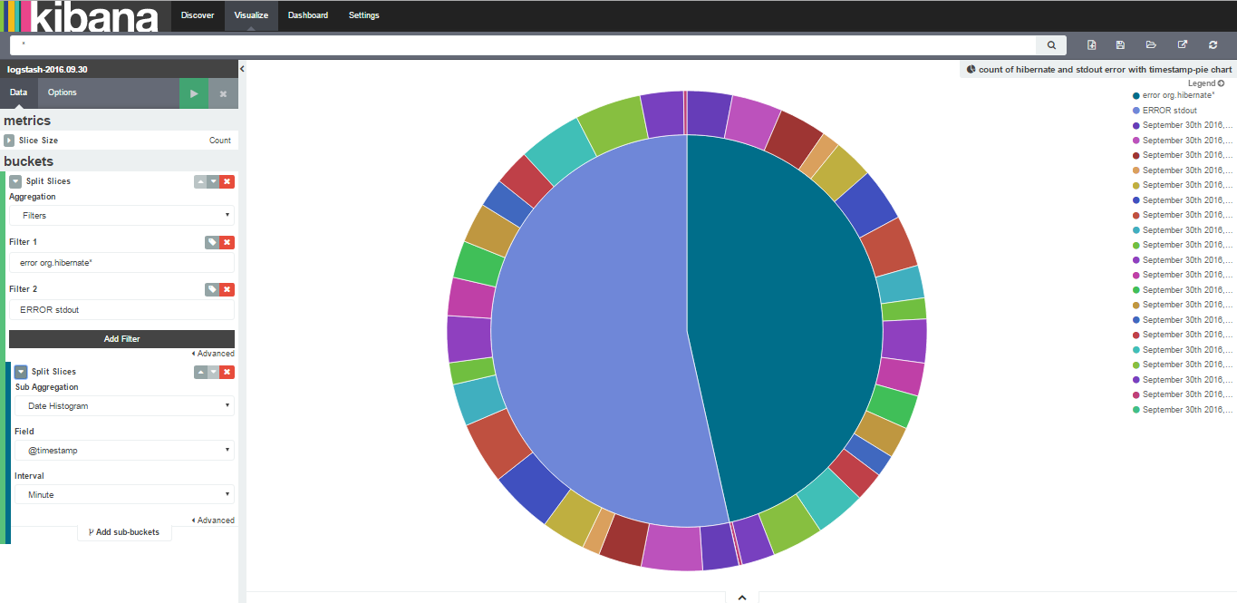
Step 4 – Setup Visualizations cont…
We can make complex Pie chart using split slices.
Choose split slices and select Filters

Slide 53
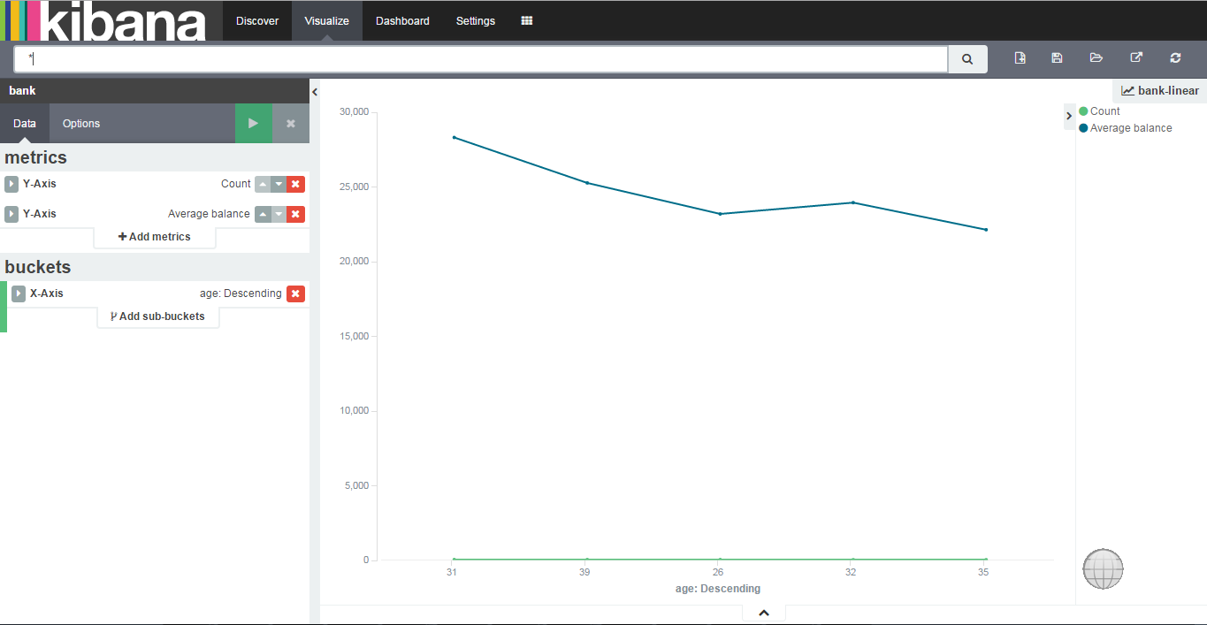
Step 4 – Setup Visualizations cont…
Click on Line chart, then From a new search.
After created the Line chart we can save visualization by using save button
Save visualization
Define X Axis and Y Axis

Slide 54
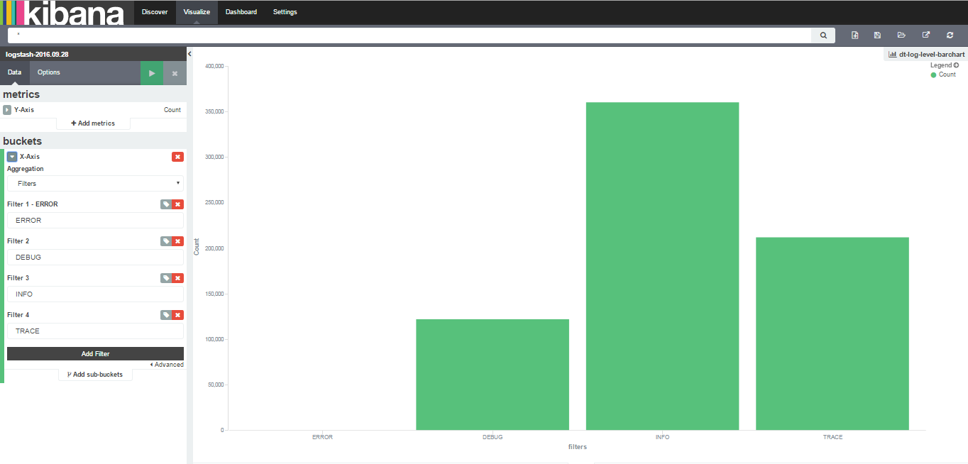
Step 4 – Setup Visualizations cont…
Click on Bar chart, then From a new search.
After created the Bar chart we can save visualization by using save button
Click on buckets and select Filter in the dropdown.

Slide 55
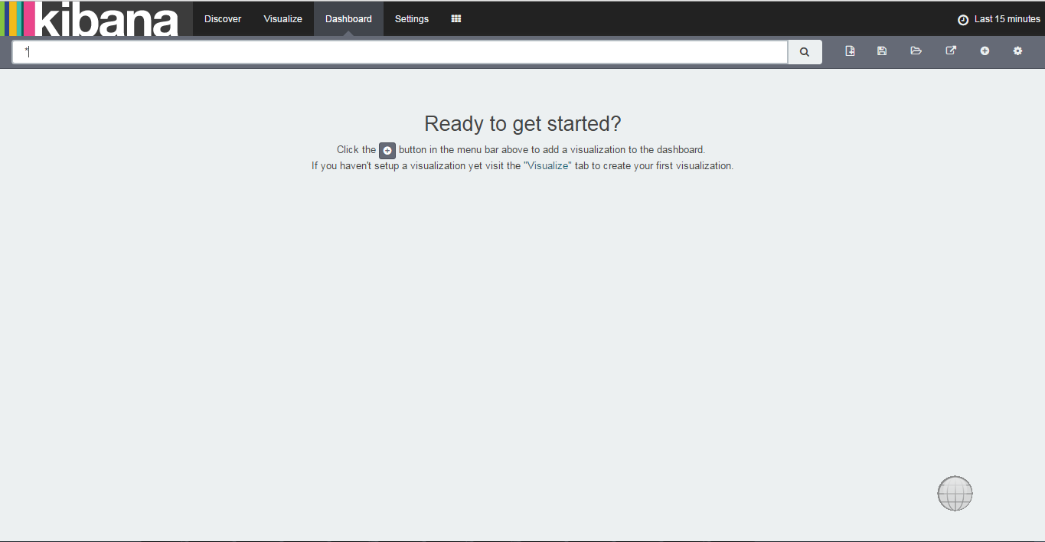
Step 5 – Assembled visualizations into a Dashboard
Open a browser and navigate to http://localhost:5601
Click the Dashboard tab.
Save Dashbard
Use + button to add visualizations in dashboard

Slide 56
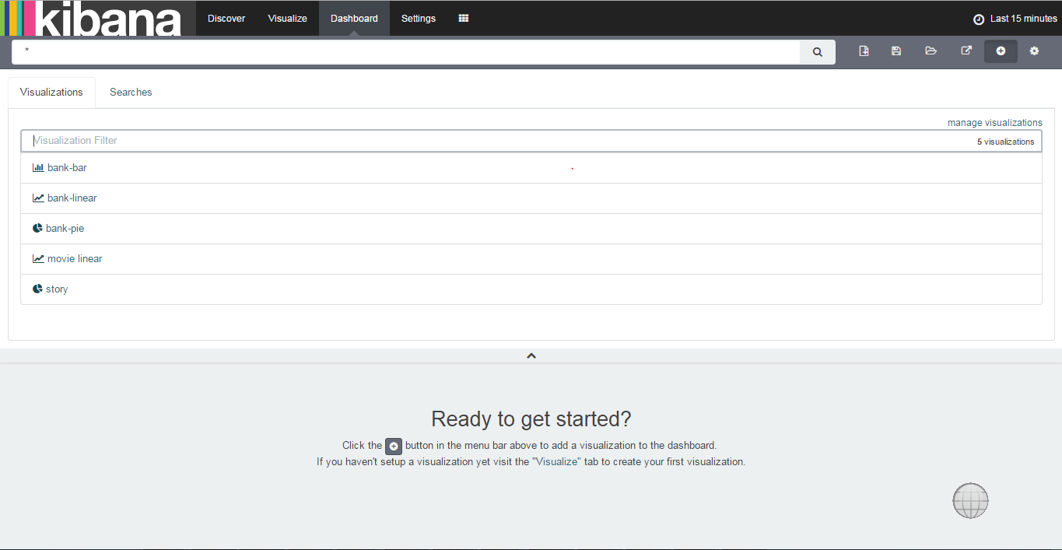
Step 5 – Assembled visualizations into a Dashboard
Click the Dashboard tab.
Choose saved visualizations into dashboard

Slide 57
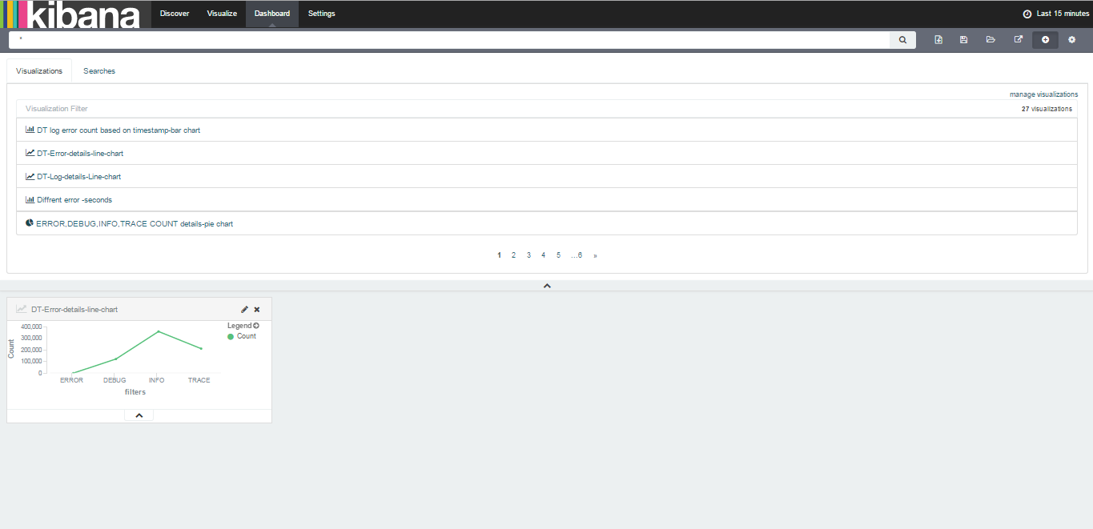
Step 5 – Assembled visualizations into a Dashboard
Choose saved visualizations into dashboard it will be added to the dashboard.
You can add number of visualization to your dashboard.
Save Dashboard

Slide 58
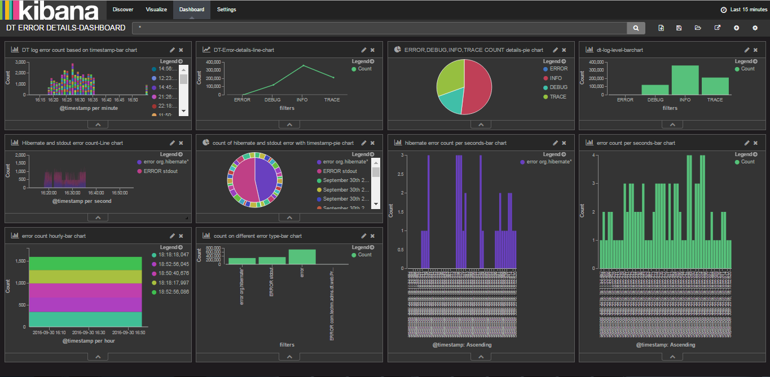
Step 5 – Assembled visualizations into a Dashboard
View dashboard after adding all visualizations into a dashboard.
Save Dashboard

Slide 59
Questions?

Slide 60
Thank You

