Slide 1
Files and Exception Handling
CAD Advanced Python Week 3

Slide 2
Intro
How do we store data for others to use or to use in later programs?

Slide 3
Intro
Files provide persistence, so the results of running programs can last longer
Files can store anything from text to information about objects.

Slide 4
Paths
Absolute path:
Path from the root/home directory to the file, and is system dependent
Relative path:
Path from the working directory i.e the directory which contains the program

Slide 5
The Open command
Python provides a simple interface for working with files.
In order to read or write to a file a file must first be opened. The command is shown below
fileVariable = open(path, flag)

Slide 6
Flags
“r” - read only, will not change the file
“w” - opens a file for writing. Destroys a file if it already exists
“a” - opens a file to append, writes data to the end of a file
“rb” - opens file to read in binary data
“wb” - opens a file to write binary

Slide 7
Writing to files
To write to files, first open a file with the write flag
Then write strings to the file using the write command. Write will put information at the current position in the file.
writefile = open(“test.txt”,”w”)
writefile.write(“hello\n”)
writefile.write(“secondLine\n”)
writefile.close()

Slide 8
Exercise #1
Write 100 random numbers to a file, with 1 number per line

Slide 9
Reading files
To read files, first open a file with the read flag. Then there are many options once you’ve done this
#read whole file at once readFile = open(“file.txt”,”r”) fileContent = readFile.read() print(fileContent) | #Read in every line readFile = open(‘file.txt”,”r”) fileContent = readFile.readlines() print(fileContent) | #Read in every line one at a time readFile = openFile(“file.txt”,”r”) line = readFile.readline() while line != “”: print(line) line = readFile.readline()

Slide 10
Exercise #2
Using the file you generated earlier, calculate the mean sum and variance of the values in the file. Try using multiple methods for reading in files and see which is the most effective.

Slide 11
Exceptions
What happens when we have an error?
Enter a number: “hello”
ERROR: “hello” is not an int

Slide 12
Exception Syntax
try:
<body>
except <ExceptionType1>:
<handler1>
except <ExceptionType2>:
<handler2>
except <ExceptionType3>:
<handler3>
except:
<handlerExcept>
else:
<process_else>
finally:
<process_finally>
try:
<body>
except <ExceptionType>:
<handler>

Slide 13
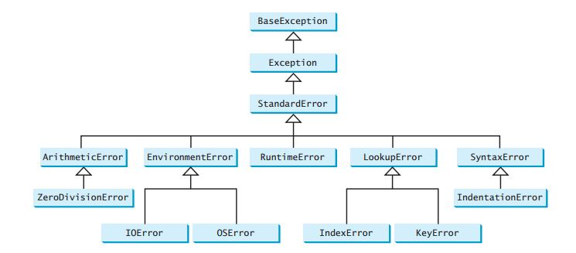
Exception Types

Slide 14
Raising an error
ex = RunTimeError(“This is an invalid input”)
raise ex
or we can also write
raise RunTimeError(“This is an invalid input”)

Slide 15
Exercise #3
Ask the user to enter a number and return the square of that number.
If the user does not enter a number, handle the exception accordingly.

