Slide 1
Final Challenge
Autonomous exploration

Slide 2
Final Challenge
Introduction
This challenge is intended for the student to review the concepts introduced in this course.
This challenge consists in autonomously exploring an unknown environment using the Puzzlebot.
The challenge must be implemented in Gazebo, and it is encouraged but not required to be implemented with the real robot.
This challenge is divided in two sections.

Slide 3
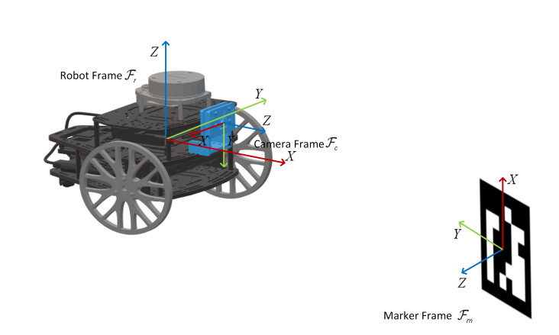
Final Challenge: Part 1
Localisation
The student must develop a camera-based EKF (Extended Kalman Filter) localisation algorithm based on artificial markers and odometry for the Puzzlebot.
The student must use ArUco Marker (fiducial) identification as the exteroceptive sensor measurement.
The algorithm must be implemented in ROS using vision algorithms for ArUco Marker pose detection.
The student must perform all the required coordinate transformations and camera parameter identification for a robust performance.

Slide 4
Final Challenge: Part 1
Localisation
The student must adequately identify or generate the observation model.
It is encouraged for the student to test different observation models for the correction step.
The student must test their localisation library in different scenarios, such as multiple marker observation, no marker observation, partial marker observation, etc. to prove its robustness.
The student can select any ArUco Marker dictionary.

Slide 5
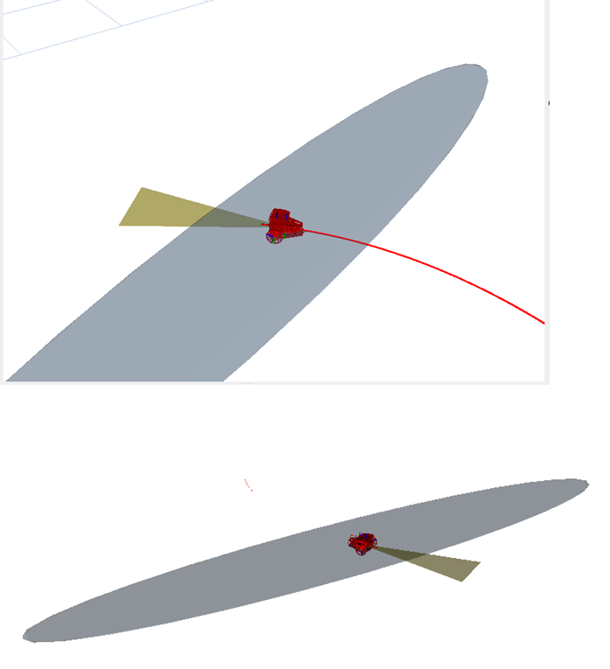
Final Challenge: Part 1
Localisation
The student must plot the confidence ellipsoids in RVIZ and their evolution over time. i.e., when the Puzzlebot cannot see the marker, when it sees it again, etc.
The student must define evaluation metrics of their algorithm to verify robustness.
The student can use any number of ArUco Markers for localisation, as long as it states the reason for choosing them.
The student must define robustness and implement strategies to achieve it.
The student must explain the reasoning behind every engineering decision made.
It is forbidden to use any other library apart from ArUco library, OpenCV and Matrix manipulation libraries such as eigen, lapack or numpy.

Slide 6
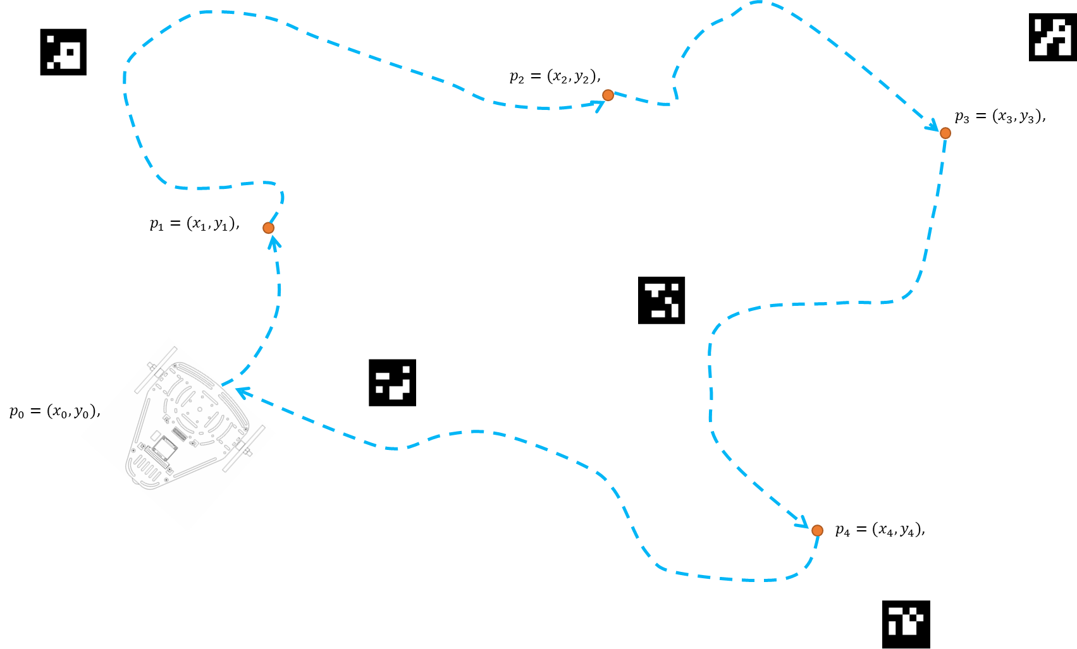
Final Challenge: Part 2
Unknown exploration
Using the Gazebo simulator, developed by MCR2, or the real robot, create a navigation algorithm.
Implement a closed trajectory for the Puzzlebot inside the world.
At least 4 target points must be selected.
No straight paths or target points closed together or in the same direction.
The robot must circumnavigate all the obstacles.

Slide 7
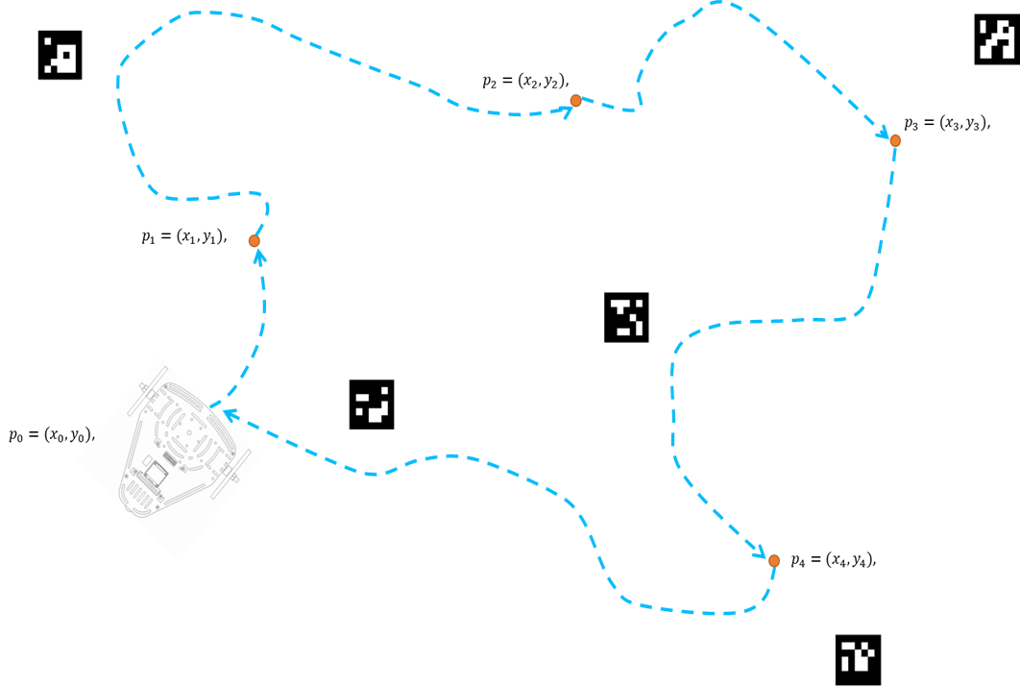
Final Challenge: Part 2
Unknown exploration
The students are encouraged to create different scenarios, to test their algorithms.
To start, the student can test their own algorithm in the worlds defined by MCR2.
The student must analyse and take into consideration the growing covariance around the pose of the robot.
The students must define the required launch files for this activity.
The students must define a correct sampling time for the simulation.
The usage of any library is strictly forbidden.

Slide 8
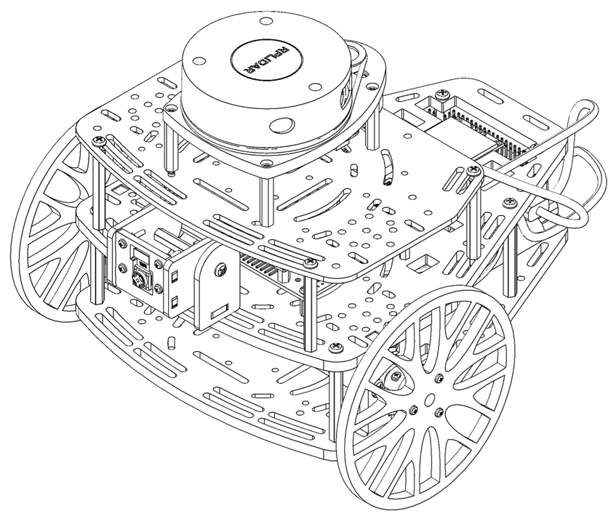
Literature
ArUco Marker Detection
ArUco Marker Module
Camera Calibration
Camera Calibration example
Camera Models
Visual localisation of mobile robots
EKF Localisation
EKF Localisation WSN
Guaranteed Slam An Interval Approach. [PhD thesis]
Guaranteed SLAM an Interval Approach
Automatic generation and detection of highly reliable ﬁducial markers under occlusion
Interval Extended Kalman Filter—Application to Underwater Localization and Control

Slide 9
Deliverables
Each team must deliver a 3-4 min. Video where you explain your algorithms and how your team solved the challenge.
The video must be in English.
The students must explain what is Kalman Filter in their own words.
The students must explain how they implemented the algorithm.
The video must contain diagrams showing the workflow of your algorithms.
The video must explain the challenges faced, solutions, comparisons, etc.
The teams must be prepared for a 2-minute Q&A session with MCR2.
The teams must submit their video via YouTube and share the link.
The teams to present the video will be selected at random from each campus.
MCR2 will select the three finalists to present to a panel of judges and decide the winners.
Criteria
Completion of the challenge
Explanation, Workflow diagrams, challenges faced, solutions, and comparisons.
Clear and concise theoretical and practical explanations
Presentation
The finalists must be prepared for a 3 min Q&A session with the judges.
Each professor at each campus will define the grading system.
Record each of your tests, and final results to show your progress.

Slide 10
Deadlines
Final Presentation: 3 June 2026, 1 PM (Central Mexico Time)
Video Submission Deadline: 2 June 2026, 4 PM (Central Mexico Time)

Slide 11
Rules
General
This is a challenge, not a class. The students are encouraged to research, improve tune explain their algorithms by themselves.
All teams must abide by the rules set at each campus when using the track.
All the students must respect each other and abide by the following rules.
Manchester Robotics reserves the right to provide any form of grading. Grading and grading methodology are done by the professor in charge of the unit.
This task will be graded according to the rules established by the professors of each campus.
Feedback
MCR2(Manchester Robotics) Reserves the right to answer a question if it is determined that the query contains a partial or an answer.
The students are welcome to ask only about the theoretical aspect of the class.
The professors at each campus are encouraged to serve only as guides for the students, not revealing in any form a partial or total answer to the question.
Race
No remote control or other form of human interaction with the robot is allowed; except at the start/end of the track (put the robot on the track at the start and remove it afterwards).
The robot must always follow the black middle line (except at the intersection).
The robot must remain bound inside the lane (between right and left black lines).
The robot must obey all the Traffic signs and Traffic Lights.
No other trajectory or changes in the course are allowed.
Hardware/Software
The track can be solved using any knowledge acquired during the course.
The students must only use the hardware given by Manchester Robotics.
It is forbidden to use any other internet libraries except standard libraries such as NumPy.
If in doubt about libraries, please ask any teaching assistant.
Improvements to the algorithms are encouraged and may be used if the students provide the reasons and a detailed explanation of the improvements.

Slide 12
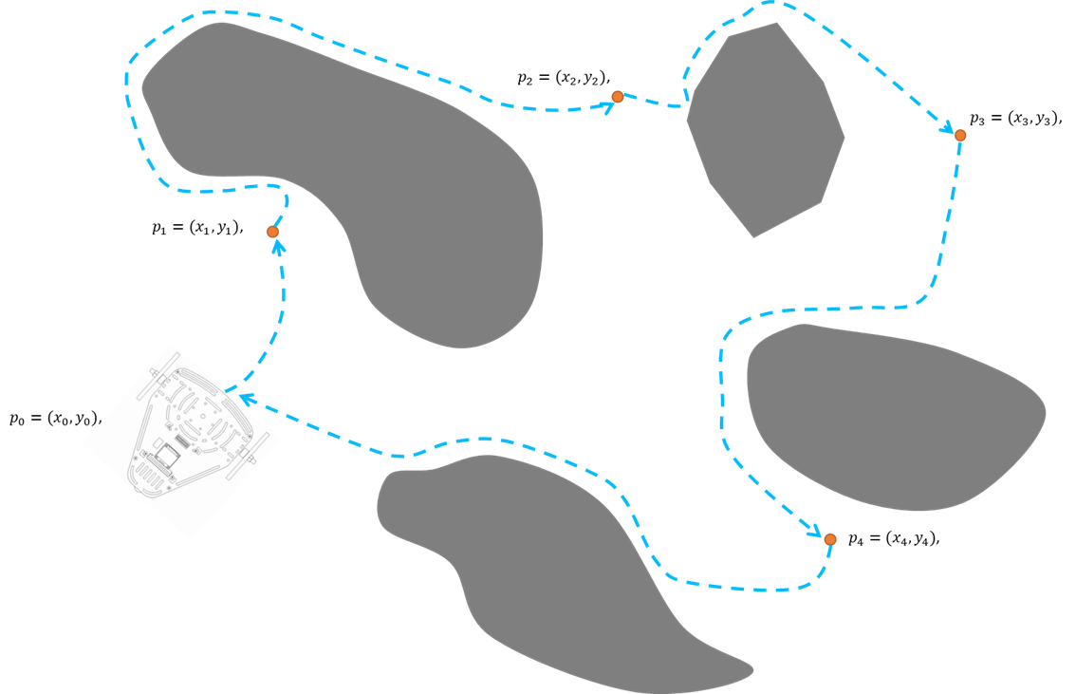
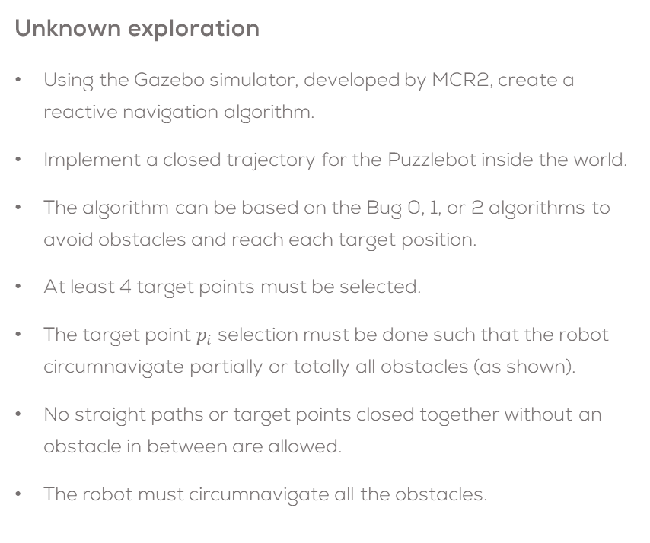
Final Challenge: Optional
Unknown exploration
Using the Gazebo simulator, developed by MCR2, create a reactive navigation algorithm.
Implement a closed trajectory for the Puzzlebot inside the world.
The algorithm can be based on the Bug 0, 1, or 2 algorithms to avoid obstacles and reach each target position.
At least 4 target points must be selected.
The target point $p_{i}$ selection must be done such that the robot circumnavigate partially or totally all obstacles (as shown).
No straight paths or target points closed together without an obstacle in between are allowed.
The robot must circumnavigate all the obstacles.

Slide 13
Final Challenge: Optional
Unknown exploration
The students are encouraged to create different scenarios, to test their algorithms.
To start, the student can test their own algorithm in the worlds defined by MCR2.
The student must analyse and take into consideration the growing covariance around the pose of the robot.
The students must define the required launch files for this activity.
The students must define a correct sampling time for the simulation.
The usage of any library is strictly forbidden.

Slide 14
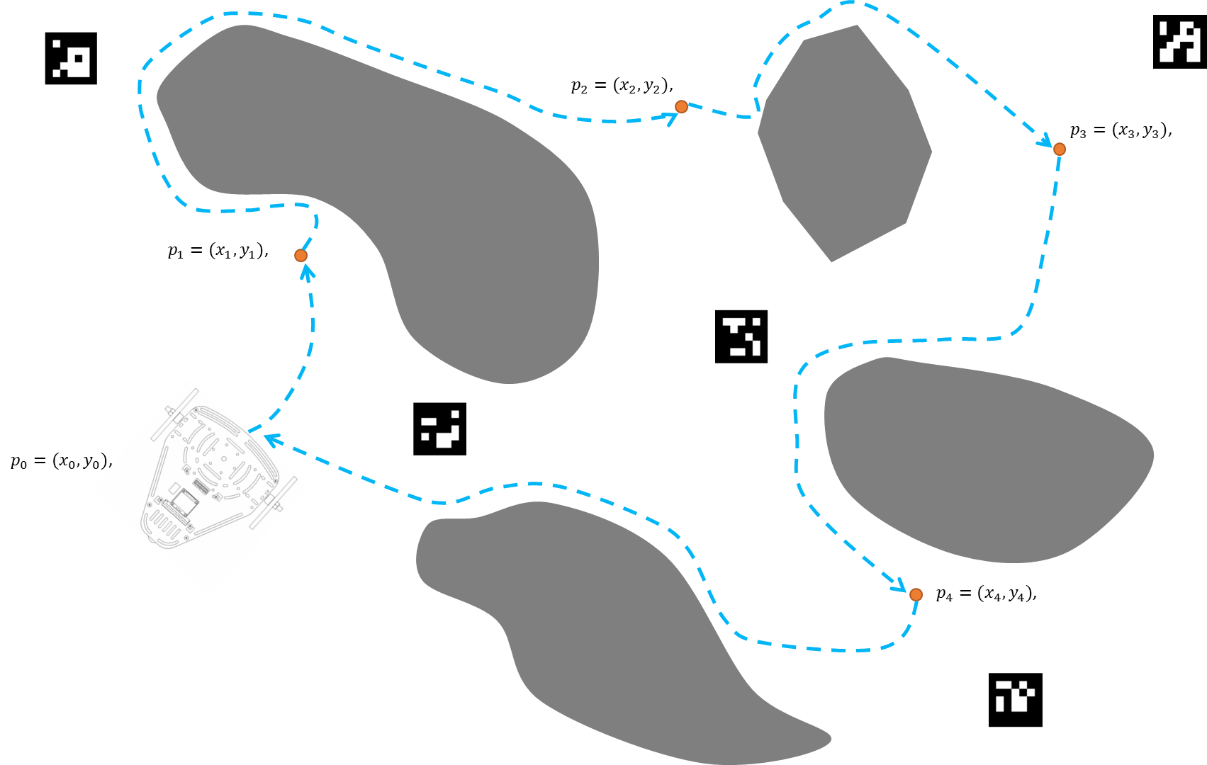
Final Challenge: Optional
Unknown exploration
Combine the visual EKF localisation algorithm developed in part 1 with the autonomous exploration and obstacle avoidance algorithm developed in this section of the challenge.
The student must place the markers in key places to perform a good localisation.
The student must use at least 4 ArUco Markers.
The student can use as many markers as required.

Slide 15
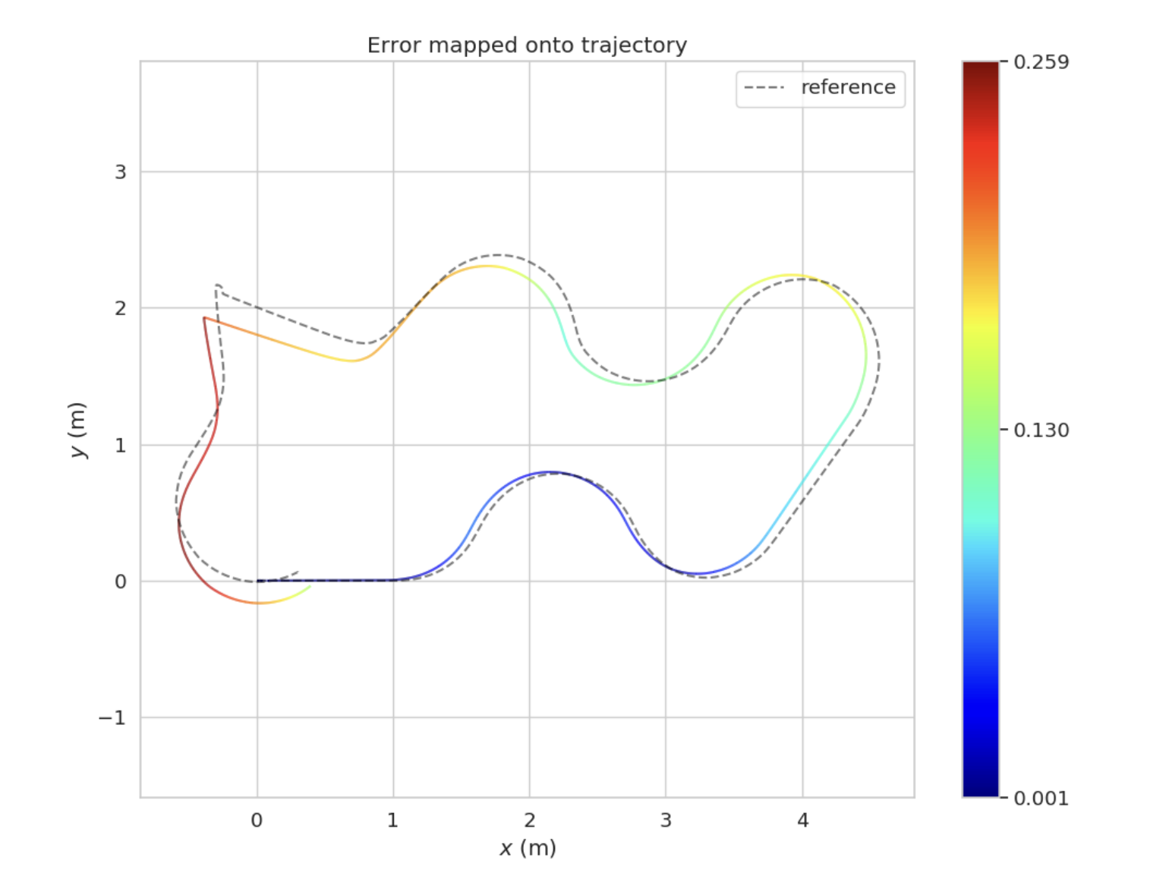
Final Challenge: Optional
Unknown exploration
The student is encouraged to test their algorithms in different scenarios.
To start, the student can test their own algorithm in the worlds defined by MCR2.
The student must plot and analyse the covariance ellipsoids around the pose of the robot in RVIZ.
The student must define evaluation metrics of their algorithm to verify robustness.
The student must test their scenarios by removing several ArUco Markers, partially obstructing them or having multiple markers at once.

Slide 16
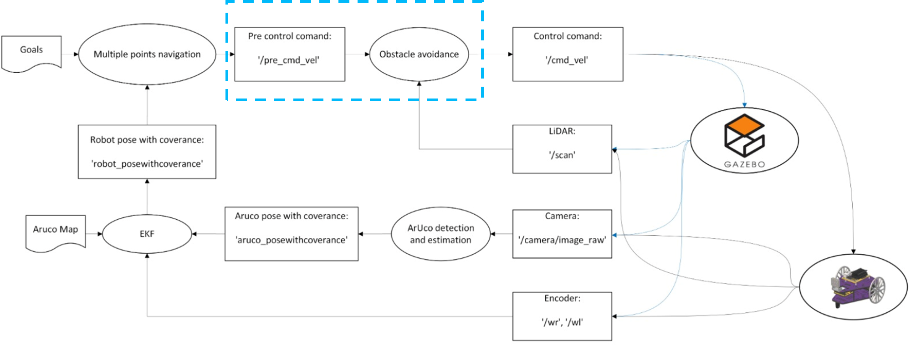
Final Challenge: Optional
Unknown exploration
The students must define the required launch files for this activity.
The students must define a correct sampling time for the simulation.
The student must explain the reasoning behind every engineering decision made.
It is forbidden to use any other library apart from ArUco library, OpenCV and Matrix manipulation libraries such as eigen, lapack or numpy.

