Slide 1
Diabetes Detection with Machine Learning Algorithm
Presented By: SACHIN NEGI

Slide 2
INTRODUCTION
Diabetes mellitus (DM), commonly known as just diabetes, is a group of metabolic disorders charac­terized by a high blood sugar level over a prolonged period of time. Symptoms often include frequent urination, increased thirst and increased appetite. If left untreated, diabetes can cause many health complications. Acute complications can include diabetic ketoacidosis, hyperosmolar hyperglycemic state, or death.Serious long­term complications include cardiovascular disease, stroke, chronic kidney disease, foot ulcers, damage to the nerves, damage to the eyes and cognitive impairment.
The project include prediction of Diabetes based on some features. More than one dataset is taken and some features are selected from them. After that both dataset are merged together. Various machine Learning algorithm are used. The algorithm include Linear Regression, Adaboost, Bagging decision tree based, Bagging K­neighbours and MLP(Multi Layer Perceptron) Classifier. The accuracy obtained from different algorithm is compared.

Slide 3
EXISTING METHOD
What do the Glycosylated Hemoglobin Test (A1c) test results mean?
An A1c test result gets reported as a percentage. The number represents the portion of hemoglobin
proteins that are glycosylated, or holding glucose. The higher the percentage, the higher your blood
sugar levels have been over the last few months.
Less than 5.7 means you don’t have diabetes.
5.7 % to 6.4% signals pre­diabetes.
6.5% or higher means a diabetes diagnosis.
7 % or lower is the goal for someone trying to manage their diabetes

Slide 4
PROPOSED METHOD WITH ARCHITECTURE
The main idea of the method used is:
Three features are selected which are:
ArmCircum:
SaggitalAbdominal
GripStrength
Different machine learning algorithm is used:
The algorithm include Linear Regression, Adaboost, Bagging decision tree based, Bagging K­neighbours and MLP(Multi Layer Perceptron) Classifier. The data is feed to the algorithm to learn the features. Based on the learning of the features. The algorithm predicts the person to be Diebetic or not Diebetic.

Slide 5
METHODOLOGY
Data
The data is collected from two different sources. Some features are selected from each dataset and then both the dataset and combined together.
Their are 3 columns(features) and 9813 rows
Pre­processing
The data is divided into two parts.
i) Training set
ii) Test set
The training set consist of 6000 rows. The remaining 3813 rows is Test set.

Slide 6
Application of Algorithm
Machine Learning Algorithm is applied which include
Linear Regression
Adaboost
Bagging decision tree based
Bagging K­neighbours
MLP(Multi Layer Perceptron) Classifier
The algorithm learn the features from training set. The learned features is used to predict the test set

Slide 7
IMPLEMENTATION
Inbuilt library is used to implement different machine learning algorithm. Sklearn library is used to im­plement algorithm: AdaBoost Classifier, Decision Tree Classifier, Bagging Classifier, K Neighbors Classi­fier.
Distribution of each features are plotted to analyse the distribution
Heat map of features are plotted.
Pair plot is also plotted for the features.
A comparative study is done based on the accuracy obtained from different machine learning algorithm.

Slide 8
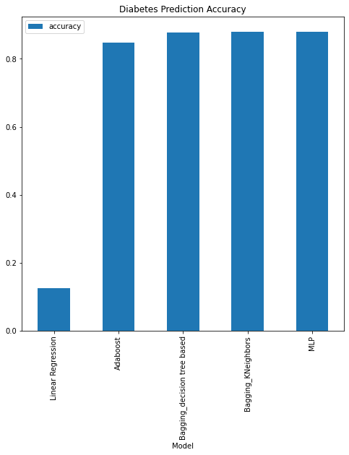
CONCLUSION
Accuracy obtained
Linear Regression: ­ 0.123966%
Adaboost: ­ 0.847364%
Bagging Decision tree based: ­ 0.87804%
Bagging K­neighbors: ­ 0.880671%
Multi Layer Perceptron: ­ 0.879098%

Slide 9
FUTURE SCOPE
Different features can be selected.
Deep Learning algorithms can be introduced

