Slide 1

Applied Data Science Program Portfolio
Caitlin Rookey SU ID: 333629736
https://github.com/cadyannn/portfolio/tree/main
Syracuse University
Spring 2024

Slide 2
Introduction
The applied data science program at Syracuse University provides students the opportunity to collect, manage, and analyze data from multiple sources using various tools and methods.
This portfolio focuses on four course projects that helped develop the above skills:
IST 659: Database Administration
IST 707: Applied Machine Learning
IST 652: Scripting for Data Analysis
IST 623: Introduction to Information Security

Slide 3
Learning Objectives
The School of Information’s Applied Data Science Program learning objectives:
Collect, store, and access data by identifying and leveraging applicable technologies.
Create actionable insight across a range of contexts (e.g. societal, business, political), using data and the full data science life cycle.
Apply visualization and predictive models to help generate actionable insight.
Use programming languages such as R and Python to support the generation of actionable insight.
Communicate insights gained via visualization and analytics to a broad range of audiences (including project sponsors and technical team leads).
Apply ethics in the development, use and evaluation of data and predictive models (e.g., fairness, bias, transparency, privacy).

Slide 4
IST 659: Database Administration
The final project for the Database Administration course involved creating a database to house requests made by students to obtain a device (laptops) and an inventory of devices donated to the foundation.
Draw.io was used to create the logical and conceptual models ahead of table creation.
SSMS was used to create and populate tables.
Triggers were created to send requests to donors for donations to the foundation.

Slide 5
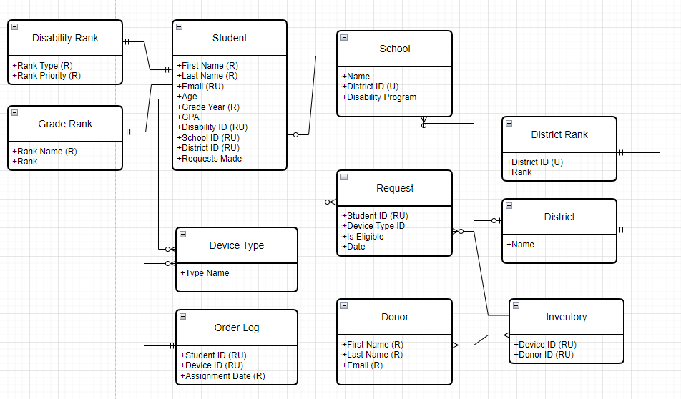
IST 659: Database Administration
Notes:
Conceptual and logical models were developed to organize the relationships b/w the various items in the database.
The conceptual model shown modeled our business objects and the relationships between them

Slide 6
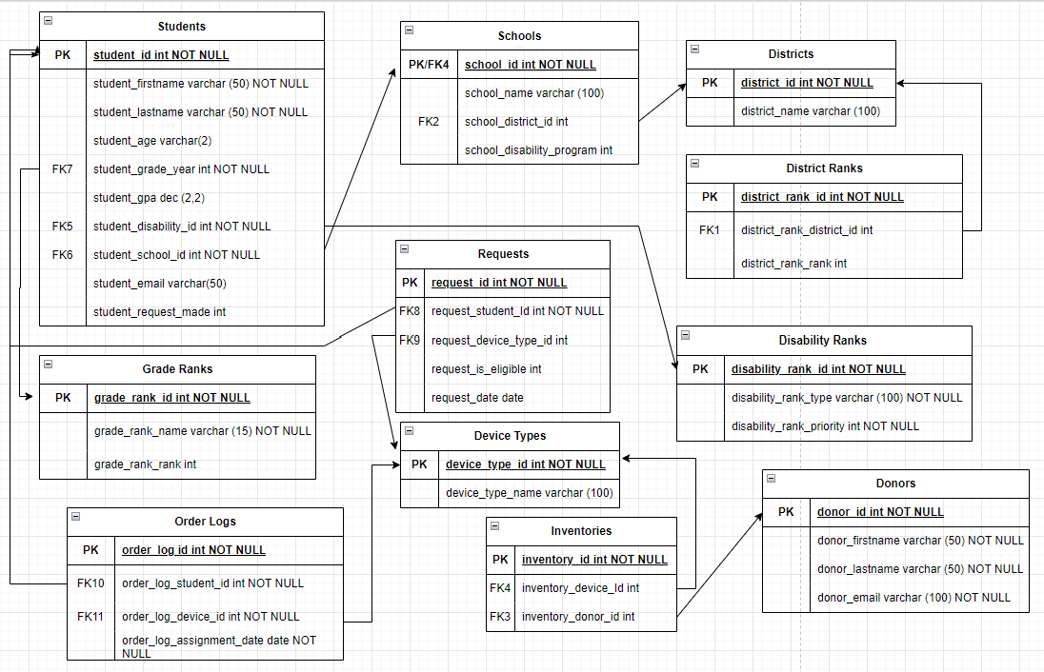
IST 659: Database Administration
Notes:
Logical model details the conceptual model, defined columns and keys – mapped out transactions

Slide 7
IST 659: Database Administration
Reflection
We used the technology provided in the course to develop a data management system that stored and delivered data to the user. Building the system gave us a view of where data scientists retrieve data within an organization. The proper organization and implementation directly impact the analysis of the data.
Completing the course and final project encouraged me to pursue the Data Pipelines and Platforms track. Skills obtained in this course are currently being utilized in IST 722: Data Warehousing where I am utilizing SQL knowledge from IST 659 on the basic troubleshooting for our ETL process buildouts.

Slide 8
IST 707: Applied Machine Learning
Our final project attempted to use Garmin running data to predict injuries in professional runners.
The motivation was to try to use some of the techniques we learned in class to predict injuries and optimize training for runners based on their training and injury history.
Eventually narrowed our scope to one specific problem: determining if a variable in the data impacted overuse injury.
Leveraged R Studio to conduct analysis using data from Kaggle

Slide 9
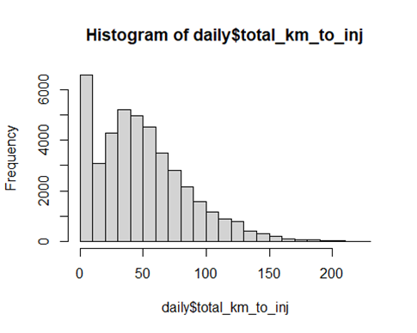
IST 707: Applied Machine Learning
Notes:
Exploratory data visualization
Histogram of calculated total_km_to_inj Histogram of Total km 7 days before “event” to view distribution of total km Athletes ran 7 days leading to “injury” or no injury Note: There’s more than 5000 rows in which athletes run a total of 0 km before possible injury.

Slide 10
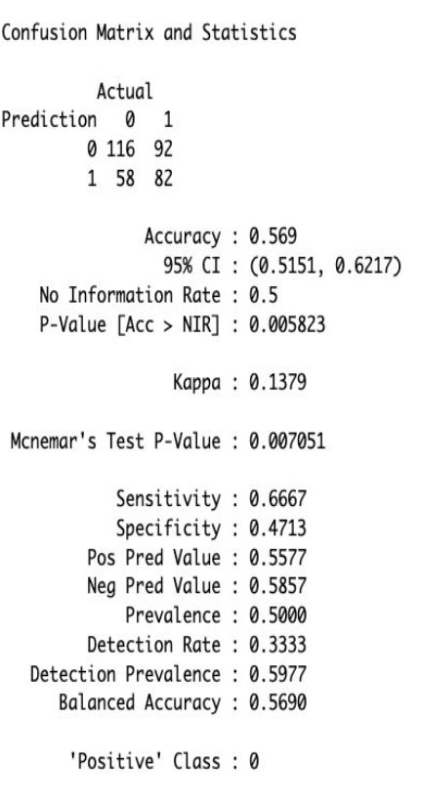
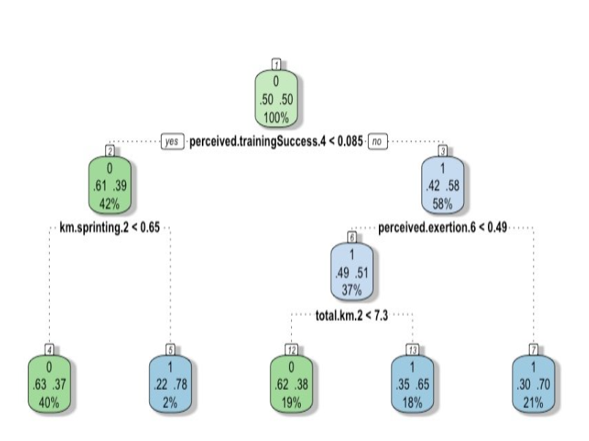
IST 707: Applied Machine Learning
Notes:
Decision Tree 1: 56% accuracy with 92 false positives and 58 false negatives
If perceived training success for the athlete was no and perceived exertion 7 days before injury was high (tired in the beginning of the wees, then it may possibly lead to injury
If Perceived exertion is low, the athlete may possible run more km 3 days before injury (km.2) and that may lead to injury
If perceived training success is higher in the middle of the week, the athlete may sprint 3 days before injury, and it may lead to possible injury.
Drawing out a complexity parameter, it shows that the more complex the dataset becomes, the less accurate. Therefore, tuning is attempted to improve accuracy

Slide 11
IST 707: Applied Machine Learning
Reflection
Though the project did not solve the problem statement, we were able to “apply visualization and predictive models to help generate actionable insight” which was that further analysis was needed with more advanced techniques.
The course honed my skills using R and introduced me to valuable applied machine learning techniques.
It also challenged my troubleshooting on a large project, as we adjusted our scope and attempted to wrangle the data.
Notes:
This project was unique, because I had spent the previous term working with more business-centered data and analysis
Possible neural network

Slide 12
IST 652: Scripting for Data Analysis
Conducted a group project analyzing Airbnb data using Python
Incorporated additional data from NYC crime statistics for comprehensive analysis.
Highlighted pricing trends, term frequency in listings, and correlations with crime statistics.
Demonstrated practical application of Python programming skills in data analysis.

Slide 13
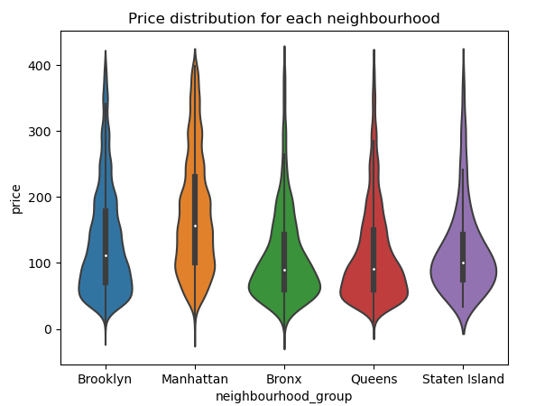
IST 652: Scripting for Data Analysis

Slide 14
IST 652: Scripting for Data Analysis
Reflection
This final project enhanced my then-novice Python skills and explored packages for visualizing our findings. I felt well prepared to enter the Big Data Analytics course the following term
This project was my first project transitioning from coding in R to Python. After researching many packages, such as Pandas and Seaborn, I generated many of the visuals for our presentation. This involved research and troubleshooting, but in the end, I was able to elevate the bar graphs we started with to a more interesting visualization of price distribution.
Notes:
I was also able to learn from my teammates, who had a versatile background and experience using Python to generate heat maps.

Slide 15
IST 623: Introduction to Information Security
The final project for IST 623 required our group to research a data breach of our choosing.
Our team agreed to breakdown the multiple breaches that occurred at Yahoo starting in 2012.
We used timelines to illustrate the breaches, response, and aftermath.
Notes:
Their questionable data handling and security practices made for a robust and engaging project. Our research involved untangling numerous breaches at Yahoo over multiple years and how it impacted the company and users. There was significant crossover with the Information Policy course I completed the previous semester. I was able to more critically review the court filings and SEC actions and wonder how more proactive policy and regulation might have prevented the events.

Slide 16
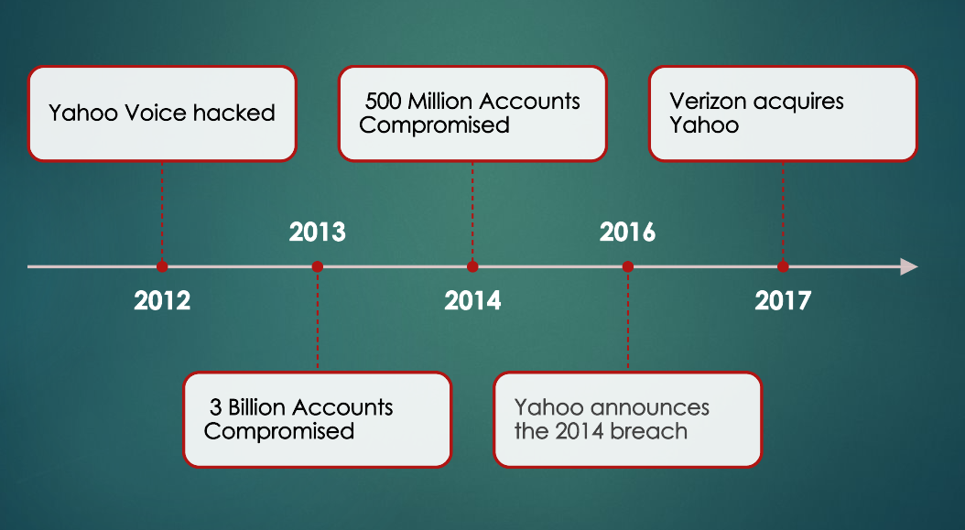
IST 623: Introduction to Information Security

Slide 17
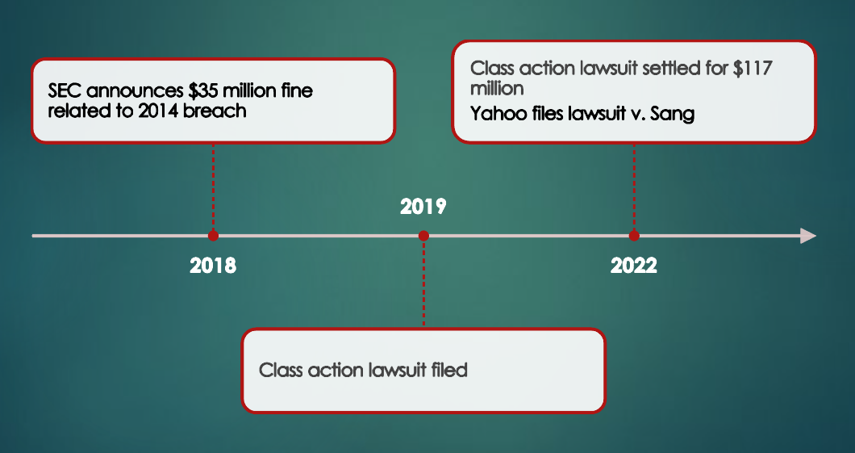
IST 623: Introduction to Information Security

Slide 18
IST 623: Introduction to Information Security
Reflection
The Introduction to Information Security and Introduction to Information Policy courses have directly impacted the actions I take and decisions I make in my current position.
Applying ethics in the development, use and evaluation of data and predictive models protects the data and the organization from legal consequences. These ethical data practices contribute to the long-term sustainability of data-driven technology and culture.
Notes:
CIPP and information policy

Slide 19
Learning Objectives
Collect, store, and access data by identifying and leveraging applicable technologies.
IST 659
Create actionable insight across a range of contexts (e.g. societal, business, political), using data and the full data science life cycle.
IST 707
IST 652
Apply visualization and predictive models to help generate actionable insight.
IST 707

Slide 20
Learning Objectives
Use programming languages such as R and Python to support the generation of actionable insight.
IST 707
IST 652
Communicate insights gained via visualization and analytics to a broad range of audiences (including project sponsors and technical team leads).
IST 707
IST 652
IST 659
Apply ethics in the development, use and evaluation of data and predictive models (e.g., fairness, bias, transparency, privacy).
IST 623

Slide 21
Conclusion
Syracuse University’s School of Information allows students to integrate data collection, management, and analysis.
Skills learned in the program have given me knowledge to deliver actionable insights using various techniques and nurtured strategies to improve organizational efficiency.
As the program draws to a close, I find myself equipped with the skills to address a wide range of problems and the resources to explain observations to diverse audience of stakeholders.

Slide 22
Thank you!
All projects discussed located at https://github.com/cadyannn/portfolio/tree/main

