Slide 1

How oral must an oral poem be? The eEdition as argument
  Daniel Paul O'Donnell

Slide 2
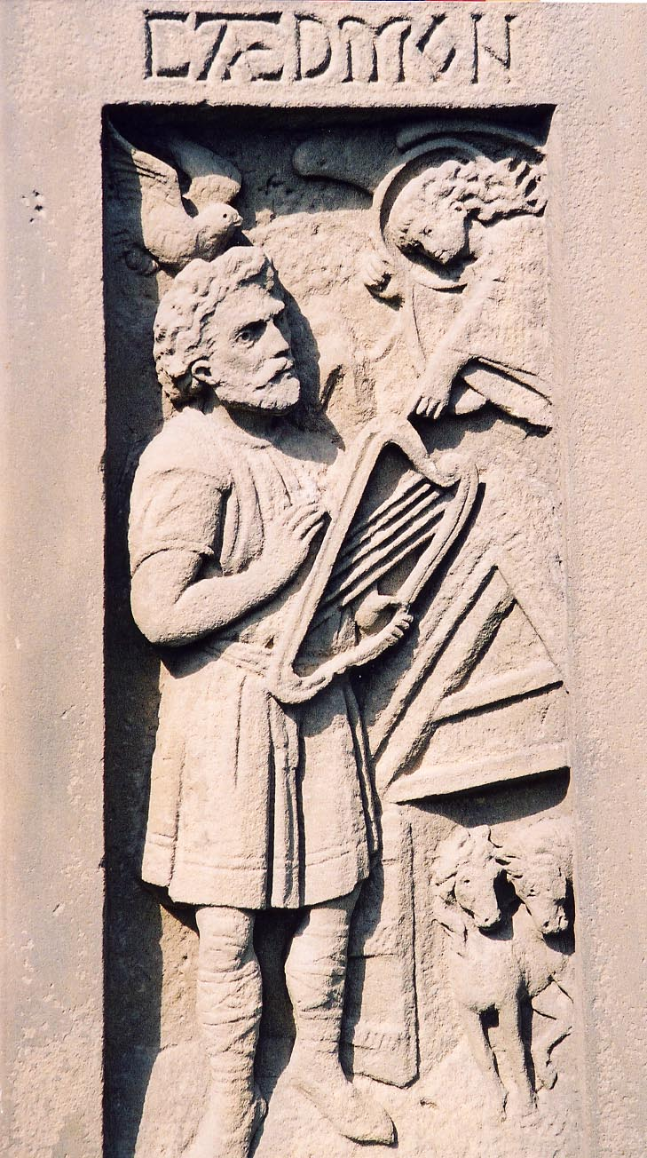
Cædmon's Hymn: an (almost) indisputably oral poem
Cædmon panel, Whitby
Notes:
Almost-contemporary report of composition
Story sets poem in oral-environment
Story not classical Parry-Lord
Evidence of back-translation relatively unconvincing

Slide 3
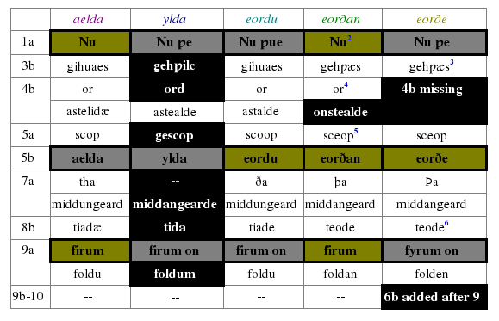
Cædmon's Hymn has longitudinally stable text
Recensional variation in Cædmon's Hymn (O'Donnell 2005 § 5.2)‏
Notes:
Relatively little recensional variation over three hundred years and two dialects

Slide 4
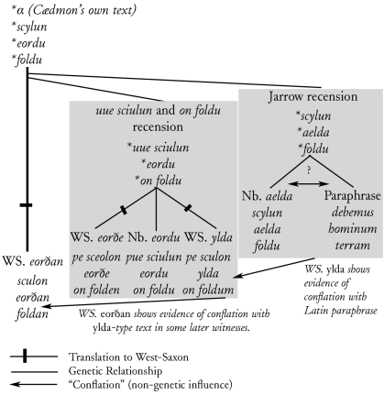
Inter-recensional variation can be largely explained
Recensional and cross-recensional development (O'Donnell 2005 § 5.37)‏
Notes:
What variation there is can be accounted for scribally

Slide 5
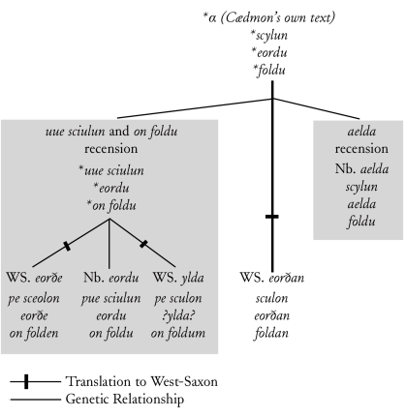
Recensions (mostly) also internally stable
Recensional and cross-recensional development (O'Donnell 2005 § 5.37)‏
Notes:
Of five recensions, only two show evidence of living textual variation
aelda (s. viii)‏
eorðan (s. x¹-s.xii^{ex})‏
Others are defective or post-Anglo-Saxon

Slide 6
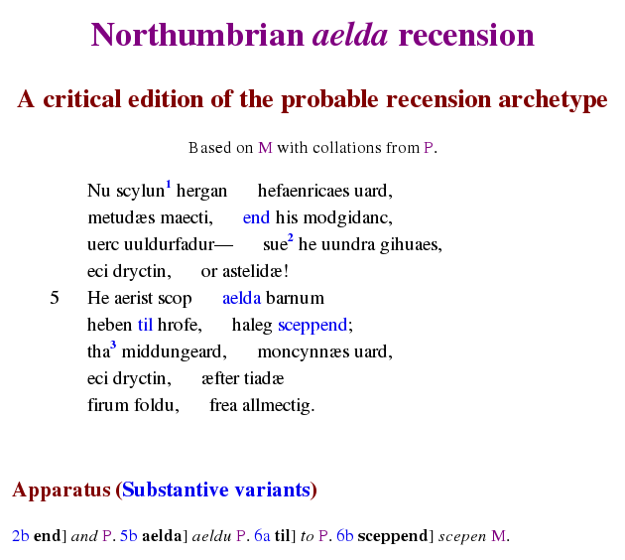
Northumbrian aelda-recension: Few variants
Northumbrian aelda recension (O'Donnell 2005)‏

Slide 7
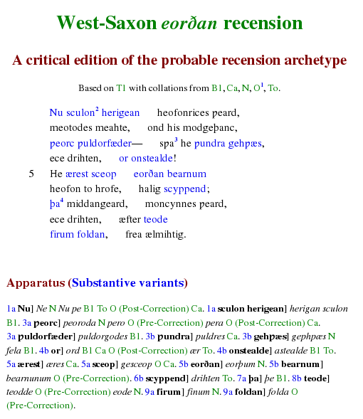
West-Saxon eorðan-recension: More variable
West-Saxon eorðan recension (O'Donnell 2005)‏

Slide 8
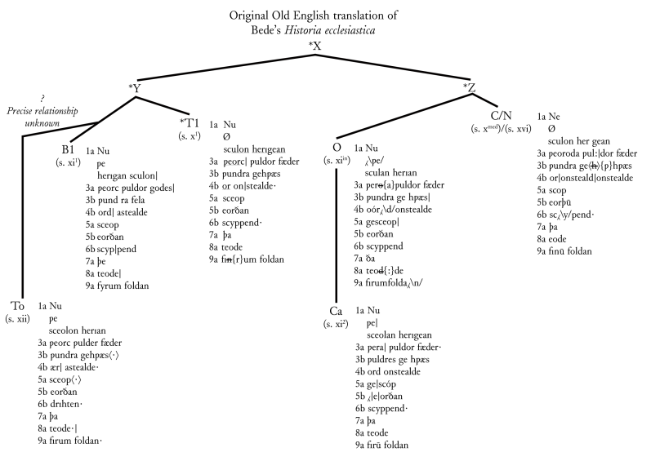
Pattern of variation is more significant than amount
Variation, eorðan recension (O'Donnell 2005 § 7.62)‏
Notes:
Often seen as evidence of oral transmission
Distribution suggest a non-societal causes
quite limited
associated with different, local phenomena in each MS

Slide 9
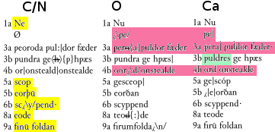
C-O-Ca Recension
Notes:
In case of COCa, very little variation that cannot be ascribed to fairly common error:
Sub-recension as a whole differs in weoroda (error)‏
Other variants:
Errors on part of Nowell (16th C copiest)‏
Corrections on part of scribe of O (who heavily corrects his text of the OE HE as well
When these are removed, there is only one variant in entire tradition.

Slide 10
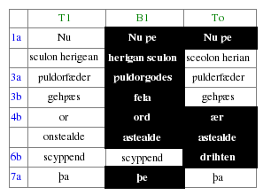
T1-B1-To Recension
Notes:
In case of T1-B1-To
some odd readings introduced in the late To
but otherwise to be attributed to B1
a scribe who shows similar types of variation in his Old English prose (new slide)‏

Slide 11
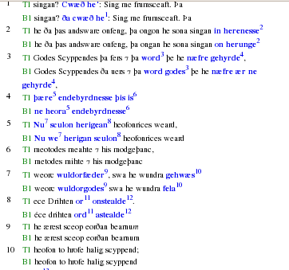
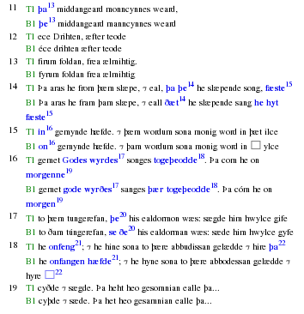
B1 Performance

Slide 12
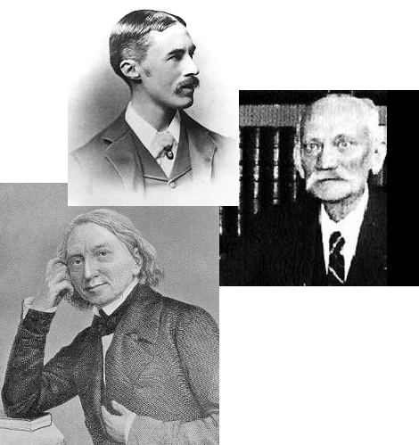
Editorial issues
Famous editors
(Bottle of wine to person who gets them all)‏
Notes:
It is misleading editorially to suggest that text of Cædmon's Hymn was not relatively stable
But a presentation that focussed on recensional texts hides important scribal histories

Slide 13
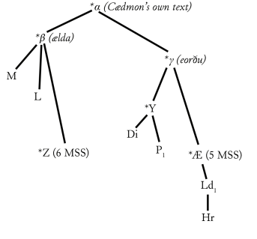
Dobbie (1937 vs. 1942) illustrates danger
Recensional variation from Dobbie 1937

Slide 14
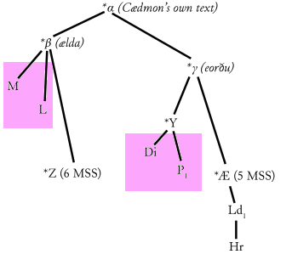
Dobbie (1937 vs. 1942) illustrates danger
Recensional variation from Dobbie 1937

Slide 15
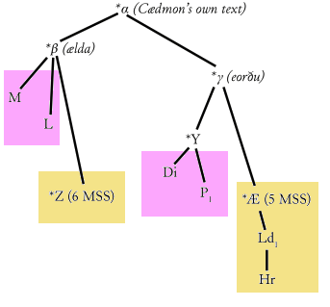
Dobbie (1937 vs. 1942) illustrates danger
Recensional variation from Dobbie 1937

Slide 16
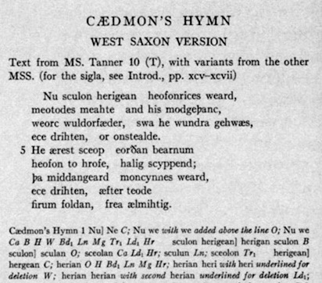
Dobbie (1937 vs. 1942) illustrates danger
Recensional variation from Dobbie 1937
Dialectal text from Dobbie 1942

Slide 17
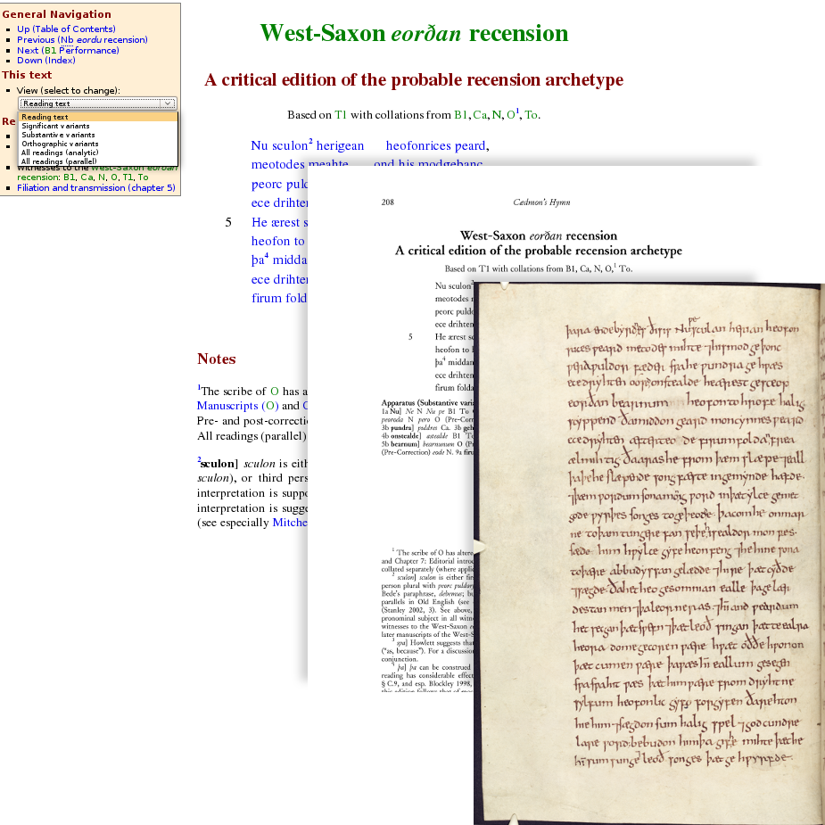
Solution
Electronic, print, and facsimile views from O'Donnell 20005
Notes:
Use different formats to emphasis different types of texts
Print edition to describe and distinguish among different types of text
Electronic edition to give user access to evidence

Slide 18
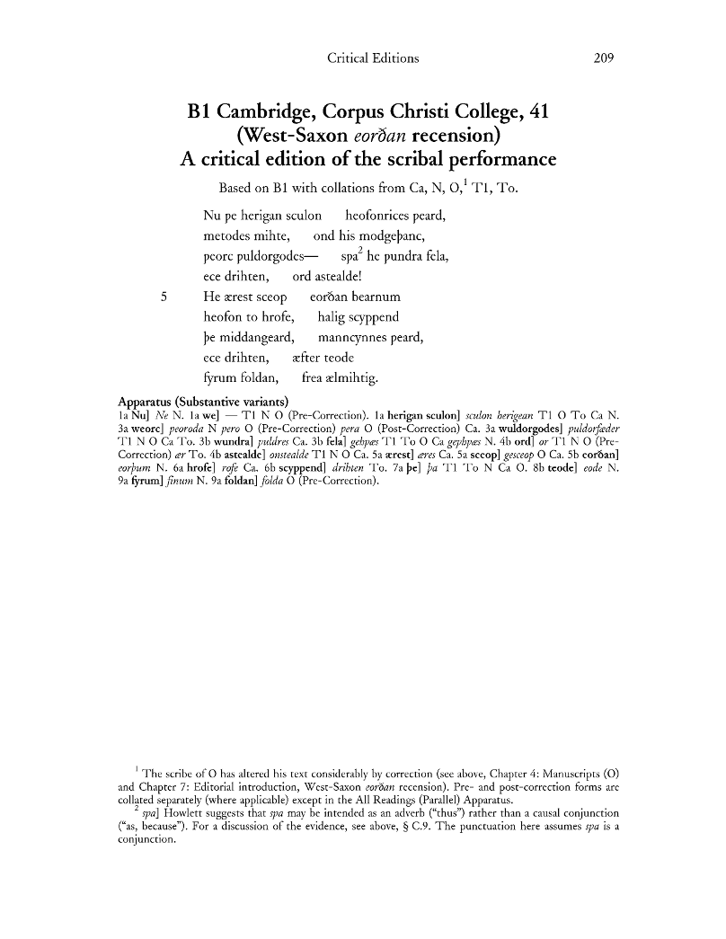
Print edition for 'canonical' editorial texts
Notes:
Ready reference
Directs "non-specialist" reader to expert opinion
Encapsulates editorial introduction in textual format

Slide 19
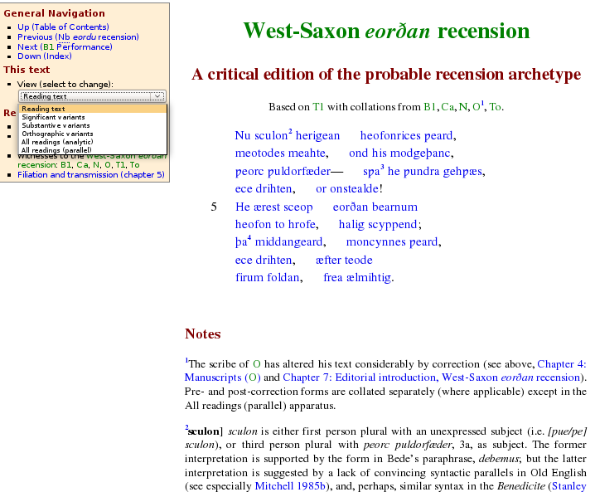
Electronic edition for argument
Notes:
Highlights artificial nature of text
Presents multiple view points
Encourages reader to weigh editorial decisions

Slide 20
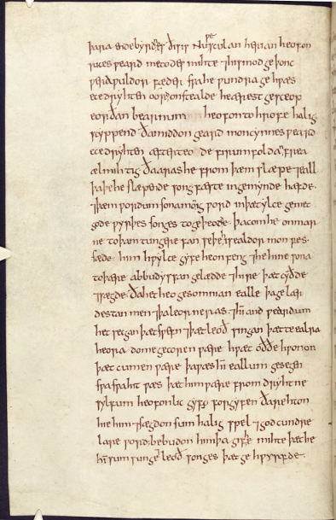
Facsimiles for scholarship
Notes:
Provides context for understanding scribal performance

Slide 21
Digital editions can now serve more than one master
Notes:
Often seen as evidence of oral transmission
Distribution suggest a non-societal causes
quite limited
associated with different, local phenomena in each MS

